Slide 1
Bot Framework

Slide 2
What are Chatbots?
Computer program posing as a human
Origin - Alan Turing (Turing Test, 1950)
Types
Voice assistants
Text Chats

Slide 3


Voice Assistants
Microsoft Cortana
Apple Siri
Google’s Assistant
Amazon Alexa
.
Text Chats
Answer Bot (customer relationships)
Replika (emotional growth)
Mitsuku (time waster)
Lark (personal health coach)
.

Slide 4
Bot Framework
Tool to build a bot
3 things required
Bot Application (has reference to the SDK)
Contains all the necessary components to build a bot
Bot Controller
Invokes the root dialog
Bot Dialog
Brains of the bot
Bot Builder SDK
C#, Node.js
Bot Emulator
Desktop app to test and debug your bots

Slide 5
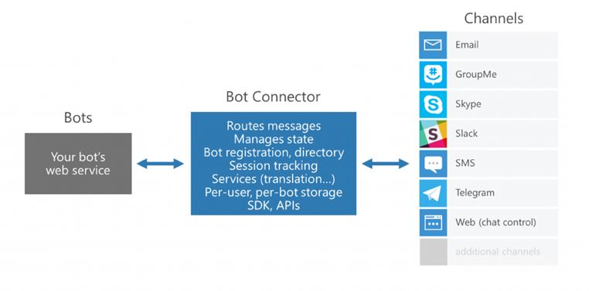
Architecture

Slide 6
Dialogs
The brains of the bot
Rely on an implementation of IDialog

Slide 7
Example
A bot that can perform some Maths, say, add two numbers / find square root
If we draw that out as a flow diagram, we can understand what the “Dialogue” i.e conversation with the bot will look like

Slide 8
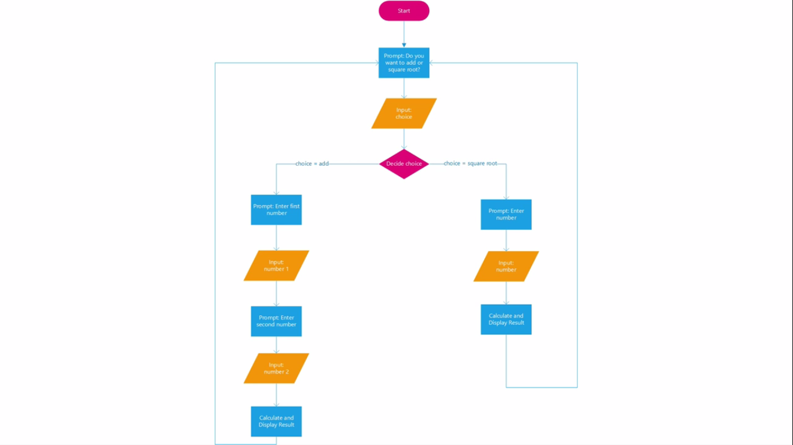

Slide 9
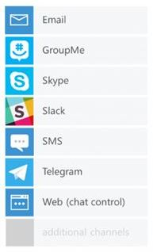
Channels
This is where your bot operates
The user talks to the bot through this channel

Slide 10
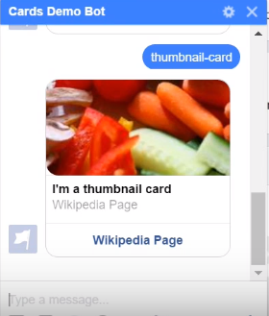
Cards
No text strings. Just attachments with pictures and texts
Comprises of a title, description, link, and images.

Slide 11
Cards
AdaptiveCard (Any combination of images, texts, buttons etc.)
AnimationCard (GIFs)
SignInCard (To enable a bot to request a user sign-in)
HeroCard (One large image, one or two buttons and text)
ReceiptCard (List of items and the total amount including tax or whatever)
ThumbnailCard (One thumbnail image, one or more buttons and text)

Slide 12
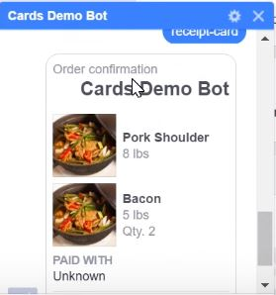

Receipt Card

