Slide 1

🧭 React Router DOM — Beginner Guide
📦 1. What is React Router?
React Router is a standard routing library for React. It enables:
Navigation between views/components
Dynamic URL handling
🔧 2. Installation
Run this in your React project:
npm install react-router-dom

Slide 2
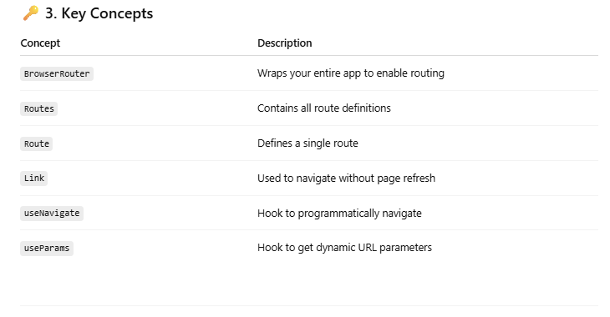

Slide 3
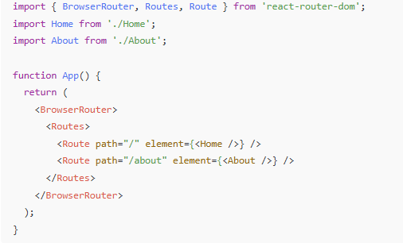
🏗️ 4. Basic Setup Example

Slide 4
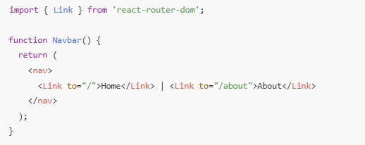
🔗 5. Navigation with <Link>

Slide 5
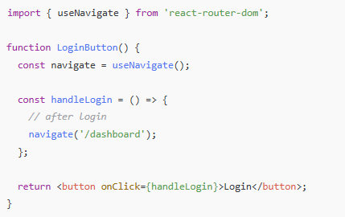
🔁 7. Programmatic Navigation

Slide 6
🔀 What is <Outlet /> in React Router DOM?
✅ Definition:
<Outlet /> is a placeholder component that tells React Router where to render the child routes.
It is used in nested routes when you want to render one layout (like a navbar/sidebar) for multiple pages inside it.
🧱 Why Use <Outlet />?
You use it when:
You have shared layout (e.g., header, sidebar, footer).
You want to nest multiple child components under the same parent route.

Slide 7
// pages/Home.js
export default function Home() {
return <h2>Welcome to the Home Page!</h2>;
}
// pages/About.js
export default function About() {
return <h2>About Us Page</h2>;
}
// pages/Contact.js
export default function Contact() {
return <h2>Contact Page</h2>;
}

Slide 8
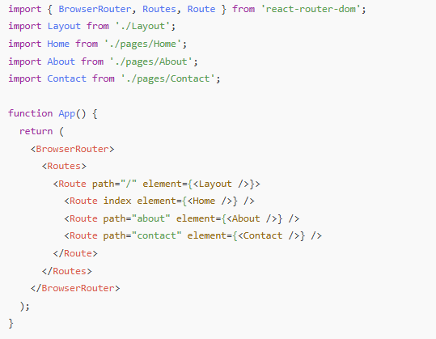
Define Routes with Nesting

Slide 9
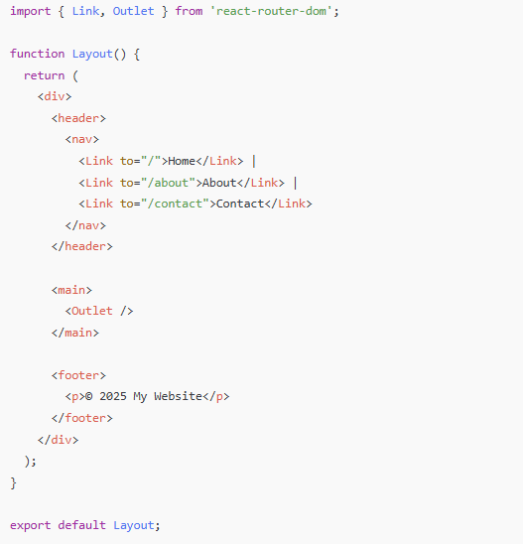
Create a Shared Layout with <Outlet />

Slide 10
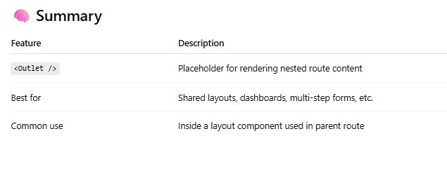
✅ What Happens Here:
You visit /about → React loads Layout, and inside <Outlet /> it renders About.
The header and footer stay the same for all pages.
Only the <Outlet /> content changes.

Slide 11
How to Create a 404 Page in React Router DOM
✅ 1. Create a NotFound.tsx Page
// pages/NotFound.js
import { Link } from 'react-router-dom';
export default function NotFound() {
return (
<div style={{ textAlign: 'center', marginTop: '50px' }}>
<h1>404 - Page Not Found</h1>
<p>The page you're looking for doesn't exist.</p>
<Link to="/">Go Back Home</Link>
</div>
);
}
🔍 How It Works:
The path="*" route matches any path that hasn’t been matched earlier.
This acts as a catch-all for invalid routes.
Placing it last ensures all valid routes are checked first.

Slide 12
✅ 2. Add a Route with path="*"
Update your App.js:
import { BrowserRouter, Routes, Route } from 'react-router-dom';
import Layout from './components/Layout';
import Home from './pages/Home';
import About from './pages/About';
import Contact from './pages/Contact';
import NotFound from './pages/NotFound';
export default function App() {
return (
<BrowserRouter>
<Routes>
<Route path="/" element={<Layout />}>
<Route index element={<Home />} />
<Route path="about" element={<About />} />
<Route path="contact" element={<Contact />} />
{/* 404 Route */}
<Route path="*" element={<NotFound />} />
</Route>
</Routes>
</BrowserRouter>
);
}

Slide 13
📘 What is index in React Router DOM?
In React Router v6+, the index attribute is used to specify the default child route that should render when no specific path is provided within a nested route.
<Route path="/" element={<Layout />}>
<Route index element={<Home />} />
<Route path="about" element={<About />} />
</Route>
🔍 What happens here?
When the user goes to /, React Router:
Matches the parent route (path="/" with <Layout />)
Inside <Layout />, it renders <Home /> because of index
💡 So index is like:
“If no more specific child path is provided, show this one by default.”

Slide 14
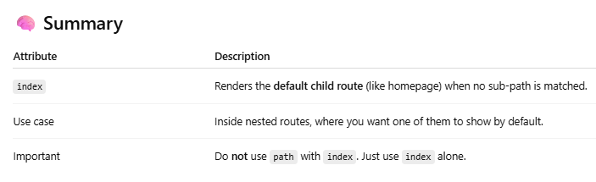

Slide 15
🧪 Exercise: Navigation System with Shared Layout
🎯 Goal of the Exercise:
Create a React application with three pages: Home, About, and Contact.
Build a Layout component that uses <Outlet /> to show the active page.
The layout should include:
A fixed navigation bar (Navbar) at the top
A footer at the bottom
A <main> section in the middle where the content of each page will be rendered based on the route
Add a 404 Not Found page using path="*"
Try using useNavigate() to add a button that redirects the user back to the Home page.

