Slide 1

What is React?
A JavaScript library for building user interfaces
Created by Facebook in 2013
Used to build single-page applications (SPAs)
Why Use React?
⚛️ Component-based: Build reusable UI pieces
⚡ Fast Rendering: Uses a Virtual DOM
🔄 One-Way Data Binding: Predictable data flow
🌍 Strong Ecosystem: Works with tools like Redux, React Router
Who Uses React?
Facebook, Instagram, Netflix, Airbnb, WhatsApp, and many more!

Slide 2
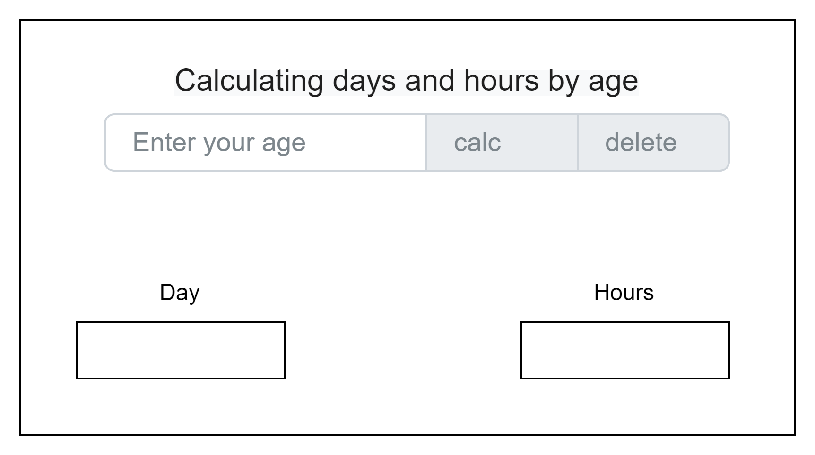

Slide 3
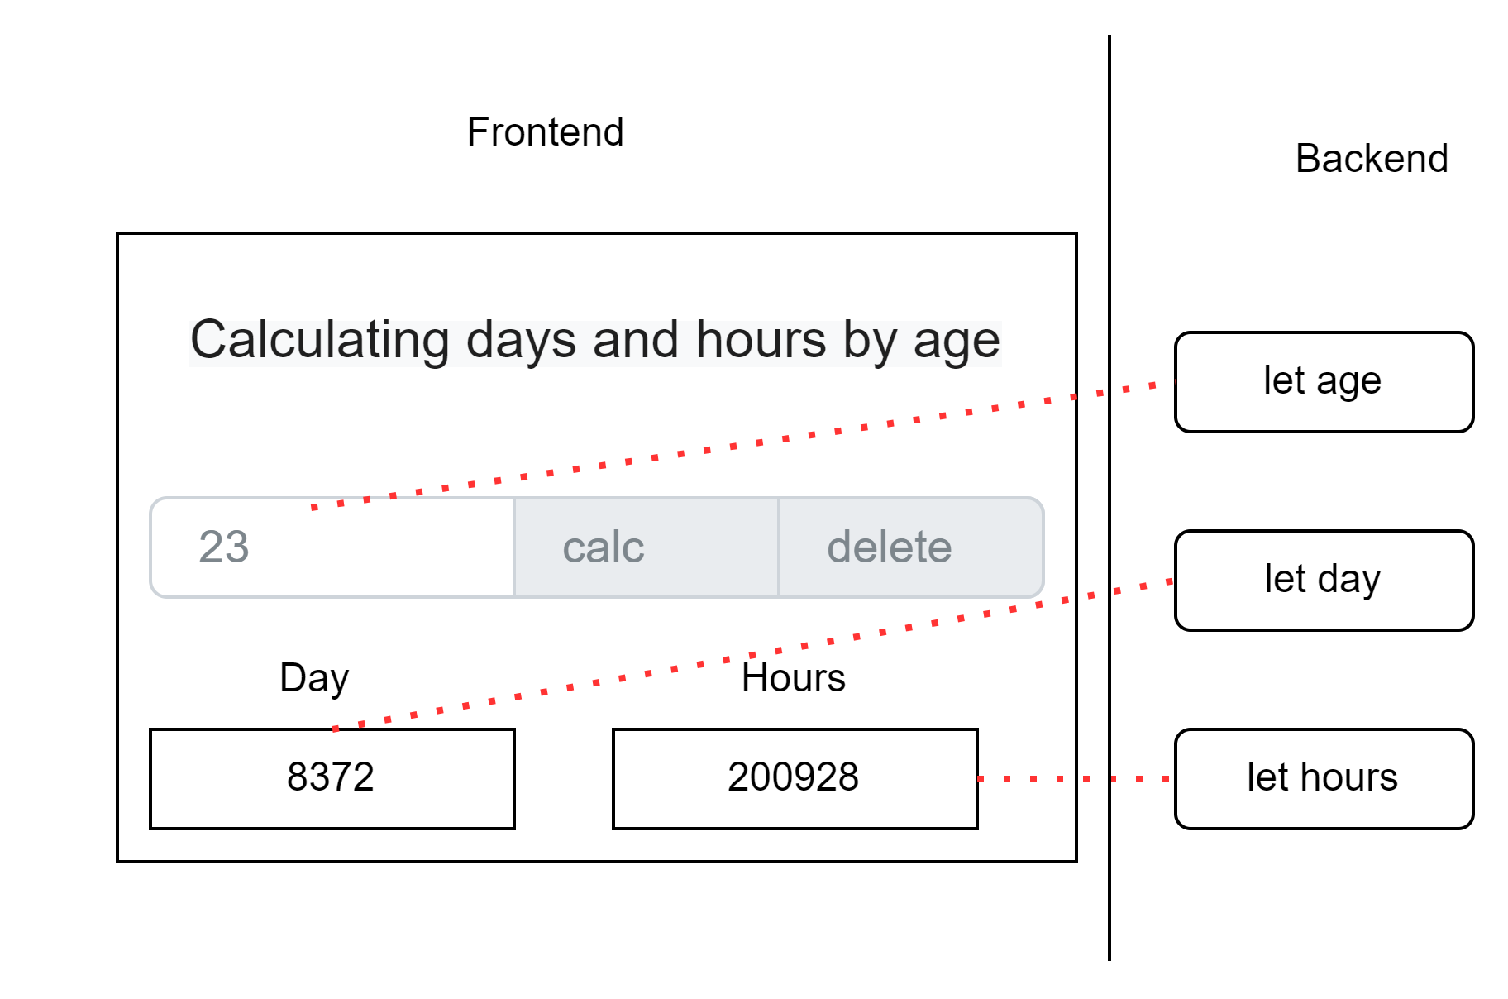

Slide 4
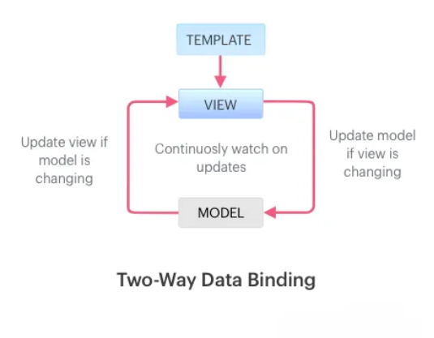

Slide 5
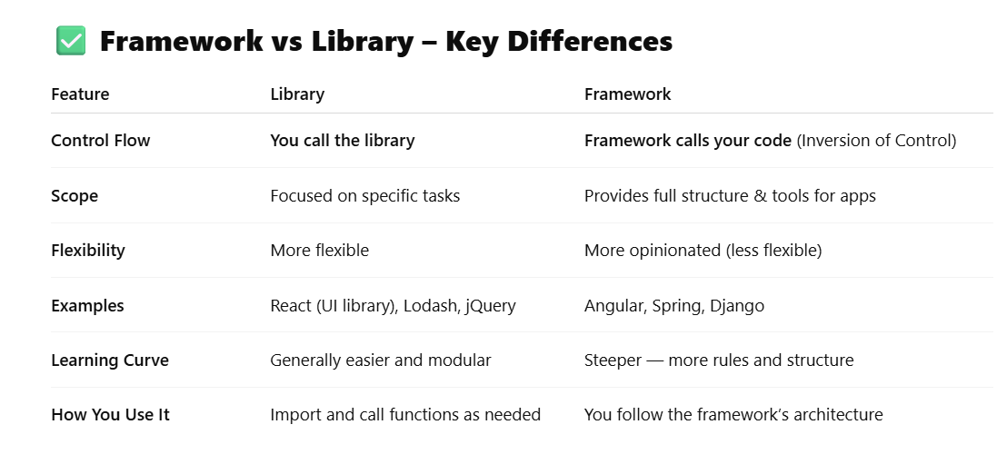
https://react.dev/learn

Slide 6
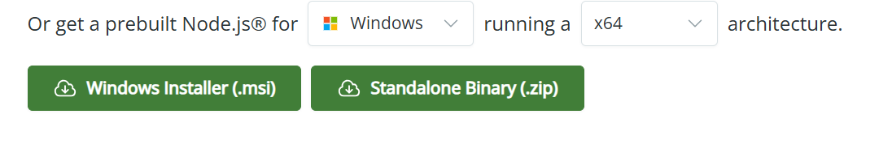

Node JS
Download Node.js
https://nodejs.org/en/download
npx create-react-app my-app
Need node js for run “NPX/NPM”

Slide 7

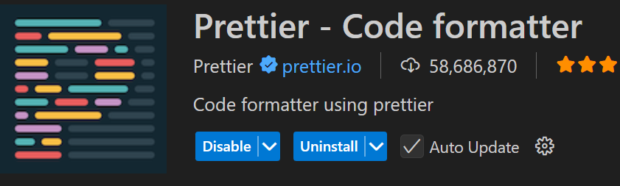
Setup environment
Editor : https://code.visualstudio.com/
Extensions
Linting : find problems in your code
Formatting :
Browser extension
https://chromewebstore.google.com/detail/react-developer-tools/fmkadmapgofadopljbjfkapdkoienihi?hl=en

Slide 8

https://github.com/r5n-labs/vscode-react-javascript-snippets/blob/HEAD/docs/Snippets.md
Create filename.js => rfc import React from 'react'
export default function fileName() {
return <div>fileName</div>
}

Slide 9
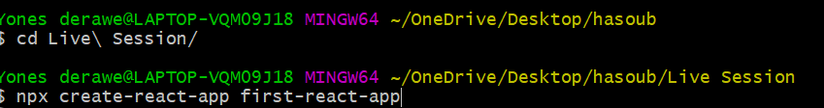
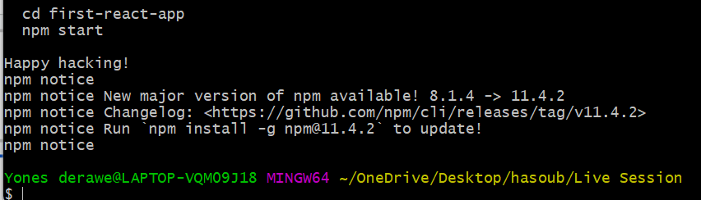
Create react app
npx create-react-app my-app
Git bash or cmd 1- open new dir
2- cd dir
3- run command
1- don't use capital letter
2- can use - for spaces

Slide 10
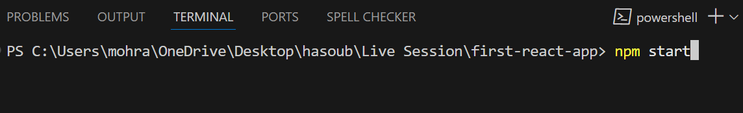

Run app
Open terminal from VS code
http://localhost:3000/

Slide 11
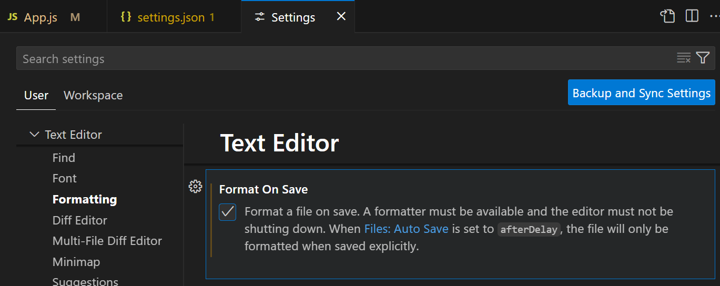
Check Format
Ctrl + Shift + p

Slide 12
Structure react project
Start from index.html
<div id="root"></div>
index.js
const root = ReactDOM.createRoot(document.getElementById('root'));
root.render(
<React.StrictMode>
<App />
</React.StrictMode>
);

Slide 13
Render HTML Elements to the DOM
So far, you've learned that JSX is a convenient tool to write readable HTML within JavaScript. With React, we can render this JSX directly to the HTML DOM using React rendering API known as ReactDOM.
ReactDOM offers a simple method to render React elements to the DOM which looks like this: ReactDOM.render(componentToRender, targetNode), where the first argument is the React element or component that you want to render, and the second argument is the DOM node that you want to render the component to.
As you would expect, ReactDOM.render() must be called after the JSX element declarations, just like how you must declare variables before using them.
const JSX = (<div>
<h1>Hello World</h1>
<p>Lets render this to the DOM</p>
</div>);
ReactDOM.render(componentToRender, targetNode)
ReactDOM.render(JSX,document.getElementById('root'))

Slide 14
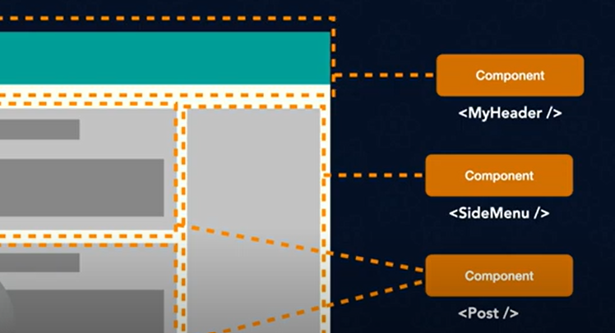
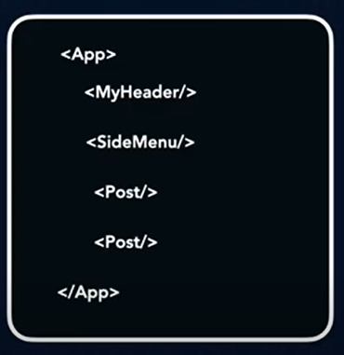

Slide 15
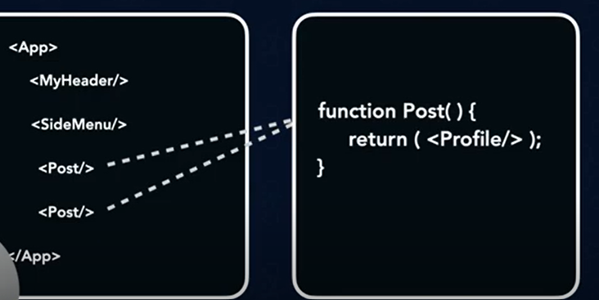
Nested Component

Slide 16
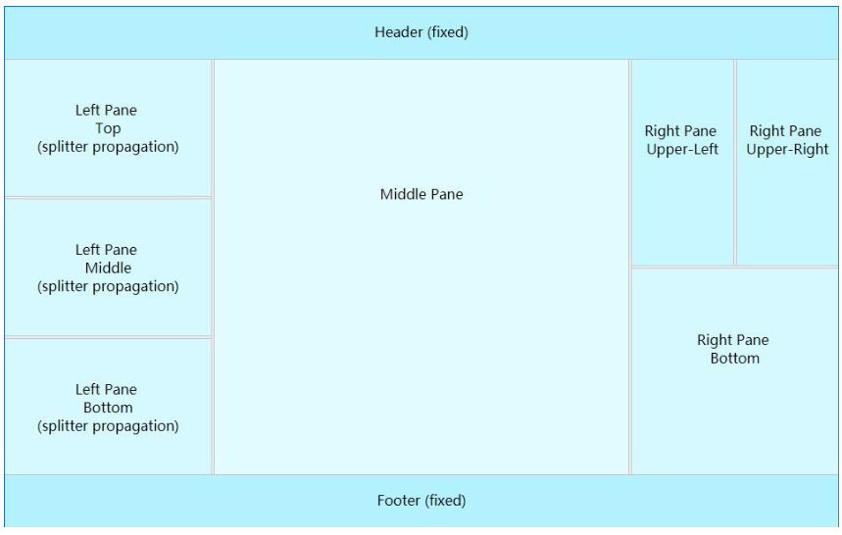

Slide 17
JSX :
React uses a syntax extension of JavaScript called JSX that allows you to write HTML directly within JavaScript. This has several benefits. It lets you use the full programmatic power of JavaScript within HTML, and helps to keep your code readable. For the most part, JSX is similar to the HTML that you have already learned, however there are a few key differences that will be covered throughout these challenges.
For instance, because JSX is a syntactic extension of JavaScript, you can actually write JavaScript directly within JSX. To do this, you simply include the code you want to be treated as JavaScript within curly braces: { 'this is treated as JavaScript code' }.
However, because JSX is not valid JavaScript, JSX code must be compiled into JavaScript. The transpiler Babel is a popular tool for this process
Jsx => Babel => js

Slide 18
JSX-Javascript XML
1- close tag <h1> </h1>
2- Custom Component self close <MyFirstComponent />
3- Return one element call wrapper
4- All tags in wrapper is child
5- can write javascript in html using { }

Slide 19

React components are JavaScript functions that return markup:
function MyButton() {
return (
<button>I'm a button</button>
);
}
can nest it into another component:
export default function MyApp() {
return (
<div>
<h1>Welcome to my app</h1>
<MyButton />
</div>
);
}
1- Starts with a capital letter.
2- HTML tags must be lowercase.
3- The export default keywords specify the main component in the file.
4- Wrap them into a shared parent. Cna use <>...</> fragment
5- Self close tags <MyButton />

Slide 20
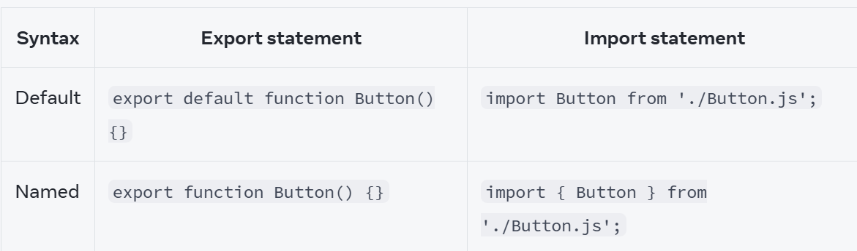

Slide 21
Complex JSX Element
The last challenge was a simple example of JSX, but JSX can represent more complex HTML as well.
One important thing to know about nested JSX is that it must return a single element.
This one parent element would wrap all of the other levels of nested elements.
For instance, several JSX elements written as siblings with no parent wrapper element will not transpile.
Valid JSX:
<div>
<p>Paragraph One</p>
<p>Paragraph Two</p>
<p>Paragraph Three</p>
</div>
Invalid JSX:
<p>Paragraph One</p>
<p>Paragraph Two</p>
<p>Paragraph Three</p>

Slide 22
Add Comments in JSX
JSX is a syntax that gets compiled into valid JavaScript. Sometimes, for readability, you might need to add comments to your code. Like most programming languages, JSX has its own way to do this.
To put comments inside JSX, you use the syntax {/* */} to wrap around the comment text.
<div>
<h1>This is a block of JSX</h1>
{/* <p>Here's a subtitle</p> */}
</div>

Slide 23
Create a Stateless Functional Component
Components are the core of React. Everything in React is a component and here you will learn how to create one.
There are two ways to create a React component. The first way is to use a JavaScript function. Defining a component in this way creates a stateless functional component. The concept of state in an application will be covered in later challenges. For now, think of a stateless component as one that can receive data and render it, but does not manage or track changes to that data. (We'll cover the second way to create a React component in the next challenge.)
To create a component with a function, you simply write a JavaScript function that returns either JSX or null. One important thing to note is that React requires your function name to begin with a capital letter. Here's an example of a stateless functional component that assigns an HTML class in JSX:
const DemoComponent = function() {
return (
<div className='customClass' />
);
};

Slide 24
After being transpiled, the <div> will have a CSS class of customClass.
Because a JSX component represents HTML, you could put several components together to create a more complex HTML page. This is one of the key advantages of the component architecture React provides. It allows you to compose your UI from many separate, isolated components. This makes it easier to build and maintain complex user interfaces.
const MyComponent = function() {
return <div> Yones </div>
}
With custom class css
const MyComponent = function() {
return <div className='yonesCss'> Yones </div>
}

Slide 25
!!!Not Recommended!!!
Create a React Component
The other way to define a React component is with the ES6 class syntax. In the following example, Car extends React.Component:
class Car extends React.Component {
constructor(props) {
super(props);
}
render() {
return (
<h1>Hi</h1>
);
}
}

Slide 26
This creates an ES6 class Car which extends the React.Component class. So the Car class now has access to many useful React features, such as local state and lifecycle hooks. Don't worry if you aren't familiar with these terms yet, they will be covered in greater detail in later challenges. Also notice the Car class has a constructor defined within it that calls super(). It uses super() to call the constructor of the parent class, in this case React.Component. The constructor is a special method used during the initialization of objects that are created with the class keyword. It is best practice to call a component's constructor with super, and pass props to both. This makes sure the component is initialized properly. For now, know that it is standard for this code to be included. Soon you will see other uses for the constructor as well as props.

Slide 27
React component VS functional component
Class
class MyComponent extends React.Component {
constructor(props) {
super(props);
}
render() {
return (
<div>
<h1>Hello React!</h1>
</div> )
}
};
Functional
const MyComponent = function() {
return <div>Hello React!</div>
}

Slide 28
Learn About Self-Closing JSX Tags
So far, you’ve seen how JSX differs from HTML in a key way with the use of className vs. class for defining HTML classes.
Another important way in which JSX differs from HTML is in the idea of the self-closing tag.
In HTML, almost all tags have both an opening and closing tag: <div></div>; the closing tag always has a forward slash before the tag name that you are closing. However, there are special instances in HTML called void elements, or elements that don’t require both an opening and closing tag before another element can start.
For example the line-break tag can be written as <br> or as <br />, but should never be written as <br></br>, since it doesn't contain any content.
In JSX, the rules are a little different. Any JSX element can be written with a self-closing tag, and every element must be closed. The line-break tag, for example, must always be written as <br /> in order to be valid JSX that can be transpiled. A <div>, on the other hand, can be written as <div /> or <div></div>. The difference is that in the first syntax version there is no way to include anything in the <div />. You will see in later challenges that this syntax is useful when rendering React components.

Slide 29
Create a Component with Composition
Now we will look at how we can compose multiple React components together. Imagine you are building an app and have created three components: a Navbar, Dashboard, and Footer.
To compose these components together, you could create an App parent component which renders each of these three components as children. To render a component as a child in a React component, you include the component name written as a custom HTML tag in the JSX. For example, in the render method you could write:
return (
<App>
<Navbar />
<Dashboard />
<Footer />
</App>
)
When React encounters a custom HTML tag that references another component (a component name wrapped in < /> like in this example), it renders the markup for that component in the location of the tag. This should illustrate the parent/child relationship between the App component and the Navbar, Dashboard, and Footer.

Slide 30
const ChildComponent = () => {
return (
<div>
<p>I am the child</p>
</div>
);
};
const ParentComponent = function (){
return (
<div>
<h1>I am the parent</h1>
<ChildComponent/>
</div>
);
};

Slide 31
Use React to Render Nested Components
The last challenge showed a simple way to compose two components, but there are many different ways you can compose components with React.
Component composition is one of React's powerful features. When you work with React, it is important to start thinking about your user interface in terms of components like the App example in the last challenge. You break down your UI into its basic building blocks, and those pieces become the components. This helps to separate the code responsible for the UI from the code responsible for handling your application logic. It can greatly simplify the development and maintenance of complex projects.

Slide 32
const TypesOfFruit = () => {
return ( <div>
<h2>Fruits:</h2>
<ul>
<li>Apples</li>
<li>Strawberries</li>
<li>Bananas</li>
</ul>
</div>
);
};
const Fruits = () => {
return (
<div>
<TypesOfFruit />
</div>
);
};
const TypesOfFood = () =>{
return (
<div>
<h1>Types of Food:</h1>
<Fruits/>
</div>
);
};

Slide 33
Introducing Inline Styles
There are other complex concepts that add powerful capabilities to your React code. But you may be wondering about the more simple problem of how to style those JSX elements you create in React. You likely know that it won't be exactly the same as working with HTML because of the way you apply classes to JSX elements.
If you import styles from a stylesheet, it isn't much different at all. You apply a class to your JSX element using the className attribute, and apply styles to the class in your stylesheet. Another option is to apply inline styles, which are very common in ReactJS development.
You apply inline styles to JSX elements similar to how you do it in HTML, but with a few JSX differences. Here's an example of an inline style in HTML:
<div style="color: yellow; font-size: 16px">Mellow Yellow</div>
JSX elements use the style attribute, but because of the way JSX is transpiled, you can't set the value to a string. Instead, you set it equal to a JavaScript object. Here's an example:
<div style={{color: "yellow", fontSize: 16}}>Mellow Yellow</div>
Notice how we camelCase the fontSize property? This is because React will not accept kebab-case keys in the style object. React will apply the correct property name for us in the HTML.

Slide 34
const Colorful =()=> {
return (
<div style={{fontSize :"72px", color :"red"}}>Big Red</div>
);
};

Slide 35
Define an HTML Class in JSX
Now that you're getting comfortable writing JSX, you may be wondering how it differs from HTML.
So far, it may seem that HTML and JSX are exactly the same.
One key difference in JSX is that you can no longer use the word class to define HTML classes. This is because class is a reserved word in JavaScript. Instead, JSX uses className.
In fact, the naming convention for all HTML attributes and event references in JSX become camelCase. For example, a click event in JSX is onClick, instead of onclick. Likewise, onchange becomes onChange. While this is a subtle difference, it is an important one to keep in mind moving forward.
const JSX = (
<div className="myDiv">
<h1>Add a class to this div</h1>
</div>
);

Slide 36
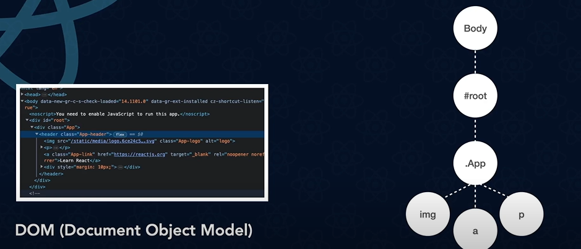

Slide 37
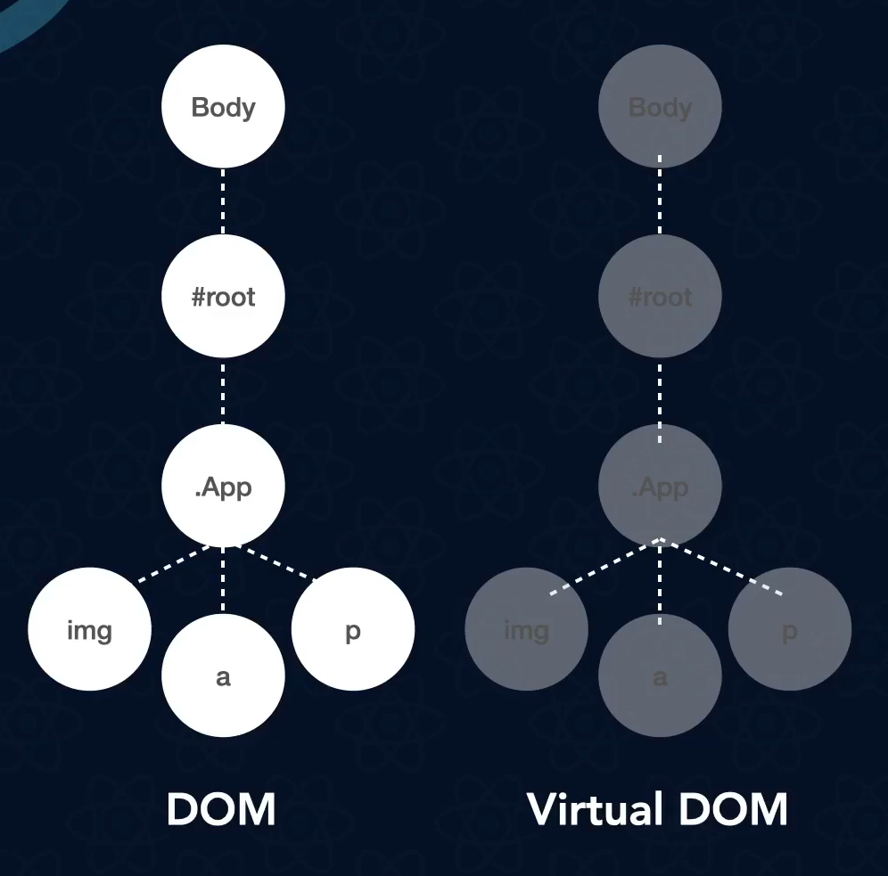
copy from dom

Slide 38
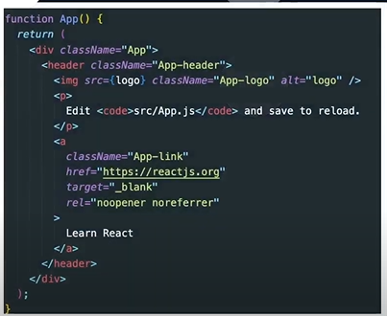
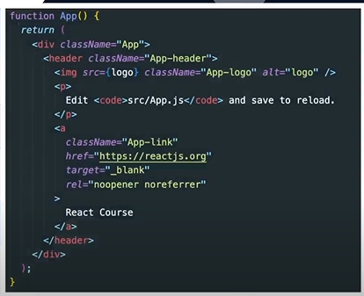
Change Learn React to React Course

Slide 39
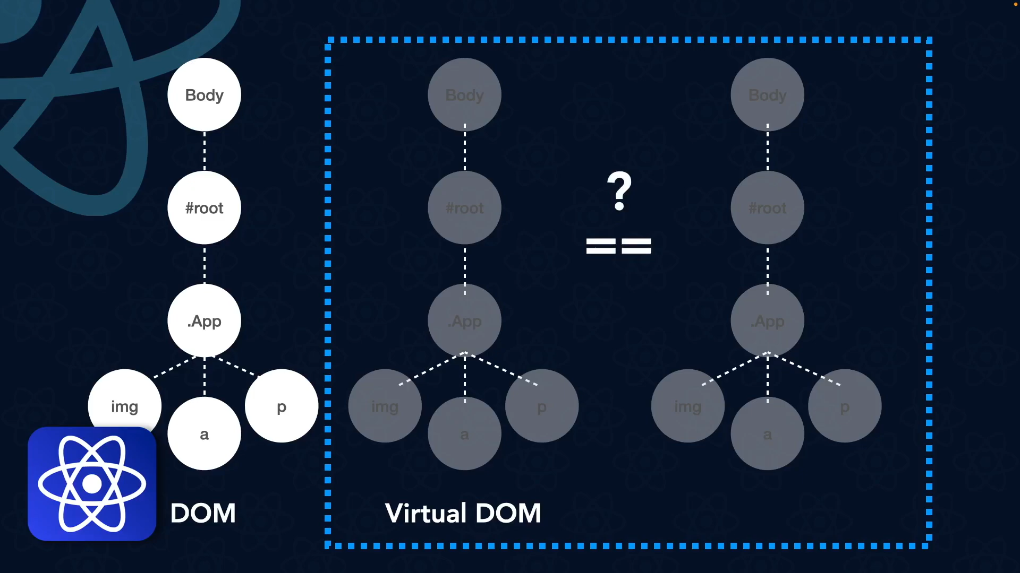

Slide 40
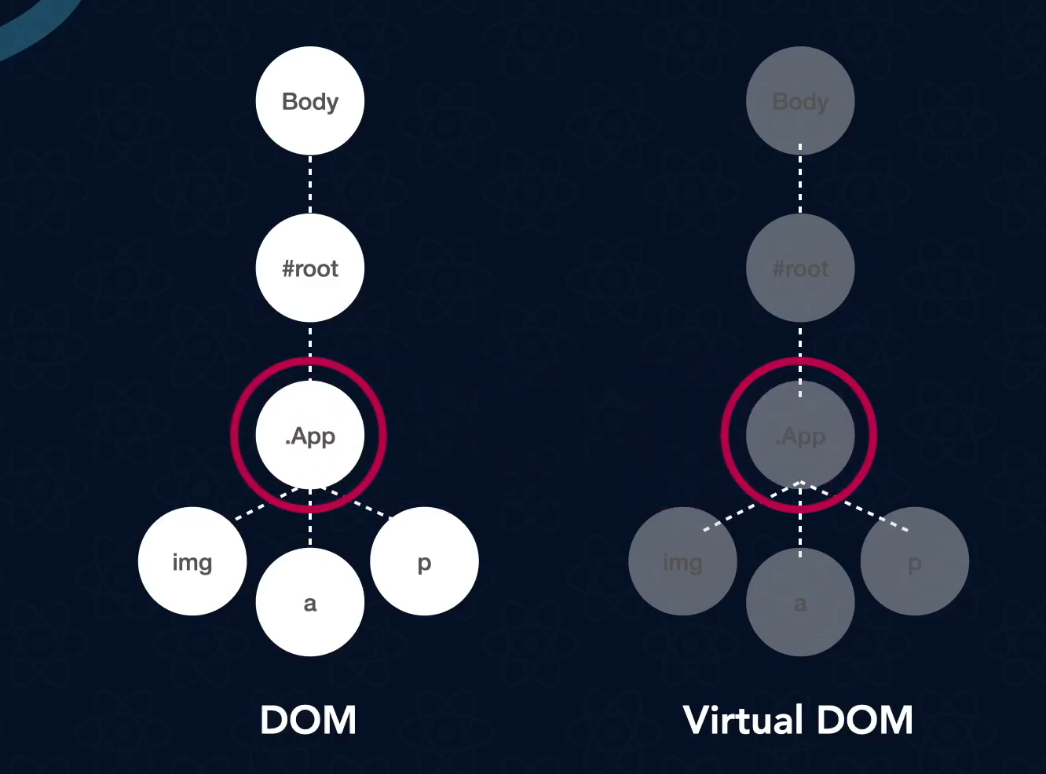
Re Rendering component that has changed

