Slide 1
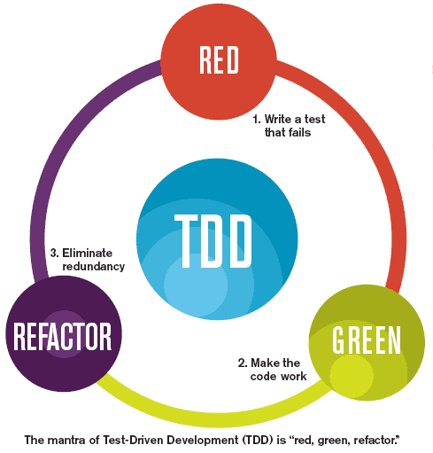
Session 16.1 - Test-driven development (TDD)

Slide 2
Test-driven development (TDD)

Slide 3
Objectives
Students will understand why we test our codebase
Students will understand what Test-driven development (TDD) is
Students will understand unit testing in TDD

Slide 4
Why Test Our Code?
Tests Improve Design
Writing tests forces you to make your code testable. Specifically, you tend to rely less on bad habits like using global variables, instead making your code more component based and easier to use.
Tests Defend Against Other Programmers
Larger projects and applications are touched by many programmers. With code tests, you can ensure that when another programmer changes the code, the test breaks and informs the programmer of the problem. This behavior avoids breaking unknown sections of the code that are relying on that code

Slide 5
Why Test Our Code?
Testing Forces You to Slow Down and Think
TDD design requires programmers to think about function inputs and outputs
Tests Reduce Bugs in Existing Features
With proper unit testing we can ensure that functions won’t be broken during refactoring of code
Testing Makes Development Faster
TDD helps you to realize when to stop coding. Your tests give you confidence that you've done enough for now and can stop tweaking and move on to the next thing
Tests Reduce Fear
One of the biggest fears that programmers encounter is making a change to a piece of code and not knowing what is going to break. Having a complete test suite allows programmers to remove the fear of making changes or adding new features.

Slide 6
Test Driven Development (TDD)
TDD tests small sections of code in an automated fashion in order to make sure that when small critical sections of the code work we can rely on larger sections that rely on the smaller sections to work also.
Unit Tests - testing individual units of code in isolation.

Slide 7
TDD Method
Test-driven development (TDD) is a software development process that relies on the repetition of a very short development cycle: first the developer writes an (initially failing) automated test case that defines a desired improvement or new function, then produces the minimum amount of code to pass that test, and finally refactors the new code to acceptable standards.

Slide 8
TDD Method
Write function with no code inside but knowing the desired inputs and output to accomplish the task. This will fail the test.
Write the most basic code inside your function to make it work and pass the test. This will pass the test.
When time or resources permit, revisit the function and refactor, or improve the code. Refactor.

Slide 9
Testing Tools For Javascript
Jasmine
Karma
Selenium
Selenium Webdriver

Slide 10
Writing Tests
Tests are defined in spec files in your application that test functions in your code.
Each time the code is being deployed, all tests defined in your specs should be run on your code to ensure that with the addition of your new code, previous tests still pass.

Slide 11
Jasmine
A JavaScript testing library
With an easy to use syntax
That can be used in the browser (with Selenium)
Or on the command line (TDD)
Jasmine uses the term "specs" to emphasize that they should be written before you start coding.

Slide 12
Example Test(Spec) of add()
describe("Addition function", function() {
it("should add numbers", function() {
expect(add(1, 1)).toBe(2);
});
});
We are testing that our add() function gives us the desired result of what we expect from an addition function.

Slide 13
Example Test(Spec) of add()
describe("Calculator", function() {
describe("Addition function", function() {
it("should add numbers", function() {
expect(add(1, 1)).toBe(2);
expect(add(2, 2)).toBeGreaterThan(3);
});
});
});
Multiple tests can be performed in a describe block to ensure that the function behaves correctly in multiple scenarios

Slide 14
Spec Requirements
describe("Calculator", function() {
describe("Addition function", function() {
it("should add numbers", function() {
expect(add(1, 1)).toBe(2);
expect(add(2, 2)).toBeGreaterThan(3);
});
});
});
At least one describe block (they can be nested)
At least one it block which contains a spec
At least one expectation, which consists of:
expect which is passed an expression (called the "actual" value)
A matcher with the expected value (toBe and toBeGreaterThan)

Slide 15
Using Jasmine
The Plan
We're going to write a mini string library which has the following functions.
A "first word" function which returns the first word of a string.
An "nth word" function which returns any word n of a string.

Slide 16
Using Jasmine
First we describe it
We're testing the stringUtil library.
Specifically we're testing the firstWord function.
describe("stringUtil", function() {
describe("firstWord", function() {
// Specs go here.
});
});

Slide 17
Using Jasmine
Then we spec it
describe("stringUtil", function() {
describe("firstWord", function() {
it("should return the first word of a string", function () {
expect(stringUtil.firstWord("one two")).toBe("one");
});
});
});

Slide 18
Using Jasmine
Then we run the specs
FAIL

Slide 19
Using Jasmine
Remember the TDD process.
Red -> Green -> Refactor
If you don't get red after writing your specs first, then there is something wrong with your specs.
Basically, that first red means you're doing the right thing.
stringUtil isn't defined.

Slide 20
Using Jasmine
So let's define it (in our code)
var stringUtil = {};

Slide 21
Using Jasmine
Test again and FAIL : Now we get a different error (from our spec)
stringUtil doesn't have a firstWord method
Let's fix that (in our code)
var stringUtil = {
firstWord: function() {
// Not doing anything yet.
}
};

Slide 22
Using Jasmine
Test again and FAIL : Our function isn't returning anything
Now for some actual logic
var stringUtil = {
firstWord: function(text) {
var textWords = text.split(" ");
return textWords[0];
}
};

Slide 23
Using Jasmine
We got to green!
(But that code wasn't the greatest)
Time to refactor
var stringUtil = {
firstWord: function(text) {
return text.split(" ")[0];
}
};

Slide 24
Using Jasmine
Green again!
Now lets write the specs for nthWord
describe("stringUtil", function() {
describe("firstWord", function() {
it("should return the first word of a string", function () {
expect(stringUtil.firstWord("one two")).toBe("one");
});
});
describe("nthWord", function() {
it("should return the nth word of a string", function () {
expect(stringUtil.nthWord("one two", 1)).toBe("one");
expect(stringUtil.nthWord("one two", 2)).toBe("two");
});
});
});

Slide 25
Using Jasmine
We get our first failing spec because stringUtil doesn't have a nthWord method
Let's write nthWord
var stringUtil = {
firstWord: function(text) {
return text.split(" ")[0];
},
nthWord: function(text, i) {
return text.split(" ")[i - 1];
}
};

Slide 26
Using Jasmine
All Green! TDD Unit Test Complete
describe("stringUtil", function() {
describe("firstWord", function() {
it("should return the first word of a string", function () {
expect(stringUtil.firstWord("one two")).toBe("one");
});
});
describe("nthWord", function() {
it("should return the nth word of a string", function () {
expect(stringUtil.nthWord("one two", 1)).toBe("one");
expect(stringUtil.nthWord("one two", 2)).toBe("two");
});
});
});

