Slide 1
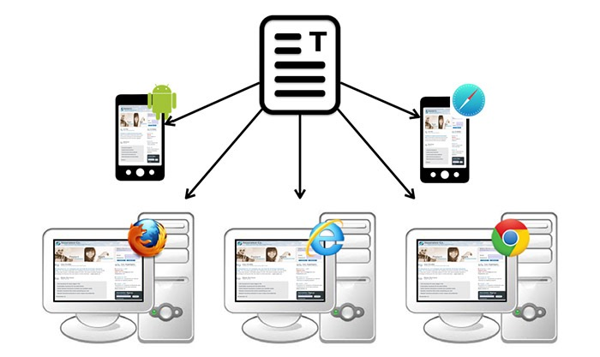

Session 16.1 - Behavior-driven development (BDD) and Load Testing

Slide 2
Behavior-driven development (BDD) and Load Testing

Slide 3
Objectives
Students will understand what Behavior Driven Development is
Students will understand how BDD is similar and differs from TDD.
Students will run BDD tests on the Eat-Da-Burger app from Week 14
Students will learn about and run load testing on the Eat-Da-Burger app

Slide 4
What is BDD?
Behavior-driven development (BDD) is a software development methodology in which an application is specified and designed by describing how its behavior should appear to an outside observer.

Slide 5
BDD vs TDD
Within the confines of the requirements and testing dictated by BDD, you will use "ordinary" TDD to develop the software. The unit tests so created will serve as a test suite for your implementing code, while the BDD tests will function more or less as acceptance tests for the customer.
Both TDD and BDD run tests on the code but BDD also tests the output of the complete application to ensure that parts of it make sense to the user.

Slide 6
BDD Testing Tools For Javascript
Jasmine - Behavior-Driven JavaScript
Karma - Spectacular Test Runner for Javascript
Selenium - Web Browser Automation
Selenium Webdriver - makes direct calls to the browser using each browser's native support for automation.

Slide 7
Writing Tests
Tests are defined in spec files in your application that test functions in your code.
Tests are in the spec/ folder of your codebase and end in spec.js. Only files ending in spec.js will be considered tests.

Slide 8
BDD Tests with Jasmine-Node & Selenium
In order to BDD a node application using BDD. We need to install the following modules.
Jasmine - http://jasmine.github.io/2.0/node.html
jasmine-node
Selenium
selenium-webdriver - http://webdriver.io/

Slide 9
Example BDD Tests
Test the homepage of a site exists and is displaying properly
Verify that the expected elements are properly displaying in the page (for example H2 tg or the page’s form)
Verify database interaction is working
Verify connect form can be sent

Slide 10
Example Test
describe('Eat-da-burger BDD Testing Homepage', function() {
// Open the Eat-da-burger website in the browser before each test is run
beforeEach(function(done) {
this.driver = new selenium.Builder().
withCapabilities(selenium.Capabilities.chrome()).
build();
this.driver.get('http://127.0.0.1:3000/').then(done);
});
});
Define describe block and before each test is run, start a new browser with default route opened.

Slide 11
Example Test
describe('Eat-da-burger BDD Testing Homepage', function() {
// Open the Eat-da-burger website in the browser before each test is run
beforeEach(function(done) {
this.driver = new selenium.Builder().
withCapabilities(selenium.Capabilities.chrome()).
build();
this.driver.get('http://127.0.0.1:3000/').then(done);
});
// Close the website after each test is run (so that it is opened fresh each time)
afterEach(function(done) {
this.driver.quit().then(done);
});
});
When the tests are finished make sure the browser started is closed.

Slide 12
Example Test
describe('Eat-da-burger BDD Testing Homepage', function() {
…
// Test to ensure we are on the home page by checking the <body> tag id attribute
it('Should be on the home page', function(done) {
var element = this.driver.findElement(selenium.By.tagName('h2'));
element.getText().then(function(value) {
// Show the value of getText
// console.log(value);
expect(value).toBe('Welcome To Eat-Da-Burger');
done();
});
});
});
Run a test inside the describe block. Look for h2 tag on the page and test to see if it contained the text “Welcome to Eat-Da-Burger”.

Slide 13
Run a More Complex Test
describe("Eat-da-burger BDD Testing for Home Page", function () {
// Open the Eat-da-burger website in the browser before each test is run
beforeEach(function(done) {
this.driver = new selenium.Builder().
withCapabilities(selenium.Capabilities.chrome()).
build();
this.driver.get('http://127.0.0.1:3000').then(done);
});
// Close the website after each test is run (so that it is opened fresh each time)
afterEach(function(done) {
this.driver.quit().then(done);
});
it("should create a new burger", function (done) {
/// Name the new burger and then create it by adding it to the Submit button
var burgerName="My New Burger, Bro " +(Math.floor(Date.now() / 1000))
this.driver.findElement(selenium.By.id('enter_text')).sendKeys(burgerName);
this.driver.findElement(selenium.By.id('text-enter-button')).click();
var element = this.driver.findElement(selenium.By.id(burgerName));
element.getAttribute('id').then(function(id) {
expect(id).toBe(burgerName);
done();
});
});
});
Create a new burger with a distant name that will create a div id for that new burger ONLY IF the burger is successfully created,

Slide 14
Exercise
Write a BDD test for Eat-Da-Burger that
“Should fill out form and successfully send email"

Slide 15
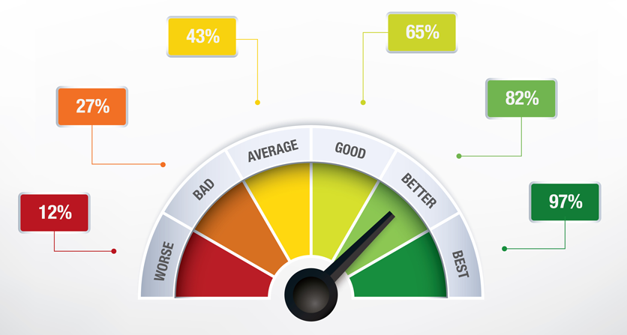
Performance Testing
Performance testing is the process of determining the speed or effectiveness of a computer, network, software program or device.

Slide 16
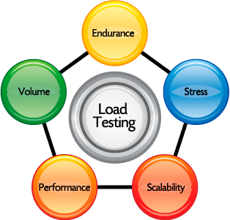
Load Testing
Load testing is the process of putting demand on a software system or computing device and measuring its response. Load testing is performed to determine a system's behavior under both normal and anticipated peak load conditions.

Slide 17

Stress Testing
Stress testing is a form of deliberately intense or thorough testing used to determine the stability of a given system or entity. It involves testing beyond normal operational capacity, often to a breaking point, in order to observe the results.
Although Selenium as an automated test tool will run quite fast, making a mini stress test. If you put the same automation running on a couple of computers on your network at the same time you'll be able to see how it behaves.

Slide 18
Load Testing Tools
Server Based Tools
loadtest (NiodeJS module)
Apache JMeter
Gatling
Cloud Based Tools
https://smartbear.com
https://loadimpact.com
https://www.loadsterperformance.com
https://loader.io
Different tools have different strengths and compatibilities

Slide 19
Load Testing Exercise
Using loadtest module to find stress points in your Eat-Da-Burger application (or use the MVC Cats application from last week (15.3)).
Instructions:
Install your app
Run various tests with loadtest for example:
node node_modules/loadtest/bin/loadtest.js -n 2000 -c 100 http://localhost:3000/
Identify stress points on various routes in the application. Test all paths on the site.
Why is there stress on those underperforming routes?
Suggestions for fixing those stress points.
Fixes for those stress points.

