Slide 1
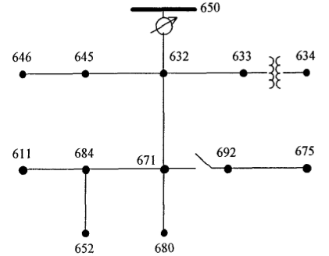
IEEE 13
13 nodes
15 groups of 20 houses
611 (1), 634 (3), 645 (2), 646 (2),
652 (1), 675 (3), 692 (3)
Identical houses, identical PV
Constant production of PV (no climate)
Switch between 671 and 692 closed
Tests for different PV percentages
(0, 20, 40, 60, 80, 100)

Slide 2
1. Normal operation: constant production, constant consumption
Parameter order (synchronization between the phases):
still equal to 1 for all percentages
→ all the nodes are
synchronized in phases
(PLL?)

Slide 3
1. Normal operation: constant production, constant consumption
Frequency:
0%PV 20%PV 40%PV
60%PV 80%PV 100%PV

Slide 4
1. Normal operation: constant production, constant consumption
Frequency:
frequency increases as the number of PV increases
→ PV tends to make the system instable
(frequency out of the acceptable interval in reality)
one node is not synchronized in frequency (652)

Slide 5
2. Change in the power flow
One capacitor tuned on at t = 300s
→ production of reactive power
Capacitor linked to node 675

Slide 6
1. Change in the power flow
Parameter order (synchronization between the phases):
still equal to 1 for all percentages
→ all the nodes are
synchronized in phases
(PLL?)

Slide 7
2. Change in the power flow
Frequency:
0%PV 20%PV 40%PV
60%PV 80%PV 100%PV

Slide 8
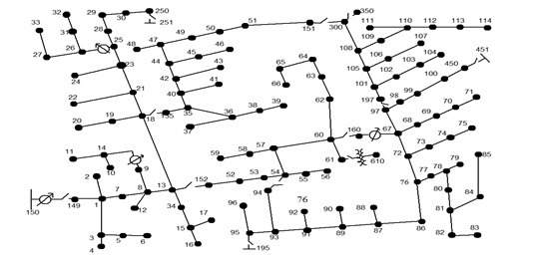
Questions
How to explain that the phases are synchronized but one node has a different frequency?
How to explain that the phases are synchronized but one node has a different frequency?
Simulations operated with PLL frequency measurement → try with SIMPLE?
Simulations on a larger grid (IEEE123):
different architecture (meshed)
→ different behavior?

