Slide 1
Procedural Nature Walk
Michael Sterle-Contala
Kendy Jeune

Slide 2
Procedural Nature Walk
Why nature?
  Natural settings have more appeal
  More challenging to model
  Chance to explore fractal patterns found in nature

Slide 3
Challenges
Asset management
Rendering
Procedural generation
User Interface

Slide 4
Models
Procedural generation => repetitive use of meshes
Instancing is key
Challenge with instance data
  Held in vector for optimized transfer to GPU
  Pointers to vector elements are unreliable
  Solution: custom pointer class

Slide 5
Textures
2 ways of creating:
  Generator methods
    accept a function object to generate texels
  Filter objects using FBOs
    Convolution filters
      gaussian blur, sharpen, Sobel edge detection
    Blending effects
      Add, multiply, apply colour

Slide 6
Shaders
Many shaders instead of shader logic for optimization
Used for:
  Shadow mapping
  Filters
  Special models (terrain, skybox)

Slide 7
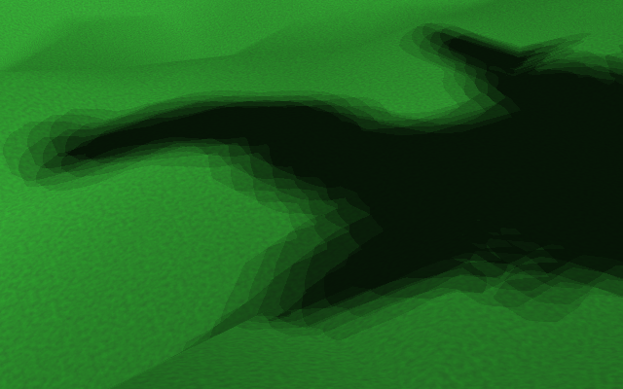
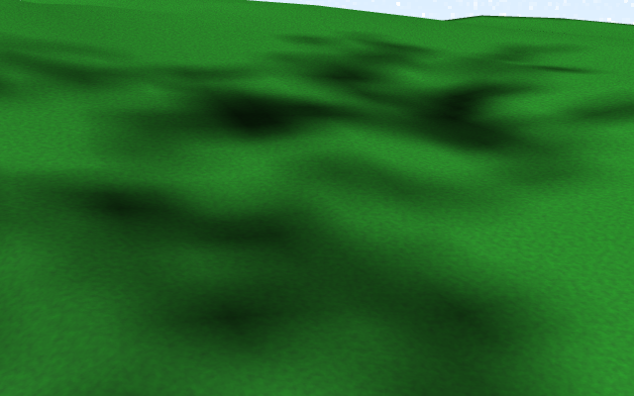
Shadow Mapping
Tested both PCF and VSM
Chose VSM:
  Faster
  Smoother blur effect
PCF – 3x3 Kernel
VSM – 3x3 Kernel

Slide 8
Procedural Generation
Generate terrain, models and textures algorithmically
Simulate natural processes
Heart of procedural generation:
  Fractals and noise

Slide 9
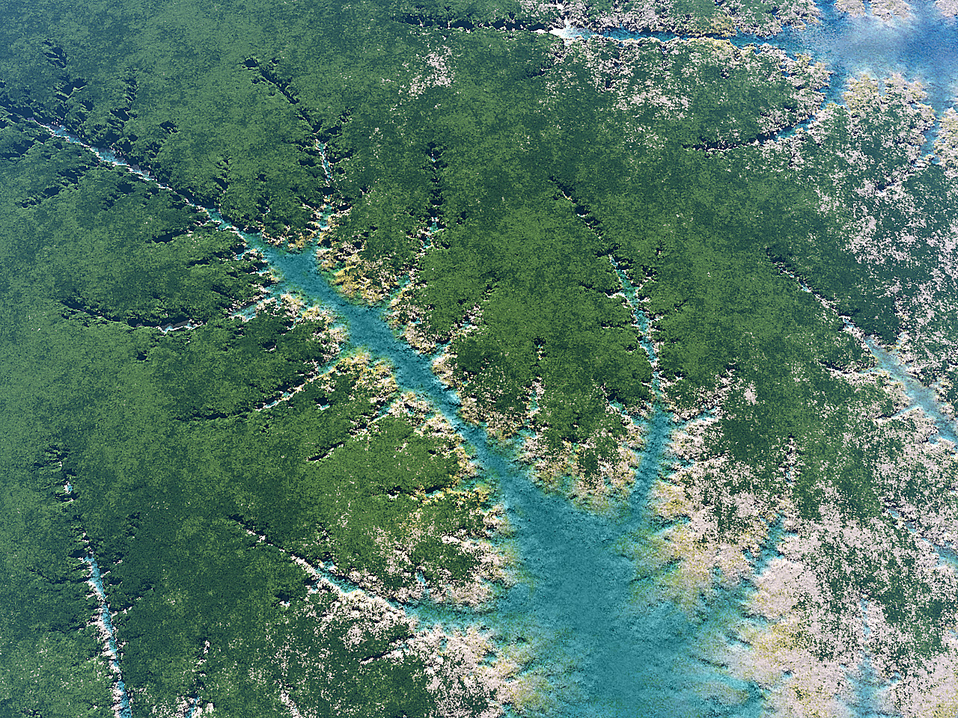
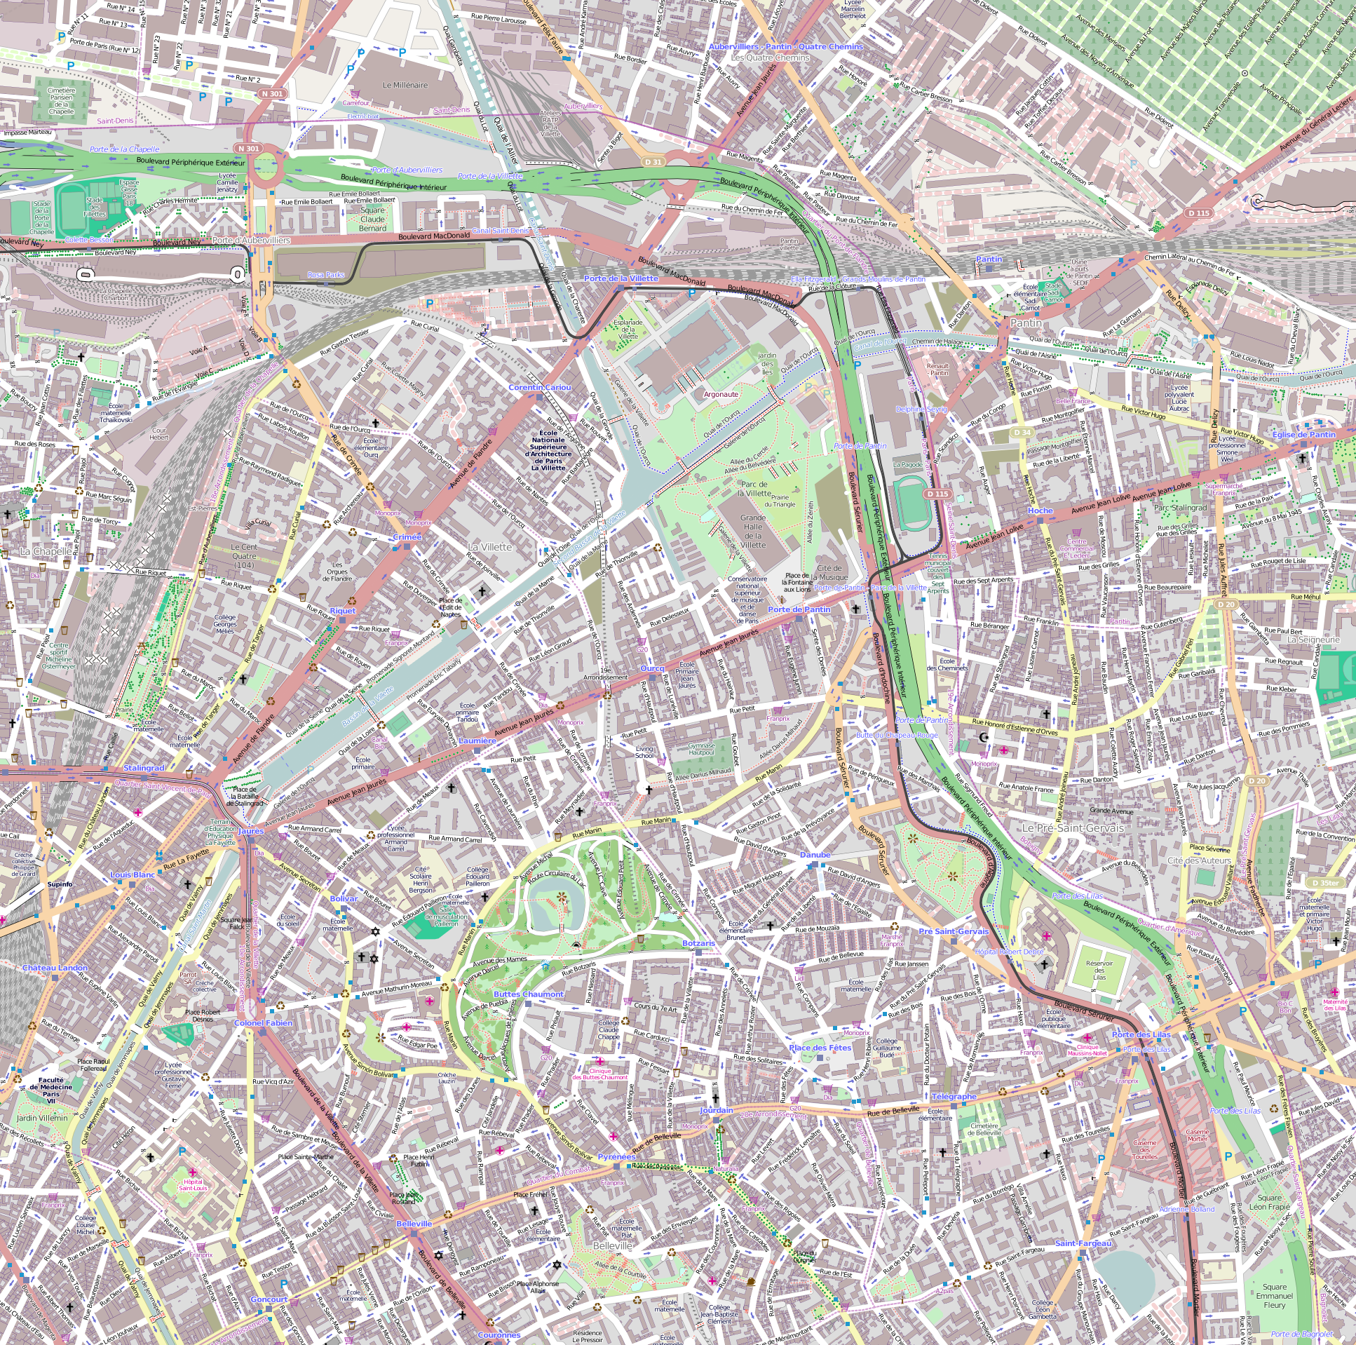
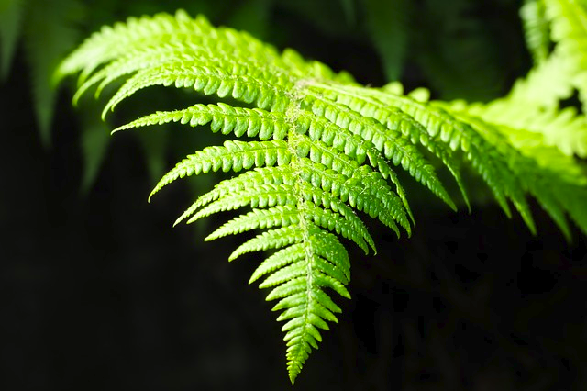
Fractals
Repeating patterns at different scales
Recursive, generated algorithmically
Found everywhere in nature and human development
©2009 Alexis Monnerot-Dumaine
©2014 OpenStreetMap
contributors

Slide 10
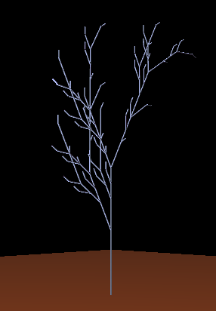
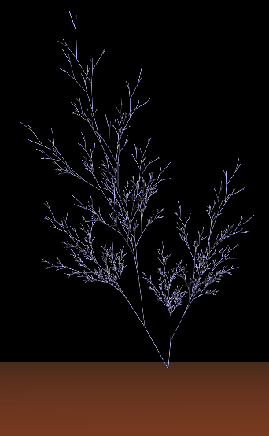
Model Generation
Lindenmayer systems ideal for plants
Simulates organic growth
Challenges:
  Had to develop compiler
  Basic vs parametric
  Turtle graphic interpreter
Simple D0L
96,768 polys
Parametric D0L
32,760 polys

Slide 11
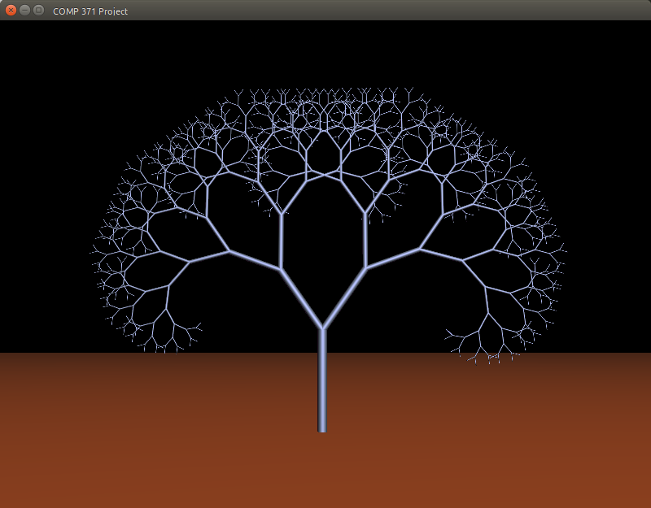
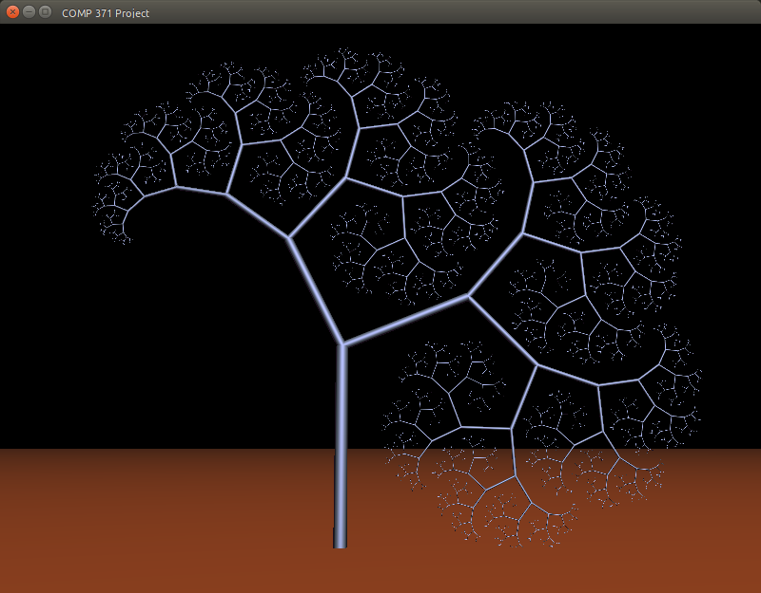
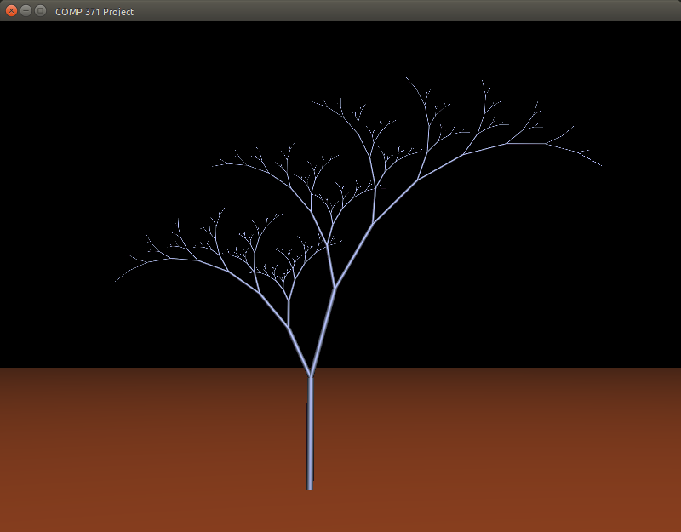
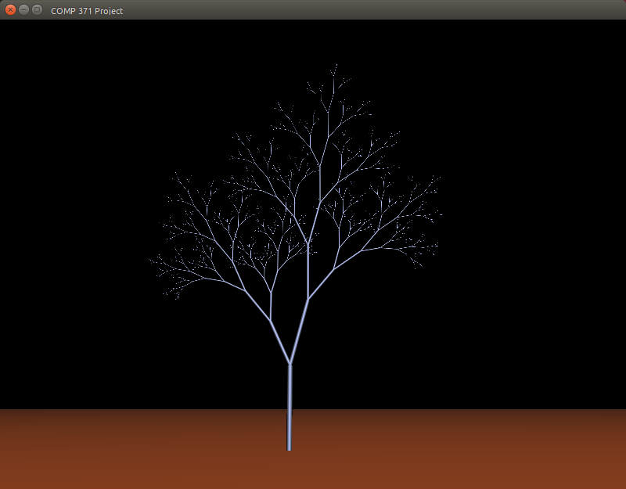
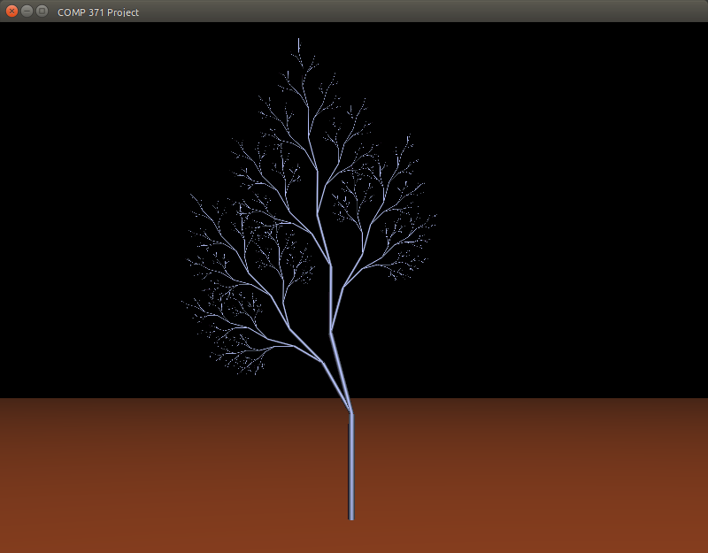
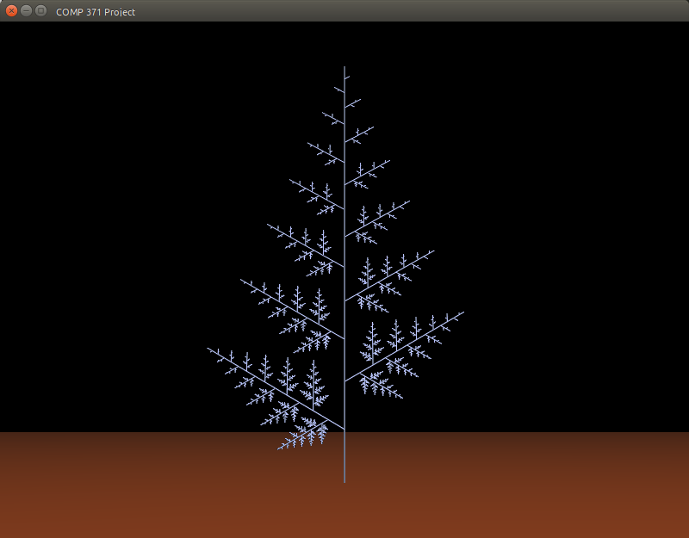
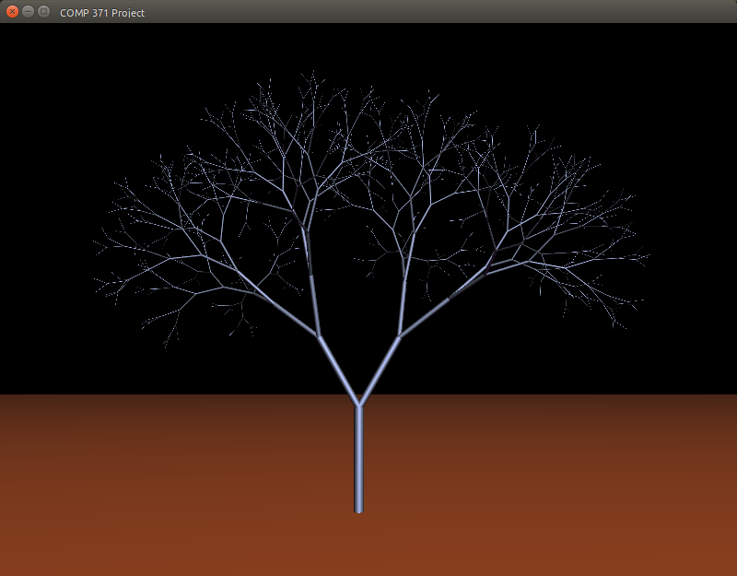
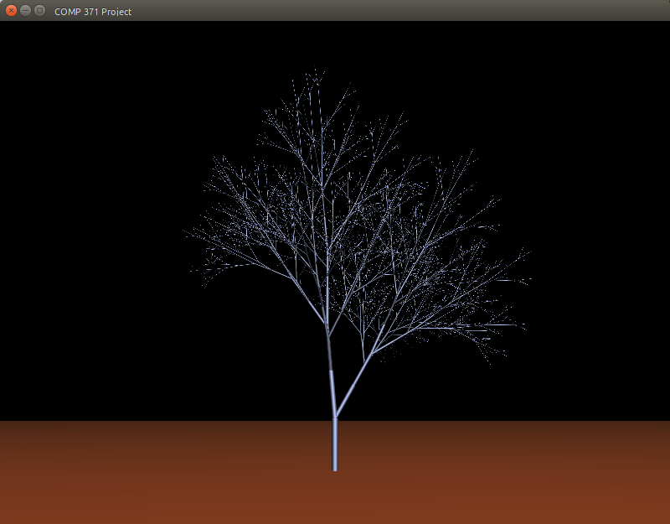
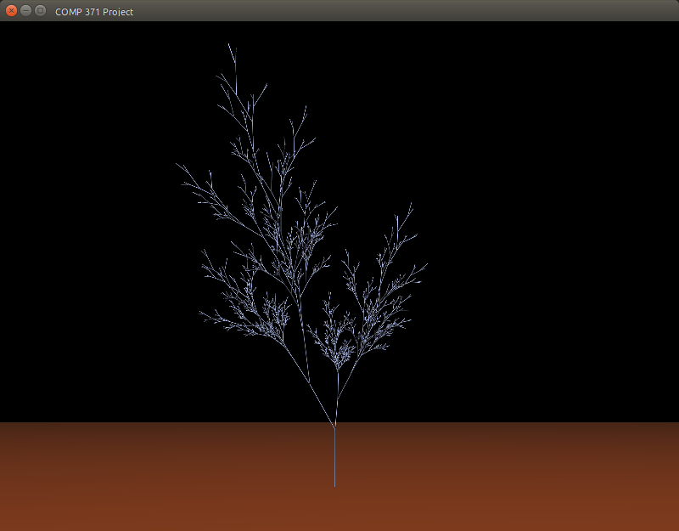
Parametric D0L System
One system, different starting parameters:

Slide 12
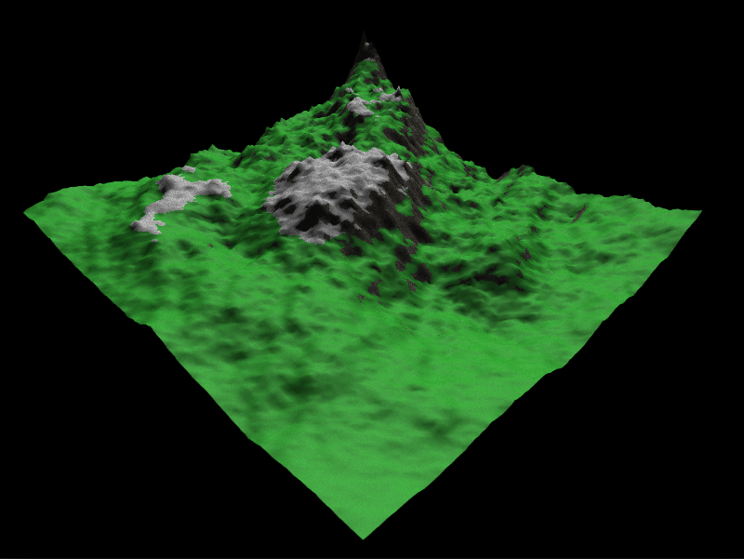
Terrain Generation
Diamond-Square fractal algorithm
  More interesting peaks and valleys at any scale
  Easy “roughness” control
Gaussian envelope
  Variety of features
  in small area

Slide 13
Terrain Texturing
3 textures generated
  Grass, snow, rock
Texture of texel decided in fragment shader
  Slope > threshold => rock
  Altitude > threshold => snow
  Altitude < threshold => grass

Slide 14
Noise
Definition:
  graphical representation, pseudo-random, continuous, randomly accessible
Perlin chosen because
  easy to implement
  easy to tile
  can be seeded
  can be made fractal

Slide 15
Perlin Noise
Developed by Ken Perlin in 1985, improved in 2002
Define a grid with gradients of unit length and random direction at grid intersections
For point P, find dot products of distance vectors to surrounding grid points and gradient vectors at those grid points
  d_{i, j}·g_{i, j}, d_{i+1, j}·g_{i+1, j}, d_{i, j+1}·g_{i, j+1}, d_{i+1, j+1}·g_{i+1, j+1}
Interpolate for C1 and C2 continuity
Can extend to 3D, 4D, etc.
g_{i, j}
g_{i+1, j}
g_{i+1, j+1}
g_{i+1, j}
d_{i, j}
d_{i+1, j}
d_{i, j+1}
d_{i+1, j+1}

Slide 16

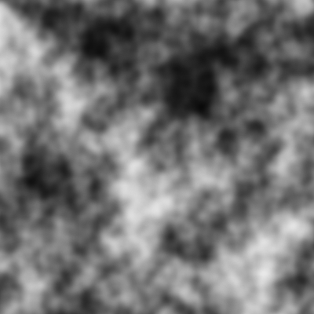
Perlin Noise
Can be implemented as fractal pattern
  Combine different ‘octaves’ (scaled versions)
Can be repeatable (good for tiling)
Basic Perlin Noise
Octave Perlin Noise
(4 octaves)

Slide 17
Skybox
Generated with octave Perlin noise
Skybox 3D coordinates projected onto sky plane 2D coordinates
Raleigh scattering effect added near horizon

Slide 18
Key Inputs
Objectives
Kept it fairly simple
Same Input for the 2 modes but different result in each Mode
Everything Resources Provided by GLFW
Walk Mode |  | Explore Mode
W, A, S, D | Move forward, backward, left, right | W, A, S, D
Unavailable | Rotate terrain around the X-Y-Z axis | X, Y, Z
Unavailable | GLPolygonMode. GL_FILL, GL_LINE, GL_Point, GL_TRIANGLE (respectively) | T, V, P, U
H | Toggle Between Walk Mode, Explore Mode | H
Unavailable | Fly upward /Move camera to +y axis | Spacebar
Shift(Hold) | Run/Increase camera speed | Unavailable

Slide 19
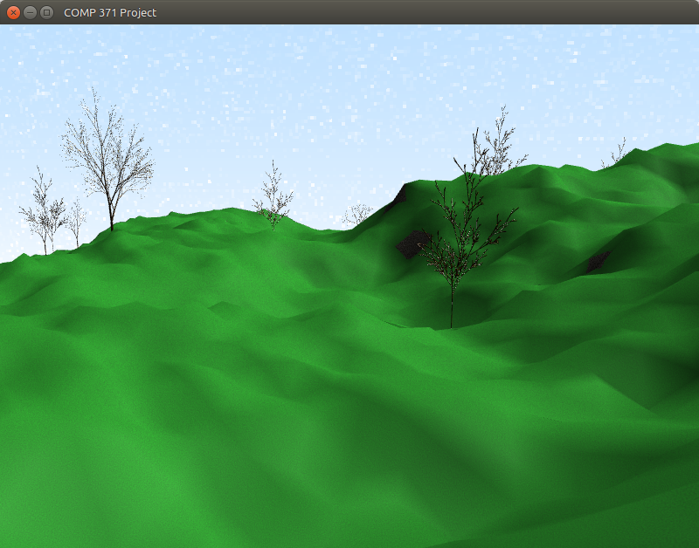
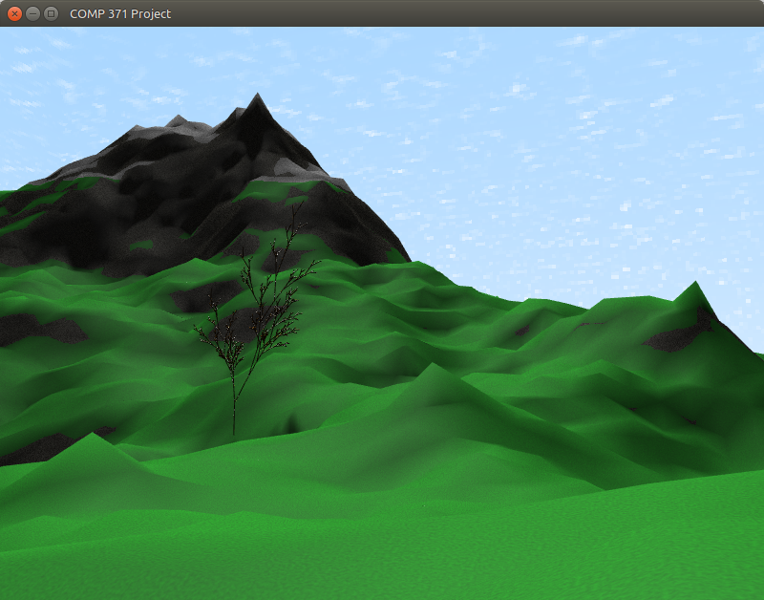
Camera Movement
Objectives
Explore mode designed to give complete control over terrain
Walk mode to provide a Player view closer look at terrain
Movement speed to be reasonable

Slide 20
Collision Detection
Objectives :
Minimize the amount of calculations needed
Bounding cylinder around the tree trunk
If collision, push back a little
Aiming to reproduce a bump effect

Slide 21
Future Work
Tree leaves
Bump maps
More efficient shadows
Better texture transitions
Stochastic and contextual L-systems
Hydrology simulation for terrain

Slide 22
References
NVIDIA Developer
Intel Developer Zone
Learn OpenGL
The Algorithmic Beauty of Plants
Przemyslaw Prusinkiewicz and Aristid Lindenmayer
Algorithmic Botany
Dept. Of Computer Science, University of Calgary
Improved Noise reference implementation
Ken Perlin

