Slide 1
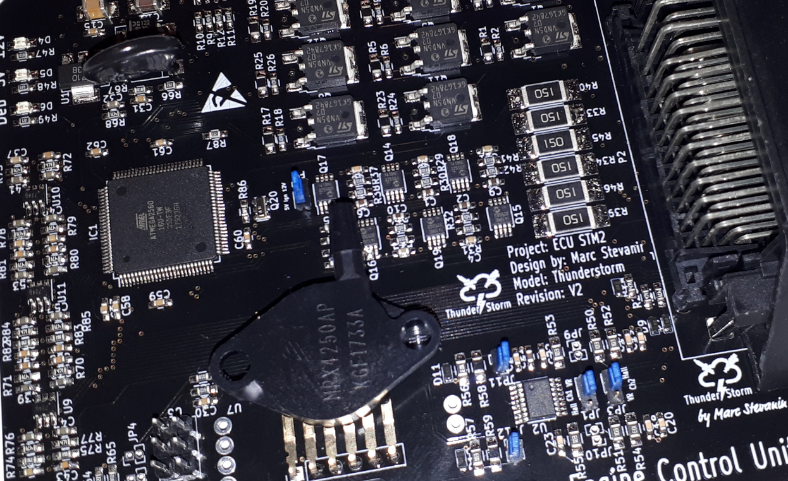
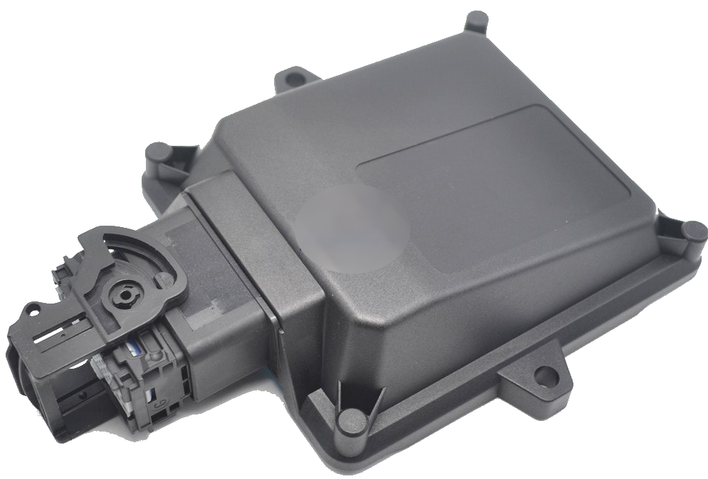

ThunderStorm Engine Control Unit by
Hardware:
Full standalone Engine Management System
Automotive range sealed connector and enclosure
Up to 12 cylinders even fire engine
13 power outputs and 14 analog inputs
Multiple communication protocols (CAN-Bus, Bluetooth, Serial-USB)
Software (key features):
Full realtime monitoring and tuning
Sequential fuel and spark*
Many trigger wheel patterns
Open or closed loop control for Idle, Boost, AFR
Flex fuel, launch control, autotune, nitrous control
Easy to update, new features will come…
Contacts:
Marc Stevanin
Email: marc_stevanin@hotmail.com
Phone: +41 78 757 04 55
*please ask for details

