Slide 1


EMPLOYEE ANALYSIS

Slide 2



Attrition
Employee attrition is the gradual reduction in employee numbers.

Slide 3

Purpose
Relationship between Company and Employee
Understanding how to improve employee satisfaction

Slide 4
Attrition
Which employees left the company?
Why they wanted to leave

Slide 5
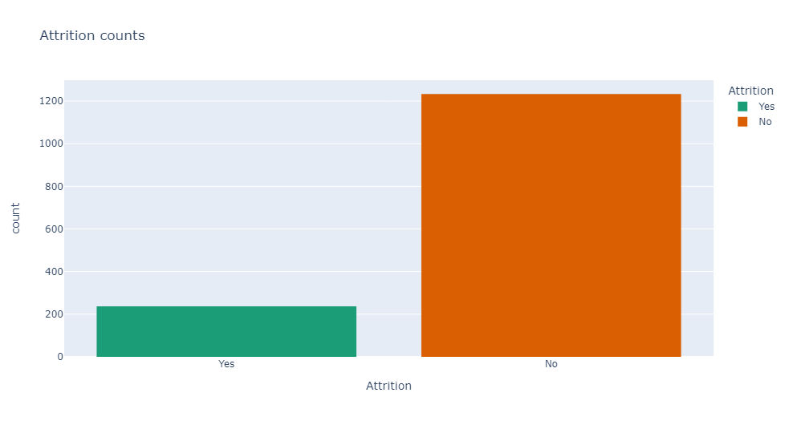
Attrition

Slide 6
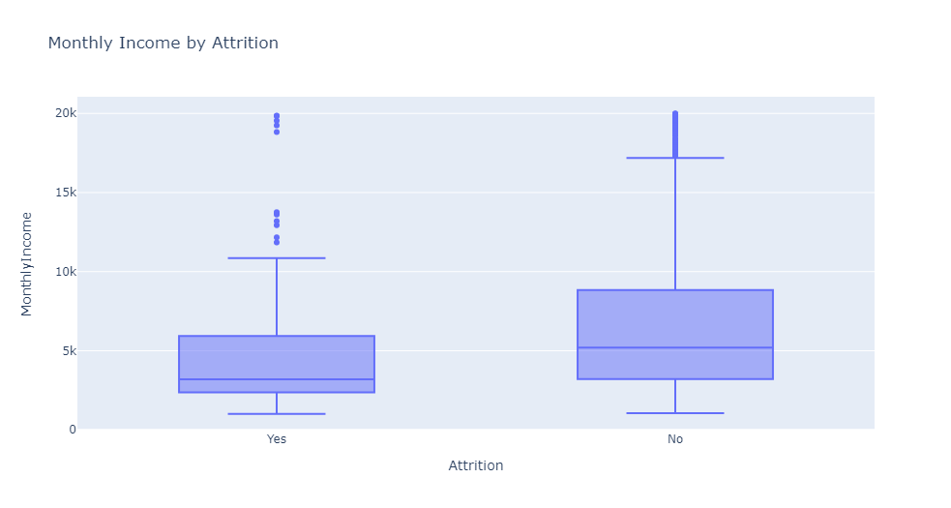
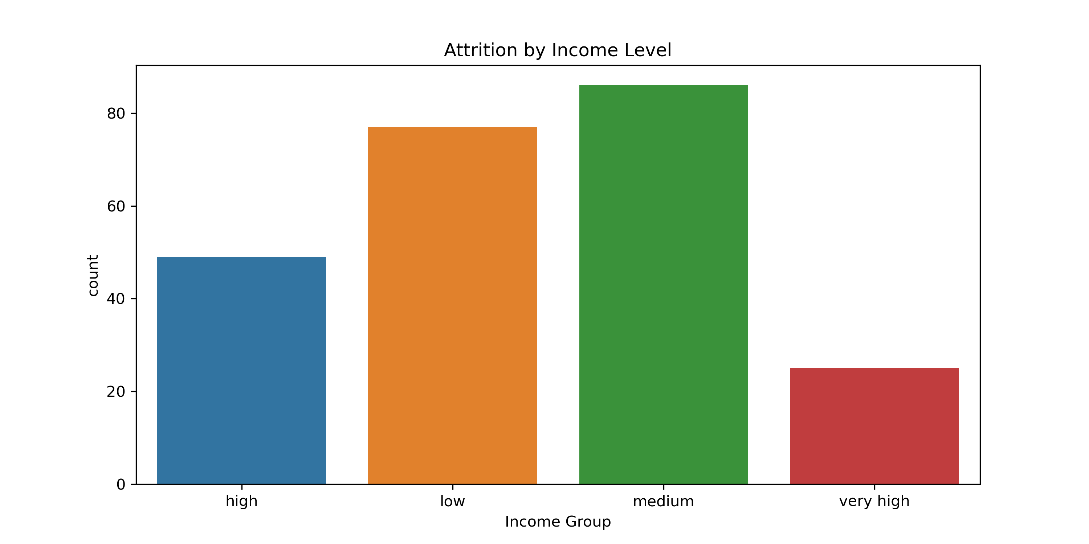

Slide 7
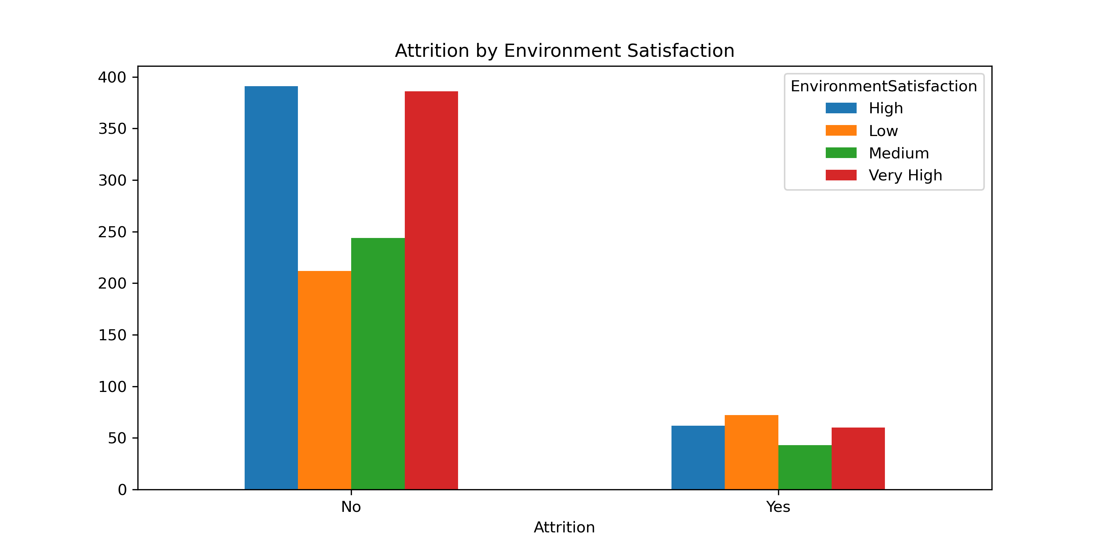
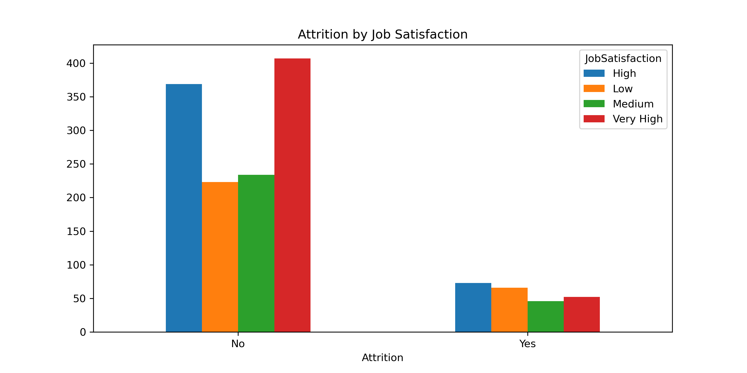

Slide 8
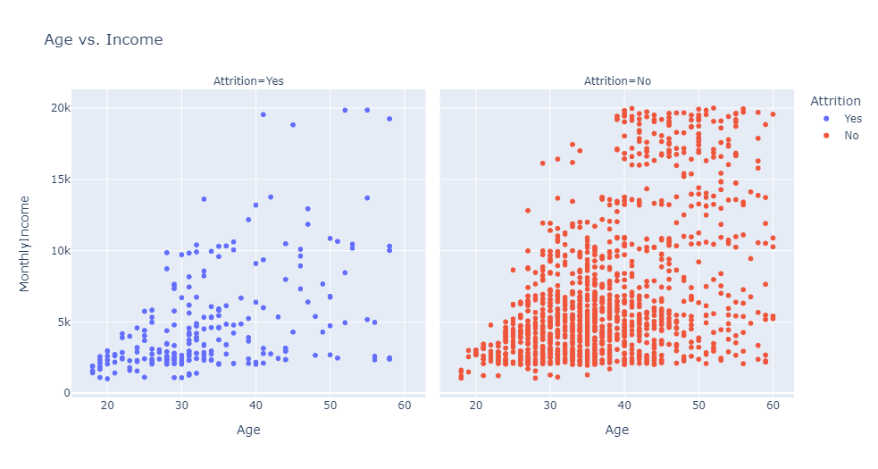

Slide 9
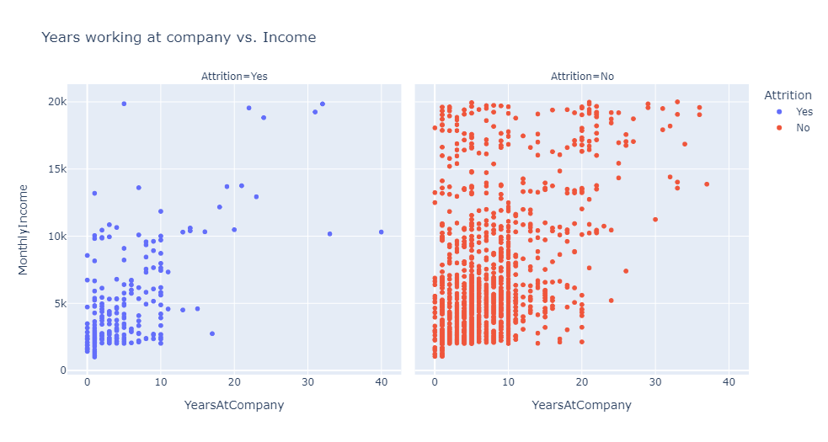

Slide 10
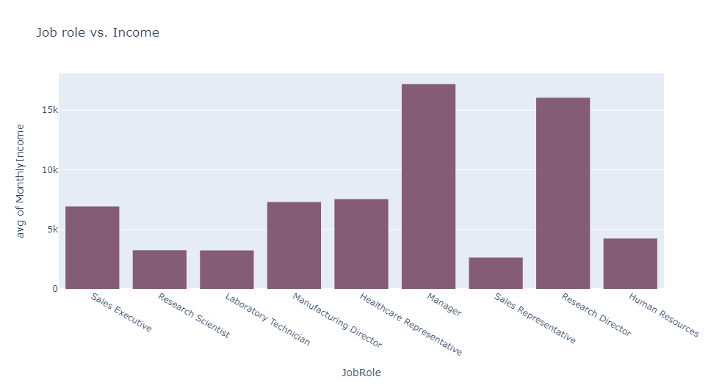

Slide 11
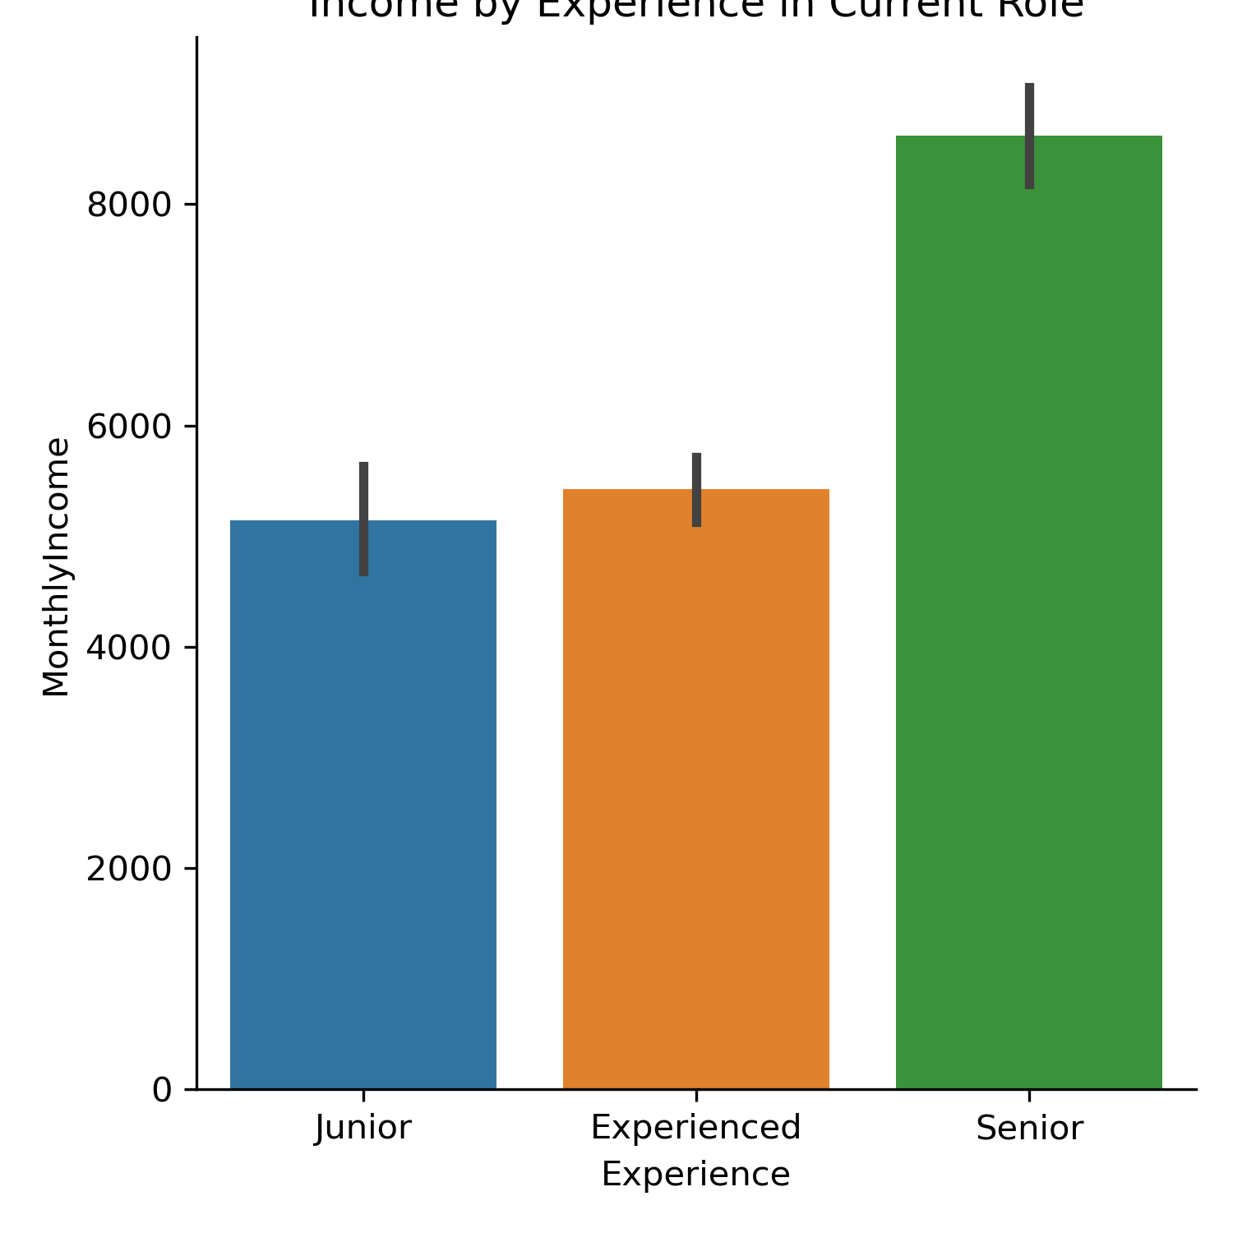
Average Income by Experience in Current Role

Slide 12
Sources
IMAGE
https://www.google.com/url?sa=i&url=https%3A%2F%2Fnectarhr.com%2Fblog%2Femployee-happiness-at-work&psig=AOvVaw3AoIVZkOcXpXYG6HfLFFdU&ust=1670002886779000&source=images&cd=vfe&ved=0CA4QjhxqFwoTCJCwh-v72PsCFQAAAAAdAAAAABAo
DATASET
https://www.kaggle.com/datasets/whenamancodes/hr-employee-attrition

