Slide 1

Fuel Economy Data Analysis
Mustafa

Slide 2
Get to know Dataset
Content
The purpose of EPA’s (Environmental Protection Agency) fuel economy estimates is to provide a reliable basis for comparing vehicles. Most vehicles in the database (other than plug-in hybrids) have three fuel economy estimates:
“city” estimate that represents urban driving, in which a vehicle is started in the morning (after being parked all night) and driven in stop-and-go traffic;
“highway” estimate that represents a mixture of rural and interstate highway driving in a warmed-up vehicle, typical of longer trips in free-flowing traffic;
“combined” estimate that represents a combination of city driving (55%) and highway driving (45%).
Estimates for all vehicles are based on laboratory testing under standardized conditions to allow for fair comparisons.

Slide 3
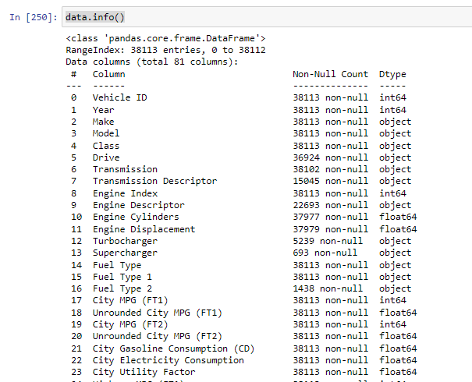
Info

Slide 4

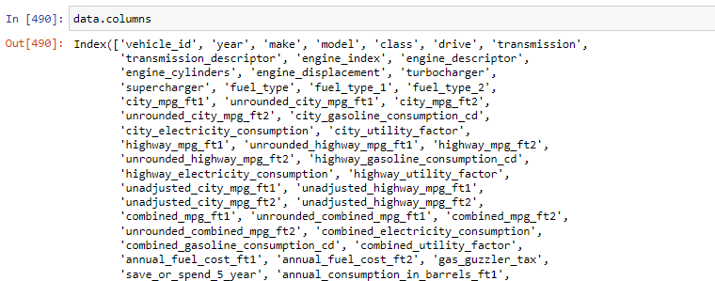
Cleaning column names

Slide 5

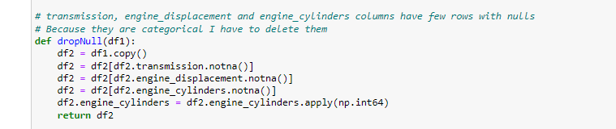
Some functions to clean data

Slide 6
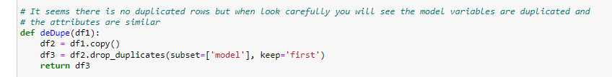
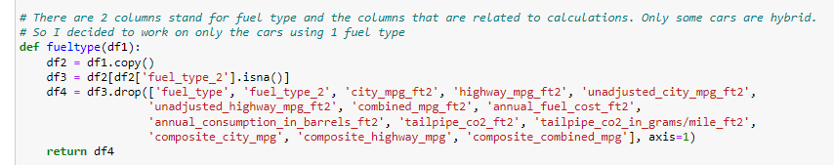
Some functions to clean data

Slide 7
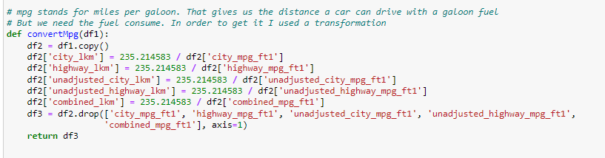
Some functions to clean data

Slide 8
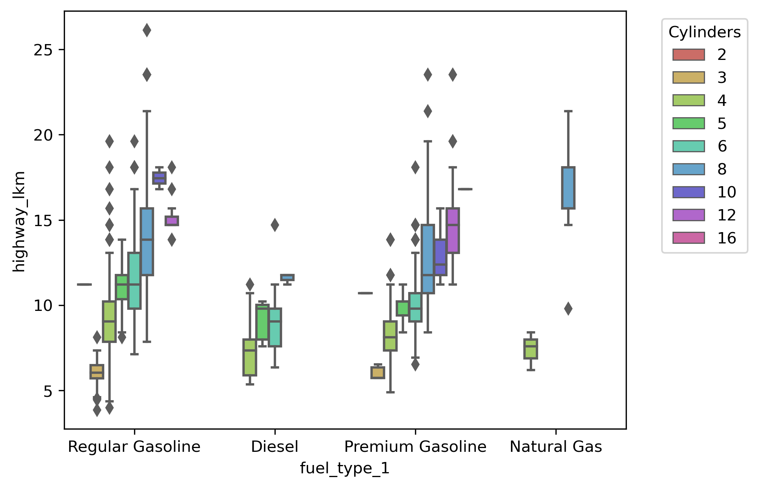
Exploratory Data Analysis
Fuel consume by fuel type

Slide 9
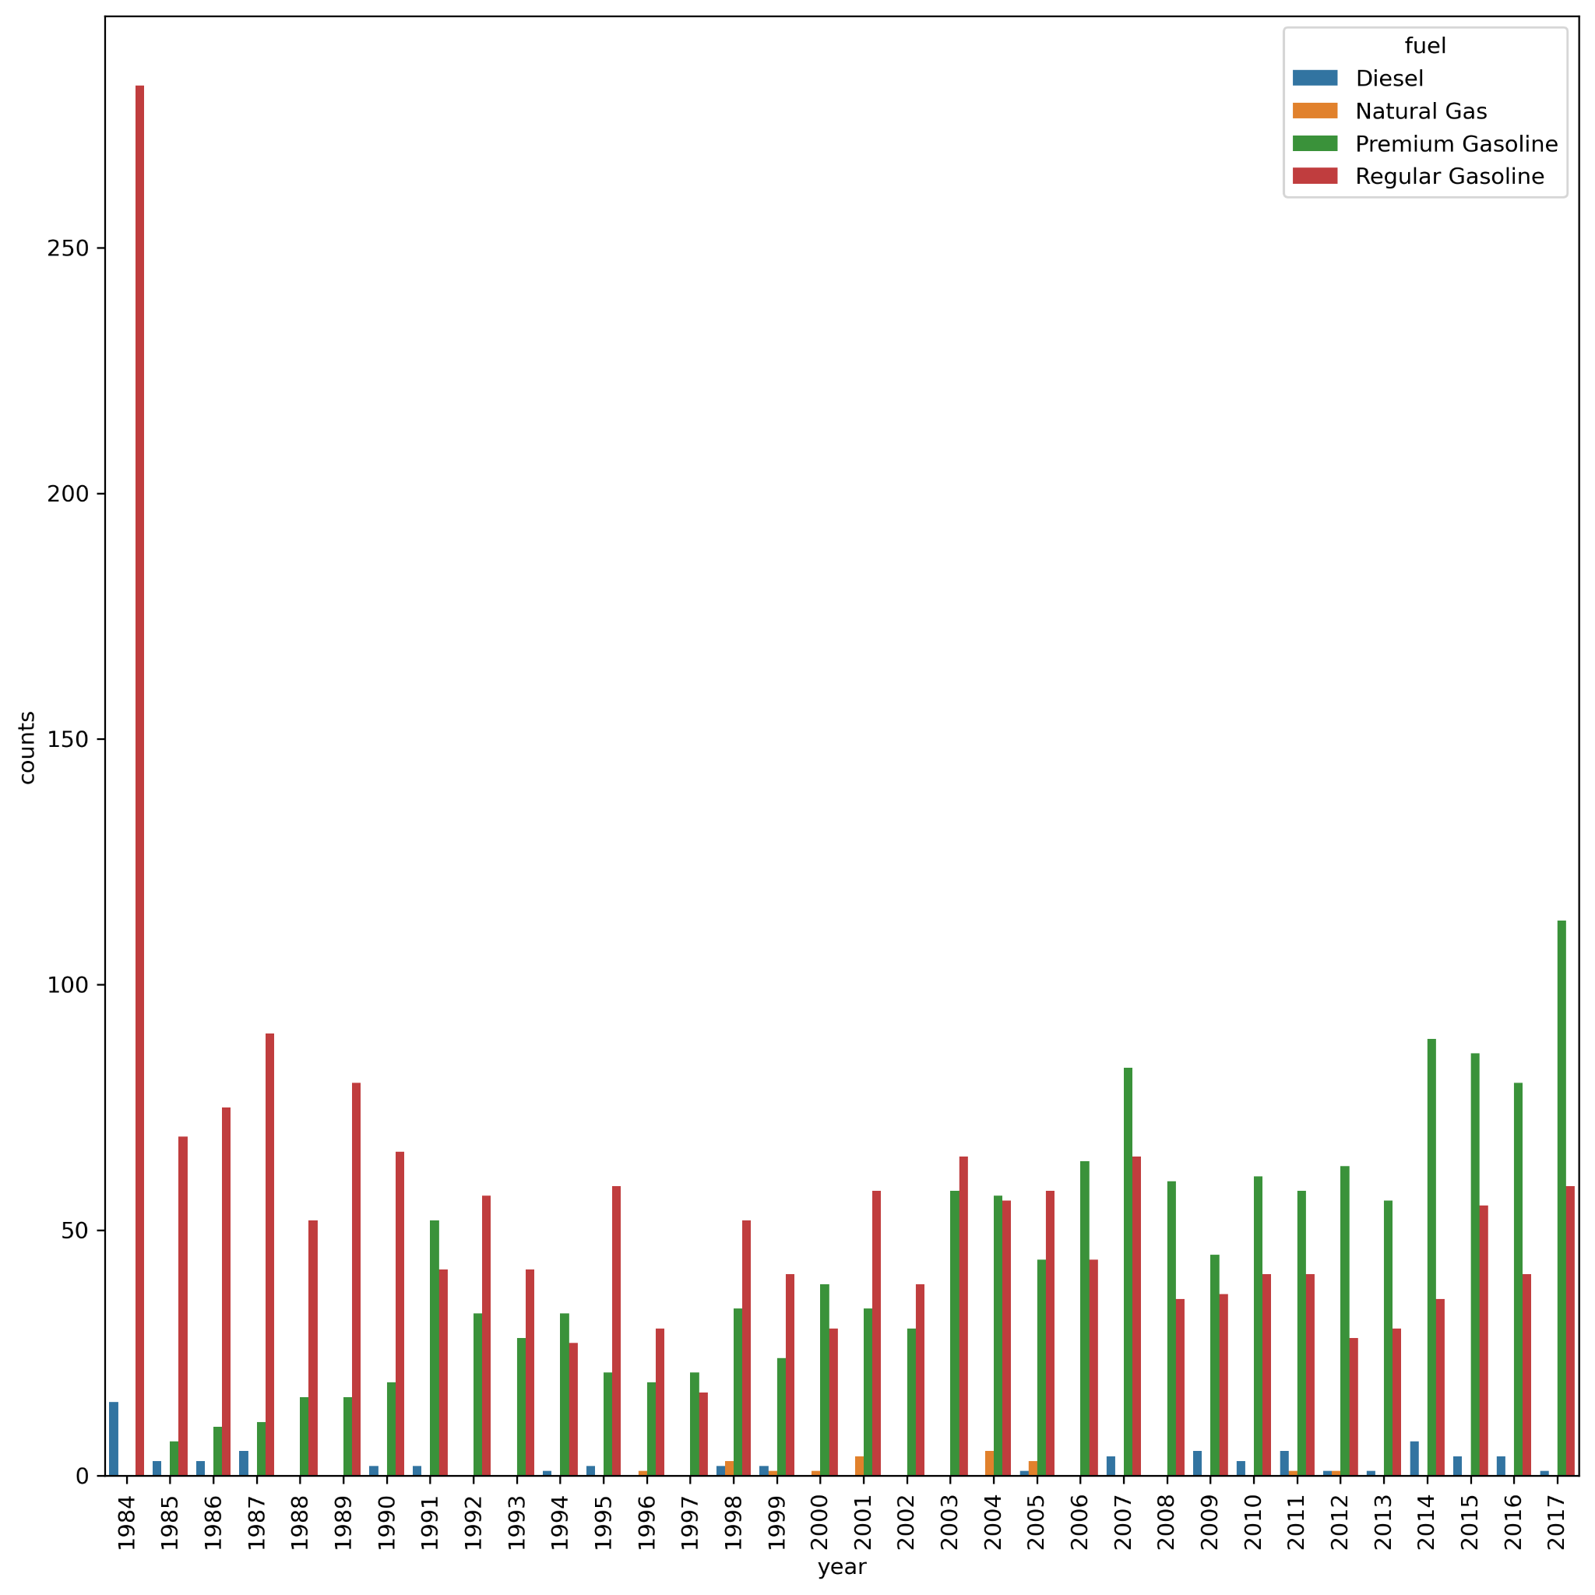
EDA
The number of cars by fuel type year to year

Slide 10
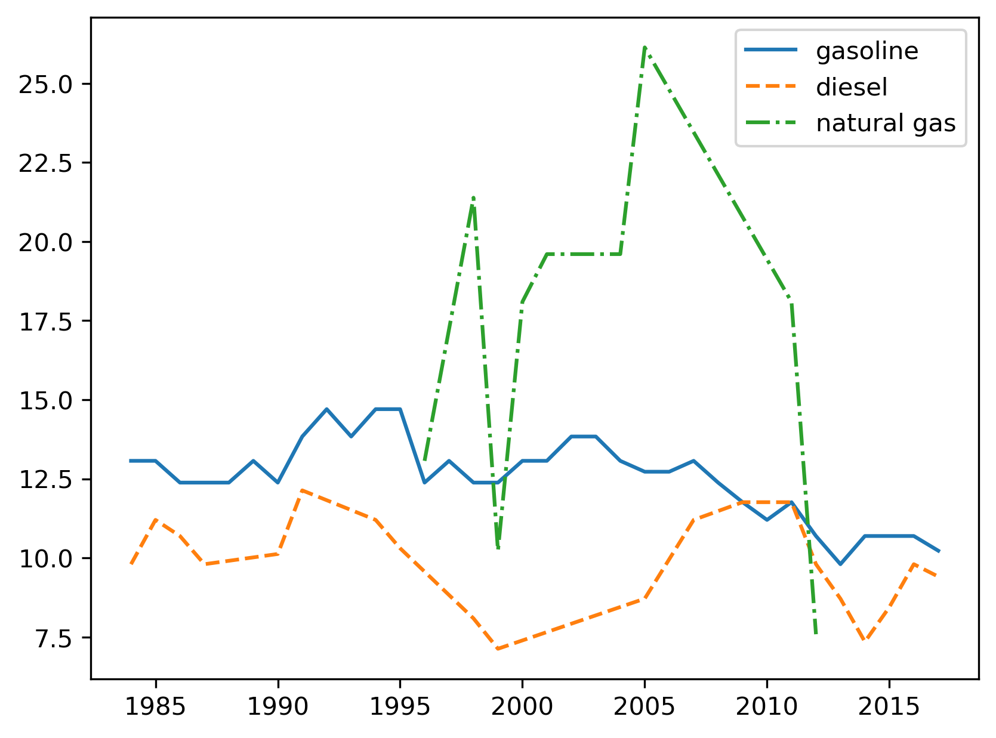
EDA
Are the fuel consume decreasing year by year?

Slide 11
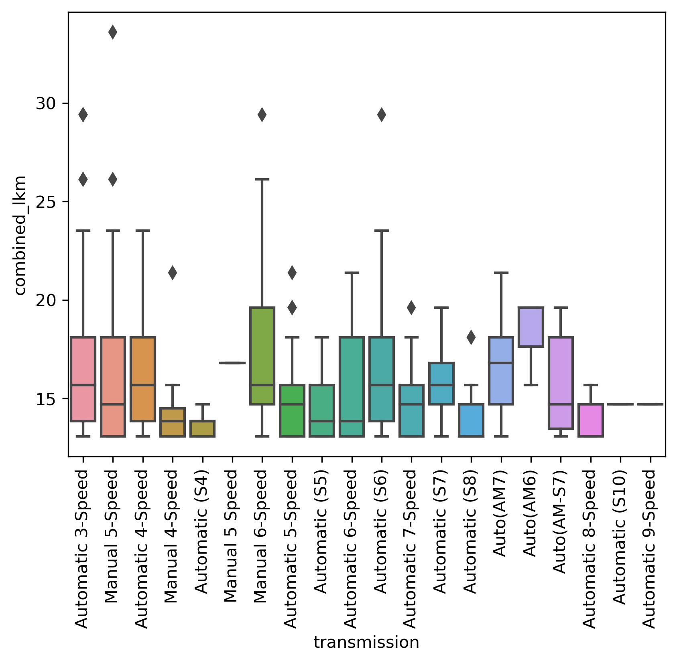
EDA
Which transmission models consume more fuel?

Slide 12
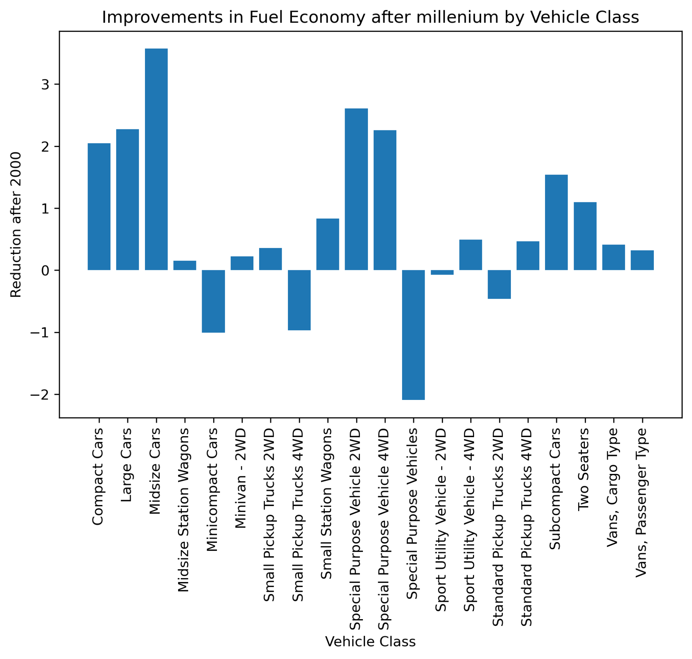
EDA
Did fuel consume change radically after milenium?

Slide 13
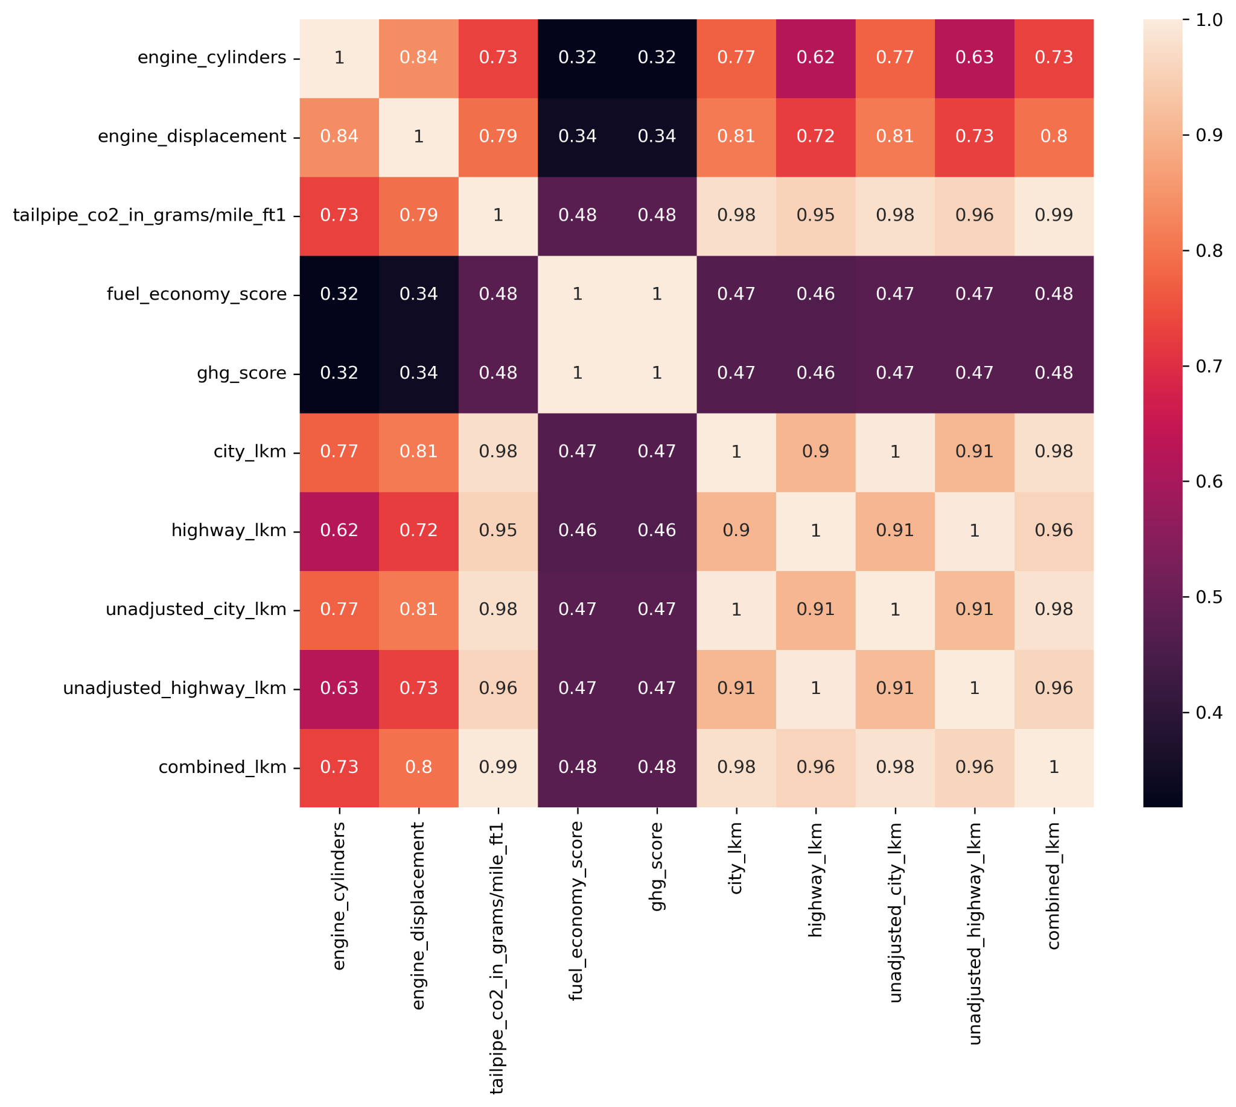
Correlation Matrix

Slide 14
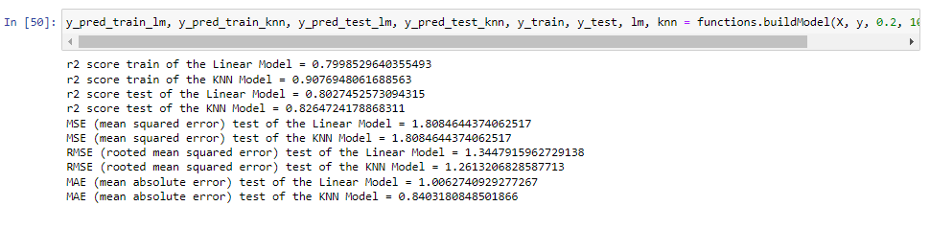
Model

Slide 15
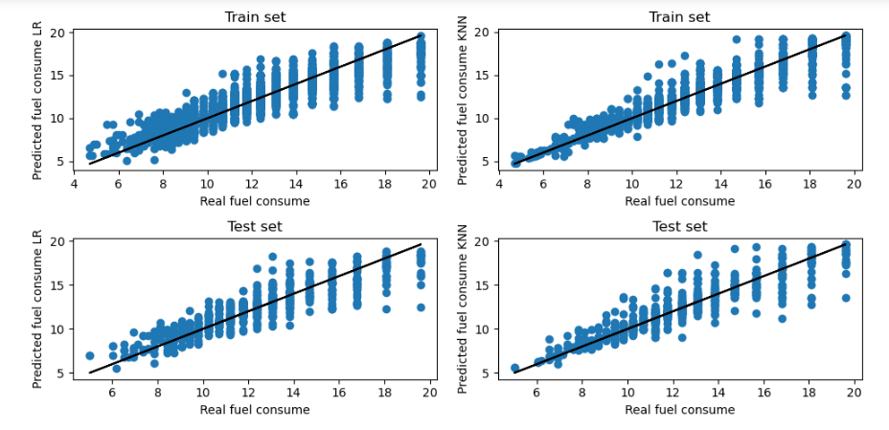
Model

Slide 16
Thank you for listening

