Slide 1

Tic Tac Toe
Jameson Shockley
Michael Stich

Slide 2
How to play and features
The name of the game is to get three x or y in a line depending on if you are player 1 or 2 respectively.
Can play single or multiplayer.
Single player is so easy you must try to lose.

Slide 3
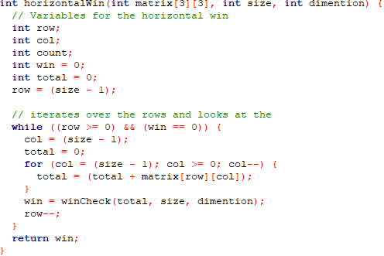
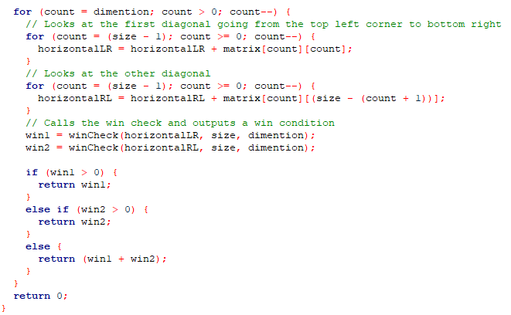
If and While Loops
While
If

Slide 4
Arrays and Functions
Array
Function

Slide 5
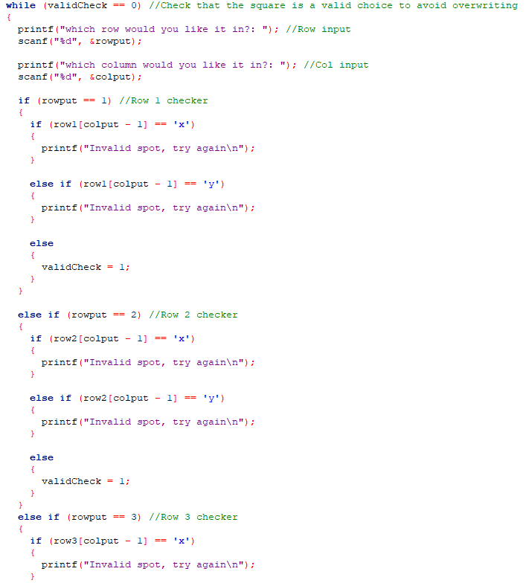
Variable Names and Error Check
Variable Names
Error Checks

Slide 6
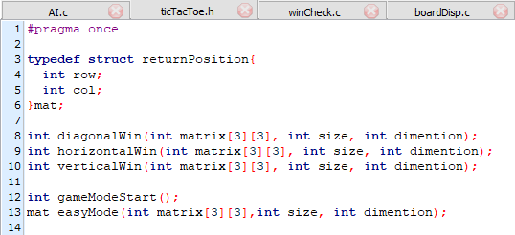

File I/O and Multiple Files
Multiple Files
File I/O

Slide 7
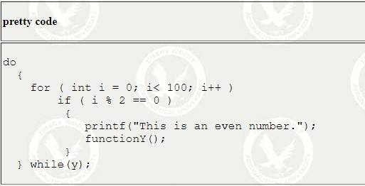
Style Guide
http://ultra.pr.erau.edu/~jaffem/classes/cs125/cs125_style_guidelines.htm

Slide 8
Refrences
GamePix.com, Tic Tac Toe image
http://ultra.pr.erau.edu/~jaffem/classes/cs125/cs125_style_guidelines.htm, Style Guide

