Slide 1
PHP Web Forum
Forum/Message board
Developed by Matthew Stinis

Slide 2
Background
Inspiration:
Music-based web forums, Reddit
Goals:
Users/guests can view boards, threads, posts
Users can create new threads and reply to posts, but not guests
Users/guests can search posts for specific content

Slide 3
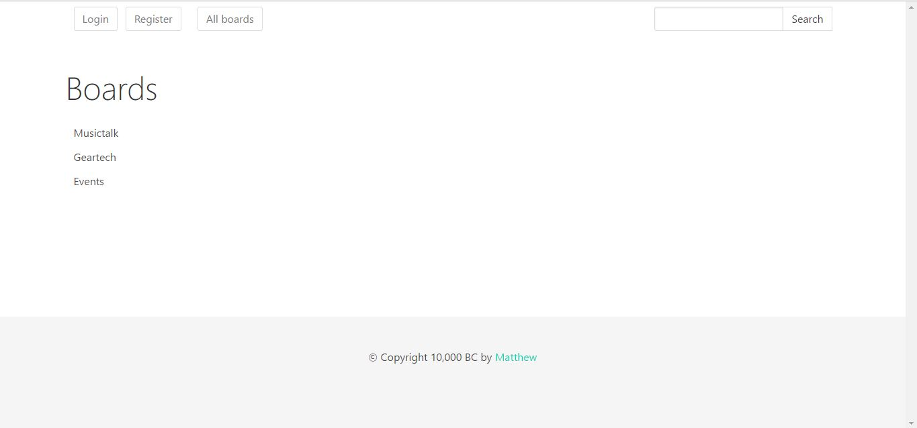
Solution Overview
Main view

Slide 4
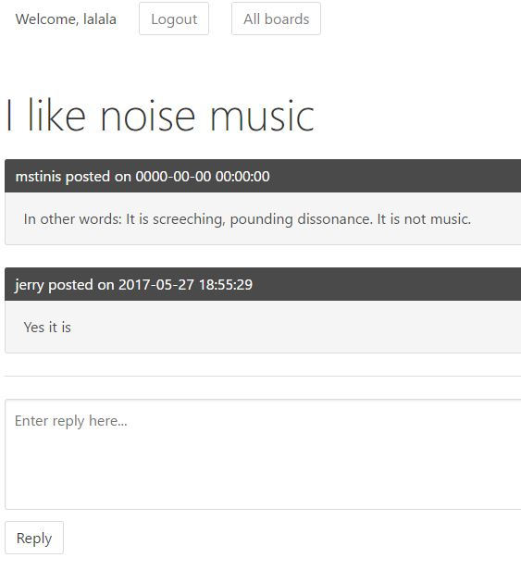
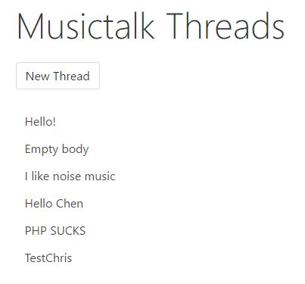
Solution Overview
Threadview and postview

Slide 5
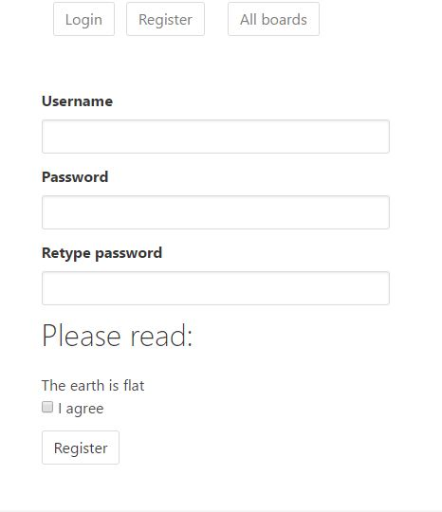
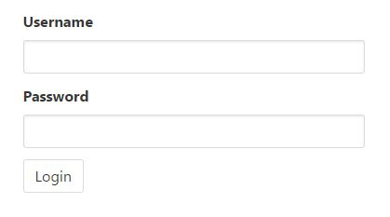
Solution Overview
Login and register

Slide 6
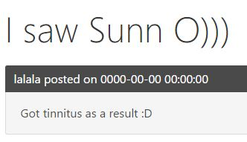
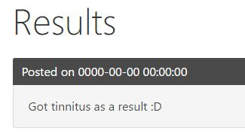

Solution Overview
Post search

Slide 7
Challenges and solutions
Search function
Creating and replying to a thread
How to properly insert and request information from DB
Displaying correct date and time corresponding to post

Slide 8
Challenges and solutions
$app->get('/search', function() use ($app) {
$keywords = $app->request()->get('keywords');
$searchResults = DB::query("SELECT * FROM posts WHERE body LIKE %ss0", $keywords);
$app->render('search_results.html.twig', array("searchResults" => $searchResults));
});
Query the post bodies and return, the posts belonging to them

Slide 9
Challenges and solutions
$date = date('Y-m-d H:i:s');
DB::insert('threads', array(
'boardId' => $boardId,
'title' => $title,
'date' => $date
));
$threadId = DB::insertId();
DB::insert('posts', array(
'threadId' => $threadId,
'userId' => $userId,
'body' => $body,
'date' => $date
));
Obtain information
from form, pass into variable,
then insert into DB by pointing fields
into variables

Slide 10
What I learned
How to use PHP, Slim, Twig, MeekroDB from the ground up

Slide 11
Future Work
User profile with avatar
“Return to parent thread“ button when viewing thread
Facebook login
Admin control, for things like creating new boards and banning trolls
Thread and post bookmarks
Post editing for logged in users

Slide 12
Summary
I learned everything I sought out to learn, as well as a little more.
Happy with the end result, and will continue to build off this project.

