Slide 1
Functors, Comonads, and Digital Image Processing
Justin Le, Chapman University Schmid College of Science and Technology

Slide 2


Let’s talk about Filters

Slide 3
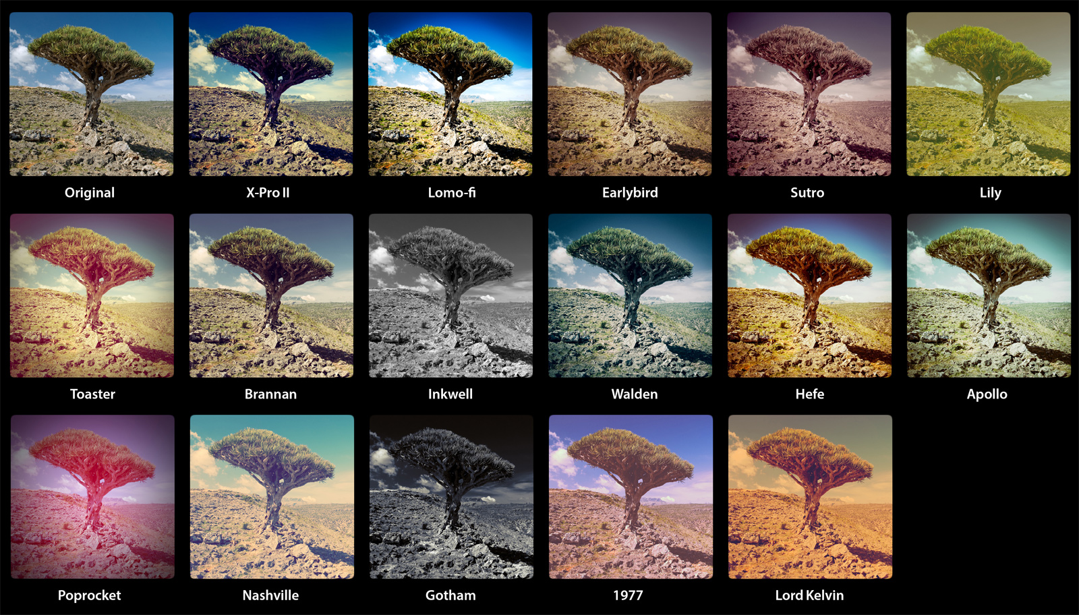
The problem with filters
getglasses.com.au
Notes:
No unifying framework; ad-hoc. Cannot be analyzed meaningfully across different types as composition. Multiple implementations means more bugs, optimizations yield less returns. Must be a better way.

Slide 4








Categories
$$𝒮$$
Objects
Morphisms
$$ℝ$$
$$round :ℝ →ℤ$$
$$ℤ$$
Set
(real numbers)
$$age :ℙ→ℝ$$
(integers)
$$ℙ$$
Composition
(people)
$$round∘age :ℙ→ℤ$$
$$\left(round∘age\right)\left(p\right)=round(age\left(p\right))$$
Notes:
Once you get a category with composition, you can do lots of crazy analysis

Slide 5
Functors
Objects to Objects
Morphisms to Morphisms

Slide 6

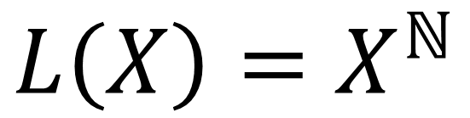



Ex: Infinite List Functor
$$L\left(X\right)=X^{ℕ}$$
X to infinite lists of things in X
92
4, 9, 8, 75, -3, ...
$$f :X→Y$$
$$L\left(f\right) :L(X)→L(Y)$$
$$∈ℤ$$
$$∈L(ℤ)$$

Slide 7

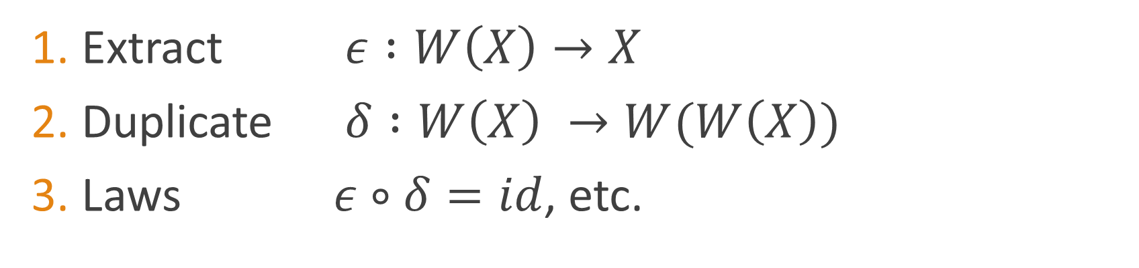

Comonads
Extract $ε :W\left(X\right)→X$
Duplicate $δ :W\left(X\right) →W(W\left(X\right))$
Laws $ε∘δ=id$, etc.
Infinite List Functor
$$ε\left([4, 9, 8, 75, −3..]\right)=4$$
$$δ\left([4, 9, 8, 75, −3..]\right)= ???$$

Slide 8
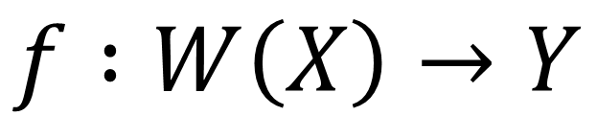
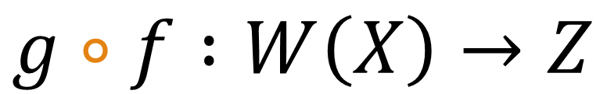
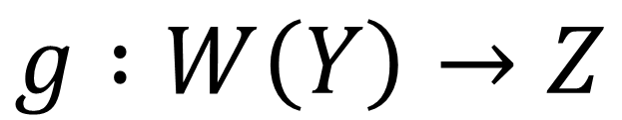
Cokleisli Arrows
$$f :W\left(X\right)→Y$$
$$g :W\left(Y\right)→Z$$
$$g∘f :W\left(X\right)→Z$$
Comonads only!
Notes:
Actually a very surprising result that these can compose meaningfully if and only iff W is a comonad.
New composition => new category => opens up worlds of analysis

Slide 9
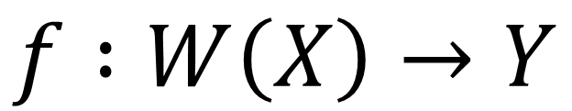
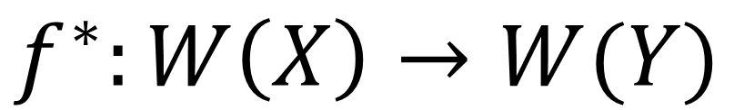
Extension
$$f :W\left(X\right)→Y$$
$$f^{∗}:W\left(X\right)→W(Y)$$
Notes:
The fact that you can do this in a meaningful way is also surprising

Slide 10

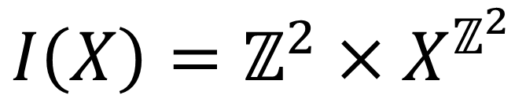


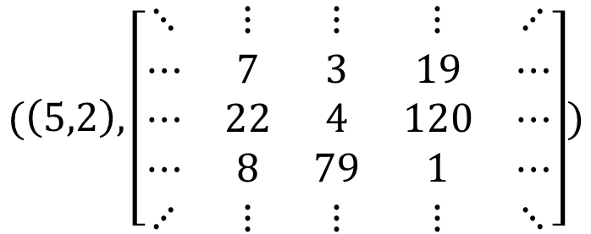
Functor 1: “Image with Focus”
$$I\left(X\right)=ℤ^{2}×X^{ℤ^{2}}$$
$$(\left(5,2\right),\left[\begin{matrix}⋱ & ⋮ & ⋮ & ⋮ & ⋰ \\ ⋯ & 7 & 3 & 19 & ⋯ \\ ⋯ & 22 & 4 & 120 & ⋯ \\ ⋯ & 8 & 79 & 1 & ⋯ \\ ⋰ & ⋮ & ⋮ & ⋮ & ⋱\end{matrix}\right])$$
$$5$$
$$∈ℕ$$
$$∈I(ℕ)$$

Slide 11
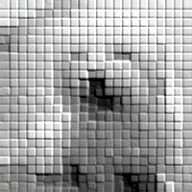
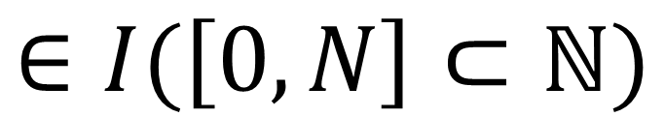
$$∈I(\left[0,N\right]⊂ℕ)$$

Slide 12



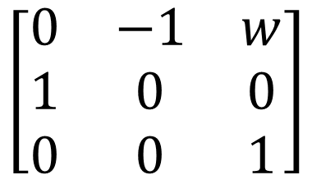
Position-Aware Transformation
$$\left[\begin{matrix}0 & −1 & w \\ 1 & 0 & 0 \\ 0 & 0 & 1\end{matrix}\right]$$
Affine Transformation Matrix
$$I\left(ℕ\right) → ℕ$$

Slide 13
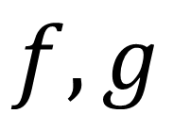
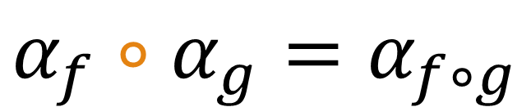
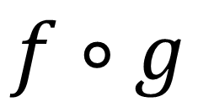
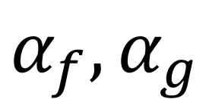
$$f, g$$
Compose Affine
$$f∘g$$
Encode
Encode
$$α_{f}, α_{g}$$
Compose Cokleisli
$$α_{f}∘α_{g}=α_{f∘g}$$
Notes:
Pick the path that’s most efficient for you!

Slide 14
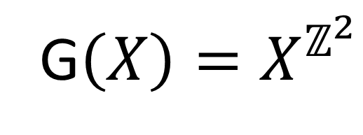

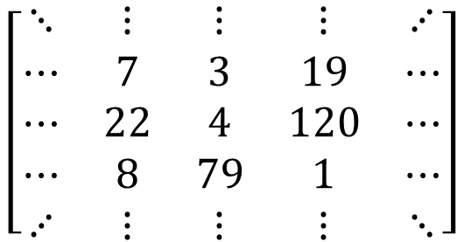
Functor 2: “Local Neighborhood”
G$\left(X\right)=X^{ℤ^{2}}$
$$\left[\begin{matrix}⋱ & ⋮ & ⋮ & ⋮ & ⋰ \\ ⋯ & 7 & 3 & 19 & ⋯ \\ ⋯ & 22 & 4 & 120 & ⋯ \\ ⋯ & 8 & 79 & 1 & ⋯ \\ ⋰ & ⋮ & ⋮ & ⋮ & ⋱\end{matrix}\right]$$
$$5$$
$$∈ℕ$$
$$∈G(ℕ)$$

Slide 15

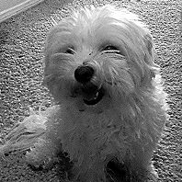



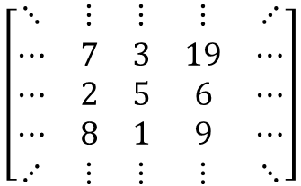
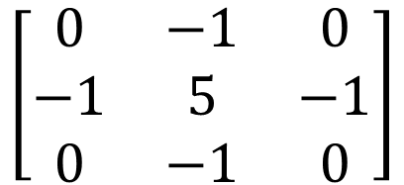
Local/Relative Transformations
$$\left[\begin{matrix}0 & −1 & 0 \\ −1 & 5 & −1 \\ 0 & −1 & 0\end{matrix}\right]$$
Kernel/Convolution Matrix
$$\left[\begin{matrix}⋱ & ⋮ & ⋮ & ⋮ & ⋰ \\ ⋯ & 7 & 3 & 19 & ⋯ \\ ⋯ & 2 & 5 & 6 & ⋯ \\ ⋯ & 8 & 1 & 9 & ⋯ \\ ⋰ & ⋮ & ⋮ & ⋮ & ⋱\end{matrix}\right]$$
$$13$$
$$G(ℤ)$$
$$ℤ$$

Slide 16
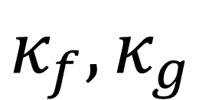
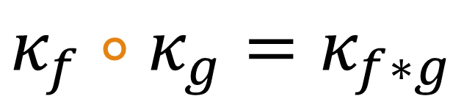
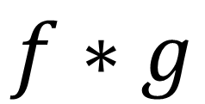
$$f, g$$
Convolve Kernels
$$f∗g$$
Encode
Encode
$$κ_{f}, κ_{g}$$
Compose Cokleisli
$$κ_{f}∘κ_{g}=κ_{f∗g}$$

Slide 17
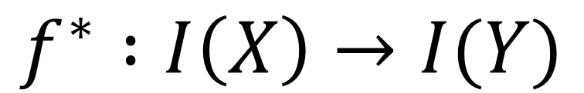
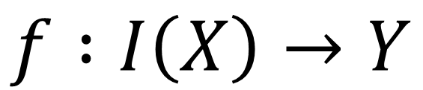
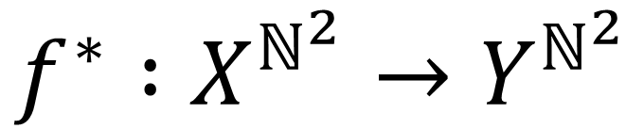
Extensions of I are Decoded Filters
$$f :I\left(X\right)→Y$$
$$f^{∗} :I\left(X\right)→I(Y)$$
focus stays same
$$f^{∗} :X^{ℕ^{2}}→Y^{ℕ^{2}}$$
Classical image filter

Slide 18
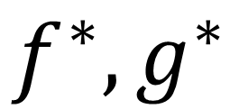
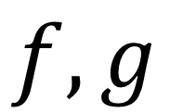
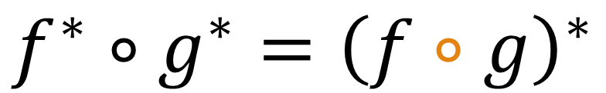

Commutation Abounds
$$f, g$$
Compose Cokleisli
$$f∘g$$
Extend
Extend
$$f^{∗},g^{∗}$$
Compose Normally
$$f^{∗}∘g^{∗}={\left(f∘g\right)}^{∗}$$

Slide 19
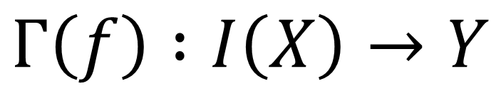
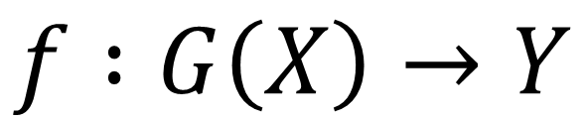
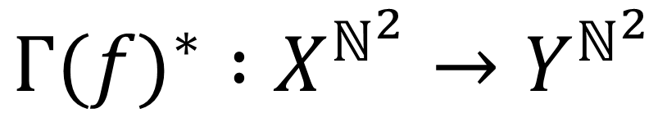
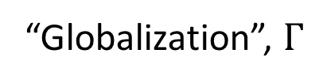
Decoded Neighborhoods
$$f :G\left(X\right)→Y$$
“Globalization”, $Γ$
$${Γ(f)}^{∗} :X^{ℕ^{2}}→Y^{ℕ^{2}}$$
$$Γ\left(f\right) :I\left(X\right)→Y$$
Classical image filter

Slide 20
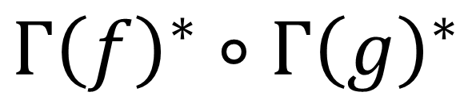
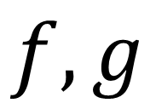
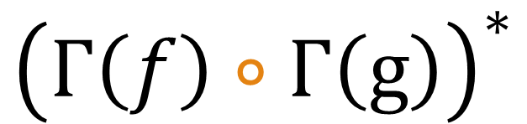
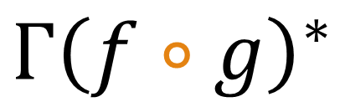
$$Γ{\left(f∘g\right)}^{∗}$$
Cokleisli compose, globalize, extend
$$f, g$$
Globalize, cokleisli compose, extend
$${\left(Γ\left(f\right)∘Γ\left(g\right)\right)}^{∗}$$
Globalize, extend, compose
$$Γ{\left(f\right)}^{∗}∘Γ{\left(g\right)}^{∗}$$

Slide 21
Extension, Globalization are Cheap
Written once: less bugs
Optimize once, unlimited return on performance
Trivially parallelizable
Globalization can handle boundary conditions, low-level

Slide 22
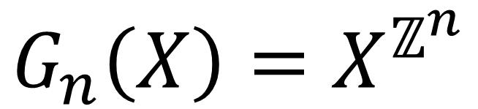
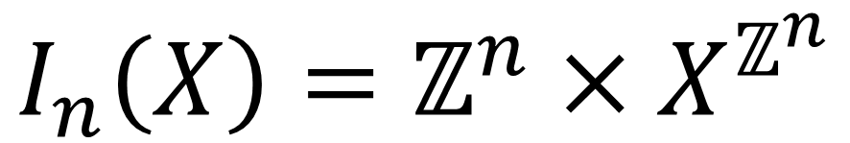
Generalization
n | Application
1 | Audio, Time signals
2 | Images
3 | Video
1000+ | Difference Equations
$$I_{n}\left(X\right)=ℤ^{n}×X^{ℤ^{n}}$$
$$G_{n}\left(X\right)=X^{ℤ^{n}}$$

Slide 23
In Conclusion
Better math
Better engineering
Better development process
Better world

