Slide 1
Functors, Comonads, and Digital Image Processing
Lambdaconf 2016, Boulder Colorado, Justin Le (http://jle.im) (github.com/mstksg)
Notes:
What insights???? Ways we think about image processing???

Slide 2
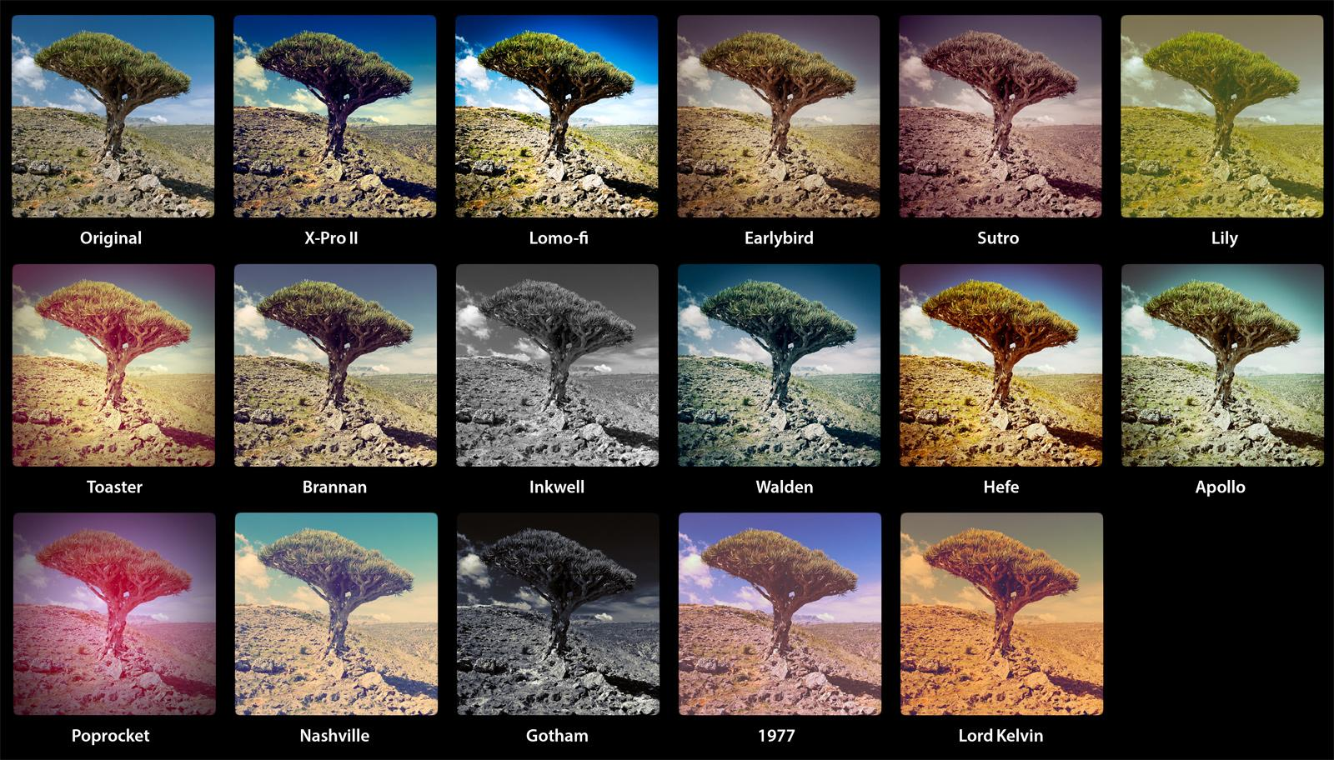
getglasses.com.au
Notes:
Consumer-facing filters, but we know real filters are compositions of smaller filters

Slide 3
Image Filters!
Blur
Colorize
Rotate
Skew
Edge-detect
Sharpen
Laplacians
Visibility masks

Slide 4
The Traditional Image Filter
foo :: Image -> Image
type Image = [Pixel] foo :: [Pixel] -> [Pixel]
bar :: [Pixel] -> [Pixel] fooThenBar :: [Pixel] -> [Pixel] fooThenBar = bar . foo

Slide 5
What’s in a Type?
The less structure, the more information
Developer intent
Restriction of implementations
Algorithmic simplicity
Equational manipulability
It’s simply the Haskell Way™!

Slide 6
What does [Pixel] -> [Pixel] tell us?
Nothing
Well, nothing useful.
It’s pure!

Slide 7
What do you think!
What’s wrong with [Pixel] -> [Pixel]? (Besides it being a list)
Problems for the writer
Too many ways to implement incorrectly
Extra things to worry about:
How to handle bounadries?
Parallelism?
Problems for the user, with respect to composition
Parallel composition?
Algorithmic (structural) composition?

Slide 8
The Functor Design Pattern
http://www.haskellforall.com/2012/09/the-functor-design-pattern.html
Functor Driven Development
FDD Manifesto:
Choosing the Category/Subcategory you work in gives you power
Feel free to write different parts of your logic in different categories
Write Functors to unite them how you please
Notes:
One of the most influential articles I’ve read! FDD is my name, not Gabriel’s

Slide 9
You wouldn’t steal a car
You wouldn’t:
lenSqS :: StateT Int (MaybeT IO) [a] -> StateT Int (MaybeT IO) Int lenSqS action = do l <- action return (length l ^ 2)
Functor-aware:
lenSq :: [a] -> Int lenSq l = length l ^ 2
Composing:
lenSqS . lenSqS
fmap lenSq . fmap lenSq or fmap (lenSq . lenSq)
Big gain if fmap is inefficient!!

Slide 10
f, g :: a -> a
compose
fmap
f . g
fmap f, fmap g
fmap
compose
fmap (f . g)
fmap f . fmap g
:: f a -> f a

Slide 11
The Search for Better Types

Slide 12
Image With Focus
Store an image with a “focused” index
data Focused a = F [a] Coord
toFocused :: [a] -> Focused a toFocused xs = F xs 0
fromFocused :: Focused a -> [a] fromFocused (F xs _) = xs
extract :: Focused a -> a extract (F xs c) = xs !! c
instance Functor Focused where fmap f (F xs c) = F (fmap f xs) c

Slide 13
Arrows as Filters
Focused a -> b
“Specify the new pixel value at that location”
(Focused a -> b) -> (Focused a -> [b])
“From a specification of a new pixel value at a given location, create a whole new image”
extendOut :: (Focused a -> b) -> (Focused a -> [b]) extendOut f (F xs c) = fmap (\d -> f (F xs d)) allCoords
extend :: (Focused a -> b) -> (Focused a -> Focused b) extend f foc@(F _ c) = F (extendOut foc) c

Slide 14
Composition
(Focused b -> c) -> (Focused a -> b) -> (Focused a -> c)
Sequencing two “Focused a -> b”s
(=<=) :: (Focused b -> c) -> (Focused a -> b) -> (Focused a -> c) (=<=) f g = \x -> let y :: Focused b y = extend g x in f y (potentially inefficient)

Slide 15
Déjà vu
extract :: Focused a -> a extend :: (Focused a -> b) -> (Focused a -> Focused b) (=<=) :: (Focused b -> c) -> (Focused a -> b) -> (Focused a -> c)
extract :: w a -> a extend :: (w a -> b) -> (w a -> w b) (=<=) :: (w b -> c) -> (w a -> b ) -> (w a -> c )
return :: a -> m a (=<<) :: (a -> m b) -> (m a -> m b) -- aka “bind” (<=<) :: (b -> m c) -> (a -> m b) -> (a -> m c)
Notes:
We’ve created …

Slide 16
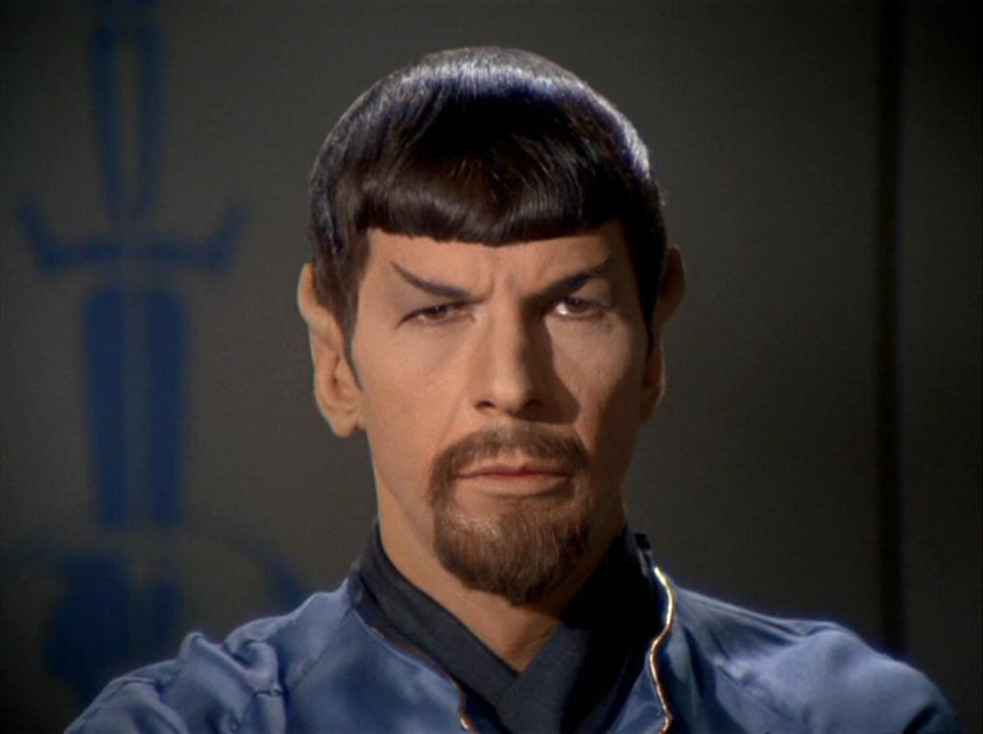
Anti-Monads
Star Trek
Notes:
Anti Monads! Just kidding.

Slide 17
Comonads
class Functor w => Comonad w where extract :: w a -> a extend :: (w a -> b) -> (w a -> w b)
“It is well known that effects correspond to monads … quite interestingly, coeffects correspond to the dual concept called comonads” (Tomas Petricek)
extract
From this context, yield a value.
extend
Take your fancy (w a -> b) jargon and bring it back into the real world like everyone else
Turned our Comonadic CoKleisli Cofilter back into a “normal” traditional filter.
Notes:
We often don’t use the Comonad typeclass, and instead use specific concrete functions and utilize the math for reassurances

Slide 18
Why Monads?

Slide 19
Because Math
f, g :: a -> m a
f <=< g
bind f, bind g
bind (f <=< g)
bind f . bind g
:: m a -> m a

Slide 20
Why Comonads?

Slide 21
Because Math (Part Deux: Comonads)
f, g :: w a -> a
f =<= g
extend f, extend g
extend (f =<= g)
extend f . extend g
:: w a -> w a
Notes:
Particularly powerful if extend and =<= have different performance and semantics

Slide 22
Power of Choice
Many ways to implement extend and (=<=)!
Parallelism and concurrency
Memoization
Behavior at boundaries
Comonad laws + Equational Reasoning allow us to interchange and reassociate.
We can stay “in the world of CoKleislis” for efficient composition
Exit only at the end with the final extend.
https://blog.jle.im/entry/inside-my-world-ode-to-functor-and-monad.html

Slide 23
Laws
Comonads
extend extract = id
extract =<= f = f
extract . extend f = f
etc.
(Just trust me)
Monads
bind return = id
return <=< f = f
bind f . return = f
etc.

Slide 24
Neighborhoods
data Tape a = Tape { tLeft :: [a] , tVal :: a , tRight :: [a] }
shiftRight :: Tape a -> Tape a shiftRight (Tape (l:ls) v rs) = Tape ls l (v:rs)
shiftRightN :: Int -> Tape a -> Tape a shiftRightN n t = iterate shiftRight t !! n
Notes:
Another nice representation of images

Slide 25
Arrows as Local Filters
blur :: Fractional a => Tape a -> a blur (Tape (l:_) v (r:_)) = (l + v + r) / 3
sharpen :: Num a => Tape a -> a sharpen (Tape (l:_) v (r:_)) = 2*v – l – r
deriv :: Fractional a => Tape a -> a deriv (Tape (l:_) v (r:_)) = ((v – l) + (r – v)) / 2
Notes:
They’re local filters!

Slide 26
Comonads Everywhere
It makes sense to “compose” (Tape a -> b)’s
That’s the smell of a comonad!
instance Comonad Tape where extract (Tape _ v _) = v extend f t@(Tape ls _ rs) = Tape ls’ (f t) rs’ where (_:ls’) = fmap f (iterate shiftRight t) (_:rs’) = fmap f (iterate shiftLeft t)
The power of composition
deriv2 = deriv <=< deriv

Slide 27
Functors and Natural Transformations
globalize :: d -> (Tape a -> b) -> (Focused a -> b) globalize d f (F xs _) = f (listToTape xs) where listToTape (x:xs) = Tape (repeat d) x (xs ++ repeat d)
A Functor from the Tape Cokliesli Category to the Focused Cokleisli Category, where the morphism mapper is globalize d.
We have some choices!
Boundary behaviors?

Slide 28
A New World of CoKleisli Categories
Arrows from different categories are everywhere
Kernel matrices
Affine transformation matrices
Finite or dependently typed neighorhoods
Be creative with Functors, get assurances with mathematics
Dimension agnostic:
Videos + Compression
Physical simulations
Difference equation modeling

Slide 29
From f, g :: Tape a -> a ...
extend (glob (f <=< g))
- or -
extend (glob f <=< glob g)
- or -
extend (glob f) . extend (glob g)
:: Focused a -> Focused a
Notes:
And remember, all of these have multiple implementations!

Slide 30
More Resources
http://hub.darcs.net/ertes/articles/browse/media-processing.lhs
Media Processing -- Ertugrul Söylemez
https://jaspervdj.be/posts/2014-11-27-comonads-image-processing.html
Image Processing with Comonads -- Jasper Van der Jeugt
https://github.com/mstksg/lambdaconf-2016-usa/tree/master/Functors, Comonads, and Digital Image Processing
Slides online

