Slide 1
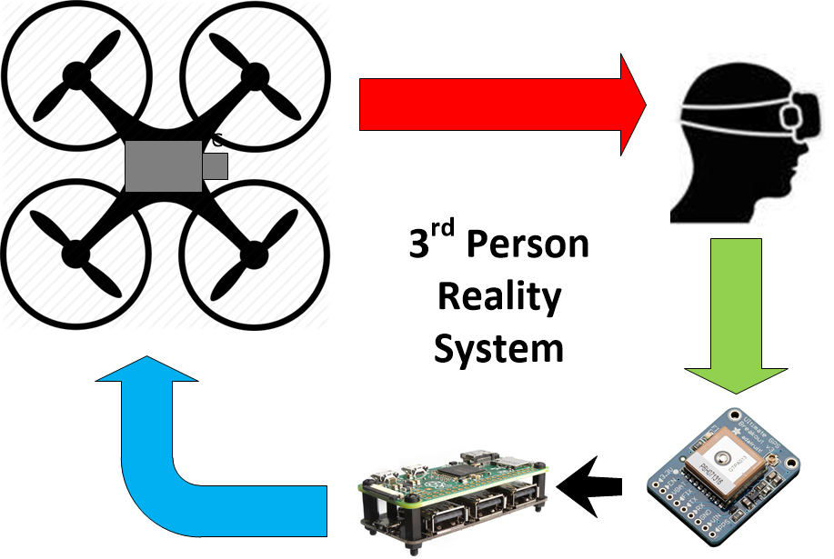
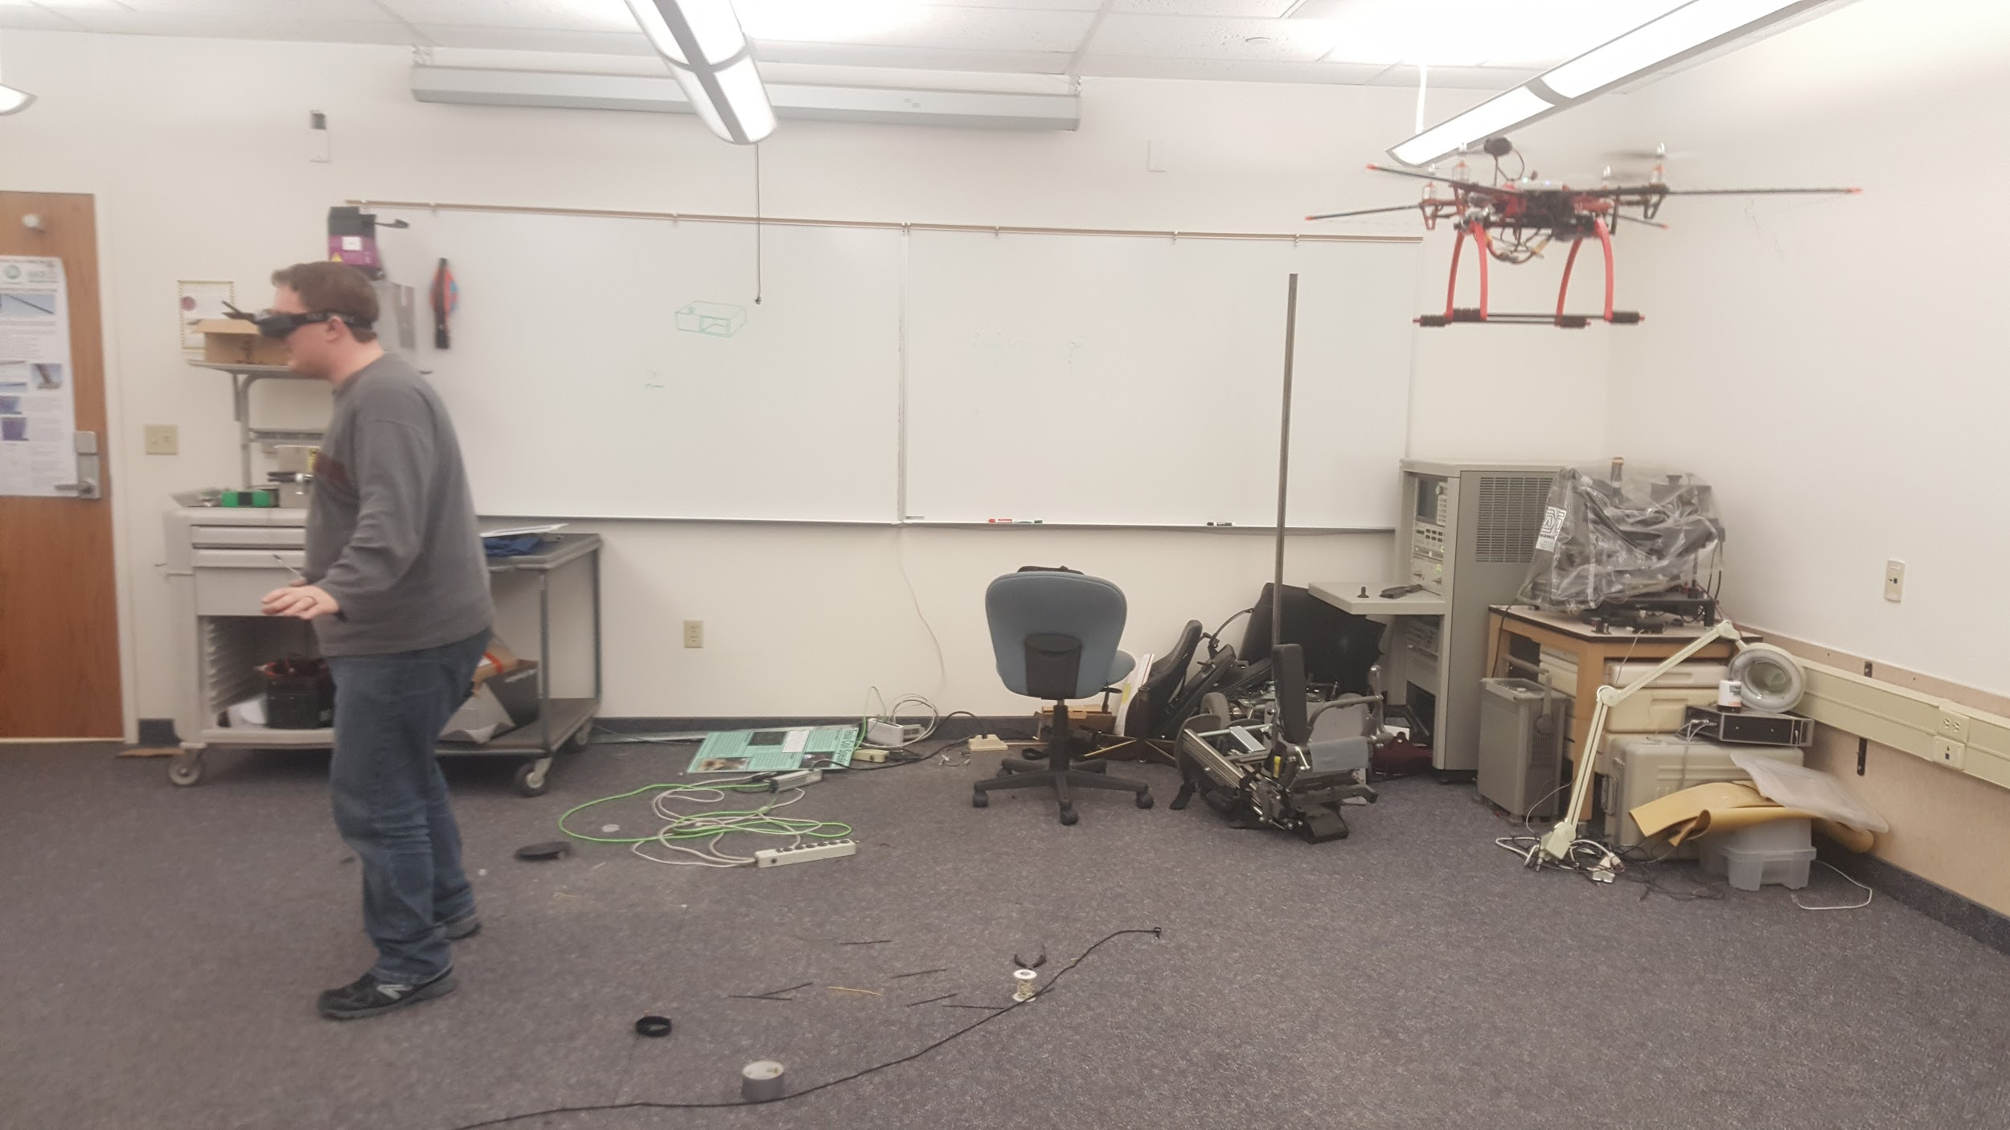
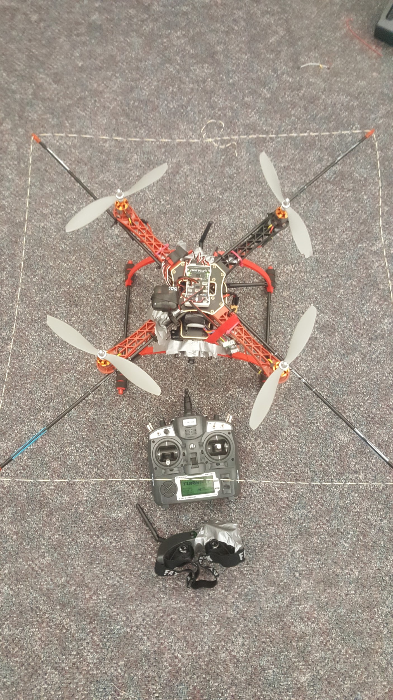
Leads
Jason Andersen
Luke Bird
Matthew Stradling
3rd Person
Reality System
BYU-Idaho
Class: ECEN 361
Overview
The 3rd Person Reality System starts with a quadcopter base controlled by a PixHawk Flight Controller. The PixHawk receives commands sent from a Raspberry Pi Zero attached to a headset worn by the user of the system. A GPS connected to the Pi tracks the changes in movement of the user. Then the Pi transforms those changes into flight commands that are sent to the PixHawk to cause the quadcopter to follow the user. A camera is mounted on the copter capturing video of the back of the user. The camera feed is streamed to the headset of the user providing a 3rd Person experience.
Parts List (HW and SW)
PixHawk Flight Controller
Raspberry Pi Zero
Adafruit Ultimate GPS
3DR Copter GPS
Quadcopter
MavProxy Software
FatShark Teleporter V3

