Slide 1
Best
Practices
Advanced Topics
Notes:
Introduce instructors
Introduce participants: who you are, how you’re hoping to use eBird data (ok, if you’re just curious and don’t have any specific project in mind)

Slide 2
Land Cover Covariates

Slide 3
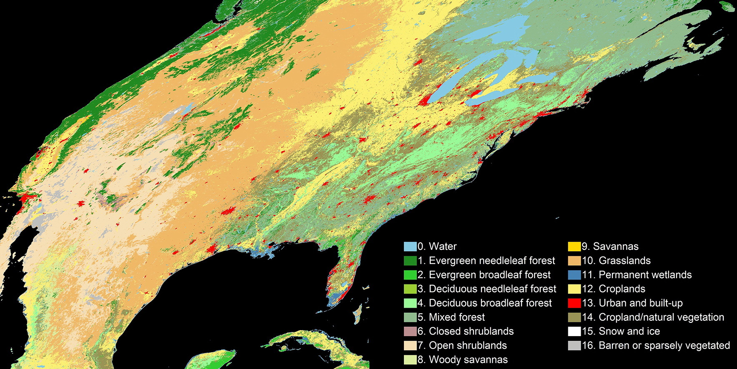
MODIS MCD12Q1 v006
Supervised land cover classification of MODIS reflectance
Global coverage
500 m spatial resolution
Annual temporal resolution (2001-2018)

Slide 4
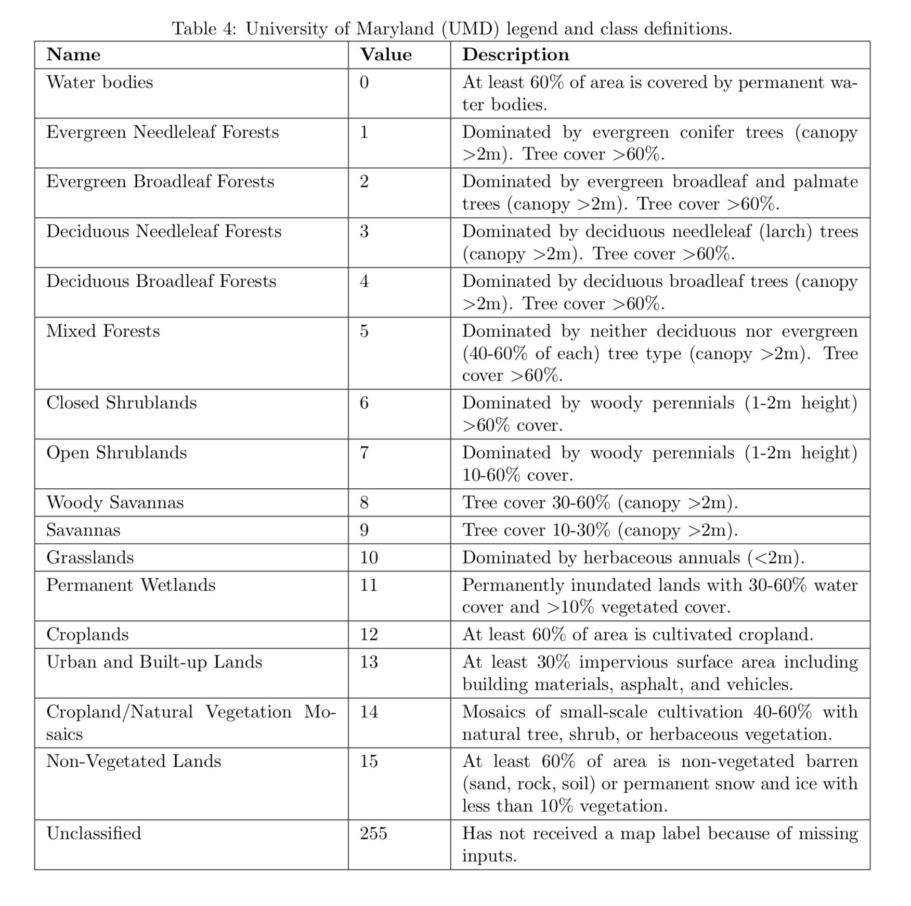

Slide 5
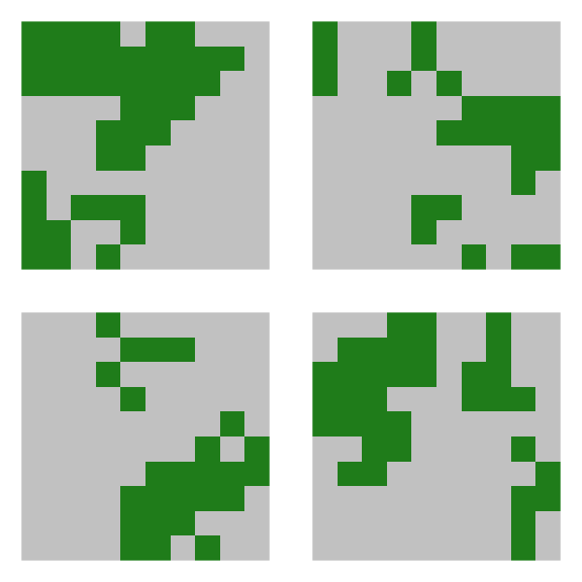
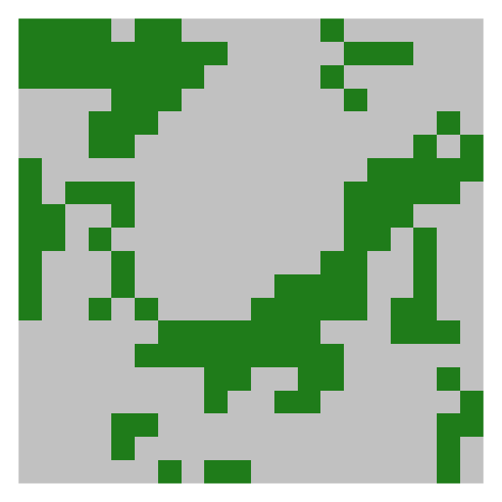
MODIS data are downloaded as tiles
MODIS R package
mosaic
GDAL
forest
croplands

Slide 6
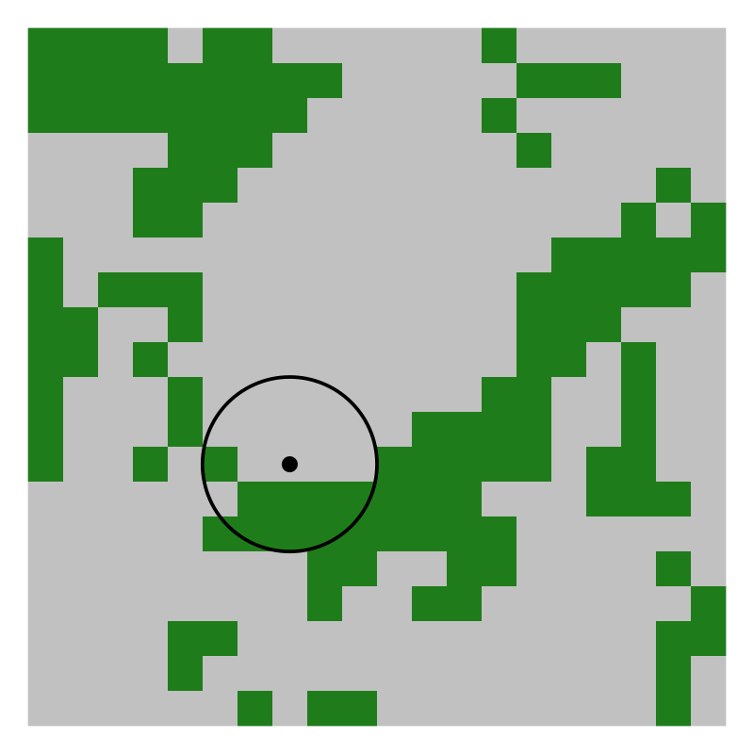
Summarize within checklist neighborhood

Slide 7


Generate a prediction surface
% forest cover
% croplands cover

