Slide 1
Best
Practices II
Modeling Relative Abundance

Slide 2
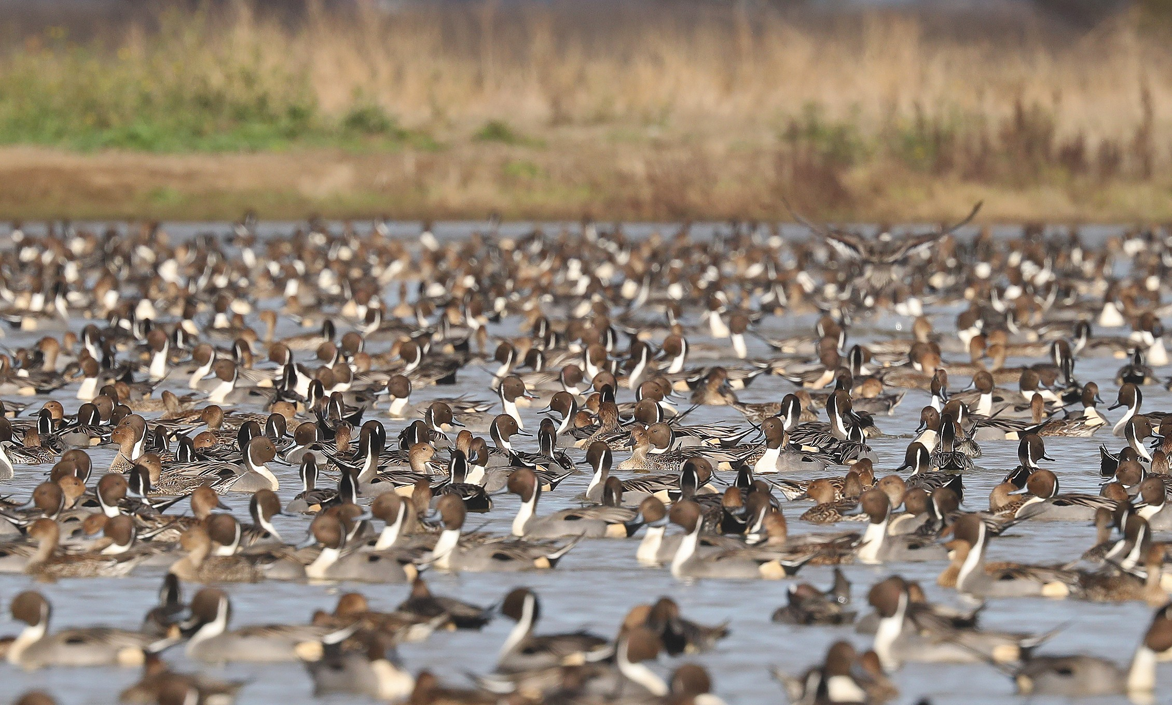
© Matt Davis & Macaulay library
Notes:
Motivation

Slide 3
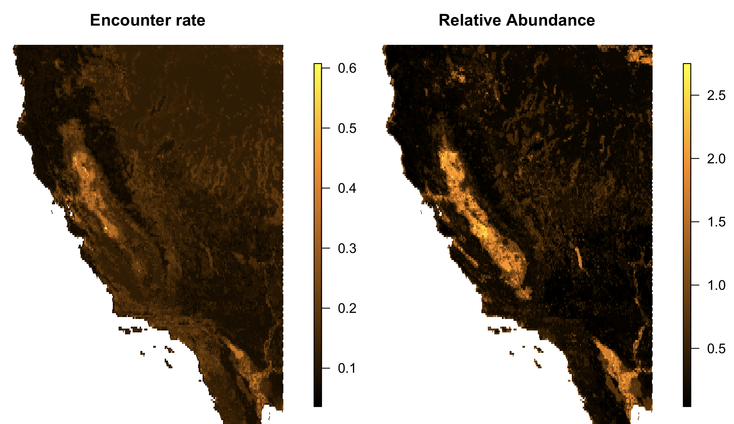

Slide 4
Challenges estimating abundance
Presence-only checklists (X)
Bias in counts
Infrequent, large flocks of birds
Data characterized by many zeros, few high counts
Notes:
Estimating Abundance is even more difficult than estimating encounter rates because….
Paricipants
Presence only
Counting in many different ways
Ecological Variation ➔ some real but very large counts
Together, these challenges result in data with many zeros and infrequent very large counts
Transition: This is a challenge for conventional statistical models

Slide 5
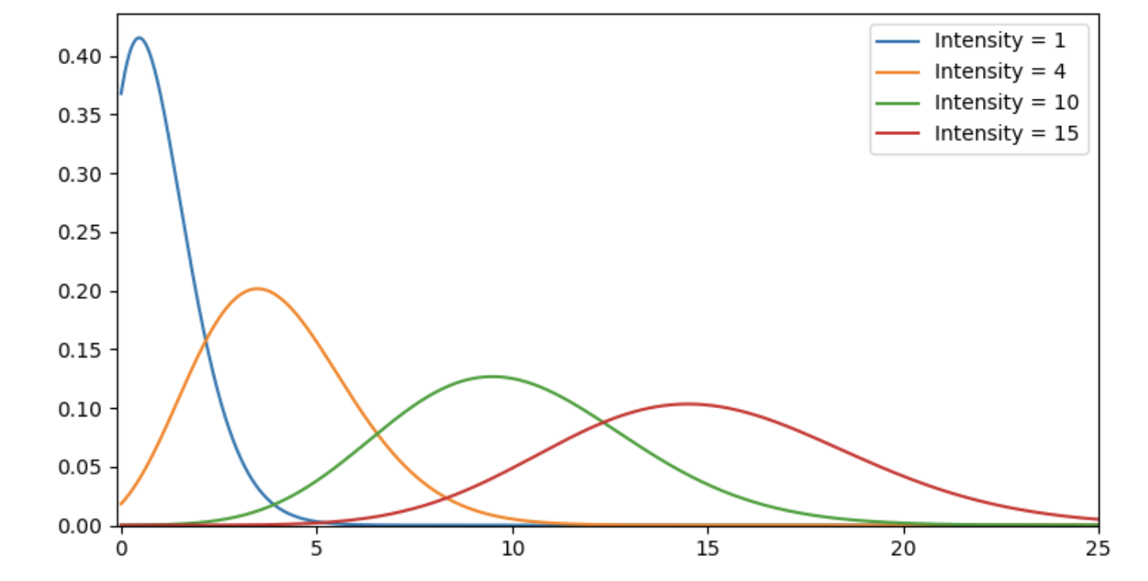
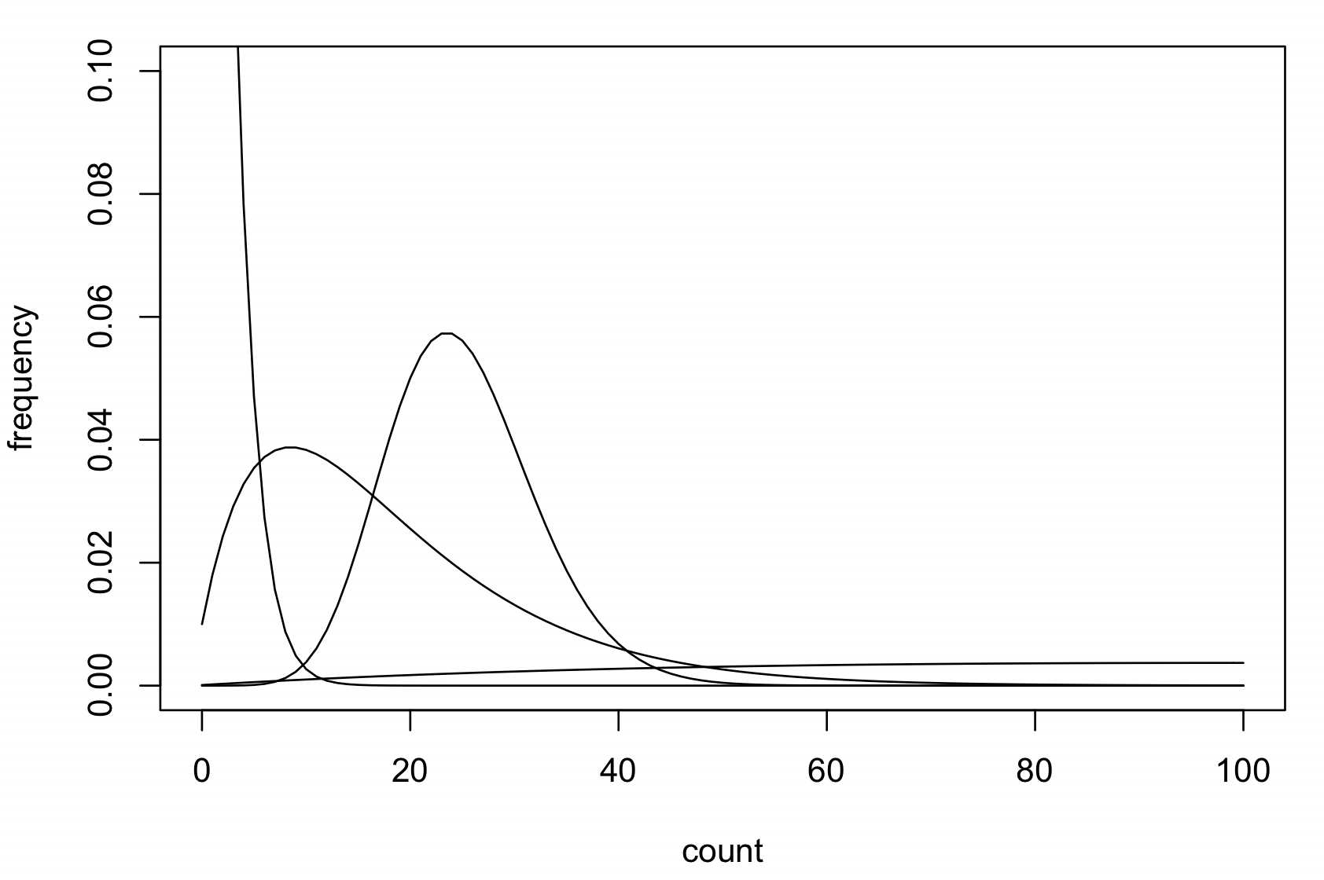
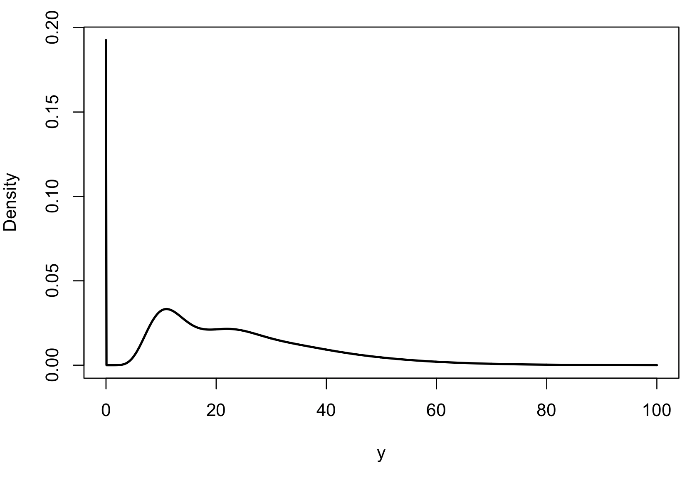
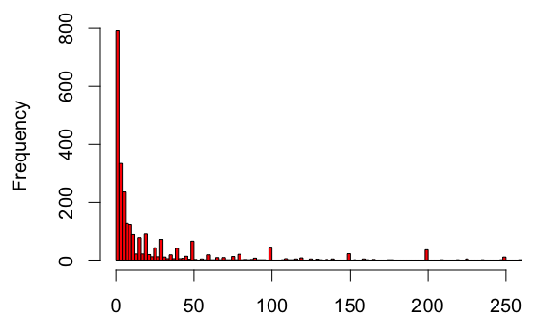
Abundance distributions
1 parameter
Negative binomial
Poisson
2
Tweedie
3
Notes:
If p close to 0, variance basically the same as mean. So same as Poisson.
If p large, variance much greater than the mean.
NB includes Poisson, but also has greater flexibility.
Here is how our Northern Pintail fit in –
97% of the data are zeros
This histogram shows most of the positive counts.
You can see it has a long tail, but this plot excludes the largest 5% of the data!
The largest count is 50k!!!!
(Here are quantiles for the positive counts)
90% 95% 98% 99% 99.5% 100%
100.00 252.00 594.72 1000.00 1960.80 50000.00

Slide 6

Separating Signal and Noise
$Y_{i} \sim f$(${habitat}_{i})+f\left({observation}_{i}\right)+ϵ_{i}$
Signals
Noise
Notes:
We are going to begin analysis by considering the following conceptual model
At a high level, the goal is to separate signal from noise
Our responses (Y) can be thought of as the product of
Signal - Consistent predictable effects.
Here we think of two types of signals – ecological and observation process
In a little more detail we want to partition the variation in the observations into 3 pieces
Noise is composed of random errors…. and unexplained effects
Take home – to do a good job modeling abundance we want models that are good at capturing signal and representing noise

Slide 7
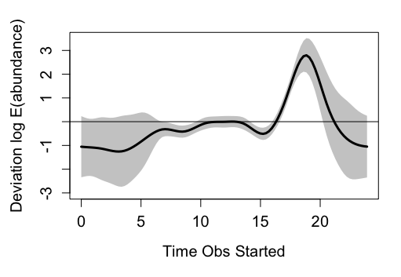
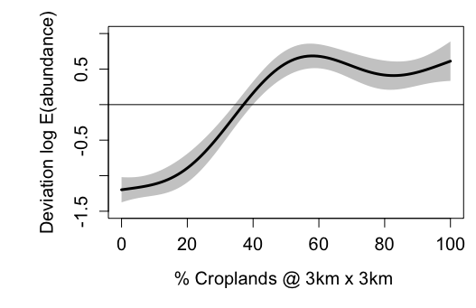
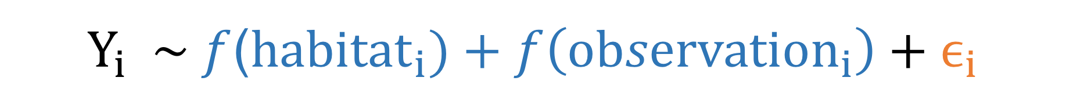
$Y_{i} \sim f$(${habitat}_{i})+f\left({observation}_{i}\right)+ϵ_{i}$
Notes:
We are going to begin by discussing Generalized Additive Models (GAMs)
They are good at capture signal from predictors – powerful and highly automated
A number of choices for error distributions – say Poisson, NB, QP, TW, & ZIP

Slide 8
Objectives
Inference
Explaining process
Is forest important habitat?
User designed
Parameter estimation
Account for Uncertainty
GAMs
Prediction
Describing patterns
Where is highest abundance?
Data Driven
Prediction Focused
Generalization
Random forests
Notes:
If there is time / interest we

Slide 9
Applications
Patterns
Where are species most or least concentrated?
Minimum estimates of Population Size
Process
Habitat use / avoidance
Climatic effects
Align validation & applications
Spatial & Temporal Scale
Mean abundance 1km, 10km
Mean abundance 1day, across season
What kinds of errors are most important?
Missed high counts
Overestimated counts

