Slide 1
Best
Practices II
Occupancy Modeling

Slide 2
Occupancy models are used to estimate the true probability of a species occurring a site while accounting for imperfect detection

Slide 3
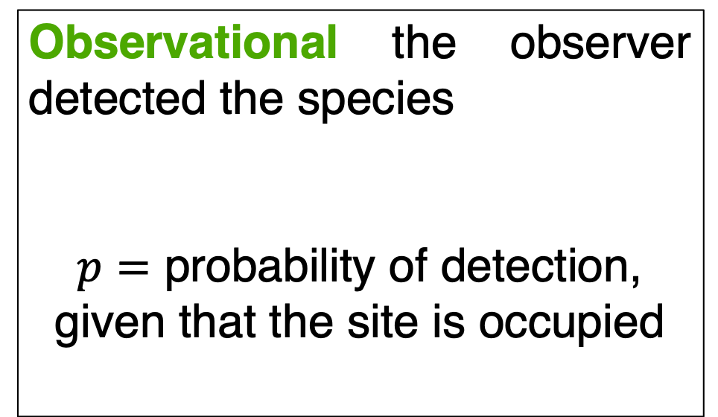
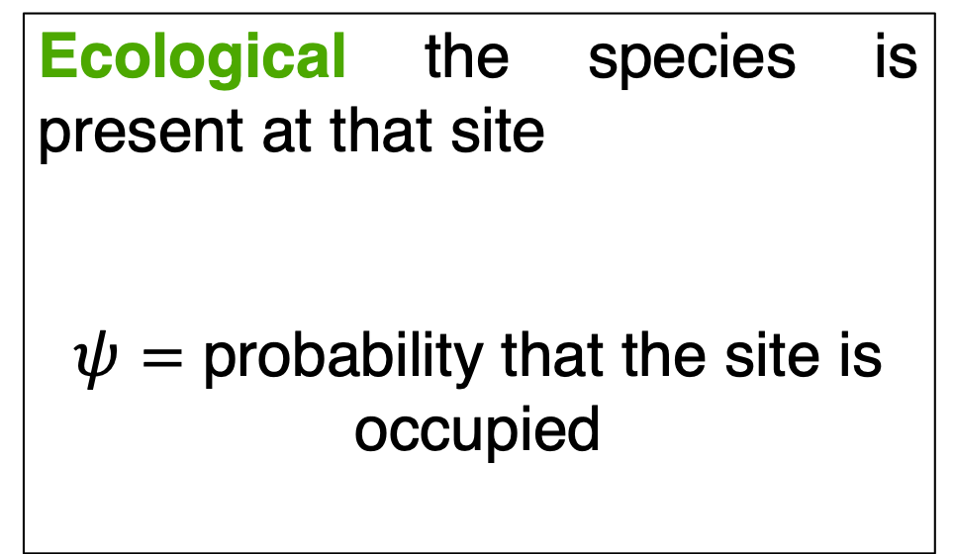
An observer recording a species at a site results from two processes
Ecological the species is present at that site
$ψ=$ probability that the site is occupied
Observational the observer detected the species
$p=$ probability of detection, given that the site is occupied

Slide 4
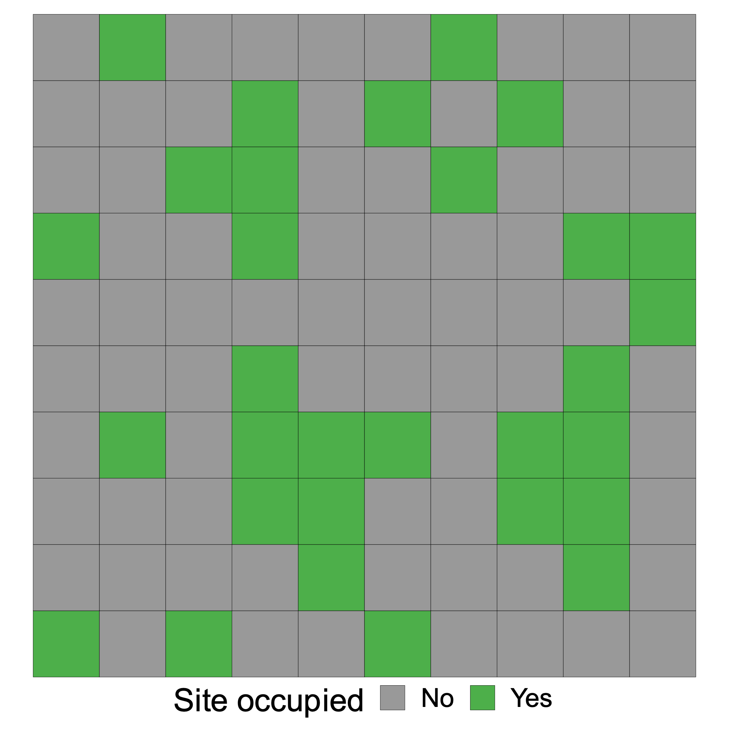
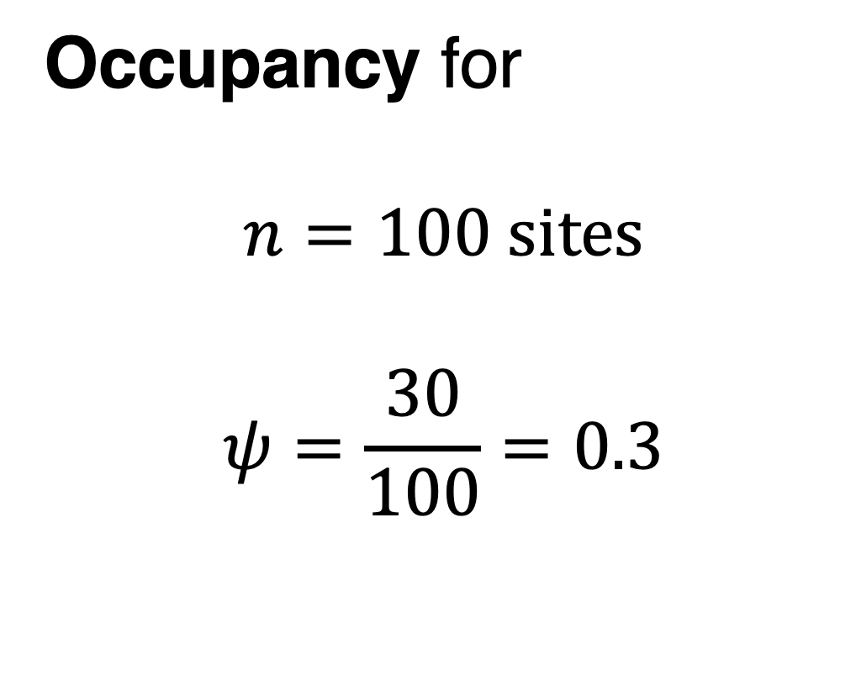
Occupancy for
$$n=100 \text{sites}$$
$$ψ=\frac{30}{100}=0.3$$

Slide 5
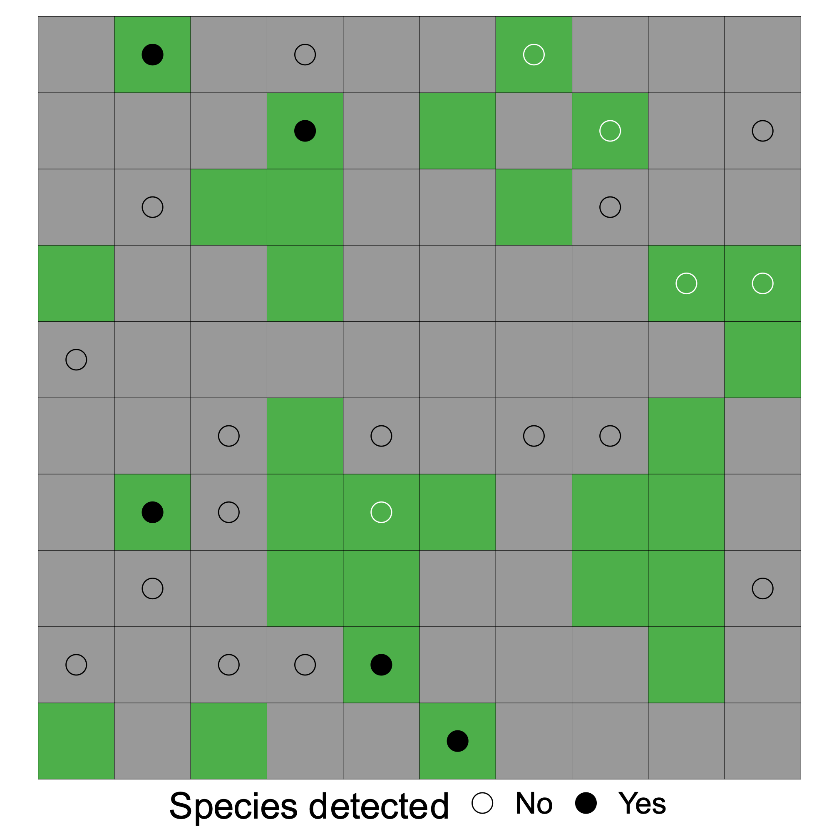
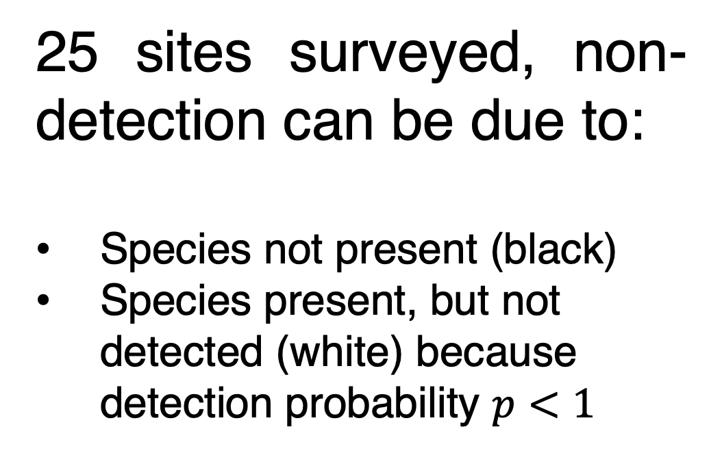
25 sites surveyed, non-detection can be due to:
Species not present (black)
Species present, but not detected (white) because detection probability $p<1$

Slide 6
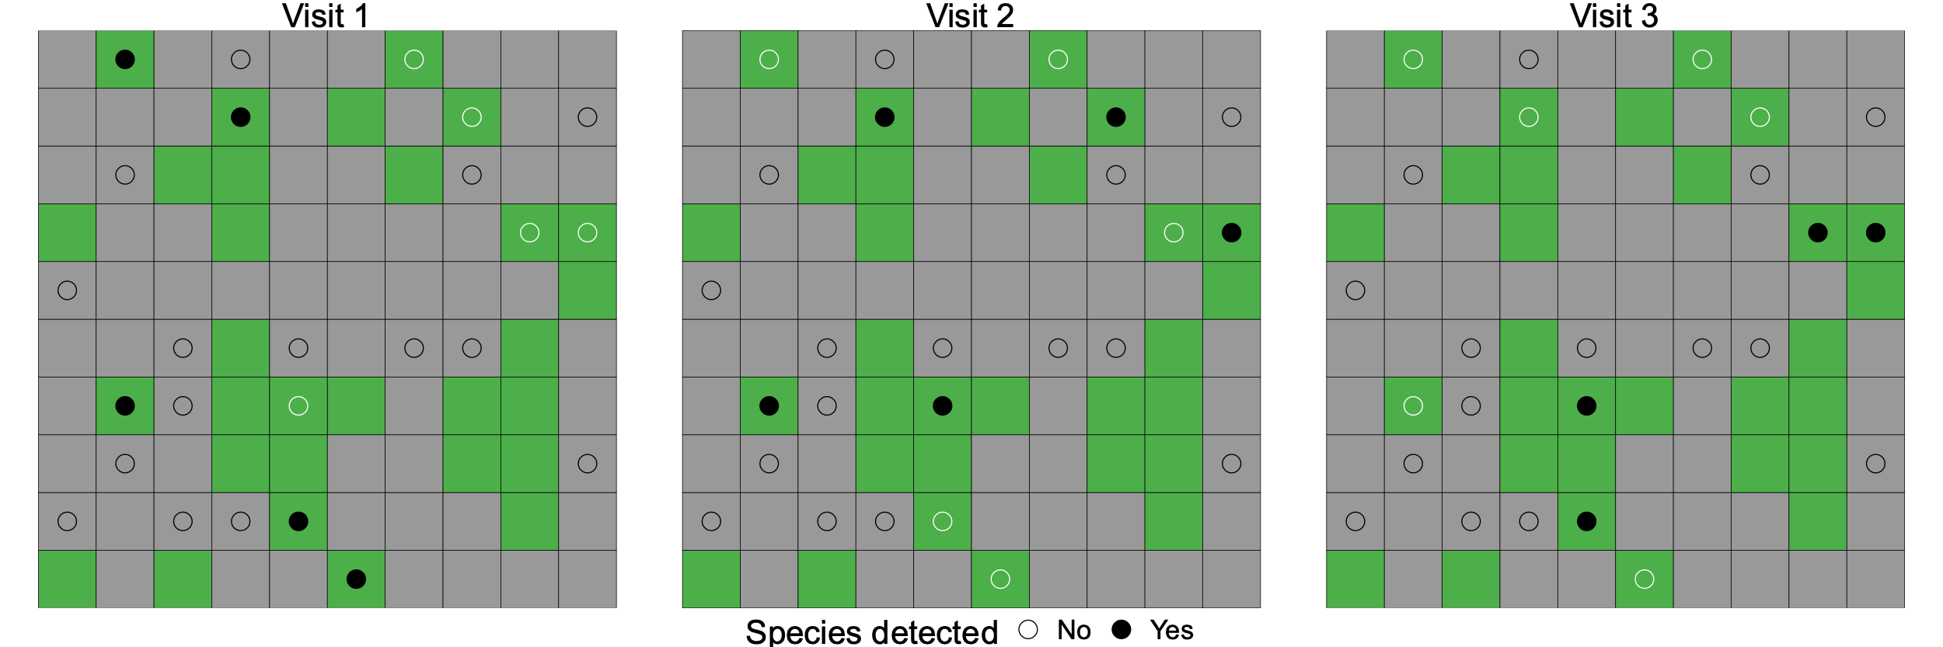

Repeat sampling can be used to estimate the detection probability $p$

Slide 7
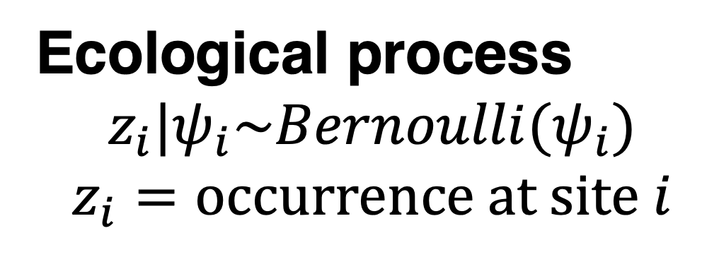
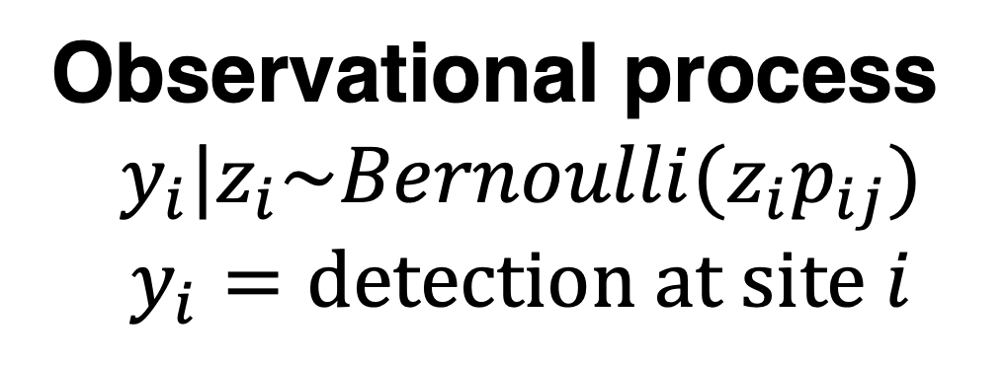
Ecological process
$$z_{i}|ψ_{i}\sim Bernoulli(ψ_{i})$$
$$z_{i}=\text{occurrence} \text{at} \text{site} i$$
Observational process
$$y_{i}|z_{i}\sim Bernoulli(z_{i}p_{ij})$$
$$y_{i}=\text{detection} \text{at} \text{site} i$$

Slide 8
Ecological process
$$z_{i}|ψ_{i}\sim Bernoulli(ψ_{i})$$
$$z_{i}=\text{occurrence} \text{at} \text{site} i$$
what we want to know
Observational process
$$y_{i}|z_{i}\sim Bernoulli(z_{i}p_{ij})$$
$$y_{i}=\text{detection} \text{at} \text{site} i$$
what we actually measure

Slide 9
Assumptions
Repeated surveys occur during a period of closure, when there is no change in occupancy state
There are no false detections
Sites are independent
The relationship between occupancy and detection probabilities and the covariates is stationary, i.e. constant across sites and visits

