Slide 1
Europe capitals: clustered by culture
A Coursera Data Science Capstone Project
by Martin Stros

Slide 2
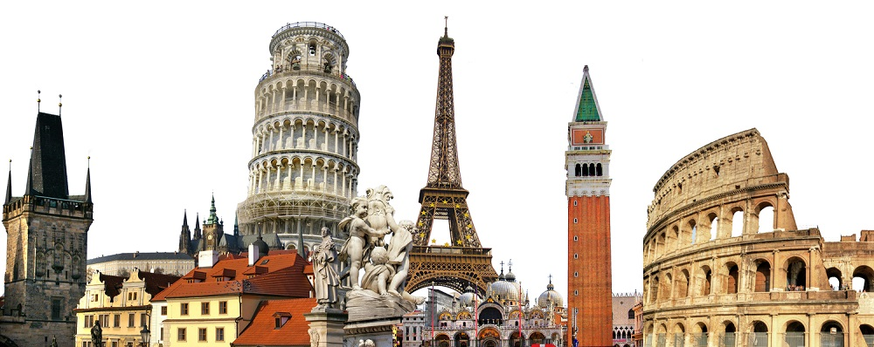
introduction
European culture is largely rooted in what is often referred to as its "common cultural heritage". Because of the great number of perspectives which can be taken on the subject, it is impossible to form a single, all-embracing conception of European culture. Nonetheless, there are core elements which are generally agreed upon as forming the cultural foundation of modern Europe.

Slide 3
objective
In this project, I will focus only on capital cities in Europe, assuming they represent their countries and nation's culture.
Using Machine Learning clustering techniques, I will group the cities into clusters to determine the similarity or dissimilarity of the cities from cultural point of view, and grouping of capitals into clusters and their visualization.
As a tourist, you might find this information useful, for example, if you liked Sarajevo (Bosna i Hercegovina) you might as well like La Valletta (Malta) and Luxembourg, due to a high number of history museums, theatres and movie theatres.
You can also use the model as a travel agent to recommend your customers different places to visit.

Slide 4
objective
Even though cuisine is usually a significant contributor to a nation's culture, I will leave out restaurants from the comparison. The idea is that while in Italy you will probably want to eat Italian food and while in Berlin you will want to eat German food, even though there are hundreds of Italian restaurants. Thus it does not make much sense in this scenario to cluster cities by the presence of restaurants. However, it might be a interesting topic to explore in a separate project.
The data I used contain venues like museums, theatres, concert halls etc.

Slide 5
methodology
All parts of this project are coded in Python. The data from Wikipedia are scrapped using Pandas built in read_html function. After that, the data needs a little bit of cleaning, as there are some special characters that would break the next steps. Geolocations (from Nominatim's OpenStreetMaps) are then added using Geopy. Using FourSquare API, as much as 50 cultural venues close to the city center are pulled for each capital. The results are explored, for example finding the most common venues in each city.
To find groups of similar cities, the data is converted to a OneHot dataframe, and is clustered using K-Means machine learning algorhytm. The optimal K is searched for.
Finally, each cluster is inspected for typical venue categories that I will present using Word Cloud visualization method.

Slide 6
data
Several data sources are combined to achieve the desired result.
First, we need a list of the capital cities of Europe. These are readily available on Wikipedia. Some data cleaning is required here.
In order to allow plotting on a map, we will need to add geographical coordinates of these cities. This is achieved by using GeoPy module in Python.
Last but not least, Foursquare API is used to fetch top 50 arts venues in each city.

Slide 7
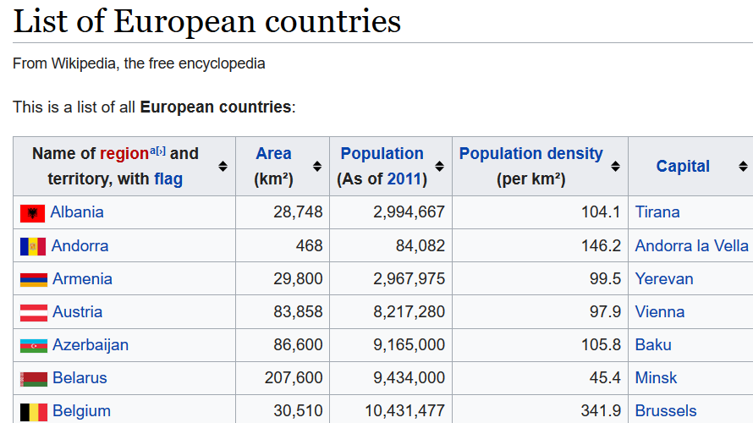
Data - Wikipedia
A table of European countries with their capitals is available on Wikipedia. I use pandas library built-in read_html function, skipping the need to use additional modules as requests and beautiful soup. A few special characters need to be removed from some country names.

Slide 8
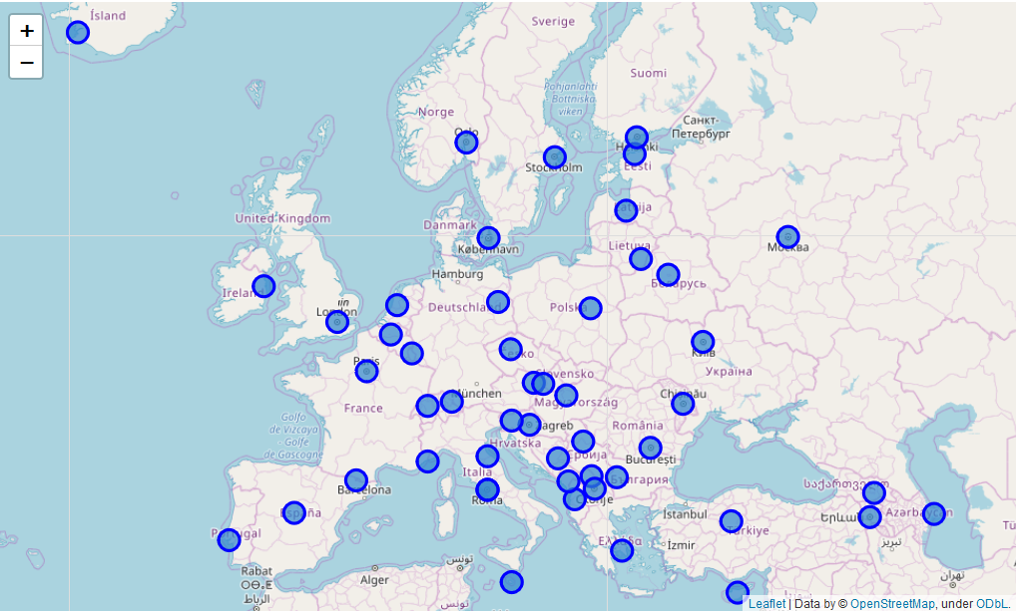
Data – geospatial details
GeoPy module is used to retrieve geospatial coordinates of a given country / city combination. These are then plotted on a map using Folium.

Slide 9
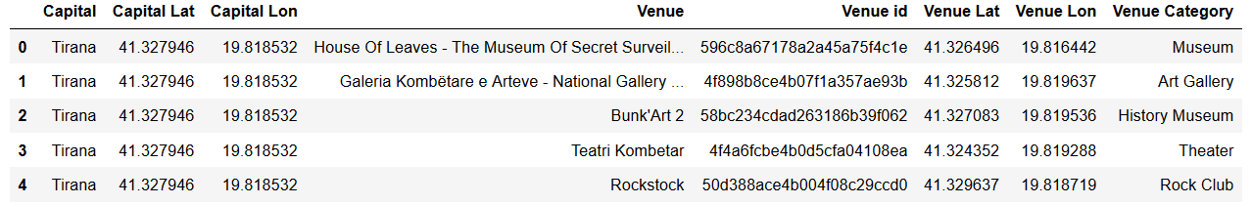
Data - foursquare
Foursquare explore functionality is used in a loop to fetch venues from the Arts section.
The problem with these data is that it will never fully cover the real world aspects of culture, like the nature of people, vibe in the city etc. So, even though Sarajevo, Luxembourg and La Valletta all look alike in terms of most prevalent venues, you might get a very different feeling of the city once you visit it.
However, the data is sufficient for this project and study.

Slide 10
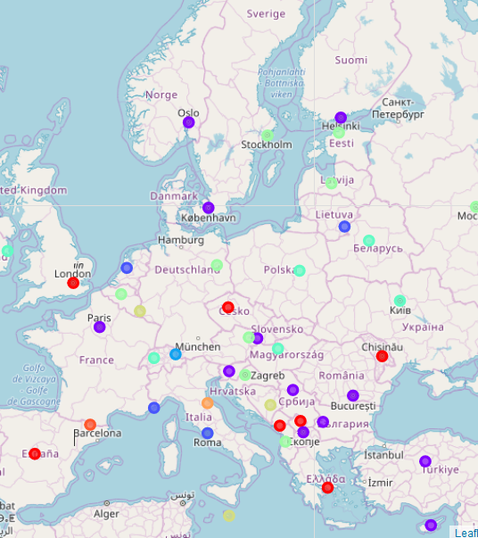
results
Using the K-Means clustering method, the capital cities were divided into ten clusters and displayed on Folium Map.
With geolocations added, various colors indicate capital cities belonging to a specific cluster.

Slide 11
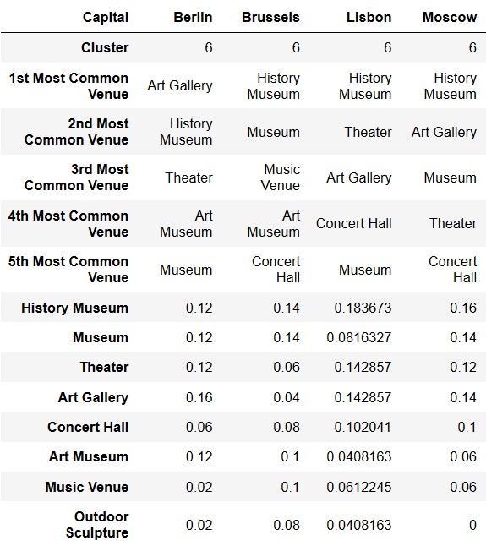
results
We can explore different clusters and compare capital cities by the most frequent venues, and assume why there are in the same cluster.

Slide 12
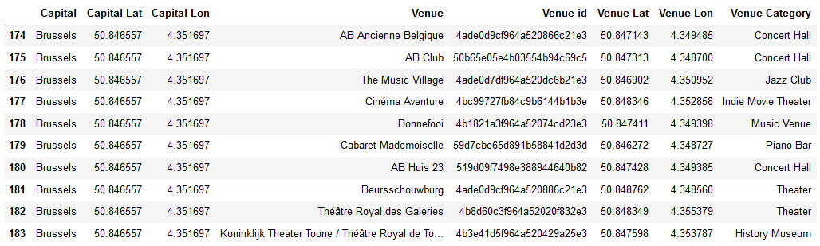
results
We can leverage the Foursquare data to explore venues in a specific city of interest.

Slide 13
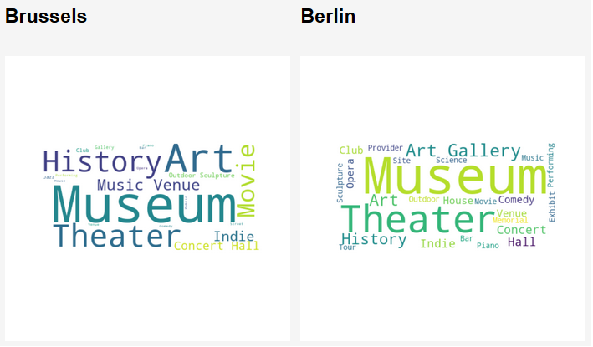
results
We can also use the word cloud visualization technique to have a more appealing look on the local venues.
As an example, we can see that two cities grouped in the same cluster, Brussels and Berlin, are similar in terms of culture venues present.
What connects them are: Museum, Theatre, Art, History.

Slide 14
discussion
When using the K-Means method always brings the problem of finding the best K. If it is not known beforehand, one of the most common ways for find it is using the so called Elbow method. However, in this scenario, the Elbow chart does not reveal a significant turning point in the curve of diminishing squared distances. For that reason, I needed to choose the K in a different way. Given that there are 50 capitals in Europe, it does not make sense to split them into too much clusters. But being a diverse continent, neither too few clusters would work. K=10 was chosen as a compromise.
Otherwise, the K-Means works well for clustering of capital cities.

Slide 15
discussion
A different kind of problem is the limitation of the free version of Foursquare API. While the limit for each city is 50 venues, some smaller cities do not have more than 5 venues. For large cities like London and Paris, 50 venues is a small part of what the city has to offer. In reality, it would be very questionable to determine similarity of cities on a relatively small sample. But the value increases for someone who could be labeled as a 'mass tourist', who will always visit the main attractions and will not be looking for the 'hidden gems'.

Slide 16
conclusion
Foursquare API is very powerful if used correctly, its advantage is that people use it all around the world. The discussion thread for every venue is very helpful to learn references from other visitors.
It is quite interesting to see that some smaller cities like Reykjavik, San Marino and Andorra la Vella are very unique and not like any other capital in Europe. On the other hand, it is great to know that after visiting the tourist staples like Prague, Madrid, London, one might go on visiting more 'exotic' places like Yerevan, Pristina, Podgorica, and have a similar experience.

