Slide 1
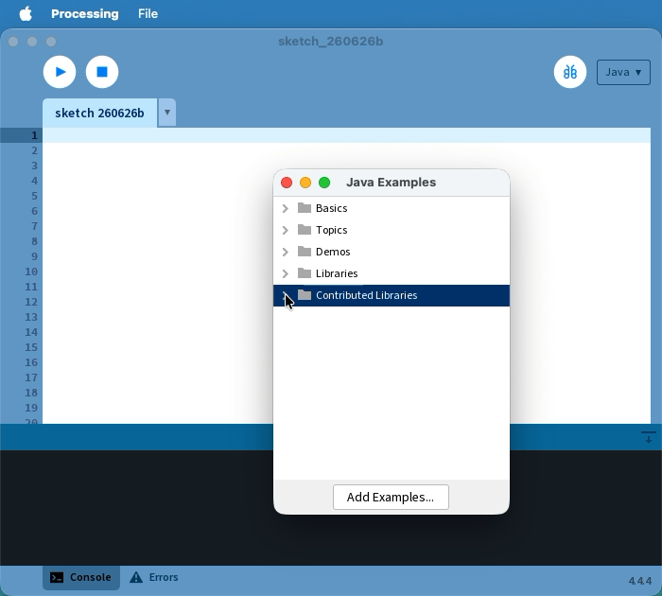
Lesson 1: Hello, Blob!
Direct instruction mini-deck for introducing the first Processing sketch.
Today students learn to:
run a sketch in Processing
tell the difference between setup() and draw()
create and display a Blob object
change the blob's color with RGB values
Students will build this sketch, then make it their own.

Slide 2
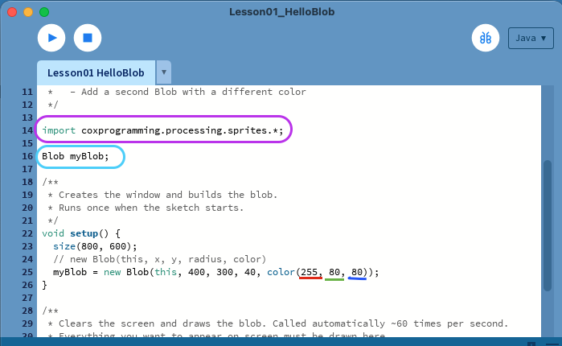
Tour the Processing Sketch
Use the screenshot to orient students before you run anything.
Point out these parts
Play runs the sketch; Stop ends it.
The import line tells Processing to use the SpriteGame tools.
Blob myBlob; is the variable we will fill in during setup().
The constructor line chooses the blob's position, size, and color.
Teacher move: ask students which line they think creates the blob.

Slide 3
setup() Runs Once
Metaphor: setup is like laying out the art supplies before class begins.
void setup() { size(800, 600); myBlob = new Blob(this, 400, 300, 40, color(255, 80, 80)); }
Constructor breakdown
this
400, 300
Means this sketch. Students should leave it alone.
The center x and y position of the blob.
40
color(...)
The radius. Bigger number = bigger blob.
RGB values decide the fill color.
When the sketch starts, setup() creates the window and builds the blob one time. If something only needs to happen at the beginning, it belongs here.
Common reminder: forgetting the import line is the #1 reason this sketch will not run.

Slide 4
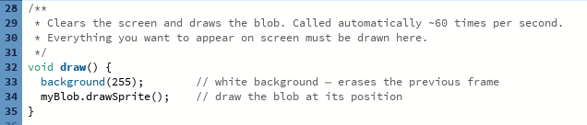
draw() Runs Forever
Each pass through draw() is a fresh frame in the animation.
background(255);
myBlob.drawSprite();
~60 times per second
Paints the screen white again so old frames do not smear.
Draws the blob in its current position every frame.
Processing repeats draw() quickly, which is why animation works.
Teacher prompt: “If we removed background(255), what do you think would happen on screen?”

Slide 5
RGB Color and “Make It Yours”
Show the Color Selector so students know the numbers are something they can choose on purpose.
new Blob(this, 400, 300, 40, color(255, 80, 80));
color(255, 80, 80)
RGB means red, green, blue
Use Tools → Color Selector
Easy student edits
Each value goes from 0 to 255. More red makes the blob redder, more blue makes it bluer, and so on.
Pick a color visually, then read the RGB numbers and type them into color(...).
Change the color, the radius, the x/y position, or the background color.
Direct instruction bridge: run the example once, then let students make one intentional change before adding a second blob later.

Slide 6
Run the Example
The movie is embedded in the PowerPoint. Click it during the lesson to replay the sketch.
PowerPoint tip: click the movie poster to play the recording inside the slide.
Things to remember:
“setup() built everything once.”
“draw() keeps repainting the screen.”
“Now you try changing one number on purpose.”

