Slide 1
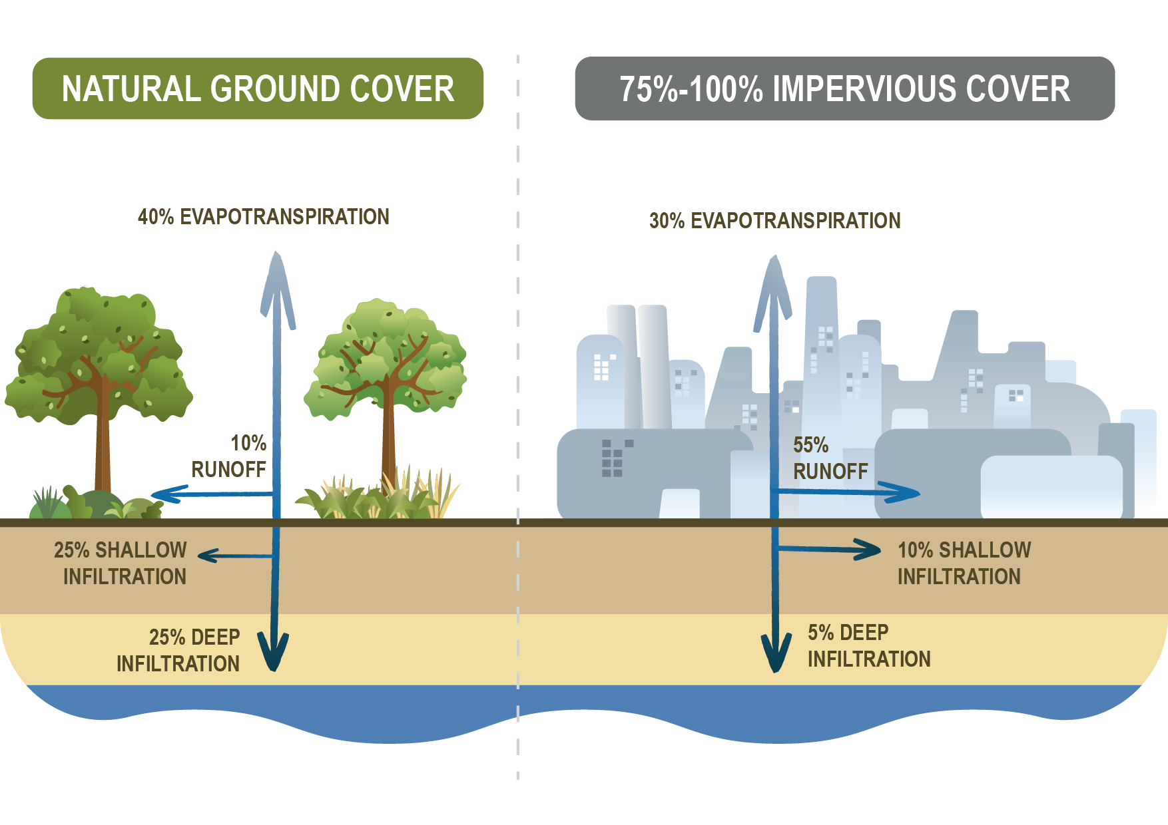
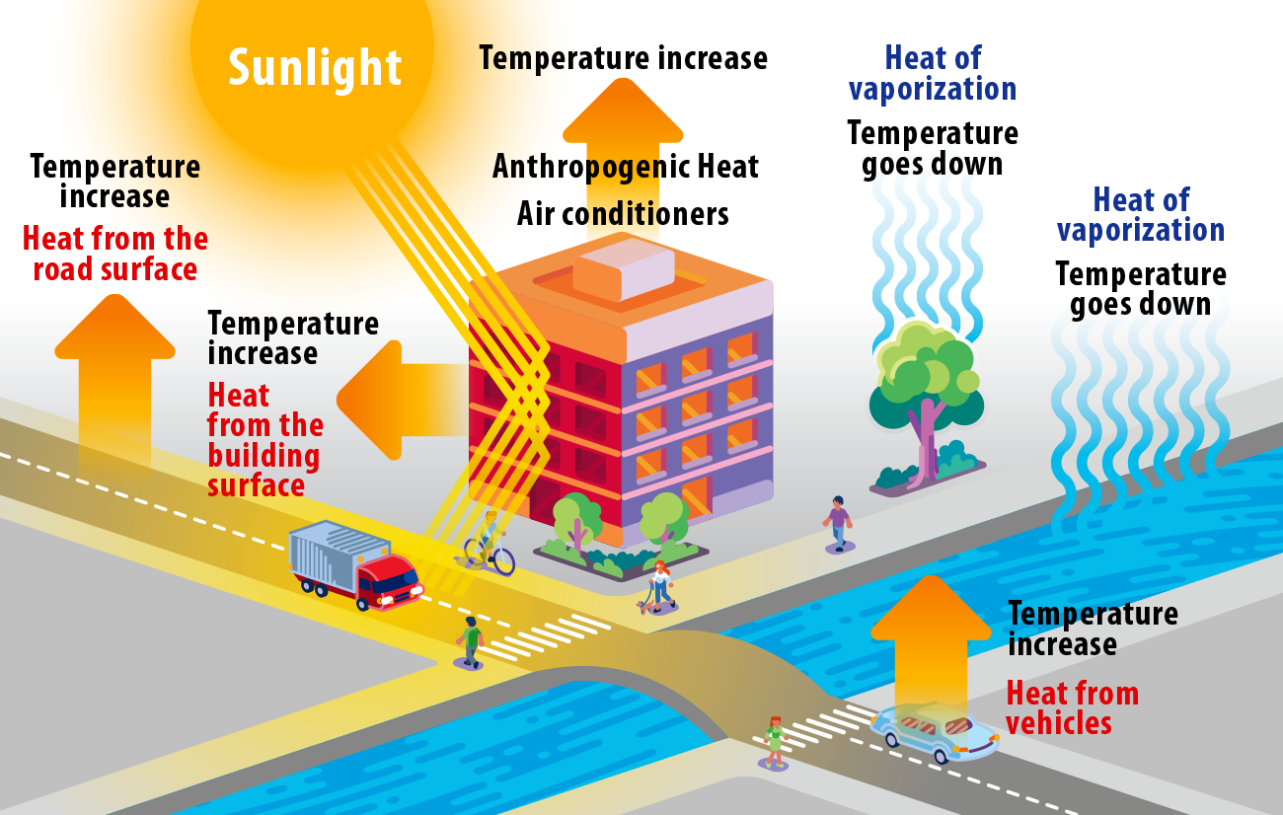
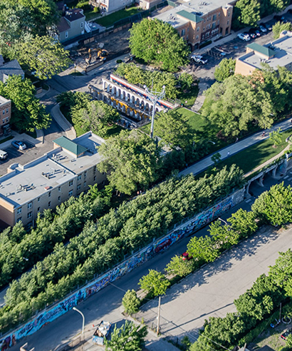
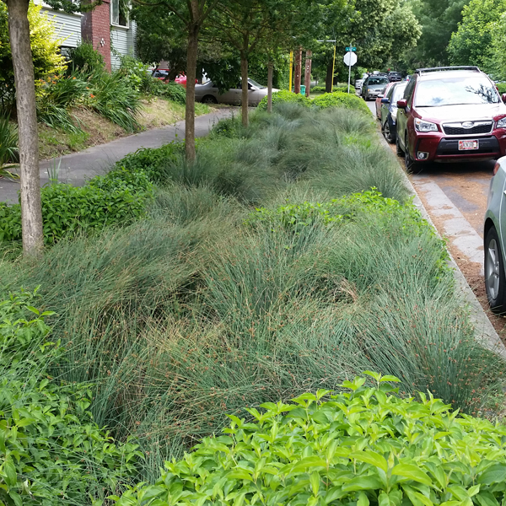
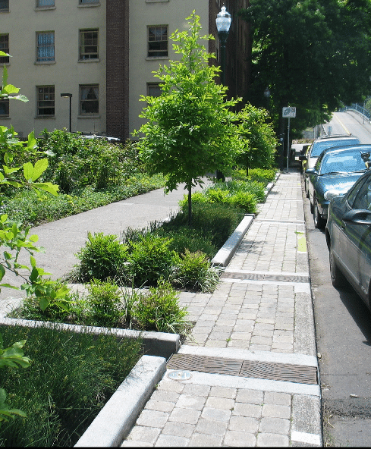
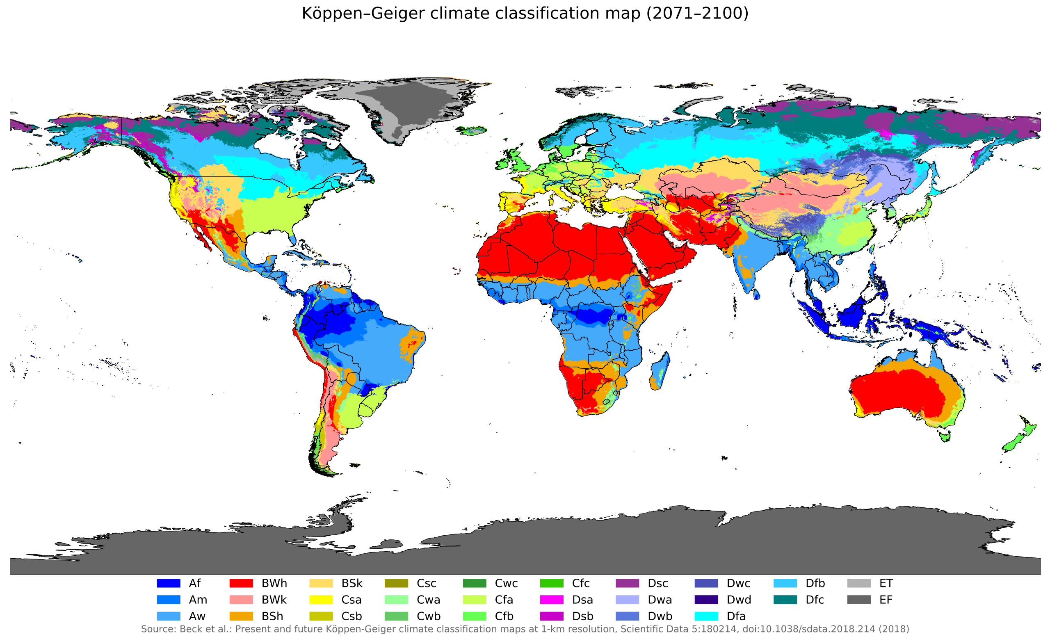
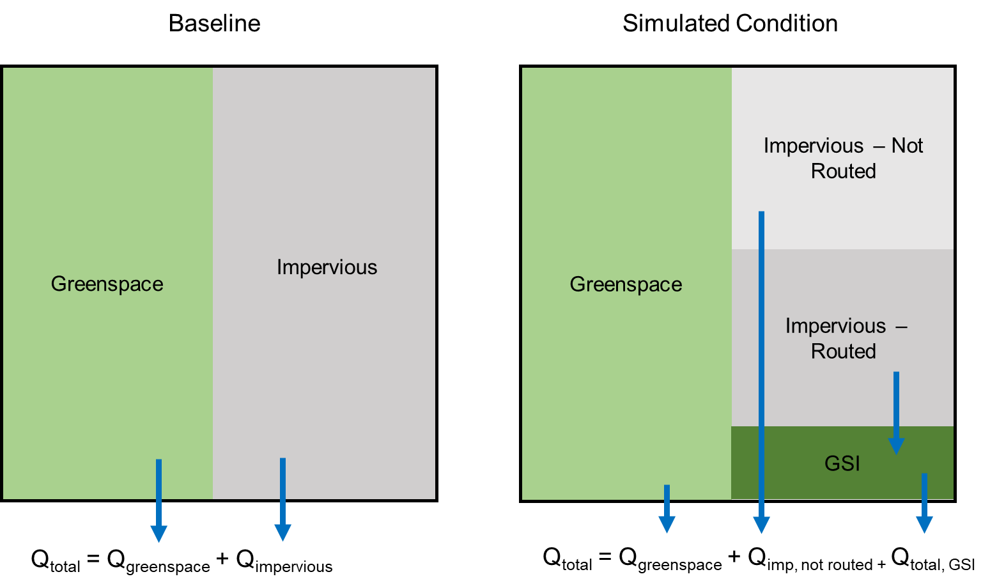
Green Infrastructure and Urban Heat: Evaluating Tradeoffs Across Climate
Maya Struzak, Advisor: Dr. Jordyn Wolfand
Background
Global population growth drives urbanization, leading to increased impervious surfaces that disrupt the natural water cycle, increasing stormwater volume and peak flows and pollution of lakes, streams and other bodies of water, as well as exacerbating the urban heat island effect. Green infrastructure (GI), including green stormwater infrastructure (GSI) such as green roofs and vegetated swales, aims to mitigate these using nature-based solutions such as mimicking the natural water cycle, although research on its potential to mitigate the urban heat island effect, especially in various climates, remains limited. New modeling approaches are crucial to understand the complex interactions between climate, landscape, runoff, and heat mitigation, aiding cities in planning more efficient and effective green infrastructure management as climates change.
Urbanization disrupts the natural water cycle
Driving Questions
Key Findings
How does background climate influence the effect of GSI in mitigating urban heat and surface runoff?
How will climate change moderate the effectiveness of GSI in mitigating urban heat and surface runoff?
How do we optimize the performance of green infrastructure given local constraints and changing climate?
Primary gaps in knowledge identified:
Studies quantifying both hydrological and cooling performance of GSI (bioretention, specifically)
Continuous, long-term monitoring of GI
UHI and GSI studies outside of Europe, China, and US
Comparisons of GSI potential in different climates
Quantification of GI benefits for urban heat (i.e., impact on quality of life)
Equity in GSI implementation
Synergism: how co-benefits work together
Impervious surfaces and human activity exacerbate urban heat
via Iowa State University
Methods
via Pavement Technology Inc.
Use land-surface model NOAH-MP to evaluate the impact of GSI and quantify feedbacks between runoff reduction and heat risk across climate regimes. The following diagram represents modeling scenarios to evaluate the effects of GSI on urban heat and runoff.
The focus for the semester is to construct an in-depth review of current literature about GSI, UHI, climate variability, and other related topics. These findings will be integrated into the project description for a grant proposal to fund this project.
Next Steps
Cooling via evapotranspiration from GSI can help reduce UHI
Potential of GSI for UHI mitigation varies by climate
Green Street via American Society of Landscape Architects
Bioretention planters via City of Portland
Bioretention planters via New Jersey Future

