Slide 1
CMSE 801
Introduction to Computational Modeling and Data Analysis
Welcome!
Department of CMSE
Dr. Devin W. Silvia

Slide 2
THE THREE THREADS OF
CMSE 801
Coding in Python: By the end of the CMSE 801 you will be a proficient programmer/coder in Python. You should be able to use Python to help you in all of future classes.
Modeling: You will learn how to build models that allow you to quantitatively solve complex problems in science, engineering and beyond. Combined with the coding aspect of the course, these models will be turned into computational models.
Data Analysis: You will learn how to handle real-world data: find it, analyze it, and draw quantitative conclusions from it. You will use your coding skills for this analysis and build models that reveal deeper insights into the data.

Slide 3
COURSE STRUCTURE
Flipped classroom: The class is structured to have pre-class assignments, which you will do before coming to class and in-class assignments done during class, often as part of a group.
There is homework every other week.
Also, the only way to learn to code is to code. We will code in class every day. Bring your computer with you every day; we will have a few backups if you need one.
There will be both a midterm and a final project.
Projects will be presented at the end of the semester, although we will start planning your projects earlier in the semester.

Slide 4
A FEW NOTES ABOUT
THE FLIPPED CLASSROOM
The flipped classroom environment will like feel very different than what you may be used to.
Learning takes place in a collaborative manner in which you learn by doing, using knowledge you acquire before coming to class
Pre-class assignments are critical for maximizing your in-class experience

Slide 5
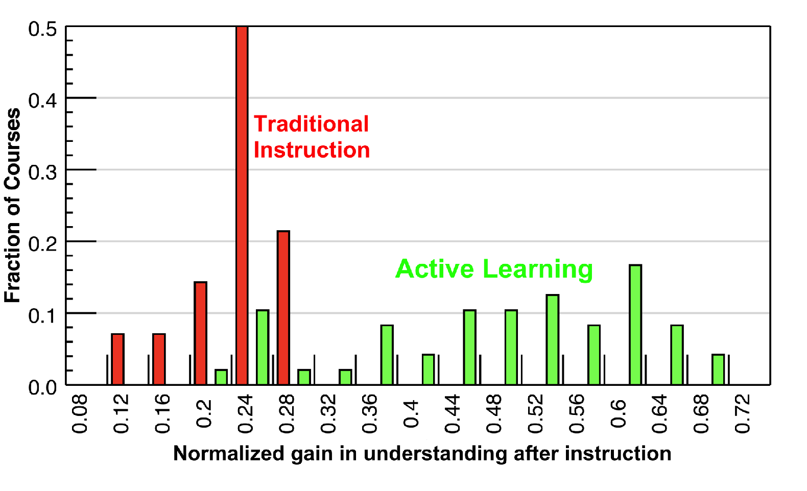
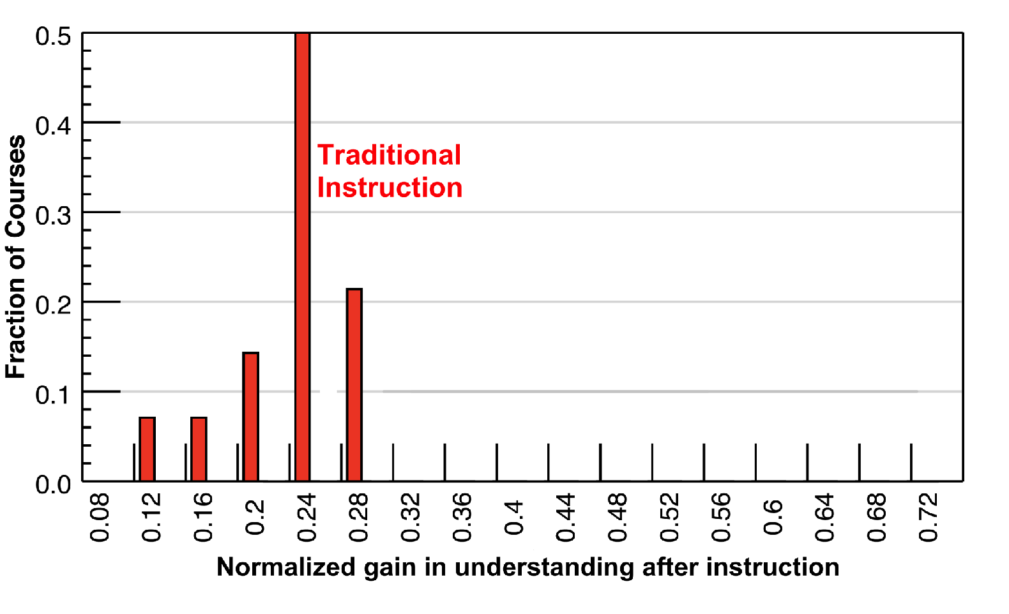
INTERACTIVE ENGAGEMENT LEADS TO MORE LEARNING!
Hake, “Interactive-engagement versus traditional methods: A six-thousand-student survey .…” American Journal of Physics. 1998.

Slide 6
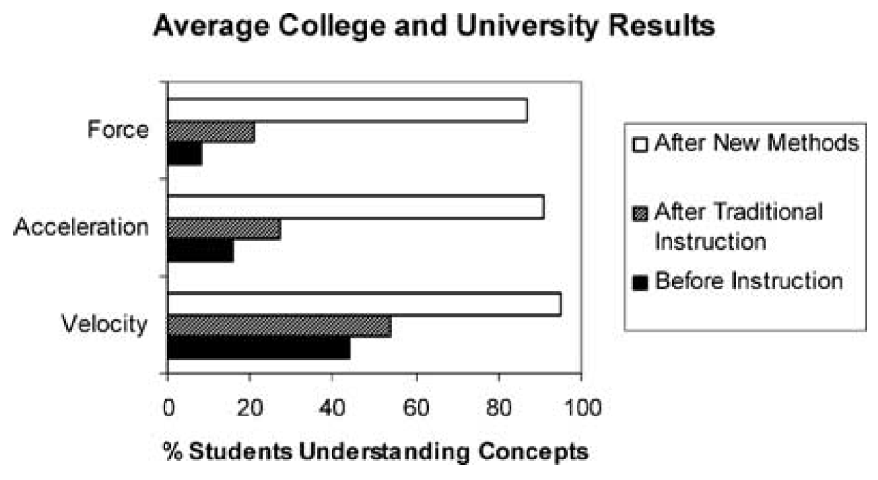
INTERACTIVE ENGAGEMENT LEADS TO MORE LEARNING!
Active engagement
Active-engagement vs. traditional instruction for improving students’ conceptual understanding of basic physics concepts (taken from Laws et al., 1999)

Slide 7
GETTING THE MOST OUT OF THE FLIPPED CLASSROOM
You are responsible for monitoring your own learning — only you can ensure that you are mastering the content!
On D2L, in the “Course Information” section, there is a PDF called “classroom_participation”. Take a moment to review this document

Slide 8
GRADES
 | pre-class assignments | participation, attendance, in-class assignments | midterm | homework | final project
percentage | 10% | 15% | 20% | 25% | 30%
4.0 | >90%
3.5 | >85%
3.0 | >80%
2.5 | >75%
2.0 | >70%
1.5 | >65%
1.0 | >60%
0.0 | <60%

Slide 9


SPARTAN CODE OF HONOR
As Spartans, we continually strive to hold ourselves to values of the highest ethical honor. As students, we will empower an atmosphere as future leaders
to uphold honesty in our work, hold our peers accountable to the highest standard, and take pride that integrity is worth more than our grade. We pledge that these ethics will carry beyond our time as students
at Michigan State University, fostering an improved recognition for personal best and integrity in our society.
Please review the pledge at: https://honorcode.msu.edu/about/

Slide 10
ACCOMMODATIONS
If you have a university-documented learning difficulty or require other accommodations, please provide me with your VISA as soon as possible and speak with me about how I can assist you in your learning.
If you do not have a VISA but have been documented with a learning difficulty or other problems for which you may still require accommodation, please contact MSU’s Resource Center for People with Disabilities (355-9642) in order to acquire current documentation.

Slide 11
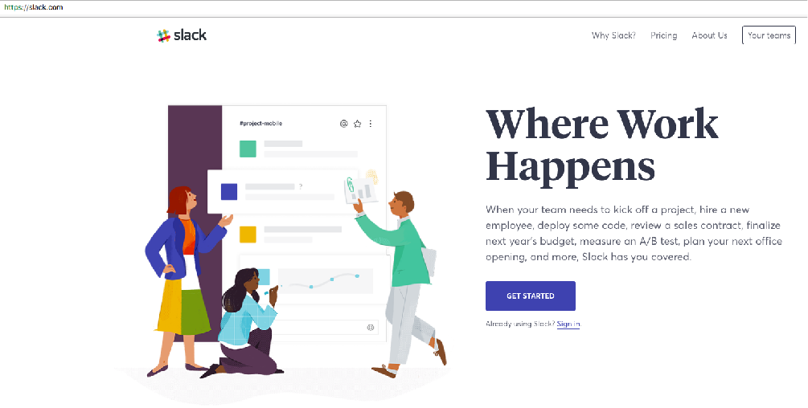
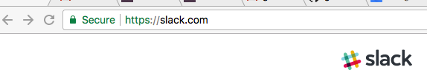
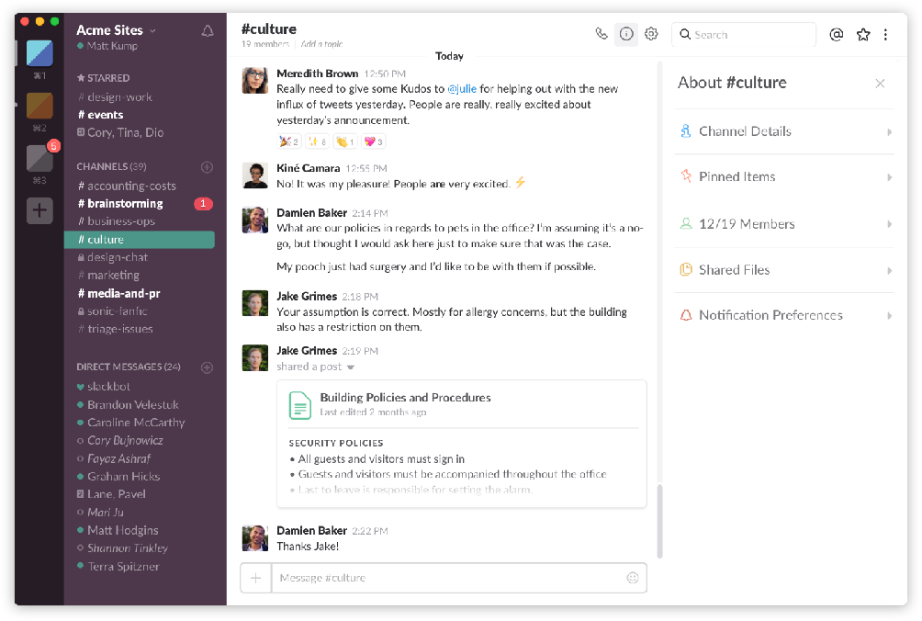
SLACK
We will be using Slack in this course.
The primary goal of Slack is to support communication between the students, but it will also enable instructor support.
Use the Slack channels to show ideas/tips/plots or to ask questions about syntax, error messages.
The Slack usage rules are in the syllabus.

Slide 12
CATME SURVEY
We’ll be using CATME as a means of forming productive groups for in-class assignments. You should have received an email about this.
If you did not receive the email contact me.
If you received the email, but didn’t do the survey,
make sure to complete it after class today!

Slide 13
THE MAIN TOOL WE WILL USE: PYTHON
In this course, we will cover most aspects of Python.
If you want more advanced Python knowledge and additional software management skills when this course is completed, please consider CMSE 802.
The environment we will work in is called a “Jupyter Notebook”, and we will walk through one in-class today.

Slide 14
GETTING STARTED
The syllabus is available in the D2L “Course Information” folder.
You should have installed Anaconda on your laptops before coming to class today. You should also have received instructions for getting this set up via email. The “Software Setup Guide” is also available on D2L

Slide 15
PLAN FOR TODAY
Getting, using and submitting a Jupyter notebook.
  go to D2L In-Class Assignments folder
  download the Jupyter notebook
  Read the notebook, answer everything in it, and submit the final notebook into the dropbox.
In-class activity: “Algorithms". Instructions are in the notebook.

