Slide 1
Welcome to CMSE 801
Find a friend and sit anywhere for now

Slide 2
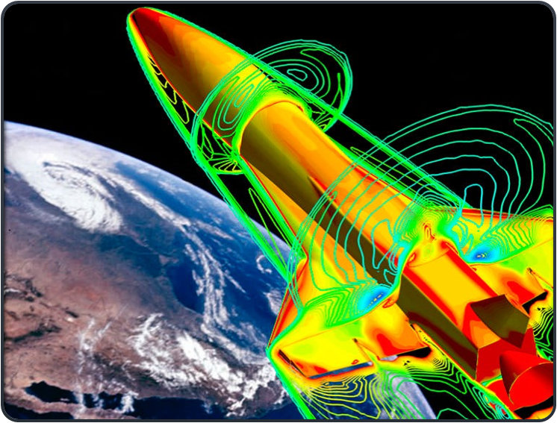
CMSE 801 Team
Dr. Mengsen Zhang
(Instructor before spring break) Dr. Guan’ao Yan
(Instructor after spring break)
Andrew Johnprakash (TA/Grader)​

Slide 3
About me
PhD in Complex Systems
@ Florida Atlantic University
Postdoc in Computational Neuroscience
@ Stanford, UNC-Chapel Hill
Assistant Professor in CMSE (MSU)
Computational Neuroscience,
Dynamical Systems,
Computational Topology
My Name:
Mengsen
Dr. Mengsen
Dr. Zhang
Prof. Zhang

Slide 4
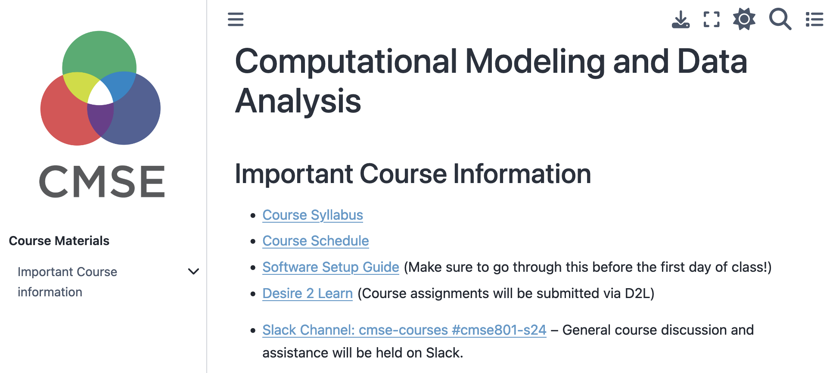
Where to get info
How to Contact Us:
Email:
mengsen@msu.edu
johnprak@msu.edu
Microsoft Teams
Office Hours:
When & Where: See most up-to-date info on course calendar: https://msu-cmse-courses.github.io/CMSE801-S26/intro.html#office-hours
Ask for different time
Course Website:
https://msu-cmse-courses.github.io/CMSE801-S26
msu-cmse-courses.github.io/cmse801-S26

Slide 5
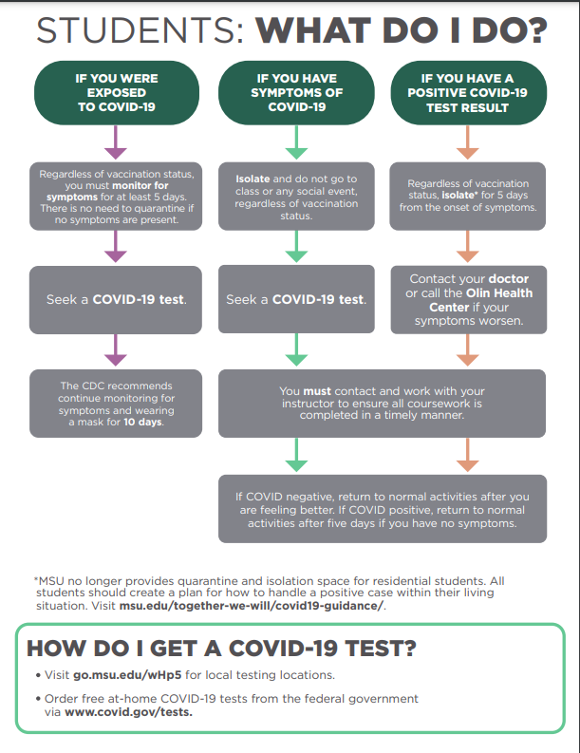
COVID & Flu Safety
University Policy​ here
DO NOT come to class if you are sick or test positive for COVID or the Flu
Contact Instructor ​

Slide 6
The Three Threads of CMSE 801
Coding in Python:
By the end of the CMSE 801 you will be a proficient programmer/coder in Python. You should be able to use Python to help you in all of future classes.​
Modeling:
You will learn how to build models that allow you to quantitatively solve complex problems in science, engineering and beyond. Combined with the coding aspect of the course, these models will be turned into computational models.​
Data Analysis:
You will learn how to handle real-world data: find it, analyze it, and draw quantitative conclusions from it. You will use your coding skills for this analysis and build models that reveal deeper insights into the data. ​

Slide 7
Course Structure
This course will require a lot of work. There is a huge amount to learn.
Link to course schedule
Flipped classroom:
Pre-class assignments, due the day before class at 5PM
In-class assignments done during class, as part of a group.
HOMEWORK: roughly every few weeks.
EXAMS: FOUR quizzes based on class assignments every few weeks​
FINAL PROJECT: presented at the end of the semester. We will plan your projects throughout the semester​
The only way to learn to code is to code. We will code in class every day. We will provide opportunities for additional practice.​

Slide 8
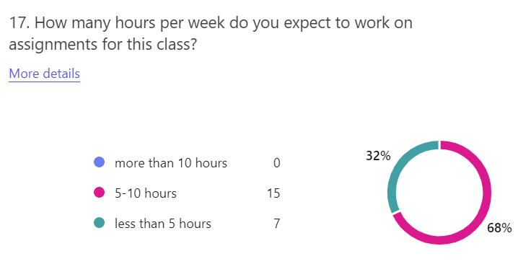
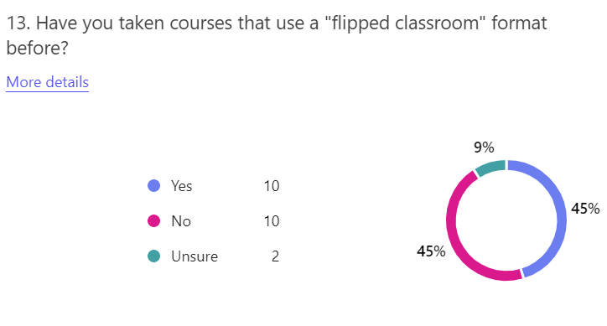
Notes about Flipped Classroom
The flipped classroom environment may like feel very different than what you may be used to
Learning takes place in a collaborative manner in which you learn by doing, using knowledge you acquire before coming to class​
Pre-class assignments are critical for maximizing your in-class experience​

Slide 9
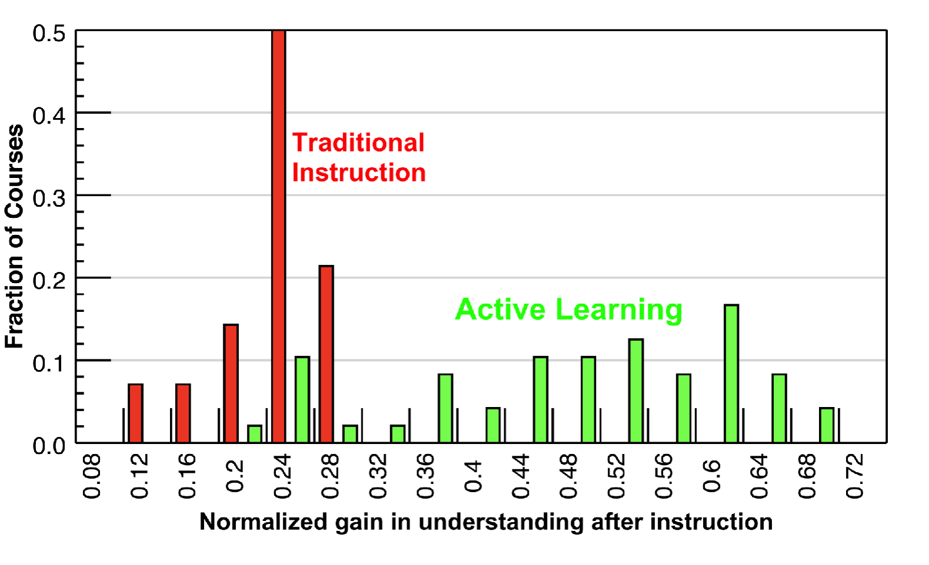
Interactive engagement leads to more learning!
Hake, “Interactive-engagement versus traditional methods: A six-thousand-student survey .…” American Journal of Physics. 1998.

Slide 10
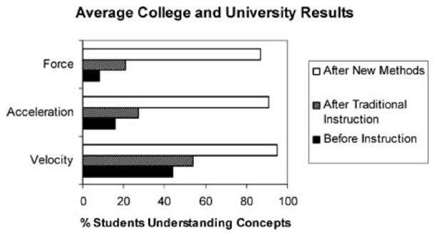
Interactive engagement leads to more learning!
Active-engagement vs. traditional instruction for improving students’ conceptual understanding of basic physics concepts (taken from Laws et al., 1999)

Slide 11
Getting the most out of the flipped classroom​
You are responsible for monitoring your own learning — only you can ensure that you are mastering the content!​
This goes for In Class Participation and Pre-class Preparation In particular​
You’ll learn more about flipped classrooms in the Day 2 pre-class assignment!​

Slide 12
Grades
​ | Participation,​ attendance,​ in-class assignments​ | Pre-class assignments​ | Exam | Homework (4)​ | Semester project​
Percentage​ | 15%​ | 15%​ | 20%​ | 25%​ | 25%​
4.0​ | >90%​
3.5​ | >85%​
3.0​ | >80%​
2.5​ | >75%​
2.0​ | >70%​
1.5​ | >65%​
1.0​ | >60%​
0.0​ | <60%​
More info on the website
https://msu-cmse-courses.github.io/CMSE801-S26

Slide 13
Grading
Pre-Class & In-Class Assignments
2 points: Reasonable effort, Survey submitted, Working Notebook
1 point: Reasonable effort, Working notebook
0 points: No submission and/or Not a working notebook
Homework/Exams:
0 points: No submission and/or Not a working notebook
Contact Us for any questions!!!
Grading Distribution
Participation, attendance, in-class assignments (15%)
Pre-class assignments (15%)
Quizzes (20%)
Homework (25%)
Semester Project (25%)
Drop 2 lowest in class grades
Drop 2 lowest pre-class grades
4.0​ | >90%​
3.5​ | >85%​
3.0​ | >80%​
2.5​ | >75%​
2.0​ | >70%​
1.5​ | >65%​
1.0​ | >60%​
0.0​ | <60%​

Slide 14

As Spartans, we continually strive to hold ourselves to values of the highest ethical honor. As students, we will empower an atmosphere as future leaders to uphold honesty in our work, hold our peers accountable to the highest standard, and take pride that integrity is worth more than our grade. We pledge that these ethics will carry beyond our time as students at Michigan State University, fostering an improved recognition for personal best and integrity in our society.​
Review the pledge at: https://honorcode.msu.edu/about/​

Slide 15
Accommodations​
If you have a university-documented learning difficulty or require other accommodations, please provide me with your VISA as soon as possible and speak with me about how I can assist you in your learning.​ If you do not have a VISA but have been documented with a learning difficulty or other problems for which you may still require ​accommodation, please contact MSU’s Resource Center for People with Disabilities (355-9642) in order to acquire current documentation.​
If you need accommodations but do not yet have documentation, please contact me! ​

Slide 16
Communication channel: Microsoft Teams
We will be using Microsoft Teams in this course.​
The primary goal of Teams is to support communication between the students, but it will also enable instructor support. ​
Use the Teams channels to show ideas/tips/plots or to ask questions about syntax, error messages. ​
The Teams usage rules are in the syllabus on the website. ​

Slide 17

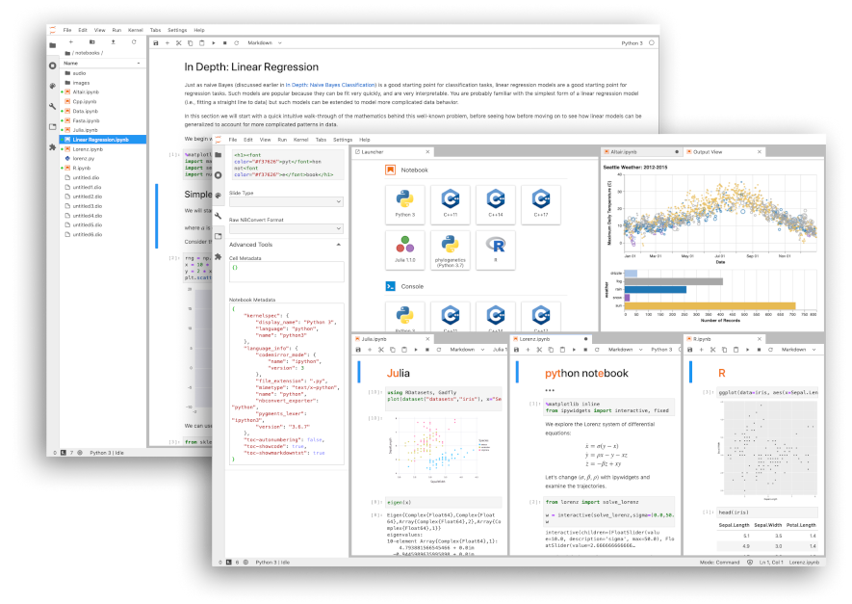
The Main Tool We Will Use: Python
In this course, we will cover some aspects of Python
The environment we will work in is called a “Jupyter Notebook/Lab”, and we will walk through one in class today.​
If you want more advanced Python knowledge when this course is completed, please consider CMSE 802
Good Resource: https://realpython.com
YouTube Channels: Socratica

Slide 18
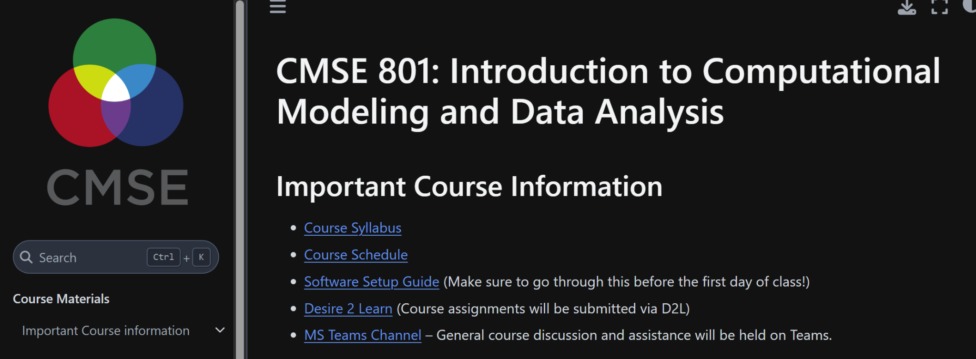
More info
The syllabus is available on the “Course Information” section of the course webpage​
You should have installed Anaconda on your laptops before coming to class today. You should also have received instructions for getting this set up via email. The “Software Setup Guide” is also available on the course webpage​
If you ever lose track of information for the course, you can also refer to the course website: https://msu-cmse-courses.github.io/CMSE801-S26

Slide 19
Questions???

Slide 20
Common Student Concerns​
I’ve never programmed before, fear of confusion
Most of your classmates have not programmed before either! This is an intro course and is designed to accommodate any amount of prior knowledge.​
Worry about keeping up, Concern about completion grades. Concern about quizzes.
You do need to do your best to keep up with the material. However, there will be regular office hours with TAs and professors. If you are having challenges that make it difficult to keep up with material, please reach out
How do I get help?
Come to office and help room hours, post in our section Teams channel, email/DM me
What resources do I have for class?
Important course content will be posted on the class website and, in some cases, D2L. Look at those resources first, but if you can’t find what you’re looking for, contact me!​

Slide 21




Coding Help

Slide 22
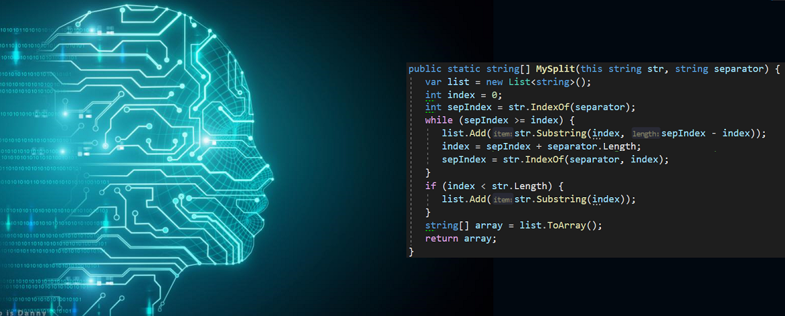
AI

Slide 23
Plan For Today​
DO NOT RUN YOUR CODE FROM THE DOWNLOADS FOLDER!
Downloading, using and submitting a Jupyter notebook​
Go to the Course Website​
Download the Jupyter notebook​
Read the notebook, answer everything in it, and submit the final notebook into the submission folder on D2L.​
NOTE: See “Downloading and Uploading Notebooks” on the course website for step-by-step instructions​
In-class activity: “Algorithms". Instructions are in the notebook.
You have randomly created groups for today. We will establish more permanent groups in a week or so.​

Slide 24
Time to get to work!

Slide 25
Do not forget !!!
Submit the survey
Submit Notebook to D2L
Day 02 Pre-Class Due Tomorrow at 5PM

