Slide 1
Getting Started with Python
Day 02 - CMSE 801
Prof. Mengsen Zhang

Slide 2
Pre-class Challenges & Questions
Finding the time and will power to do it.
Build a routine?
Getting survey to work
Can copy link to browser – same link for pre-class
Memorizing syntax
You just be able to quickly find it, use it more often like it’s a sport
Order of magnitude approximation (more next)
Variables and data types (more next)

Slide 3
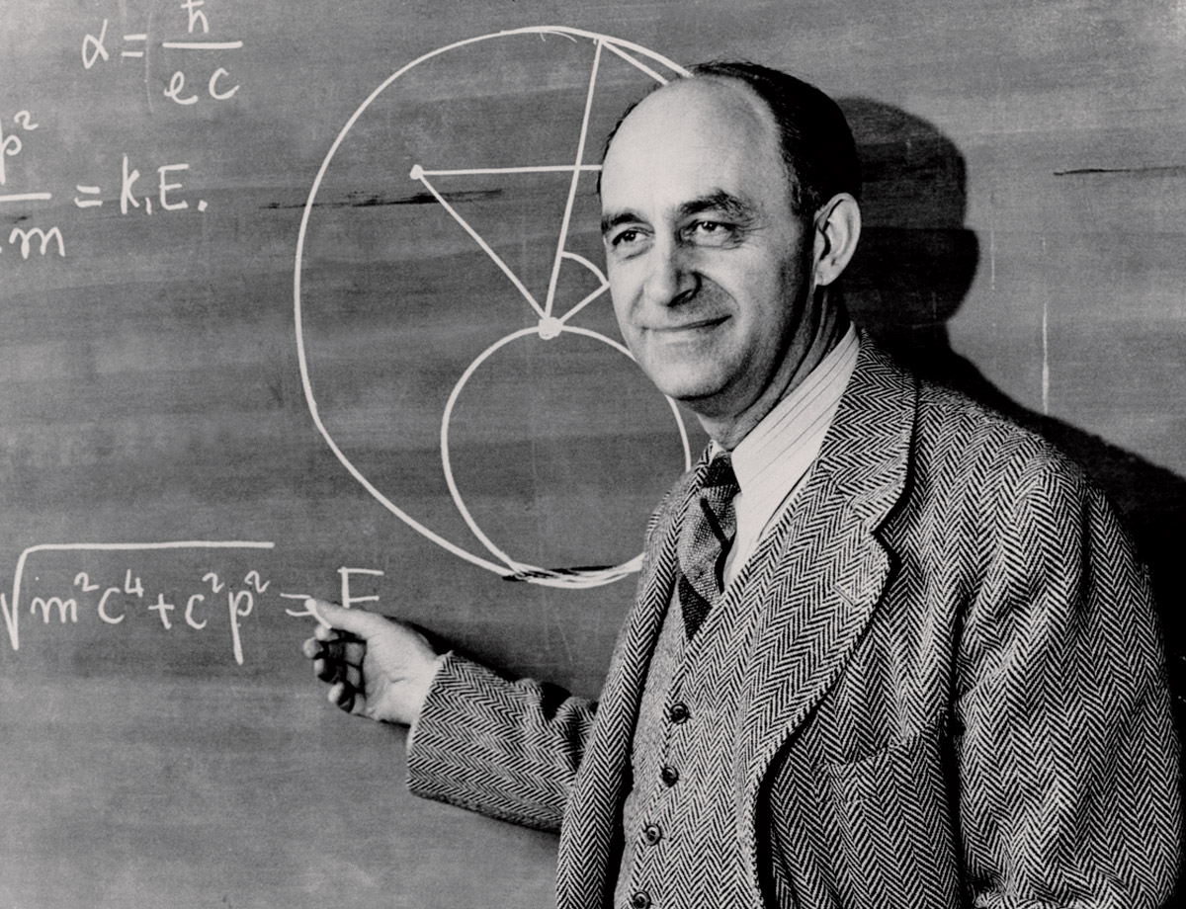

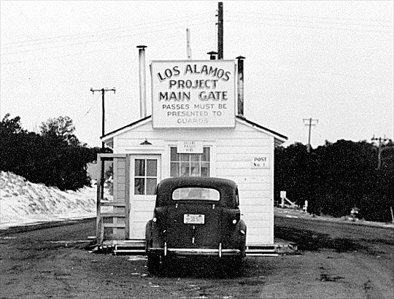
Fermi Problems/Estimates
Enrico Fermi was an Italian physicist who lived from 1901-1954, worked on the Manhattan project and won the Nobel Prize in Physics.

Slide 4
Fermi Problem
Modeling example
Helps you identify the important elements in your model and their interaction/relationships (take it apart and put it back together)
A “good enough” answer

Slide 5
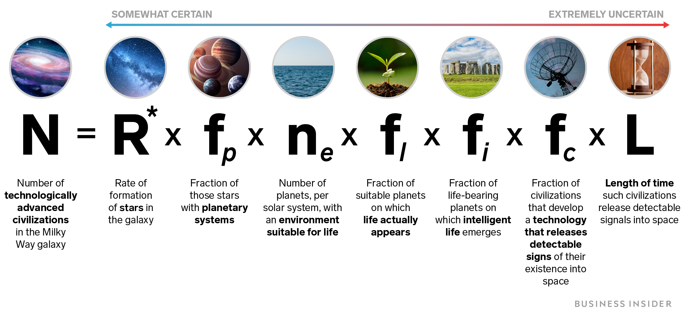
Example: Drake Equation
N ~ 50 Million!!!
Wikipedia

Slide 6

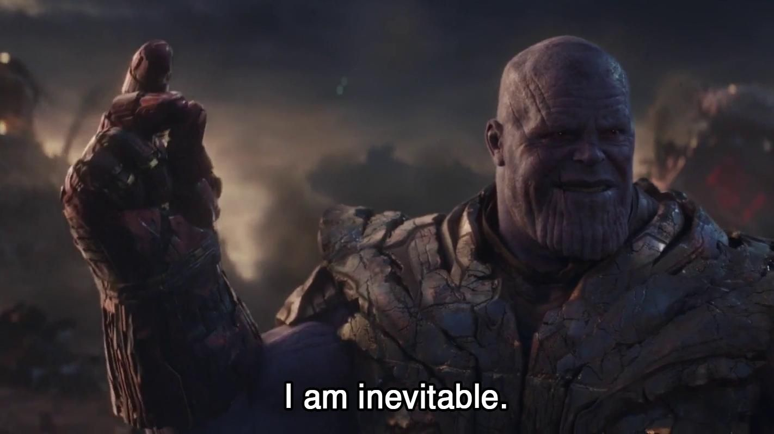
Where is Everyone?
Wikipedia

Slide 7
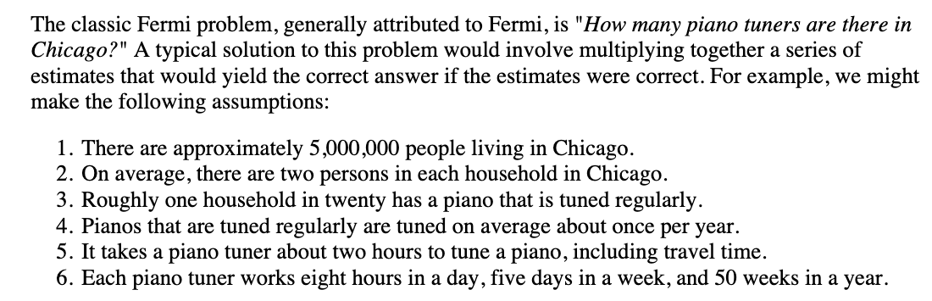
Another Example Fermi Estimate
How many piano tuners are there in Chicago?
Notes:
From these assumptions we can compute that the number of piano tunings in a single year in Chicago is: (5,000,000 persons in Chicago) / (2 persons/household) × (1 piano/20 households) × (1 piano tuning per piano per year) = 125,000 piano tunings per year in Chicago. And we can similarly calculate that the average piano tuner performs: (50 weeks/year)×(5 days/week)×(8 hours/day)×(1 piano tuning per 2 hours per piano tuner) = 1000 piano tunings per year per piano tuner. Dividing gives: (125,000 piano tuning per year in Chicago) / (1000 piano tunings per year per piano tuner) = 125 piano tuners in Chicago.

Slide 8
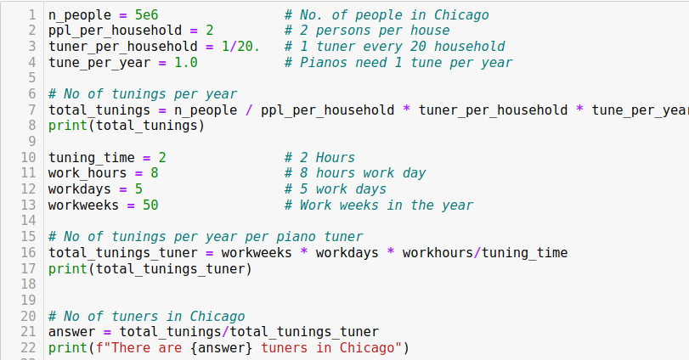
Put that into code

Slide 9
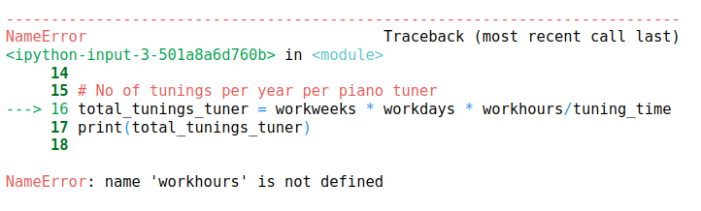

Embrace the Error Messages!
The good news about computers is that they do what you tell them to do. The bad news is that they do what you tell them to do.

Slide 10
Today’s In-Class Assignment
Form Groups of max 4 People
Download the Jupyter notebook for Day 02 In-Class Assignment from the website
Make sure it is running on your computer, and help the people around you.
Assign problem to each group
Share out at 9:40 am

Slide 11
Do not forget !!!
Submit the survey
Submit Notebook to D2L
Day 03 Pre-Class Due Monday at 5PM

