Slide 1
Assessing Image Quality

Slide 2

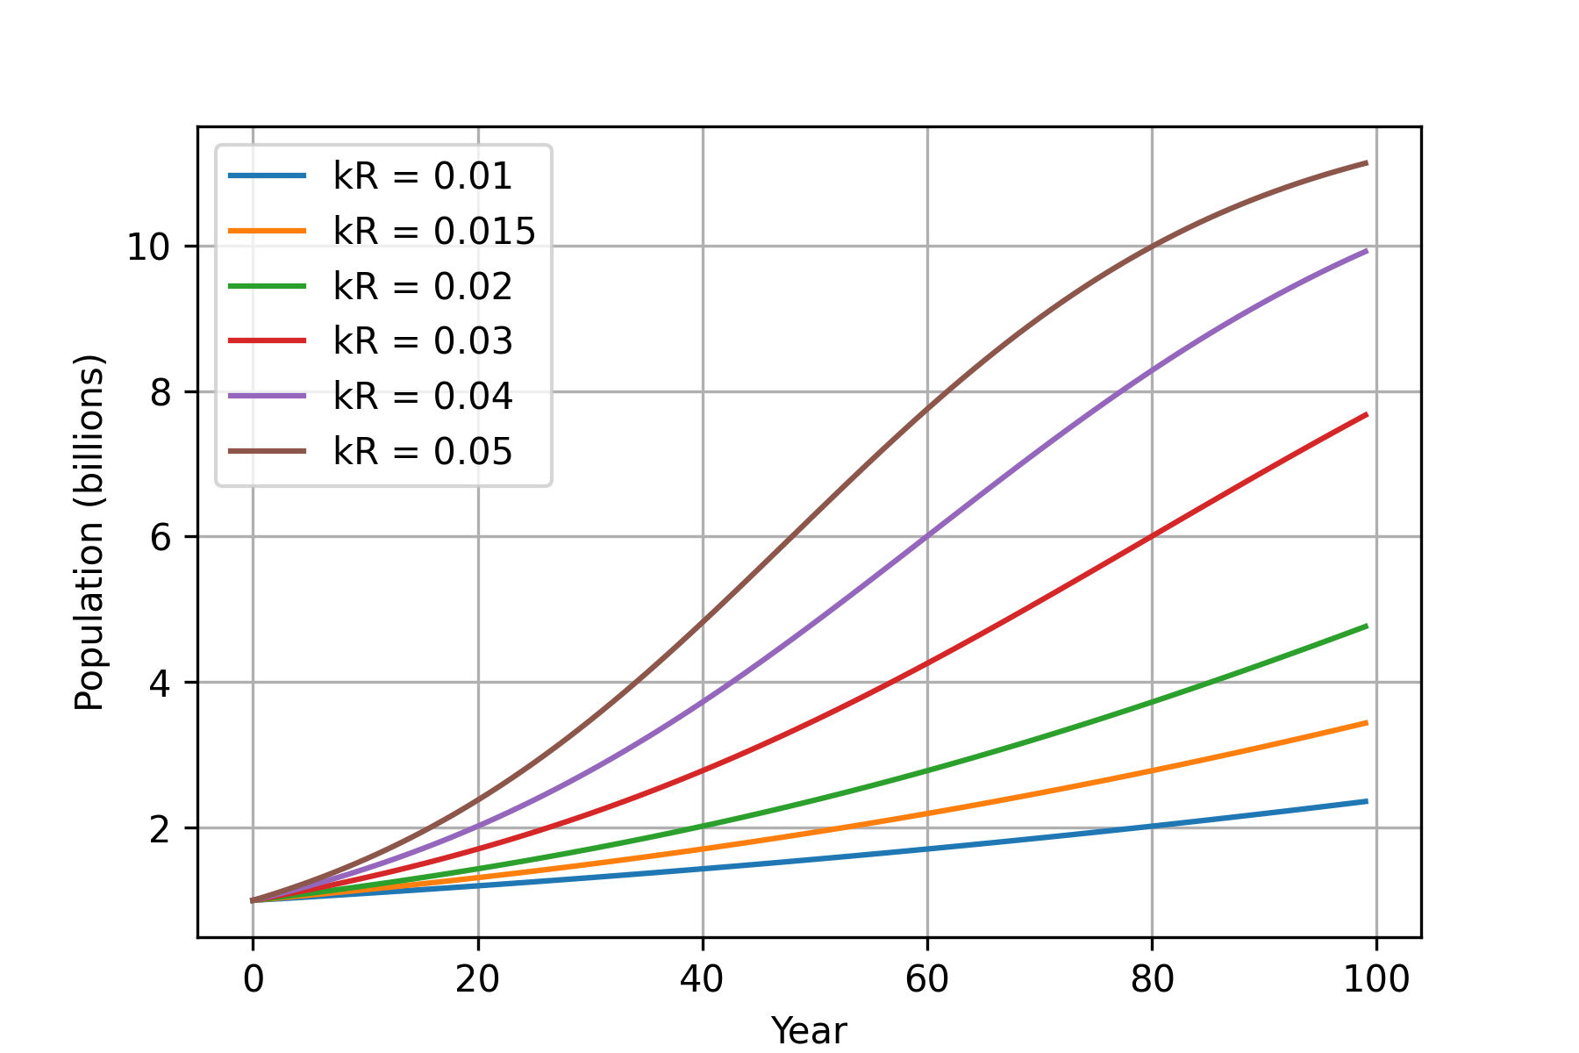
Figure 1a
Figure 1b

Slide 3
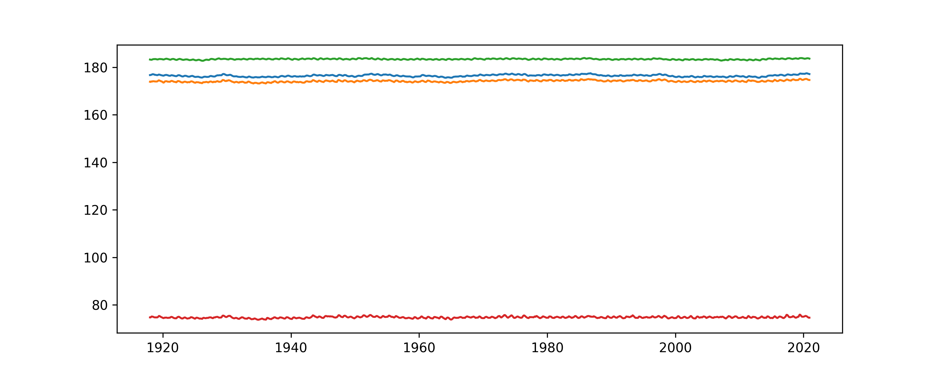
Figure 2b
Figure 2a

Slide 4
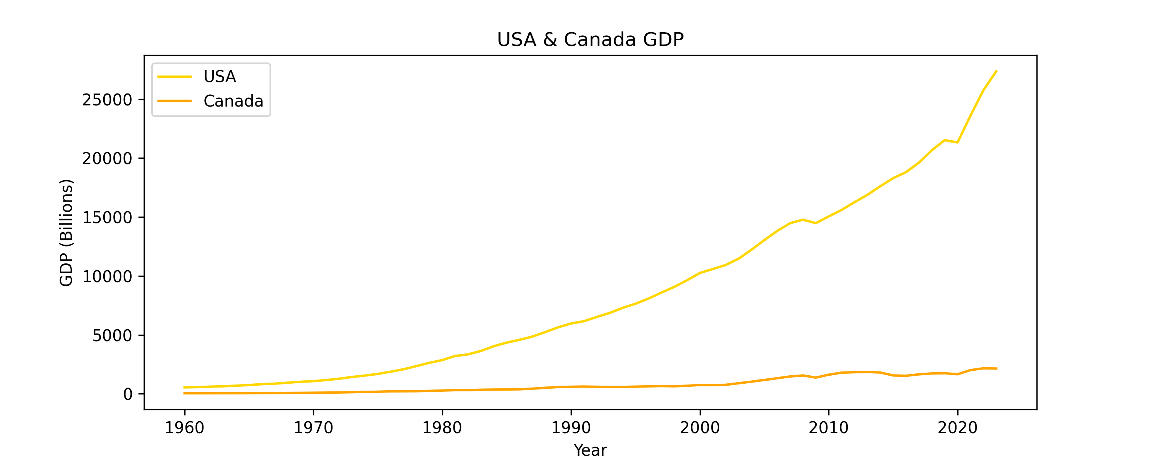
Figure 3

