Slide 1
Proximity Sensor
Alex Deadmond

Slide 2
Project Description
Sense an object and the distance away with an echo sensor
Set the mode for too close, too far, or closeness
Buzzer sends alarm depending on mode
LED bar fills up as object gets closer
Indicator LEDs show which mode it is in
Could be useful when backing up without much visibility

Slide 3
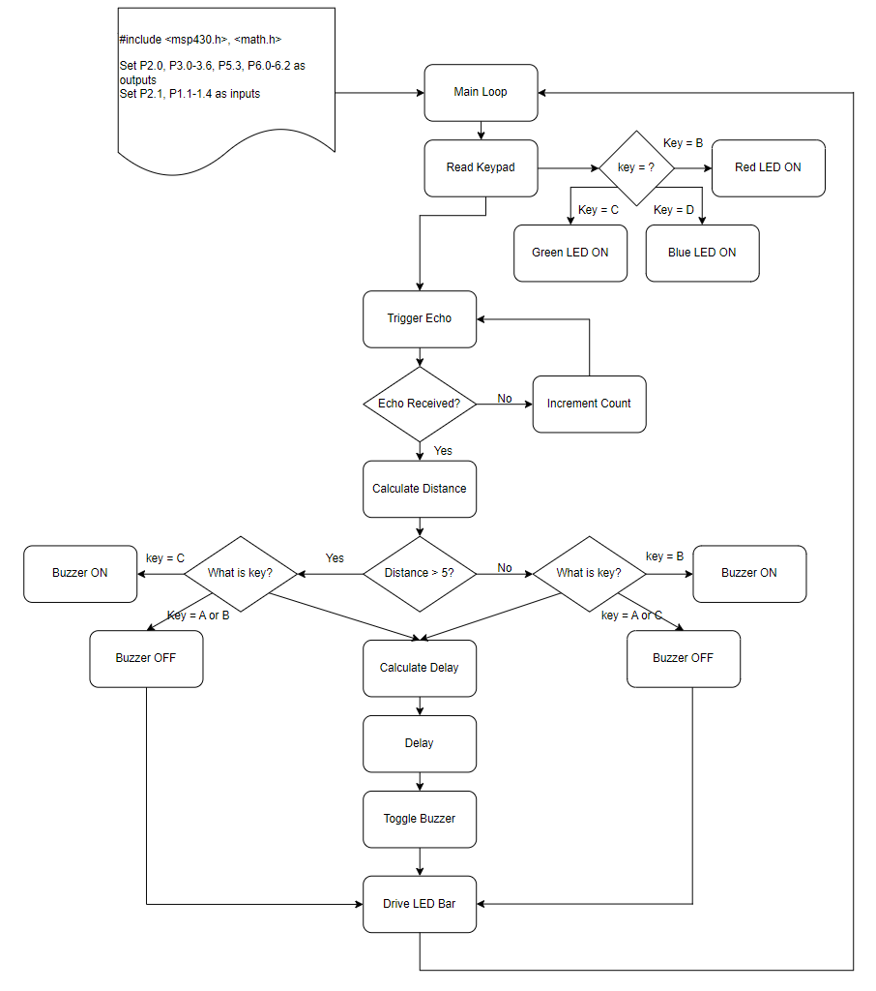
Flowchart

Slide 4
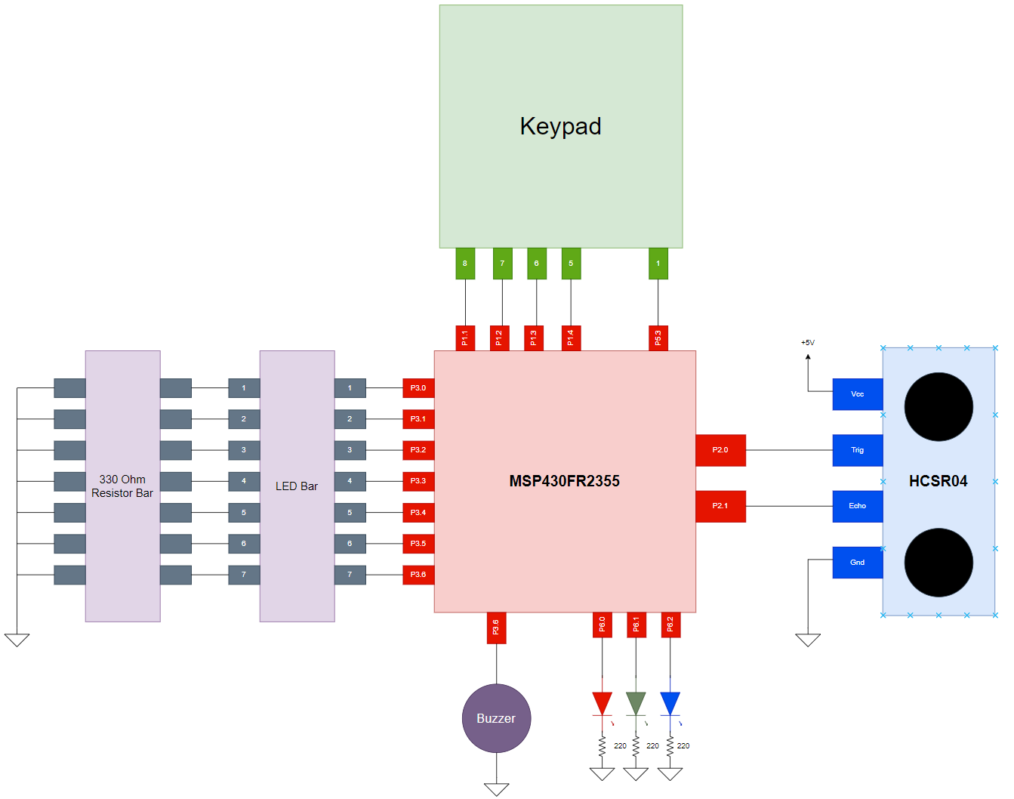
Circuit Diagram

Slide 5
Demo

