Slide 1
Mini Tetris with an MSP430
Jay Graham

Slide 2
Project Overview
Goal
Create a playable version of Tetris on an embedded system using the MSP430FR2355 microcontroller
Hardware
MSP430FR2355 microcontroller configured as I2C master
16x8 LED matrix configured as I2C slave
OLED display configured as I2C slave
Analog joystick and pushbutton
Software
Game logic runs on a timer interrupt for regular block falling
2D array tracks the game fields to identify block collisions and when row to clear rows
ADC samples joystick input to move blocks left and right
I2C used to update both LED matrix and OLED to display game field and messages

Slide 3
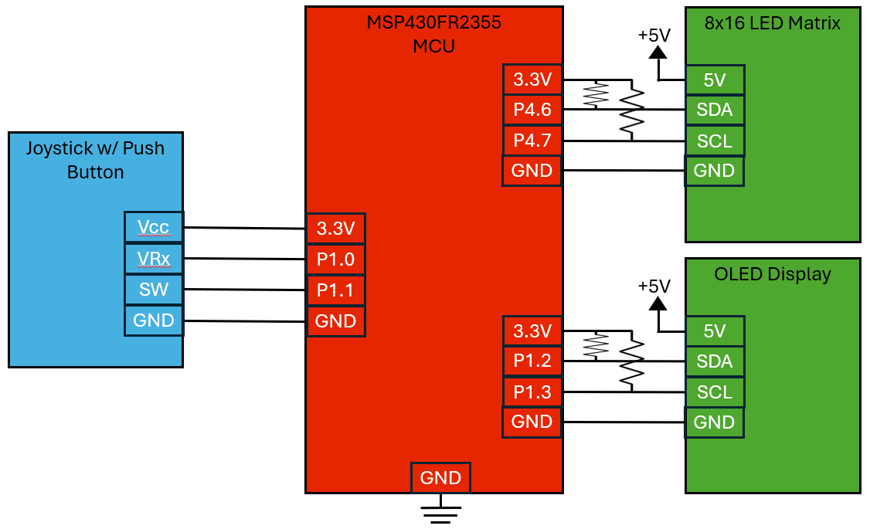
Circuit Diagram

Slide 4
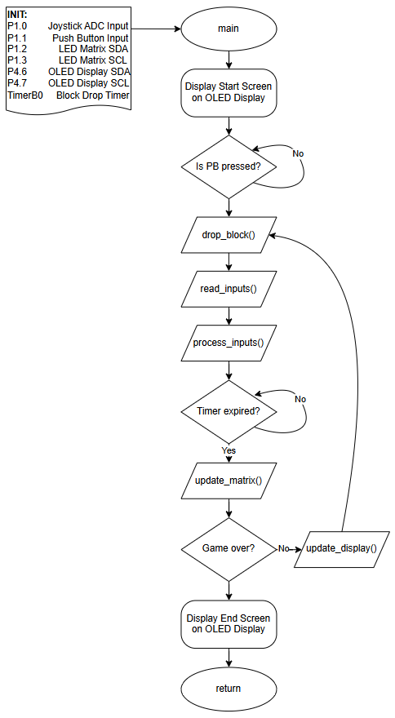
High-level
Flowchart

Slide 5
Game Features
Game Features
Game starts when players press the joystick and blocks begin falling
Fall rate and score are based on level, which is increased by clearing rows
Blocks are moved left and right with the joystick
Blocks stop at the bottom and filled rows are identified and cleared
Game ends when matrix is filled to the top
Differences from Real Tetris
Currently only uses single blocks
No rotations
No hard drops

Slide 6
DEMO

