Slide 1

EELE 465 Final Project: Text Editor
Erik Moore
05/06/2025

Slide 2
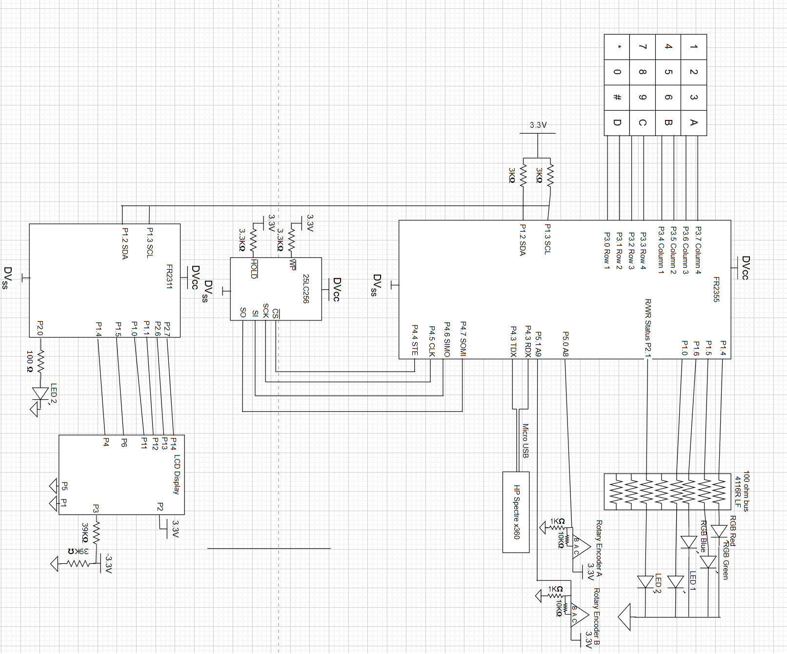
Circuit Diagram:
For this project, in addition to previous labs, I incorporated a 25LC256 EEPROM module with SPI (mode 1,1) communications to store the bulk of my text file data, an LED to notify the user when communication occurs with the EEPROM module, rotary encoders for easier control over written data and file navigation, and UART reads and writes to individual load formatted files to the system, or to send the bulk of the data to the laptop.
Note: in reality, rotary encoder B uses 2x 1K ohm resistors, as the A9 ADC reader (in practice) sinks far more current than anticipated.

Slide 3
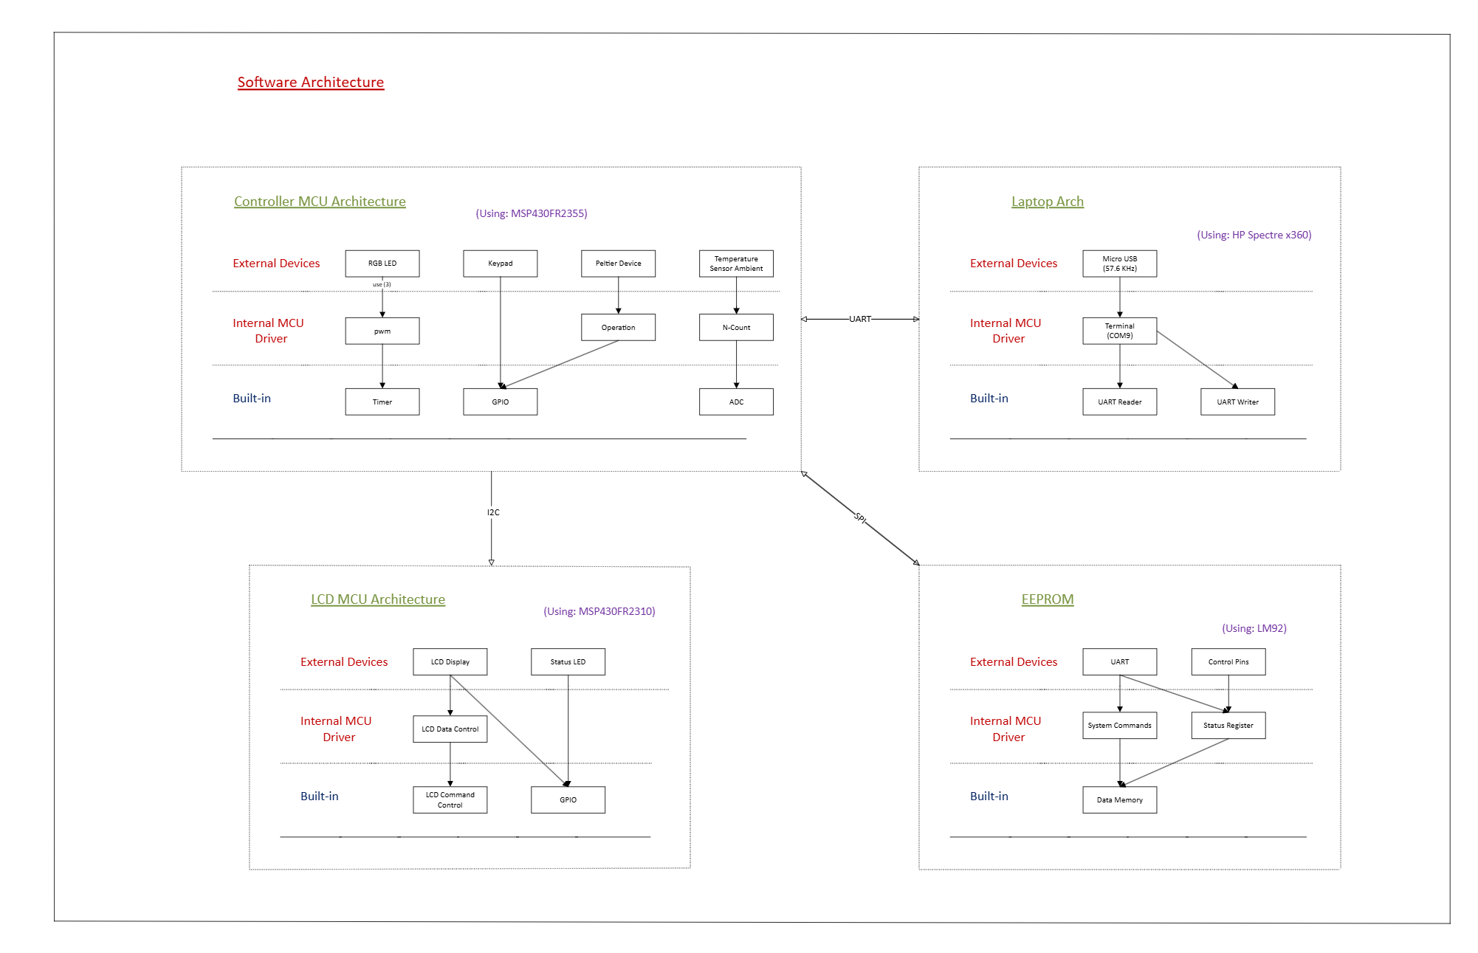
System Architecture Diagram:
Digital Encoders
EEPROM Status LED
Digital Encoders
States
EEPROM Actions
States
This system architecture diagram provides a broad overview of the communication structure between devices, as well as the methods used to control system operations.
The digital encoders use a state-like system to determine when it is appropriate to listen for certain user input, and when it is time to wait for a return to a neutral position. This results in near-perfect operation.
(using: 25LC256)

Slide 4
Code Overview: Startup
The system initializes all relevant GPIO and timers
The system initializes SPI in 4-pin mode, with active high clock and data with active low chip-select, in setting (1, 1)
The system initializes UART at BAUD rate 57.6 KHz such that it can be seamlessly toggled between Rx and Tx modes
The system initializes I2C communications such that it can communicate in a write mode to the MSP2311
The system enables interrupts and initializes the EEPROM to disable all write-protection functionality
MSP2311:
The system initializes as an I2C slave device for the MSP2355
The system initializes all relevant GPIO to perform all relevant operations on the LCD display

Slide 5
Code Overview: action select
The LCD display constantly shows the user’s last action
The user may select any option 1 through 9 to select an action to perform. These include:
1. Create File 2. Edit File 3. View File 4. Allocate Memory to File
5. Rename File 6. Delete File 7. Bulk Send Files to Laptop
8. Receive File From Laptop 9. Update Default Writing Character
Additionally, the user may lock the system from this program location by pressing D, regardless of the previous action. The user must then unlock the system by again pressing D and entering the appropriate 4-character pin.

Slide 6
Modes: File Creation, Editing, Viewing
In file creation, the user must initialize a file name, utilizing rotary encoder A (REA) to select their character, and rotary encoder B (REB) to iterate through positions. Additionally, the keypad has enabled shortcuts to allow quick access to certain character indexes. The user creates the file by pressing the ‘*’ key. Both the file name and the file contents are initialized with repetitions of the default character. The file name is always 16 total characters. The user may save the file with ‘*’.
In editing and viewing modes, the user must use REB to iterate through file names, and the ‘*’ key to select the file. The desired file is then loaded from memory.
Editing mode has the same functionality as file creation, but viewing mode re-purposes REA to iterate through lines instead of characters. This makes reading file contents far more seamless
Files are always seen 32 characters at a time, and scrolling past the bottom-right or the top-left characters loads the following or previous 32 characters onto the display, respectively. It is extremely intuitive. The screen must be refreshed to initially display any file contents. This requires the user to turn REB backwards (counter-clockwise) and then forwards (clockwise) again.

Slide 7
Memory Allocation, Renaming Files, File Deletion
The program enters file selection mode. Once a file is selected, the chosen mode if formally entered
In memory allocation, the user used REA to select a new allocation size at least as large as the previous, but no larger than 16. Files are created with a default size of 2 (128 B). Each size increase corresponds to 64 Bytes. Newly allocated memory is initialized with the default character. This requires 2 loads and one send from EEPROM.
In file re-naming, the existing name is loaded, and the user must update the name (or not) and confirm with the ‘*’ key
In file deletion mode, the user selects a file name. That file name is updated to all D’s (trivial), and the size is updated to be 19, which is interpreted as non-existent from all user perspectives, but enables tracking of free memory.
File allocation is always done by incrementing the next available location by 64, and saving that location in an array corresponding to that file. All file data is stored in arrays, and file information is tracked with a corresponding character index. Up to 32 files may exist.

Slide 8
File sends and receives, Default Character selection
For file sends, the user presses the ‘7’ key. These files are formatted as 1) file contents ~ 64 * file size characters 2) spacer character 3) file name ~ 16 characters 4) file size ~ one character size + ‘0’ so that they always appear in the terminal 5) terminating character. These files may be loaded back to the system (one at a time) using this format. They are not removed from the system upon sending.
For file receives, the system expects files in the correct format. If the format is correct, the file is loaded into the system. If not, the user may expect undefined behavior.
Whenever file contents is loaded to the MSP2355 for any reason, it is stored in a global character array size 1045. This array being multi-purposed is crucial for maintaining maximum FRAM availability on the device. This specific size enables the full format for UART sends and receives of a file of complete size, as well as a few spacing characters.
Character selection involves the user iterating through characters as normal and with DEA, and pressing ‘*’ to confirm

Slide 9
File Loads and Sends from memory
Files are loaded from and sent to memory in arrays of size 64. This is the page size, one memory location.
For writing one page, the system must first always set the write-enable-latch (sending command 0x06), then, the CS line must be re-asserted
For reading or writing, the system must send the correct command (0x03, 0x02 respectively)
Immediately following the command, the system must continue sending clocks and a 16-bit address.
Following the address, the system either sends clock pulses (read), or clock pulses along with corresponding data (write). This cycle is repeated until all corresponding file address locations (exact number recorded as file size 2 through 16) are iterated through. The file is loaded to or from the 1045-length currentFile character array.

Slide 10
Demonstration:
Please be patient, I would really like to show you everything.

