Slide 1
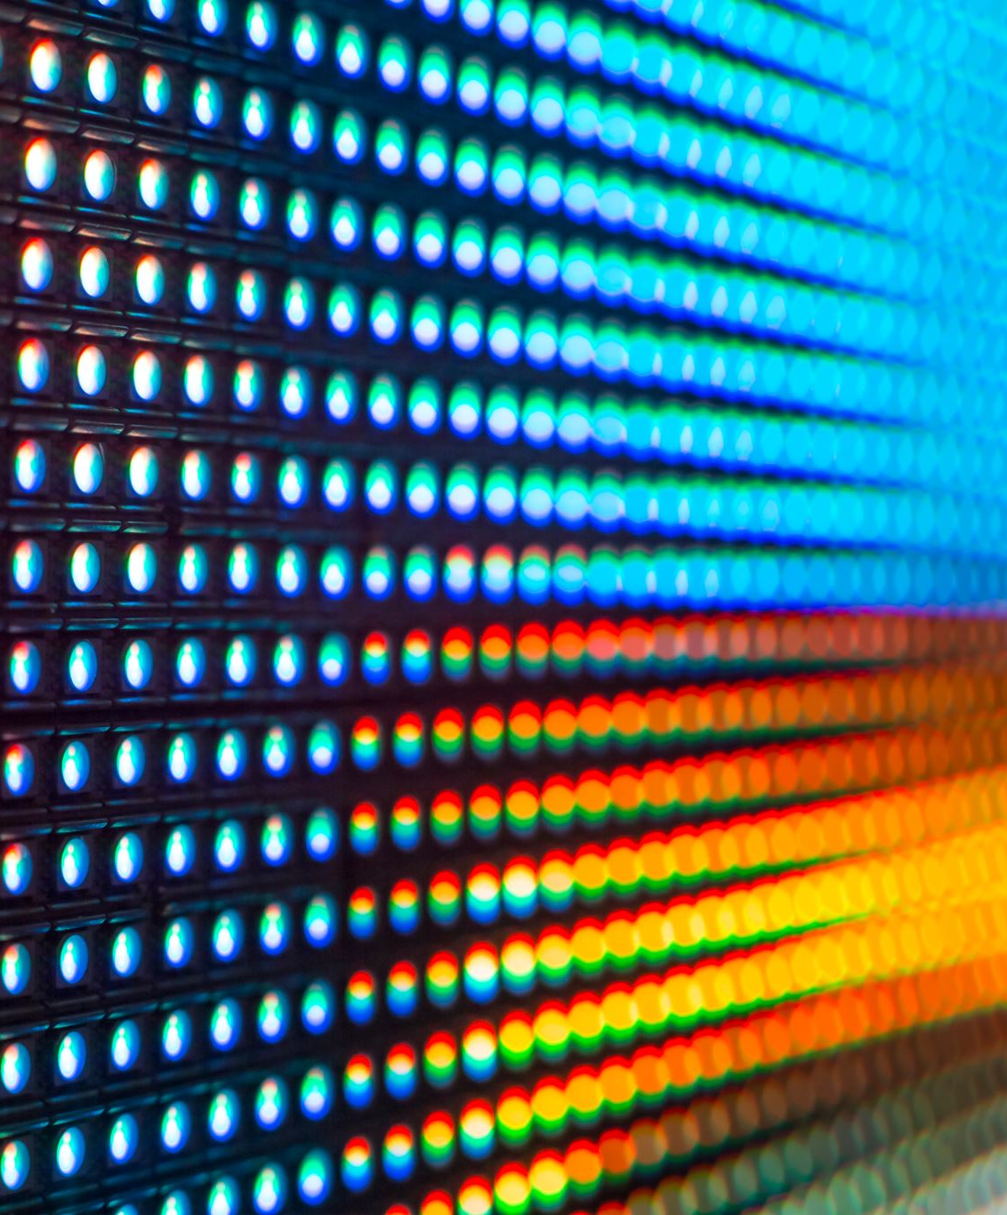
RGB Digital Dial Board
Beau Coburn

Slide 2
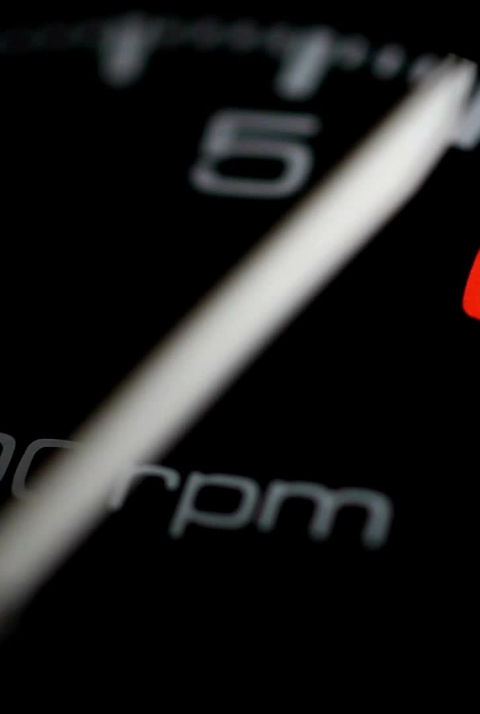
Overview/Background
What is a dial board and what is it used for?
Utilize a 64x32 RGB Matrix Display
Allow user to set a three digit dial in
Allow user to change color
Allow user to toggle state of Dial Board
Show user dial board specs in car

Slide 3
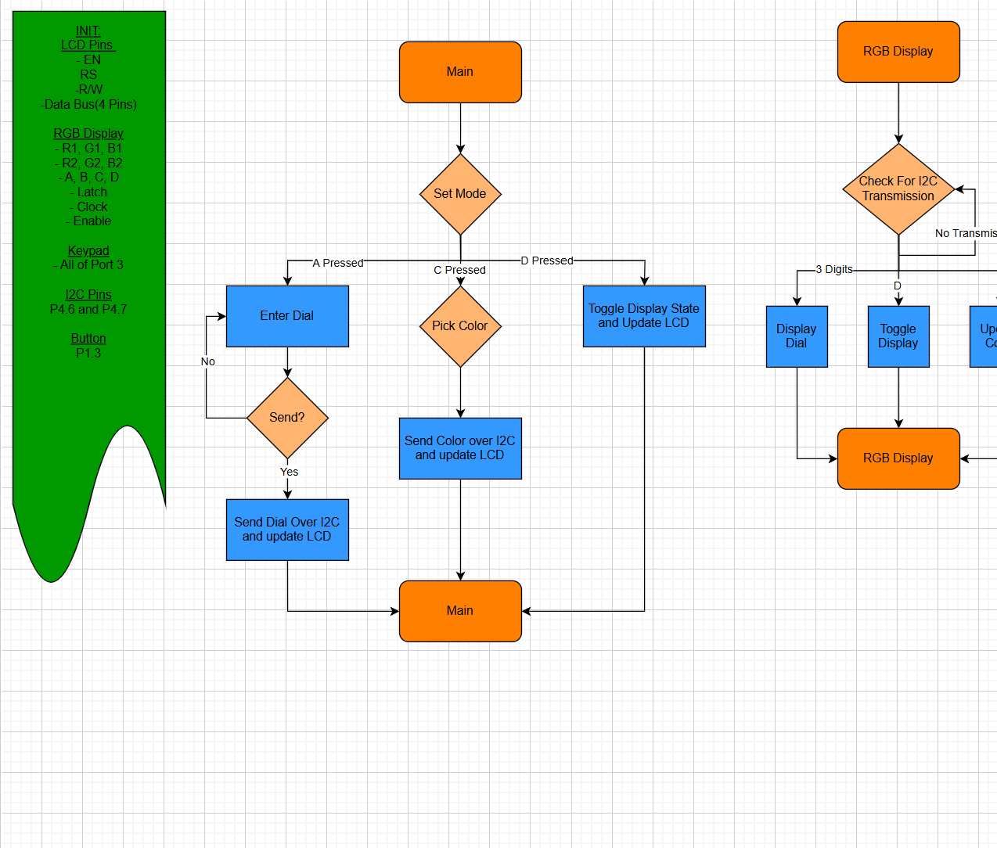
Code Flow

Slide 4
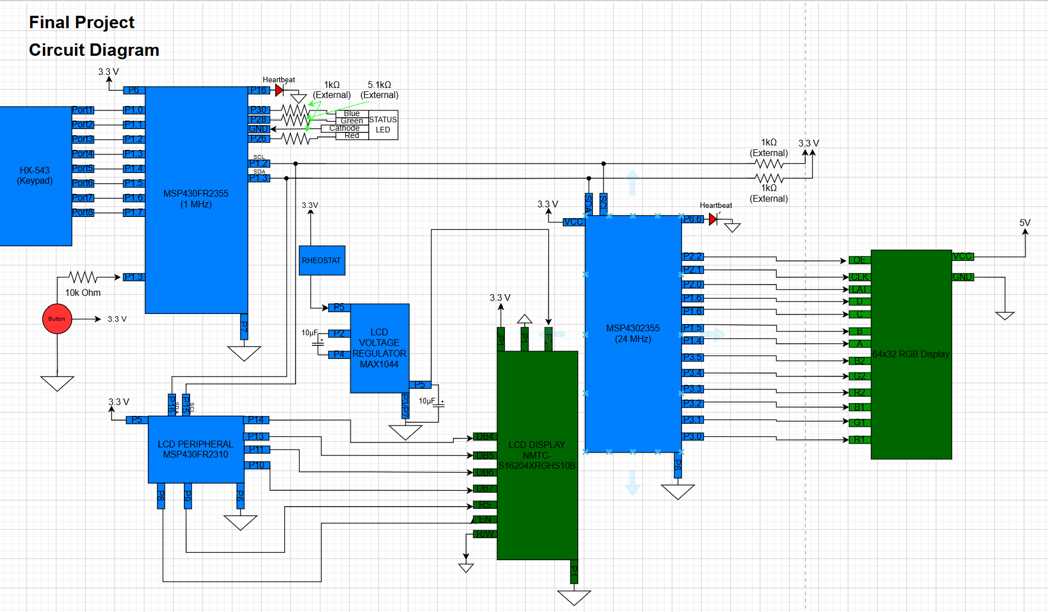
Circuit diagram

Slide 5
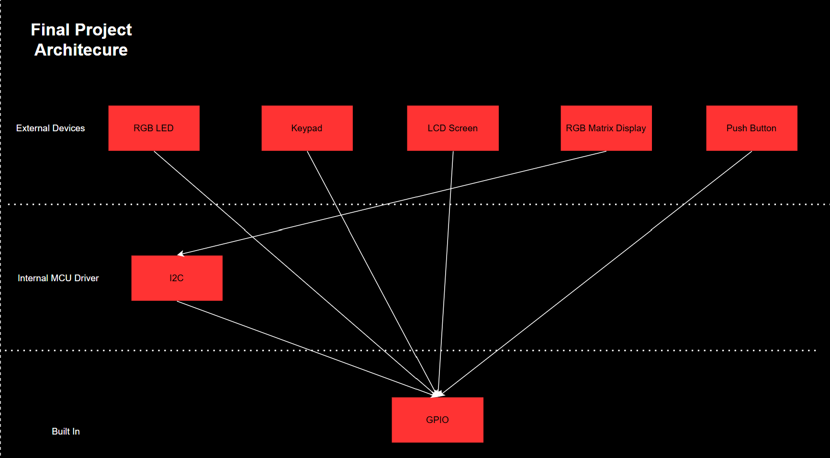
System Architecture

Slide 6

How the RGB Matrix Display Works
Utilizes Shift Registers
Evaluates what the state of each pixel on the display should be
Goes row by row
Will “shift” to the next bit in the desired data being pushed in
Color for the pixel determined (RGB)
Only one row can be on at a time

Slide 7
Road Blocks and Failures
MSP4302355 Not able to run fast enough
Only small numbers can be mustered
Unable to get IR receiving working
No Cool pictures or designs

Slide 8

Final Product
User Controlled RGB Digital Dial board!
Any combination of a three digit number
Color Control
State Control
Both in and outside the car

