Slide 1
Options Price Calculator
Ben Weizenegger

Slide 2
Goal
Create interface to input different parameters and calculate stock option price
Display those parameters, and calculation to the user
Display a “Buy” or “Sell” signal

Slide 3
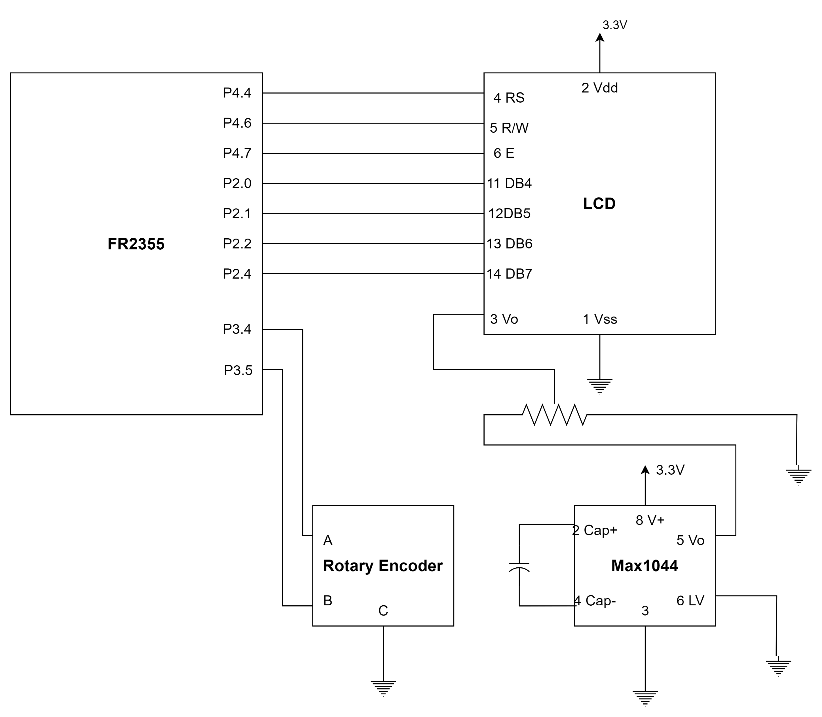
Circuit Diagram
FR2355 as master
LCD
Display option parameters
Rotary Encoder
Adjust parameters
Keypad
Select parameters to adjust
LED Bar as slave
Display difference between expected vs market

Slide 4
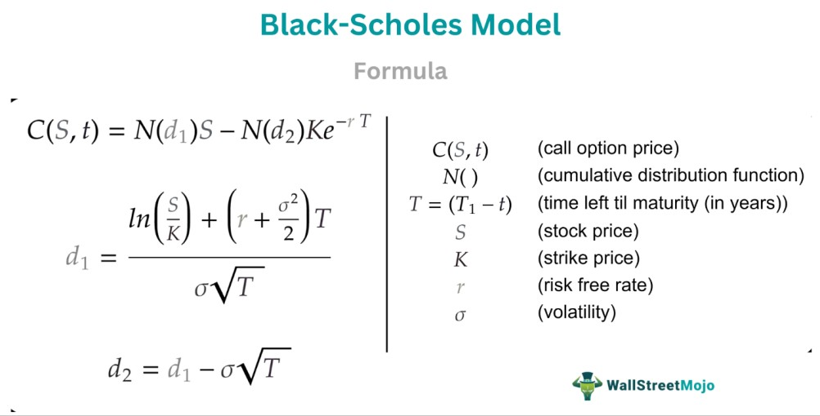

Black-Scholes Model
N()

Slide 5
What Works?
Black Scholes model surprisingly accurate to online calculators
LCD and Rotary Encoder work well
What doesn’t Work?
LED bar not accurate

