Slide 1
Sound Triangulation
Gabriella Lord

Slide 2
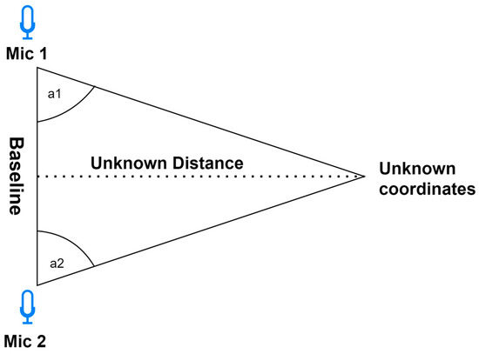
The Goal

Slide 3

The Goal
Cross correlation: measure of similarity between two waveforms
Calculate Delay between microphones
Normalize Delay [-1, 1]
Calculate AOA using Taylor Series Approximation
$\frac{π}{2}−x−\frac{x^{3}}{6}+\frac{3x^{5}}{40}+O\left(x^{7}\right)$

Slide 4
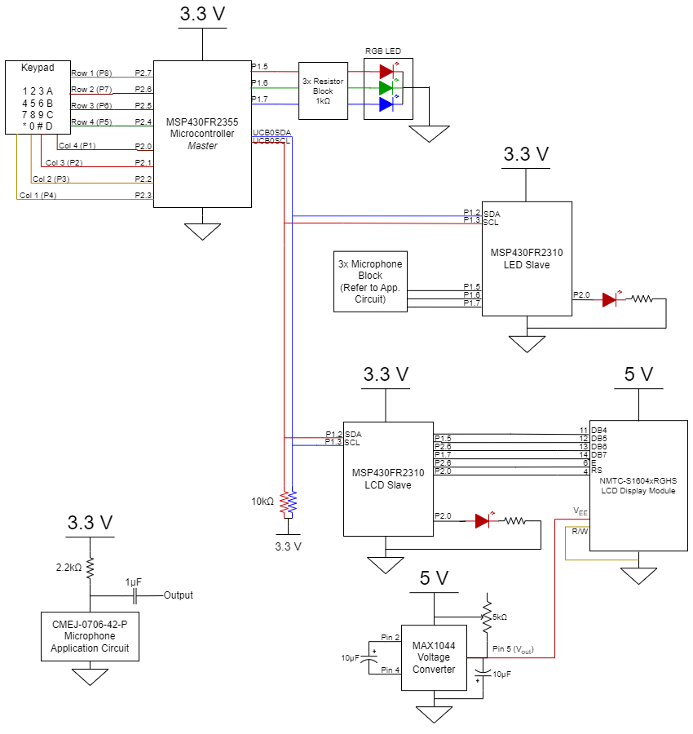
Circuit Diagram

Slide 5
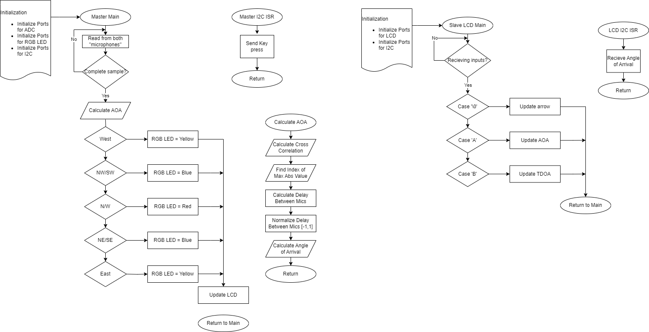
Flowcharts

Slide 6
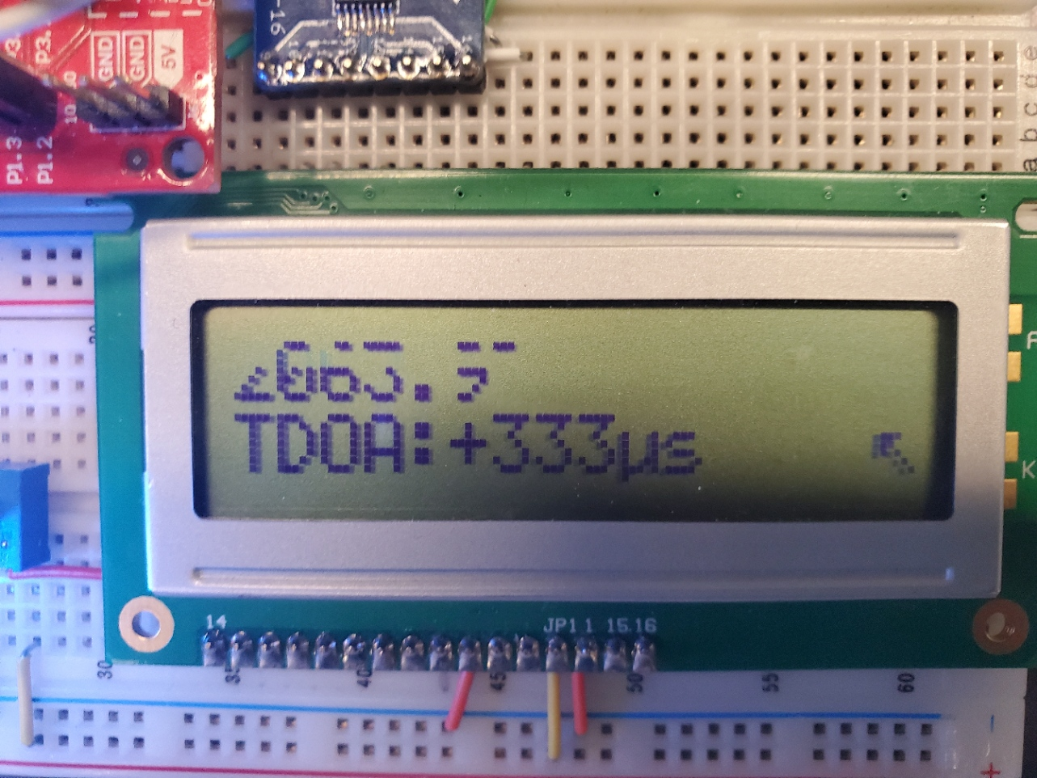
Demo

