Slide 1
Sound Triangulation
Gabriella Lord

Slide 2
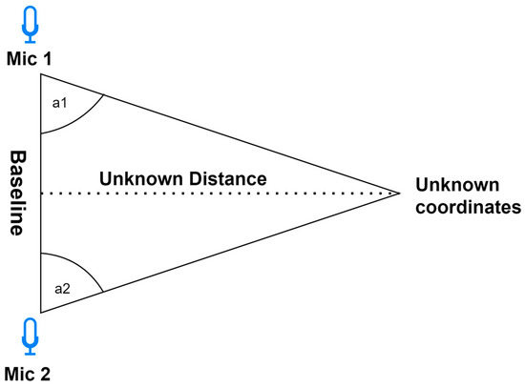
The Goal

Slide 3
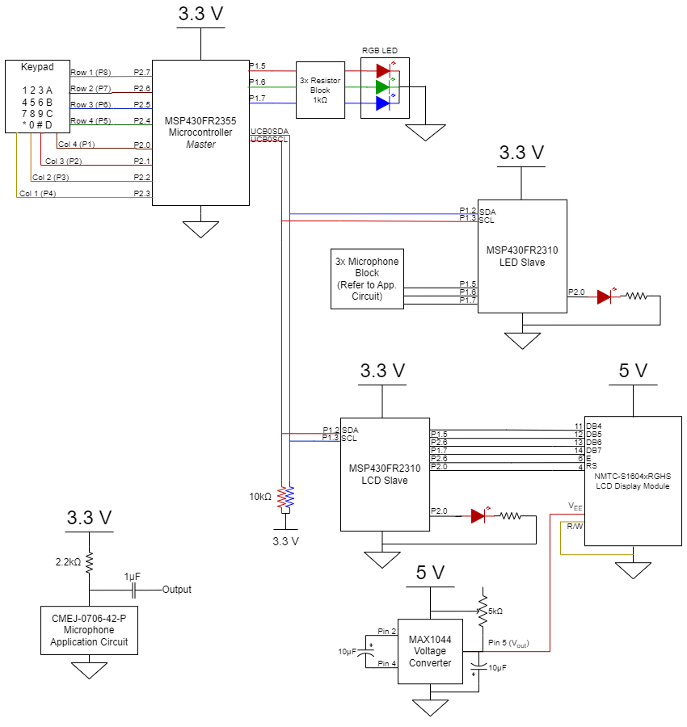
Circuit Diagram

Slide 4
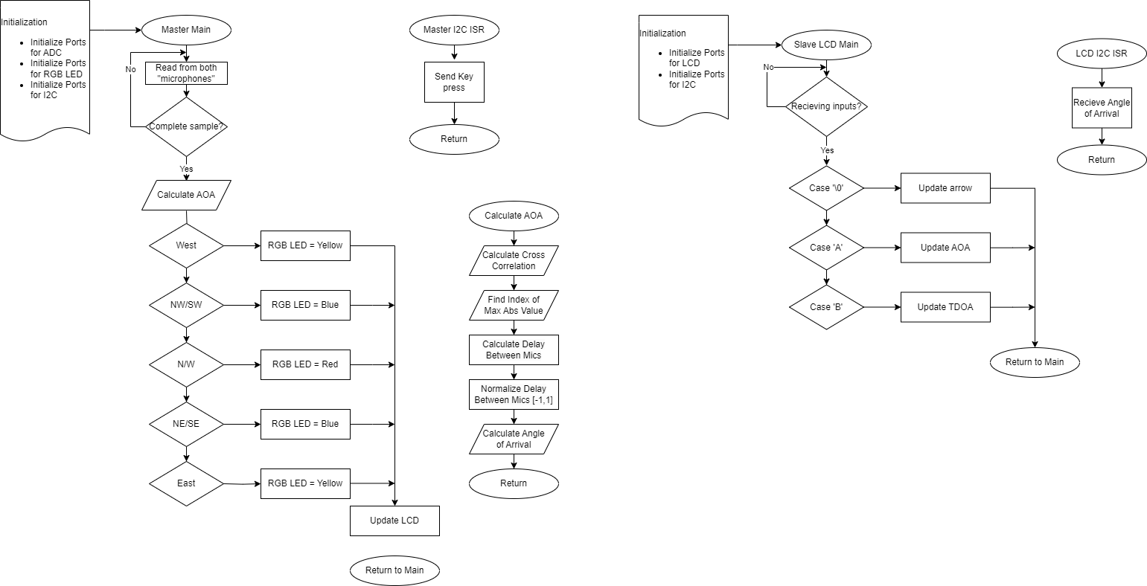
Flowcharts

Slide 5
Demo

