Slide 1

Project 1 – Heartbeat
By: Sebastian Carpenter

Slide 2
Introduction
LED flash with polling
LED flash with interrupt
Flash at 0.5 Hz
Ideally, it should be modular

Slide 3
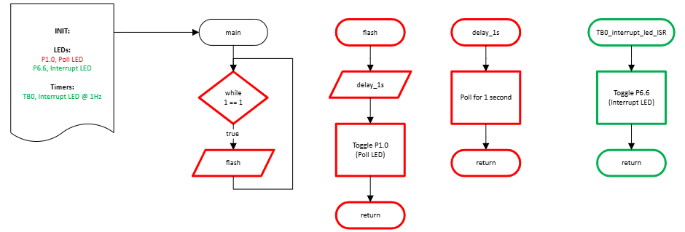
Flowchart (polling and interrupt)

Slide 4
Poll LED
Created inner loop of roughly 1ms (for fine tuning)
154h = 340d
Created outer loop of roughly 1s (coarse tuning) [1027d]
1027d
Total operations = 349180

Slide 5
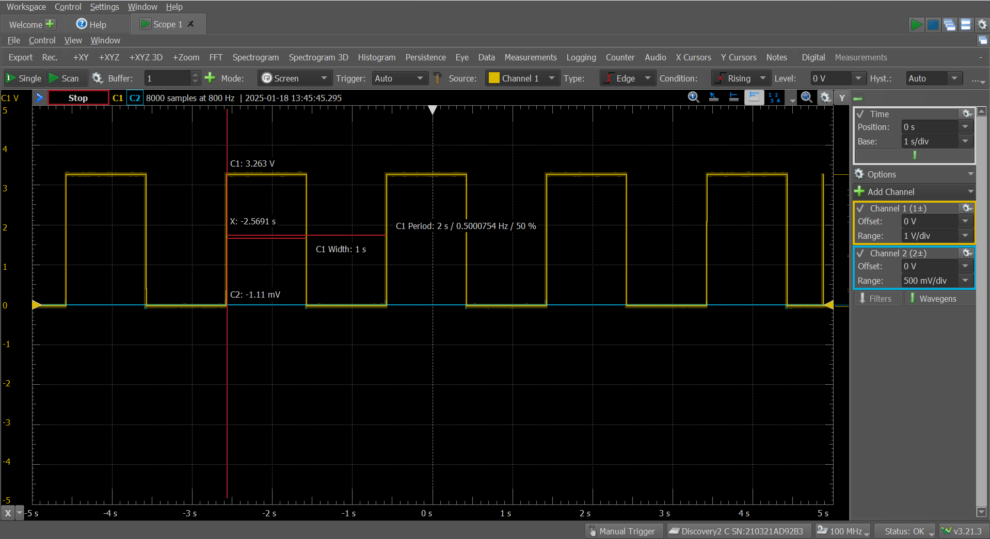

Slide 6
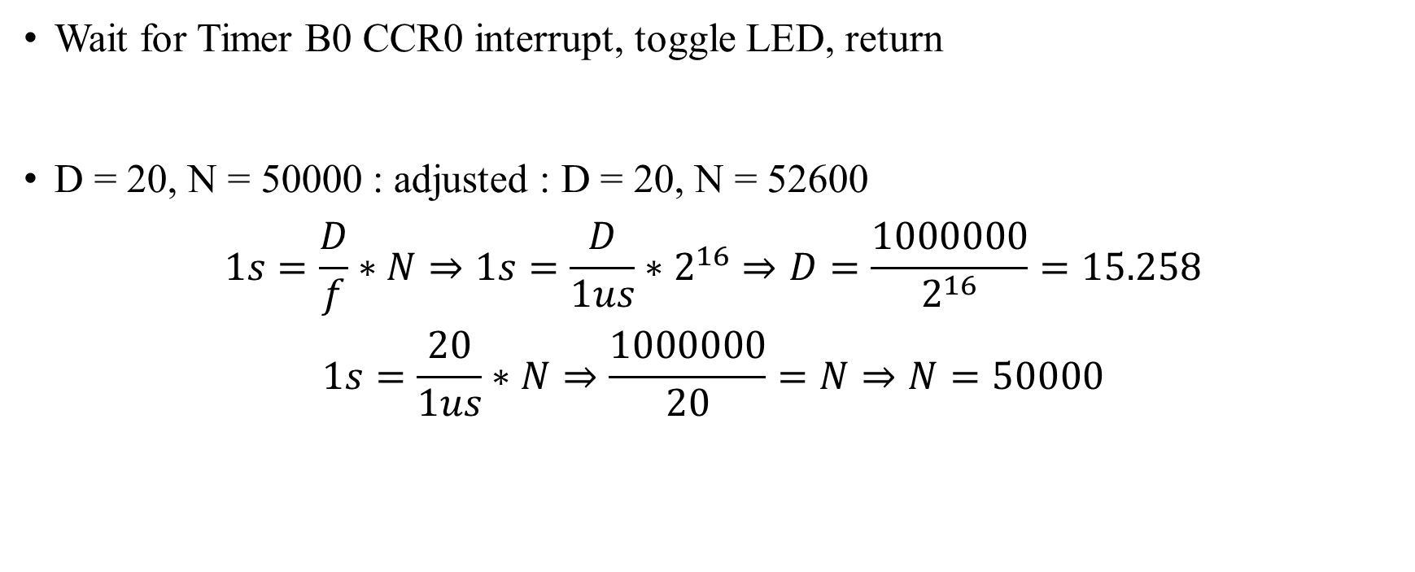
Interrupt LED
Wait for Timer B0 CCR0 interrupt, toggle LED, return
D = 20, N = 50000 : adjusted : D = 20, N = 52600
$$1s=\frac{D}{f}∗N⇒1s=\frac{D}{1us}∗2^{16}⇒D=\frac{1000000}{2^{16}}=15.258$$
$$1s=\frac{20}{1us}∗N⇒\frac{1000000}{20}=N⇒N=50000$$

Slide 7
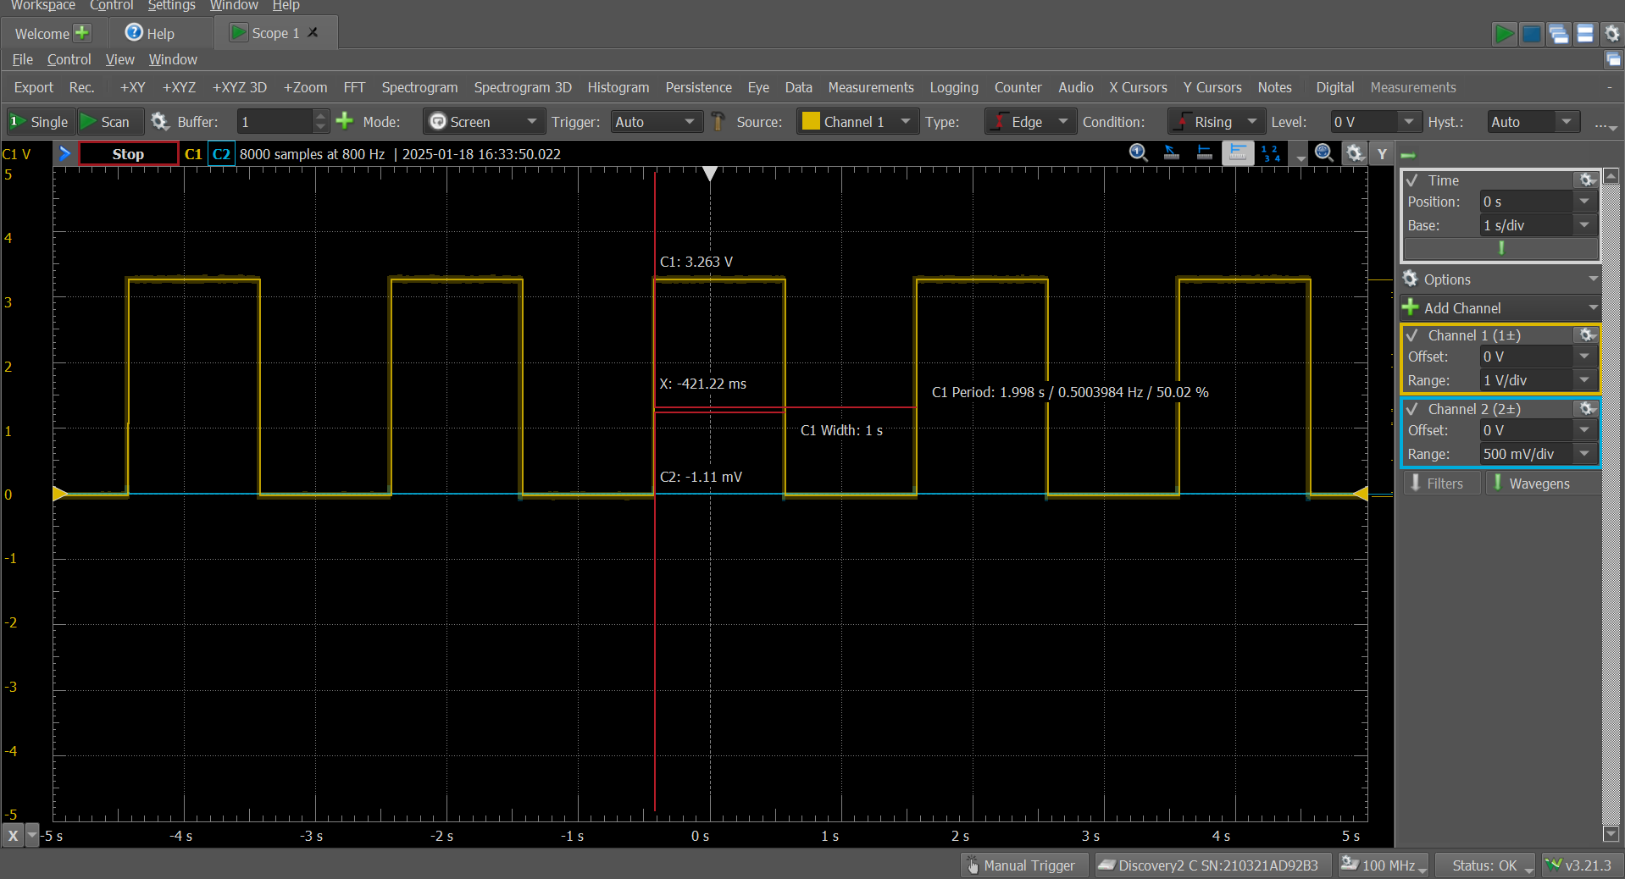

Slide 8
Polling vs Interrupt
Polling
Simple
Slow to respond
Interrupt
Complex
Fast to respond
Occurs periodically
Wasteful
Inexpensive
Could be difficult to time

