Slide 1
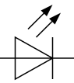
Buckley Jenson Project 2
5V
3V3
MSP430
VCC
PCF8523 Breakout
GND
VCC
SDA
P1.2
SCL
P1.3
P1.0
Led 1
Led 2
GND

