Slide 1

Project 3: Keypad and LED Patterns
Aaron Foster & Beau Coburn

Slide 2
Overview
Create a lockable system dictated by a 4x4 keypad
Drive an RGB LED to indicate the status of the system
Drive LED patterns based on input from the keypad
Alter the speed of the LED patterns based on an input from the keypad
Switch between the patterns and return to the place where they left off

Slide 3
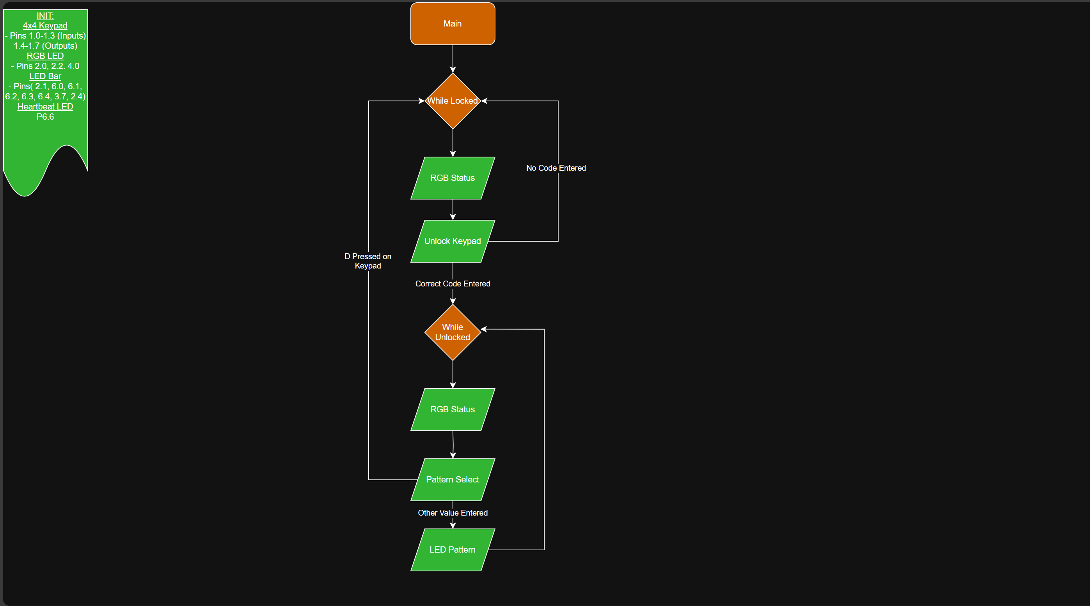
Code at a Glance
Main Loop Flow Chart

Slide 4
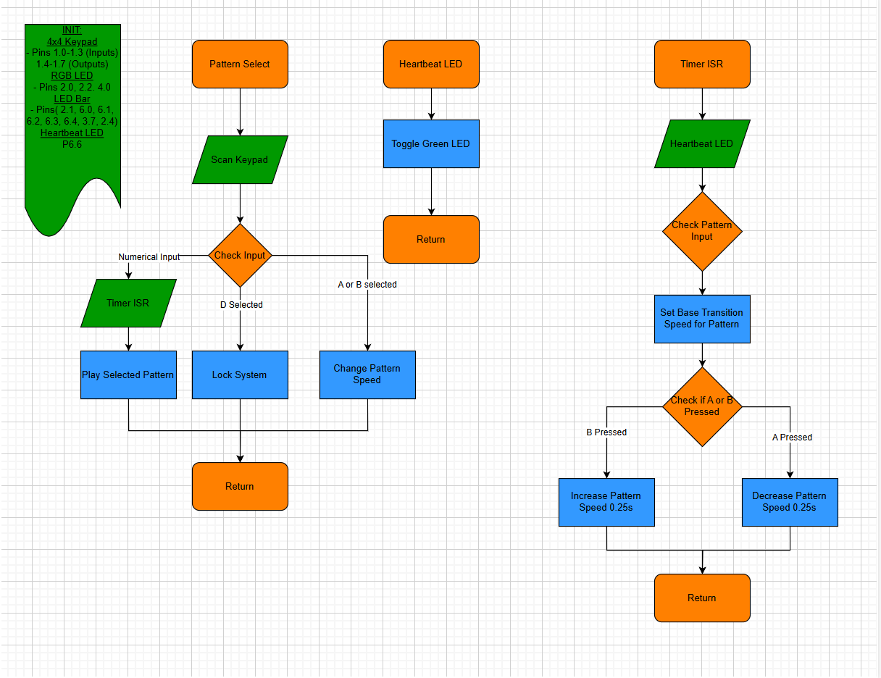
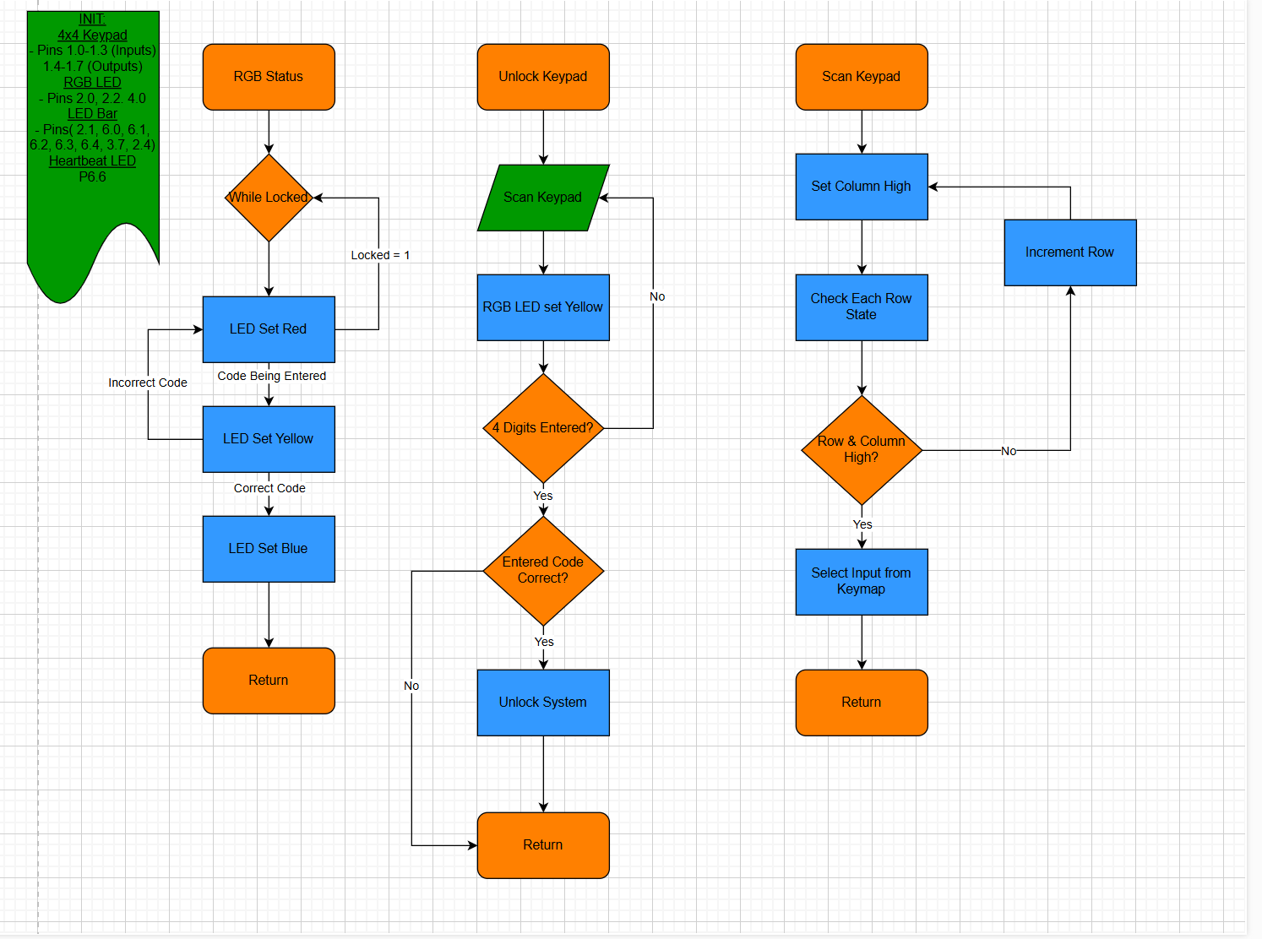
The Entire Picture

Slide 5
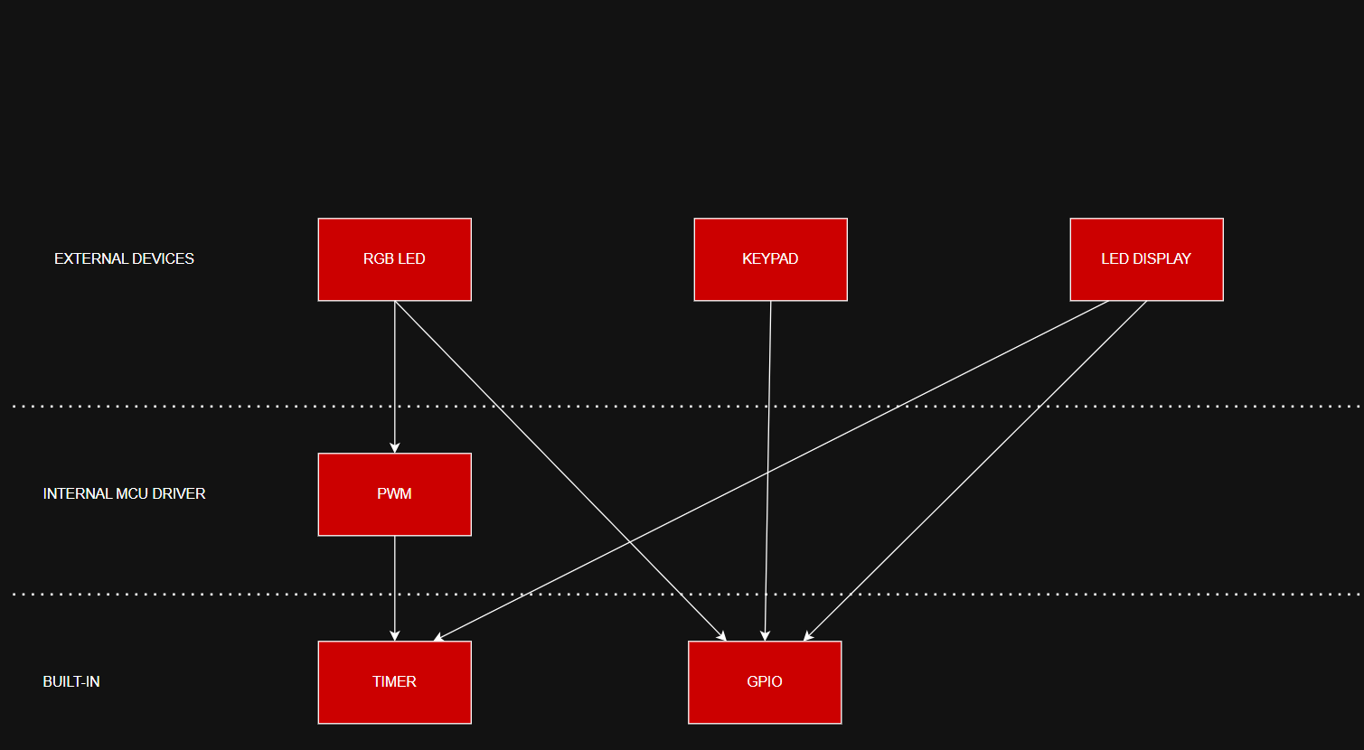
System Architecture

Slide 6
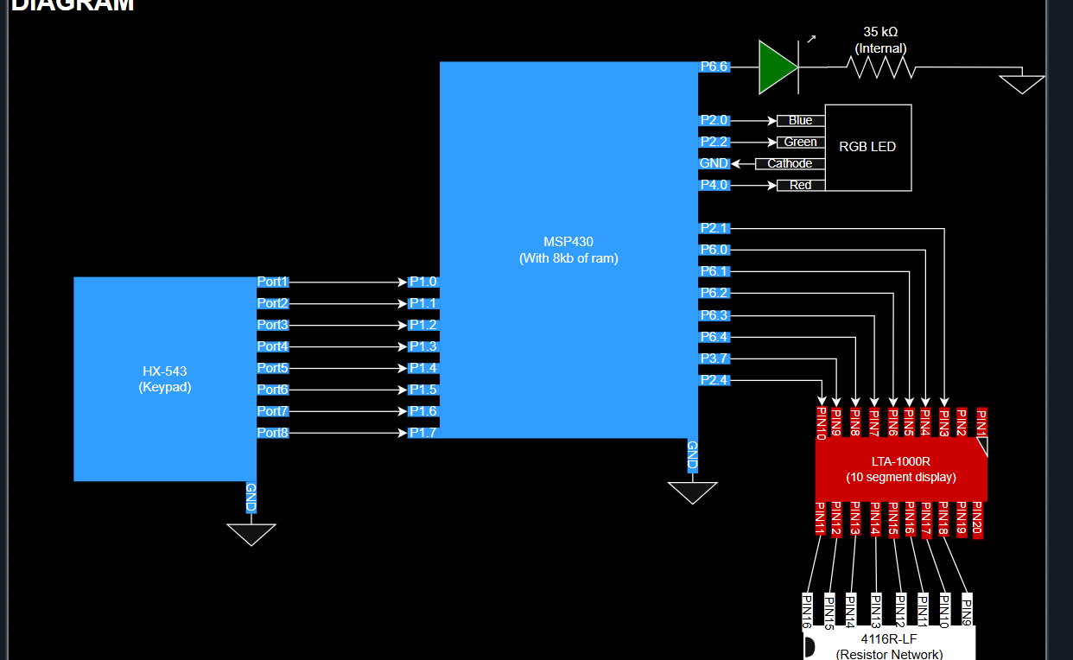
Pin Diagram

Slide 7
Pseudo-Code
Overflow ISR:
toggle heartbeat every 2 overflows
set pattern flag to 1 every base_time + inc/dec
if(pattern=1){
do pattern
custom LED color
}else if(pattern=2){
do other pattern
custom LED color
}
lock/unlock:
while(locked){
pattern LEDs off
rgb=red
call led_pattern() //Which also calls read keypad
}
while(!locked){
rgb=blue;
call read keypad
switch(case) //For A or B
if(read = 'D'){
Lock keypad
pattern iteration speed:
Switch(case){
case 'A':
increment speed by 0.25s
case 'B':
decrement speed by 0.25s
}
else if(pattern=3){
do other pattern
custom LED color
}else if(pattern=4){
do other pattern
custom LED color
}
clear ISR flag

Slide 8
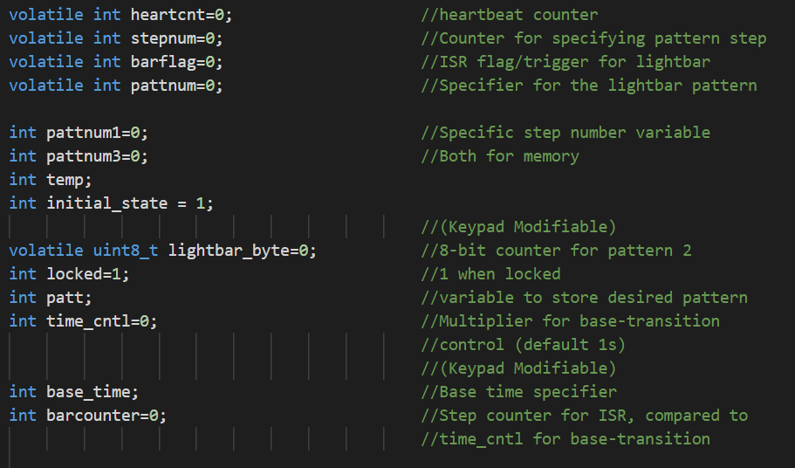
A Deeper Look (The CCS variable family)
A series of variables are used to specify:
Pattern choice
Pattern step
State (locked or unlocked)
When the overflow clock is triggered

Slide 9
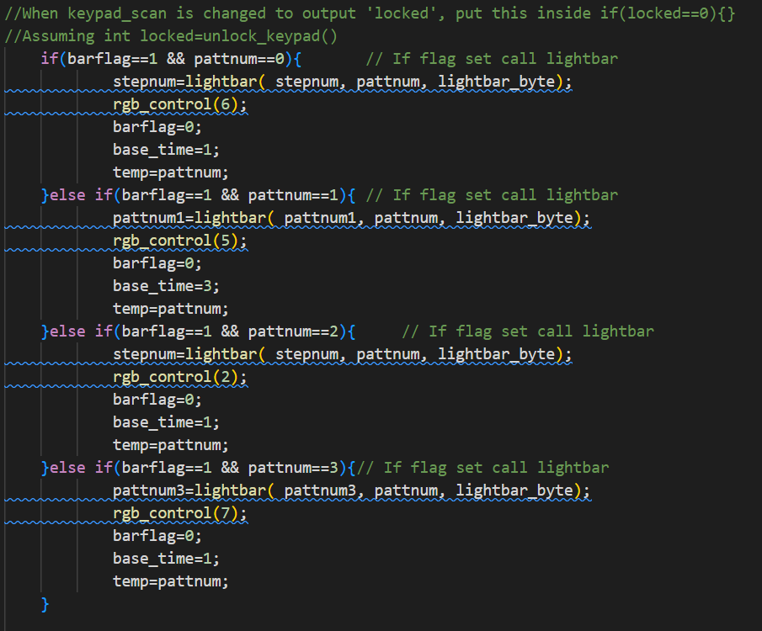
Logic to Control Pattern
Stepnum
Controlled which step the pattern was currently on
Equivalent to pattnum1/2/3
Barflag
Boolean that turned true when ISR was hit

Slide 10
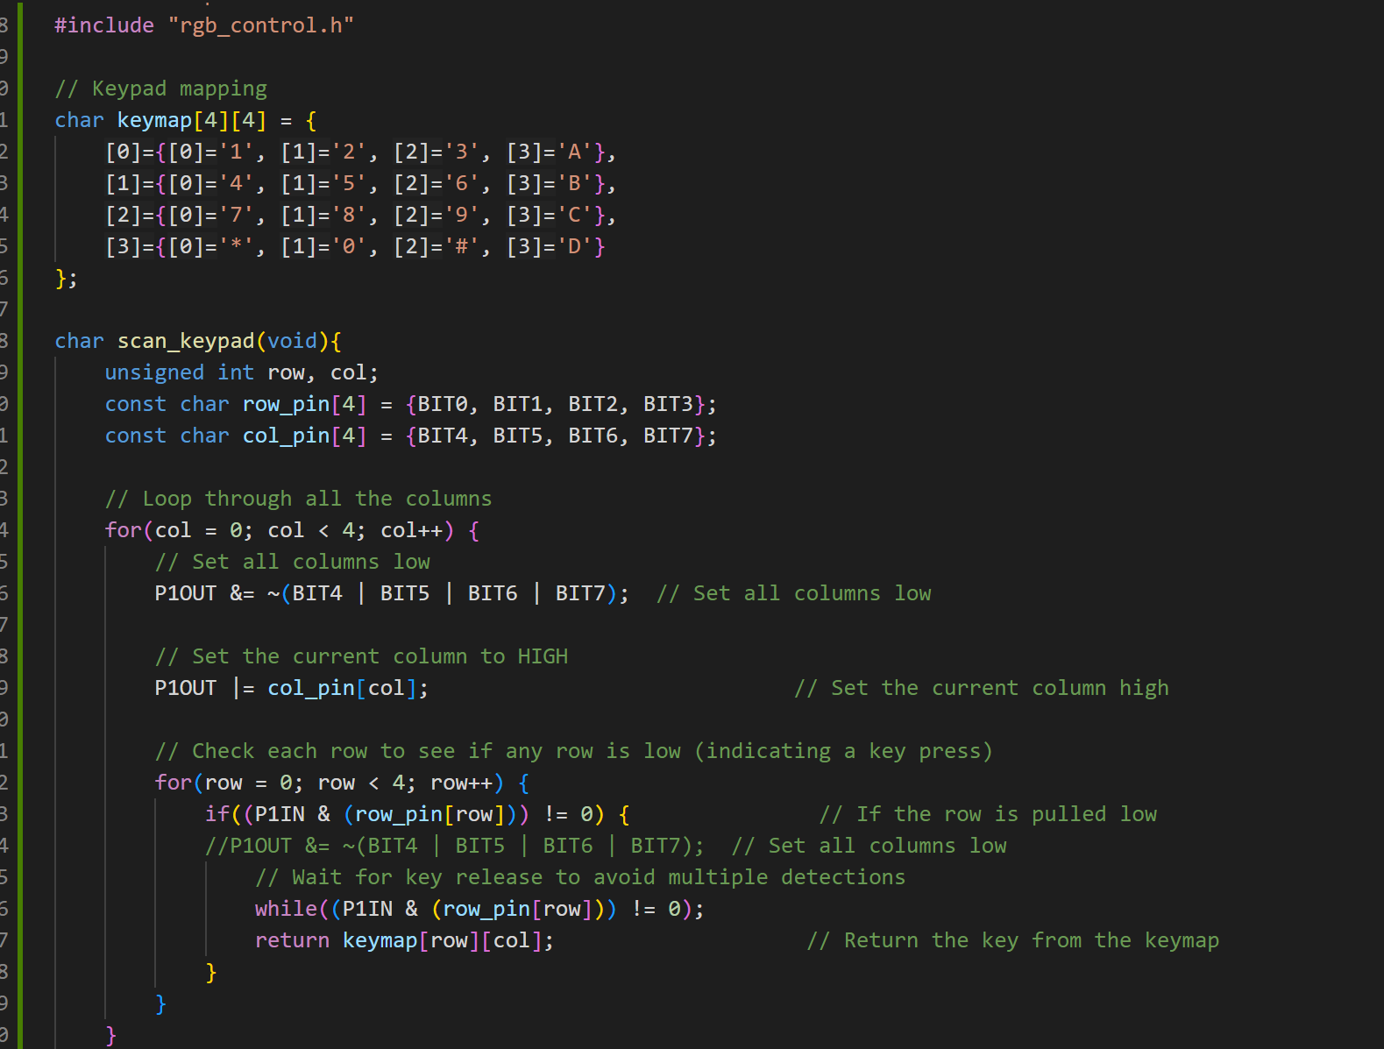
Keypad Development
4x4 Keypad
All Rows and Columns connected
Set Rows as inputs and columns as outputs
Set one column high at a time
Check state of rows
If both row and column are high select input from key map
If none are high set next column high and repeat
This process was repeated four times to get a four digit code

Slide 11
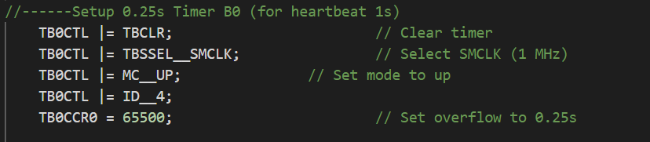
Patterns and Clock Development
Overflow clock was set to 0.25ms
Overflow needed to be raised by 3000 cycles to account for delaying logic in ISR

Slide 12
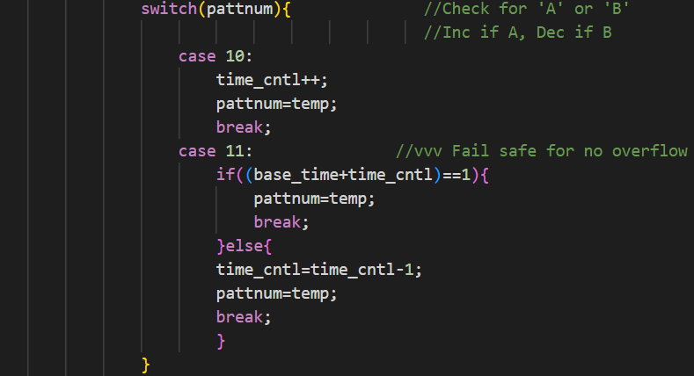
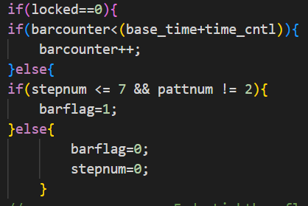
Controlling and Altering Base-Time
barcounter
Incremented each ISR call and reset when overflowing with desired time
base_time
Varied on pattern number
Inconsistency in instructions
switch case
Altered time_cntl
Prevented current time settings from turning negative and freezing program

Slide 13
RGB Development
Using Combinations of Red, Green, and Blue several colors can be created
Red denotes the system is locked
Yellow will appear when the system is being unlocked
Blue denotes the system was successfully unlocked and ready to display patterns
Unique LED color for each pattern
Color driven by RGB_Contorl module (else if statement with each color assigned a #)

Slide 14
Locking and Unlocking Development
Set a locked flag
Created a locked and unlocked while loop
Only scan for correct 4 digit code within while loop while locked
All other functionality will only happen when locked flag is not set
Can reset the locked flag by pressing D on the keypad

Slide 15
End Result
System Starts Locked with LED Red
LED turns yellow when a code is entered
System unlocked and LED is blue when correct code (6969) is entered
LED patterns can be driven by pressing 0,1,2,3 which have unique LED color
Pattern will pick up where it left off when selected after another pattern
Pressing A will decrease pattern speed, B will increase speed
Pressing D will relock and reset system

