Slide 1
Project 3: Keypad and LED bar

Slide 2
About The project
A 16-button keypad will be polled to determine which button was pressed.
It must interface with and LED bar
It must control an RGB LED with PWM

Slide 3
Main Flowchart

Slide 4
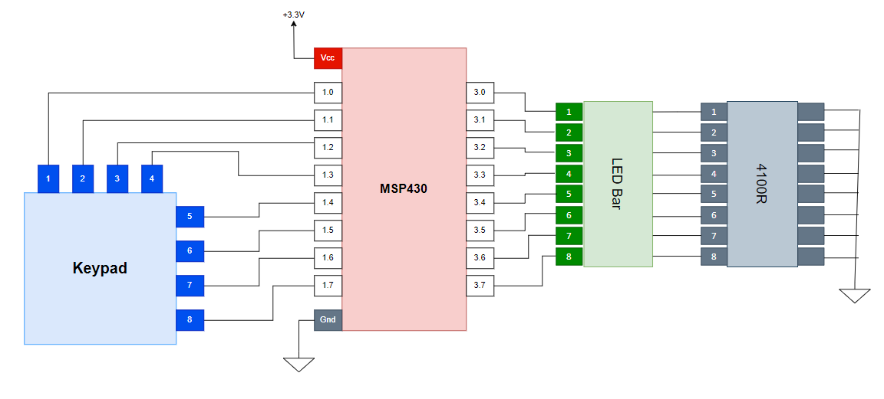
Circuit Diagram

Slide 5
Software Architecture

