Slide 1

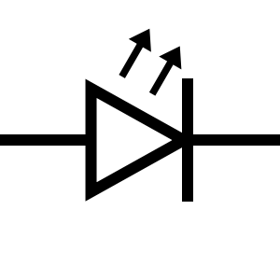
RGB LED
100Ω
MSP430FR2355
MCU
P6.2
BLU
P6.1
GRN
P6.0
RED
GND
GND
KEYPAD
330Ω Resistor IC
LED BAR
Input
P2.3
Input
P2.2
P3.7
Input
P2.1
P3.6
Input
P2.0
P3.5
P3.4
Output
P1.7
P3.3
Output
P1.6
P3.2
Output
P1.5
P3.1
Output
P1.4
P3.0

