Slide 1

Project 3 Ben Weizenegger Mark Whitney

Slide 2
Introduction
Goal: Get a keypad working using the MSP430.
3 states: Locked, Unlocking, Unlocked
- State LEDs
When Unlocked, user can use keypad to put different patterns on an LED bar, and adjust timing of the pattern

Slide 3
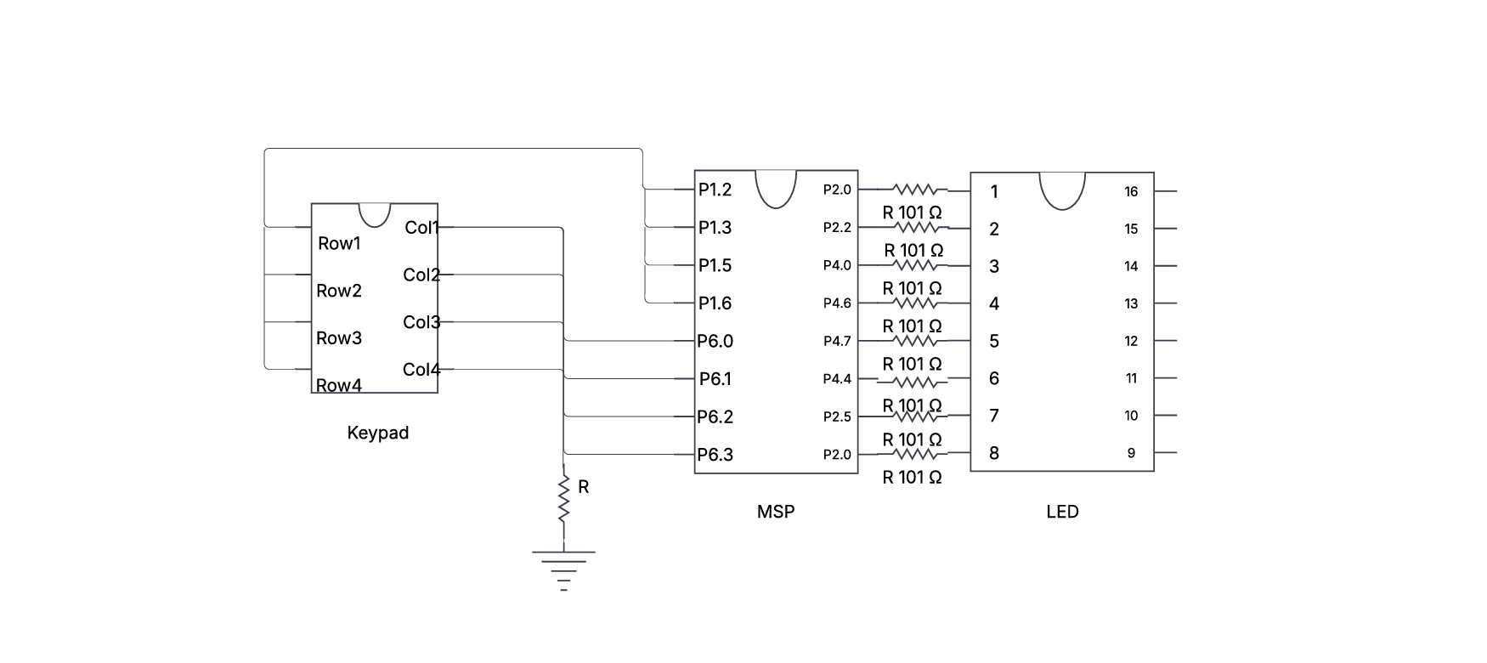
Circuit Diagram

Slide 4
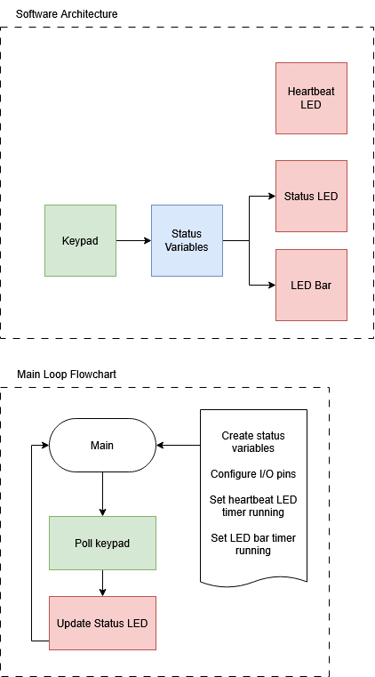
Software Architecture
&
Main Loop

Slide 5

Demo

