Slide 1
Project 5: I2C Reading an Analog Temperature Sensor with an ADC
Beau Coburn & Aaron Foster

Slide 2
Objective
Read an analog temperature sensor and display the value on the LCD
Main controller to sample an analog temperature sensor’s output and produce a moving average of n-samples (user selectable)
LCD displays sensor output in Celsius
LED bar does not change, but speed functionality removed
Locked state, unlocked, user input via keypad the same.

Slide 3
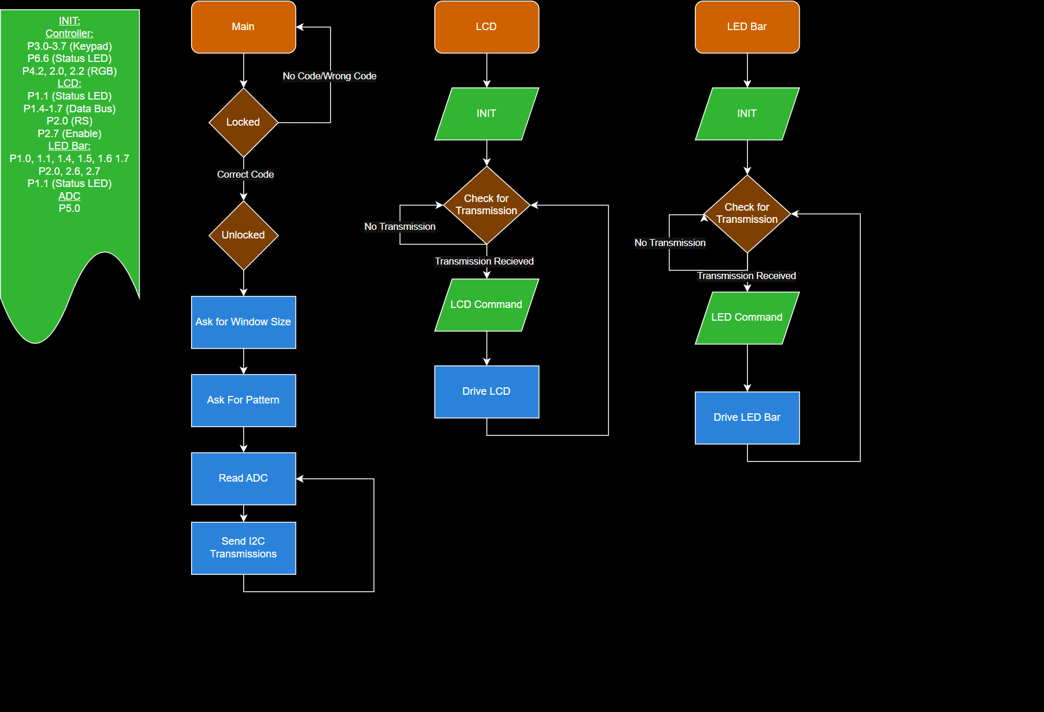
Code at a Glance

Slide 4
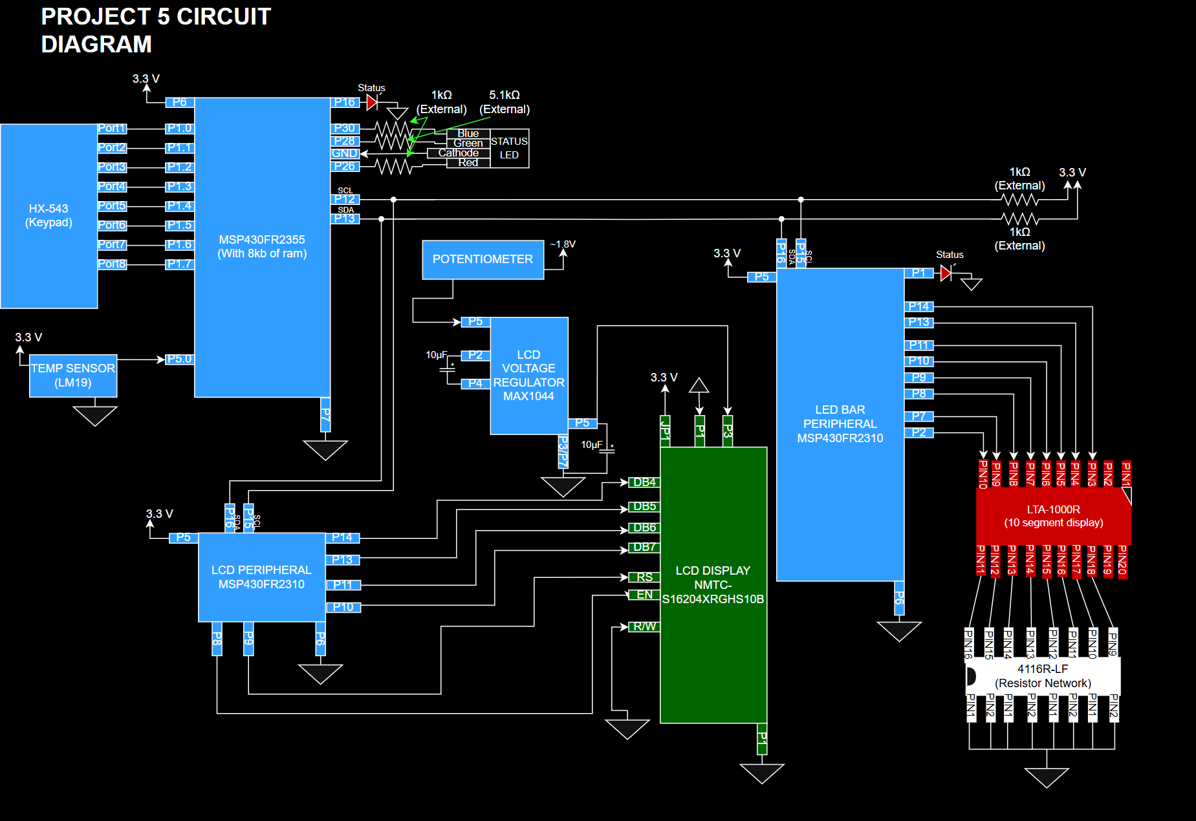

Slide 5
Main Controller
Starts in locked state
RGB LED indicates system status
Code “6969” to unlock
Constantly monitors temp sensor every 0.5s
Once unlocked, system enters idle mode
Waits for user input
User can select size of past average temp measurements
LCD constantly displays updates to the average temperature sensor
To 1 decimal place
Multiple bytes per I2C transmission

Slide 6
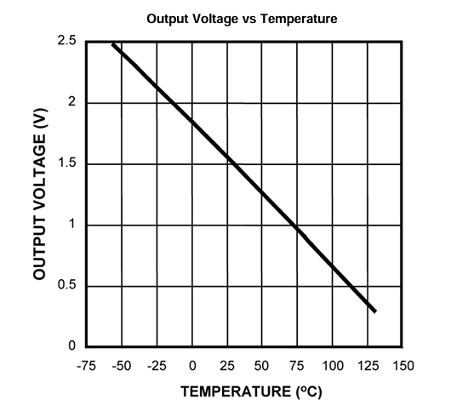
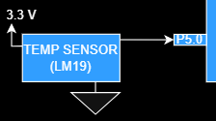
Analog Temperature Sensor
3.3V Input to CMOS integrated-circuit
Analog output based on temperature
MSP430 ADC module reads temperature sensor every 0.5s
Saves temperature value into circular array to average user selected number of values

Slide 7
LCD Peripheral
Contrast of screen can be adjusted
Set to 4 bit mode
2 line, 5x8 character
Screen cleared
I2C Slave (Receives)
Drives message or command to LCD
LED Pattern
Screen Clear
Toggle Cursor
Constantly displays average temperature from master controller

Slide 8
LED Bar Peripheral
Port initialization
Receives I2C transmission (slave)
Drive received pattern
Transition period can be changed based on transmission
Same data as sent to LCD

Slide 9
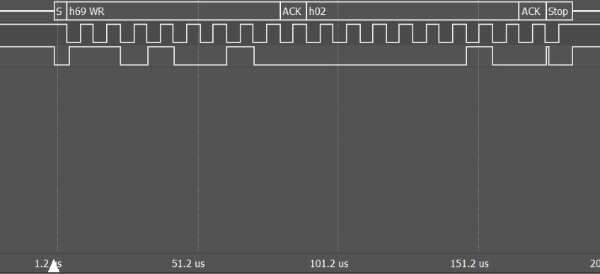

Slide 10
Final Result
Master-slave communications that is capable of:
Reading an analog temperature sensor
Constantly displaying the average temperature value over time
LED bar patterns
Displaying the current master state on an LCD screen

