Slide 1
Project 4: I2C Compatible Peripherals (LCD and LED Bar)
Beau Coburn & Aaron Foster

Slide 2
Objective
- MSP430FR2355 as main controller
- Locked system controlled by 4x4 keypad
- Two MSP430FR2310 as Peripherals controlled by I2C
- Controller sends data over I2C to control actions on peripheral MSPs
- Peripherals control LED Bar and LCD screen
- Patterns on LED Bar
- Name of pattern on LCD

Slide 3
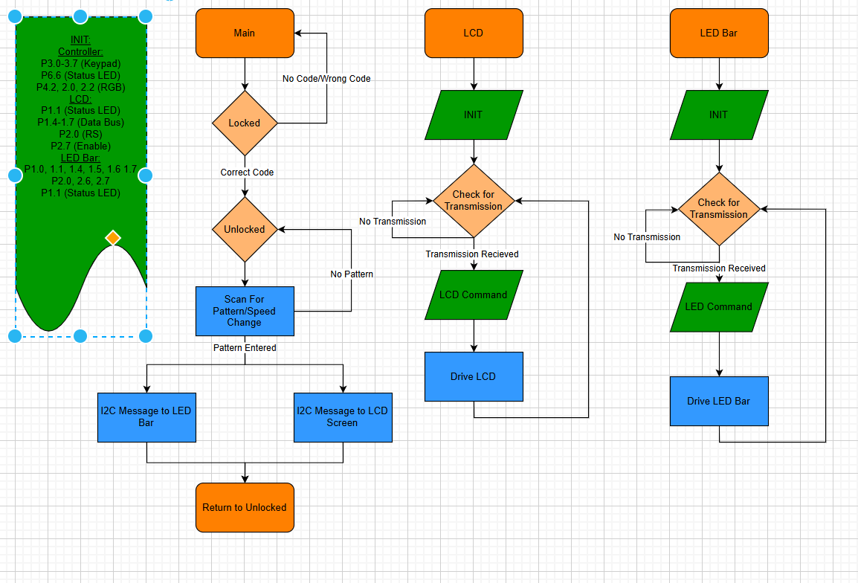
Code at a Glance

Slide 4
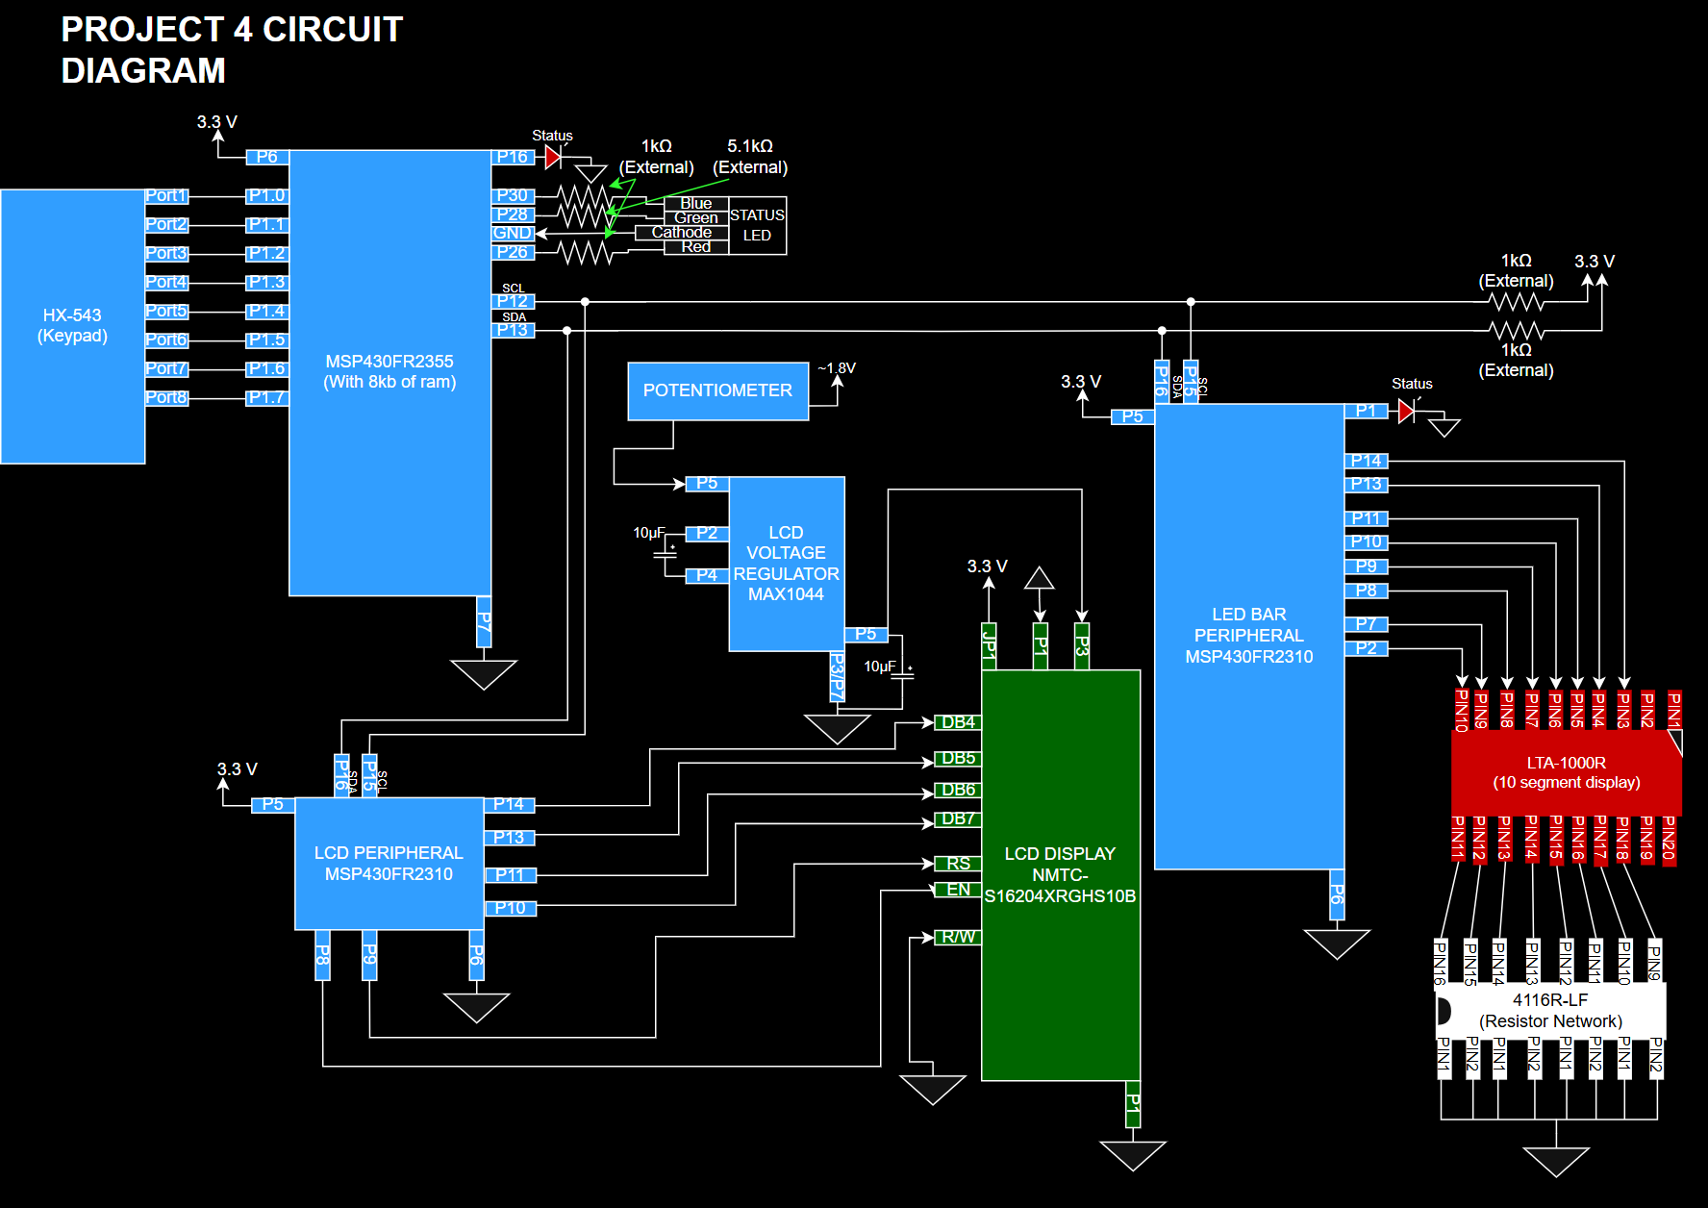

Slide 5
Main Controller
- Starts in locked state
- RGB LED indicates system status
- Code “6969” to unlock
- Once unlocked, patterns can be selected
- Pattern info transmitted over I2C bus (Master)
First transmission to led bar slave
Second transmission to LCD slave

Slide 6
LCD Peripheral
- Contrast of screen can be adjusted
- Set to 4 bit mode
- 2 line, 5x8 character
- Screen cleared
- I2C Slave (Receives)
- Drives message or command to LCD
LED Pattern
Screen Clear
Toggle Cursor

Slide 7
LED Bar Peripheral
Port initialization
Receives I2C transmission (slave)
Drive received pattern
Transition period can be changed based on transmission
Same data as sent to LCD

Slide 8
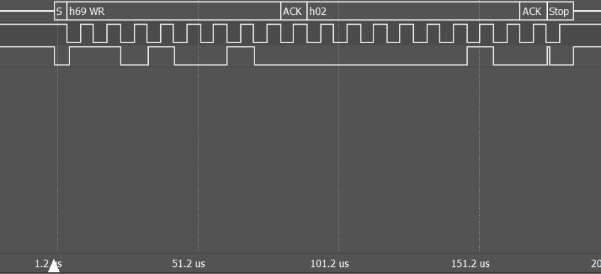

Slide 9
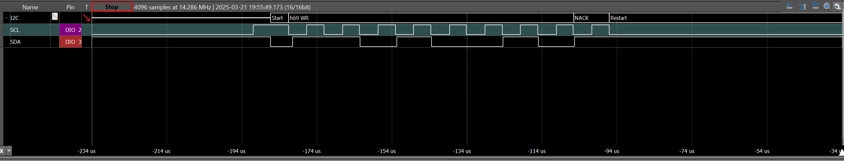
Issues I2C
SCL stayed low outside the transmission buffer
Caused slaves to not respond to called address
Hardware issue with breakout board
Fixed by keeping logic analyzer connected

Slide 10
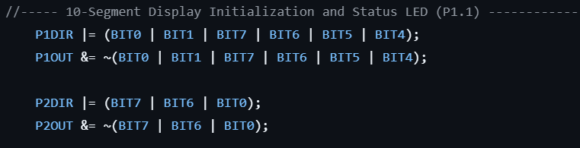
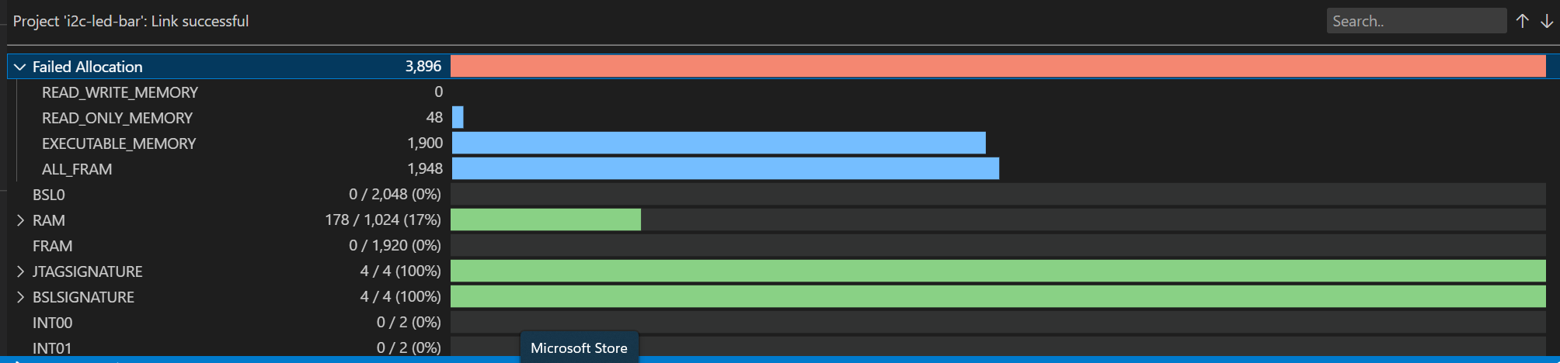
Issues Memory
MSP430FR2310 has 1KB ram
Executable memory
Fixed by changing compiler settings and initialization streamlines

Slide 11
Result
- Multi MSP system operating over serial communication
- LCD and LED Bar driven from I2C
- Can be implemented within a more complex system

