Slide 1
Yinyang K-means
Yufei Ding, Yue Zhao, Xipeng Shen, Madanlal Musuvathi, and Todd Mytkowicz
Ben Frey and Thomas Swearingen, Presenters

Slide 2
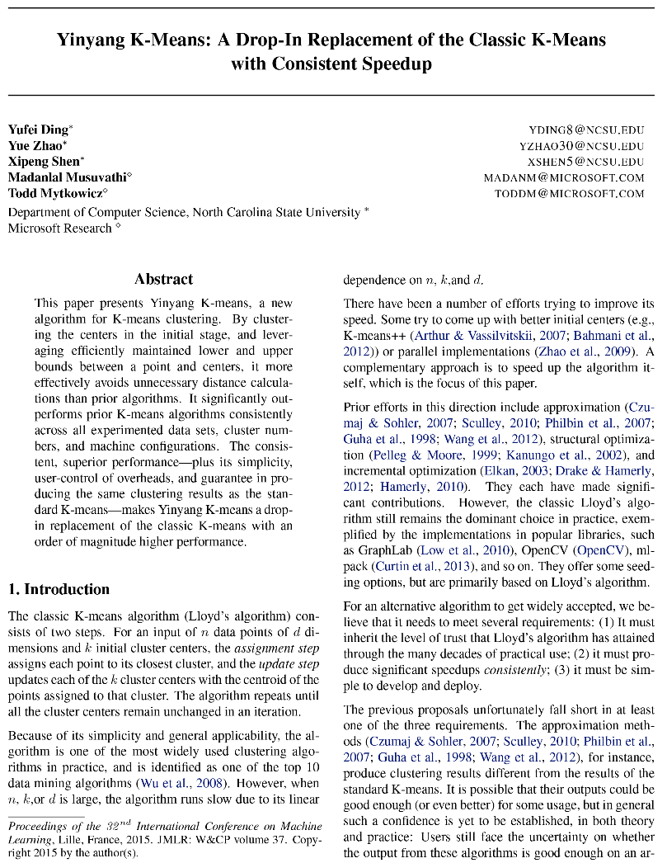
What is Yinyang K-means?
Yinyang K-means is a “drop-in” replacement for classic K-means
The authors claim it offer an order-of-magnitude speed up over classic K-means

Slide 3
Yinyang K-means
Authors reduce the amount of calculations by maintaining upper and lower bounds on data point and cluster centers
Two filters that reduce the calculation:
Global-Filtering Condition
Condition Met: Cluster assignment stays the same for a given data point
Local-Filtering Condition
Condition Met: Cluster cannot be closest for a given data point

Slide 4
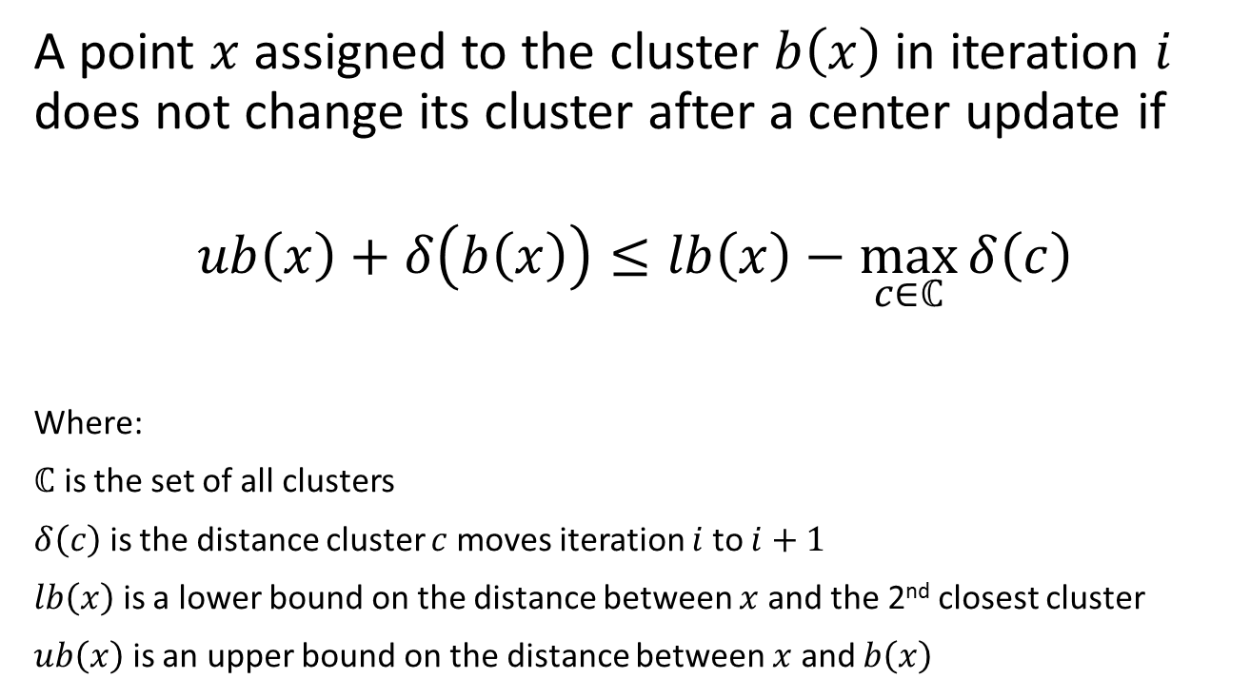
Global-Filtering Condition
A point $x$ assigned to the cluster $b\left(x\right)$ in iteration $i$ does not change its cluster after a center update if
$$ub\left(x\right)+δ\left(b\left(x\right)\right)≤lb\left(x\right)−\max_{c∈ℂ}{δ\left(c\right)}$$
Where:
$ℂ$ is the set of all clusters
$δ\left(c\right)$ is the distance cluster $c$ moves iteration $i$ to $i+1$
$lb\left(x\right)$ is a lower bound on the distance between $x$ and the 2nd closest cluster
$ub\left(x\right)$ is an upper bound on the distance between $x$ and $b\left(x\right)$

Slide 5
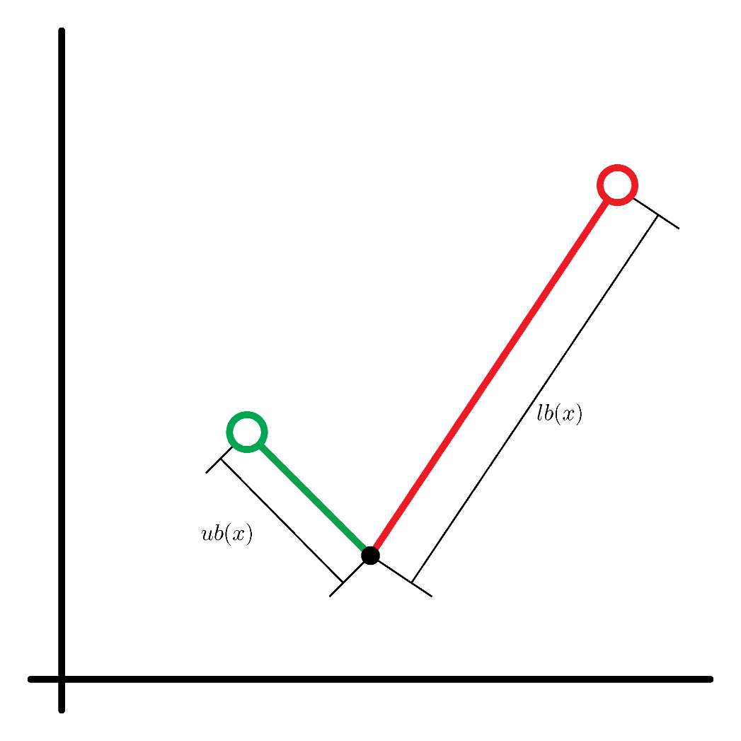

Global-Filtering Condition
$$ub\left(x\right)+δ\left(b\left(x\right)\right)≤lb\left(x\right)−\max_{c∈ℂ}{δ\left(c\right)}$$

Slide 6
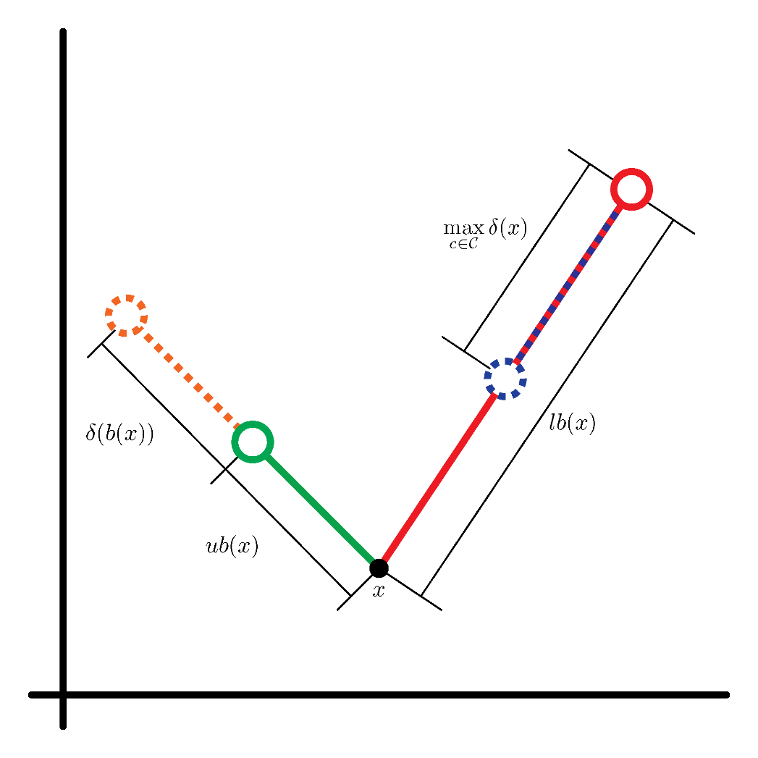

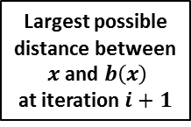
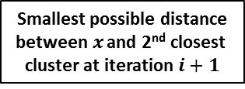
Global-Filtering Condition
$$ub\left(x\right)+δ\left(b\left(x\right)\right)≤lb\left(x\right)−\max_{c∈ℂ}{δ\left(c\right)}$$
Smallest possible distance
between$x$ and 2nd closest
cluster at iteration $i+1$
Largest possible
distance between
$x$ and $b\left(x\right)$
at iteration $i+1$

Slide 7
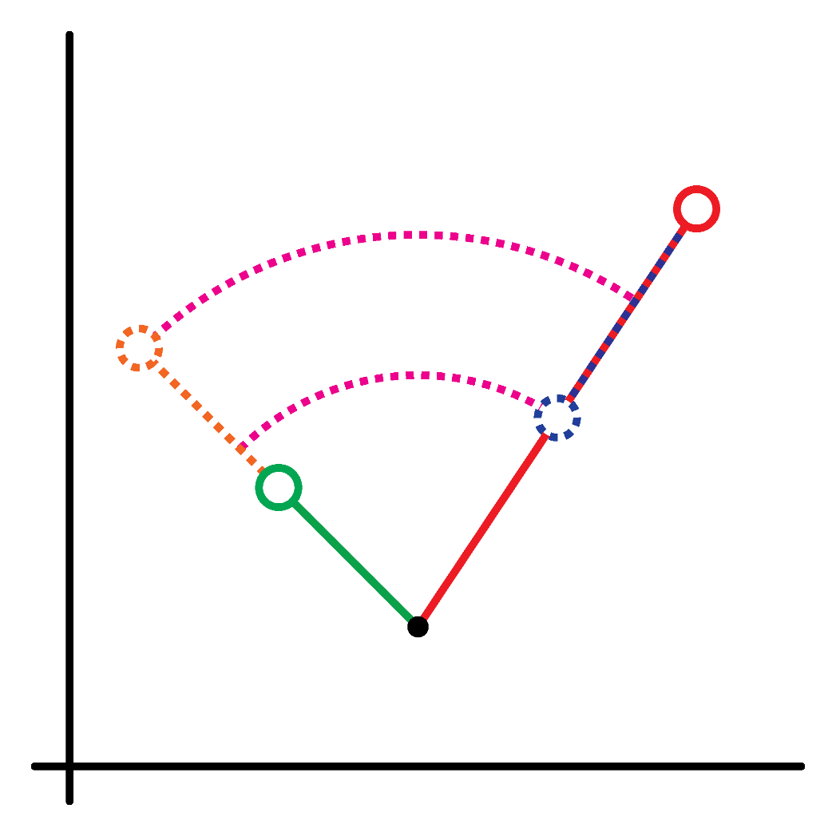

Global-Filtering Condition
$$ub\left(x\right)+δ\left(b\left(x\right)\right)≰lb\left(x\right)−\max_{c∈ℂ}{δ\left(c\right)}$$
Condition False:
the cluster center could change

Slide 8


Global-Filtering Condition
$$ub\left(x\right)+δ\left(b\left(x\right)\right)≤lb\left(x\right)−\max_{c∈ℂ}{δ\left(c\right)}$$

Slide 9
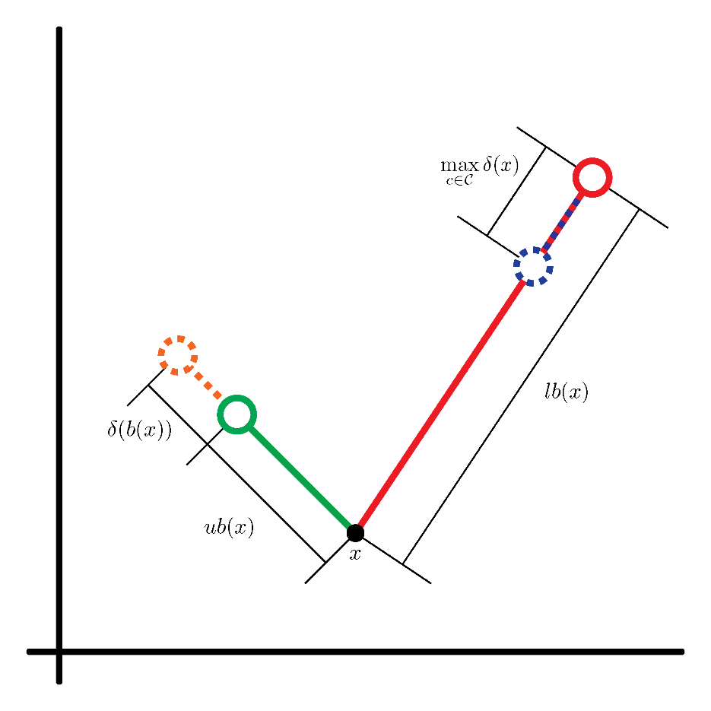
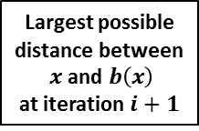
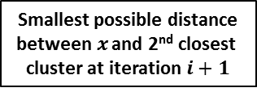
Global-Filtering Condition
$$ub\left(x\right)+δ\left(b\left(x\right)\right)≤lb\left(x\right)−\max_{c∈ℂ}{δ\left(c\right)}$$
Smallest possible distance
between$x$ and 2nd closest
cluster at iteration $i+1$
Largest possible
distance between
$x$ and $b\left(x\right)$
at iteration $i+1$

Slide 10
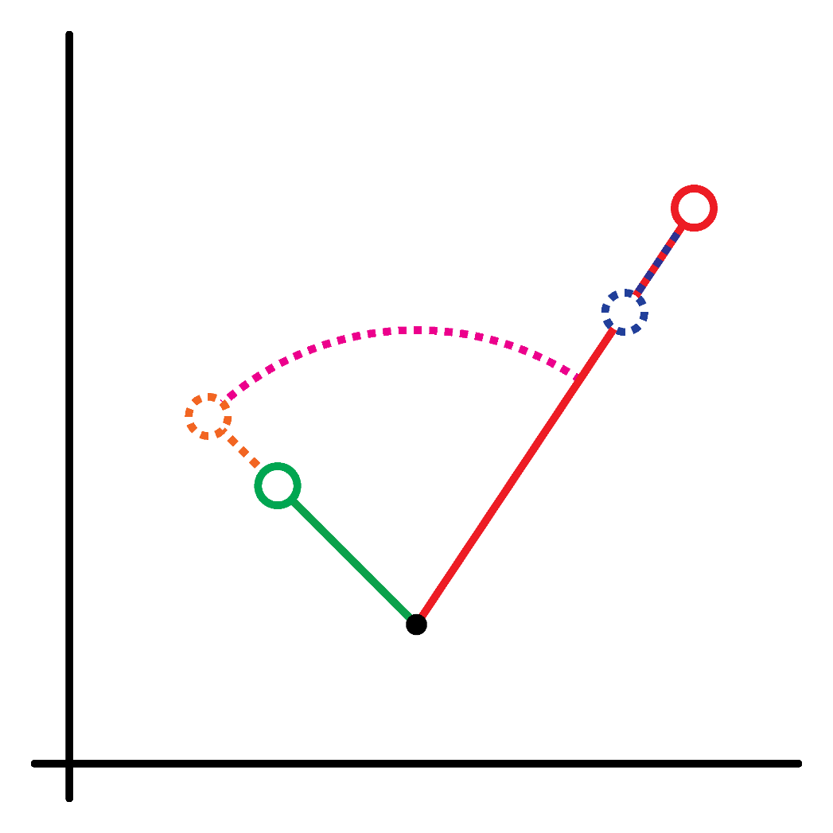

Global-Filtering Condition
$$ub\left(x\right)+δ\left(b\left(x\right)\right)≤lb\left(x\right)−\max_{c∈ℂ}{δ\left(c\right)}$$
Condition True:
the cluster center does not change

Slide 11
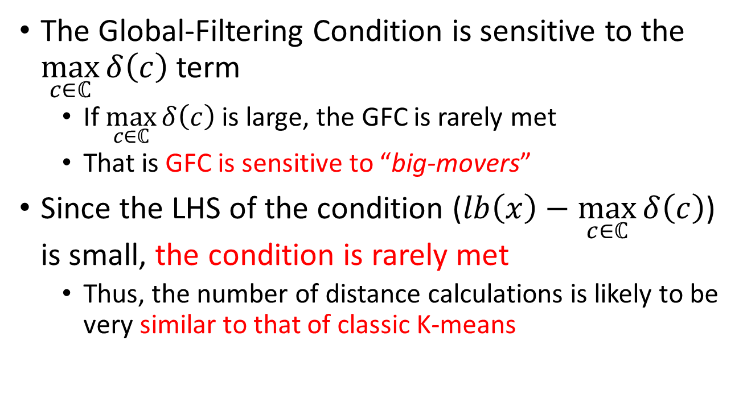
Potential Problem
The Global-Filtering Condition is sensitive to the $\max_{c∈ℂ}{δ\left(c\right)}$ term
If $\max_{c∈ℂ}{δ\left(c\right)}$ is large, the GFC is rarely met
That is GFC is sensitive to “big-movers”
Since the LHS of the condition ($lb\left(x\right)−\max_{c∈ℂ}{δ\left(c\right)}$) is small, the condition is rarely met
Thus, the number of distance calculations is likely to be very similar to that of classic K-means

Slide 12
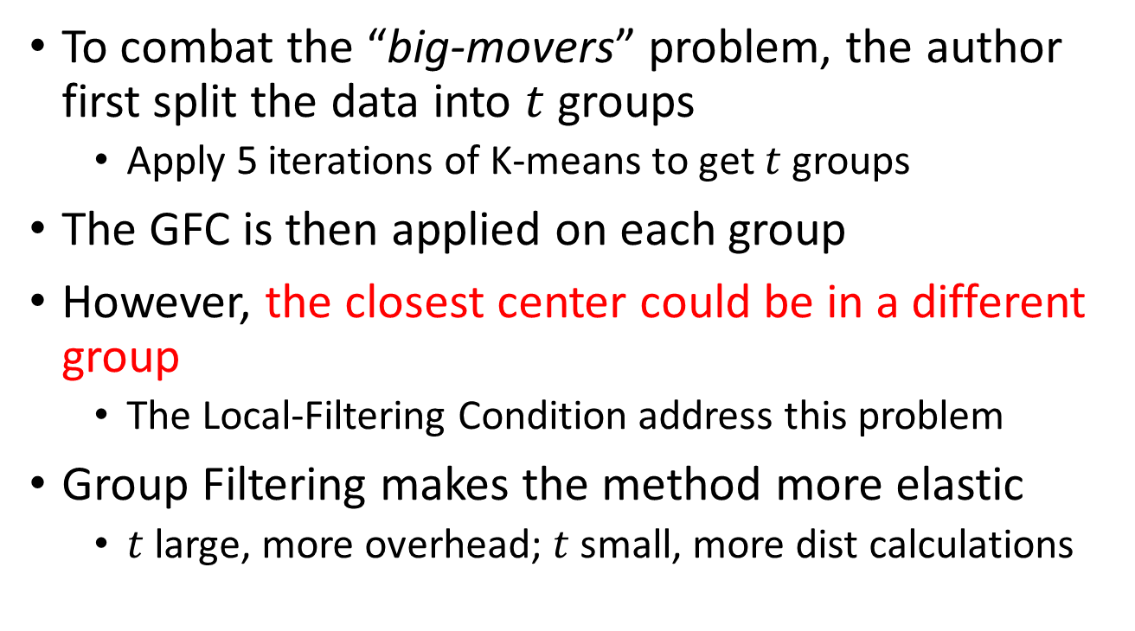
Group Filtering
To combat the “big-movers” problem, the author first split the data into $t$ groups
Apply 5 iterations of K-means to get $t$ groups
The GFC is then applied on each group
However, the closest center could be in a different group
The Local-Filtering Condition address this problem
Group Filtering makes the method more elastic
$t$ large, more overhead; $t$ small, more dist calculations

Slide 13
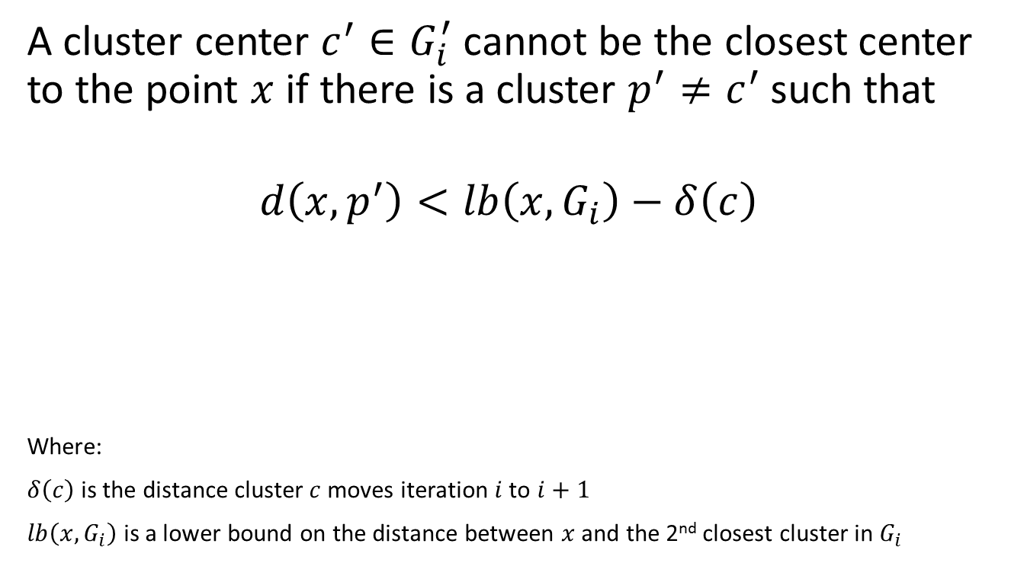
Local-Filtering Condition
A cluster center $c^{′}∈G_{i}^{′}$ cannot be the closest center to the point $x$ if there is a cluster $p^{′}≠c^{′}$ such that
$$d\left(x,p^{′}\right)<lb\left(x,G_{i}\right)−δ\left(c\right)$$
Where:
$δ\left(c\right)$ is the distance cluster $c$ moves iteration $i$ to $i+1$
$lb\left(x,G_{i}\right)$ is a lower bound on the distance between $x$ and the 2nd closest cluster in $G_{i}$

Slide 14
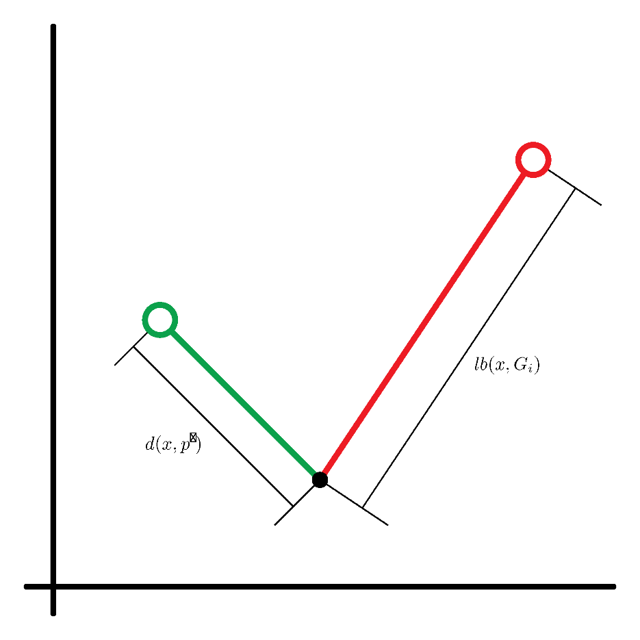

Local-Filtering Condition
$$d\left(x,p^{′}\right)<lb\left(x,G_{i}\right)−δ\left(c\right)$$

Slide 15
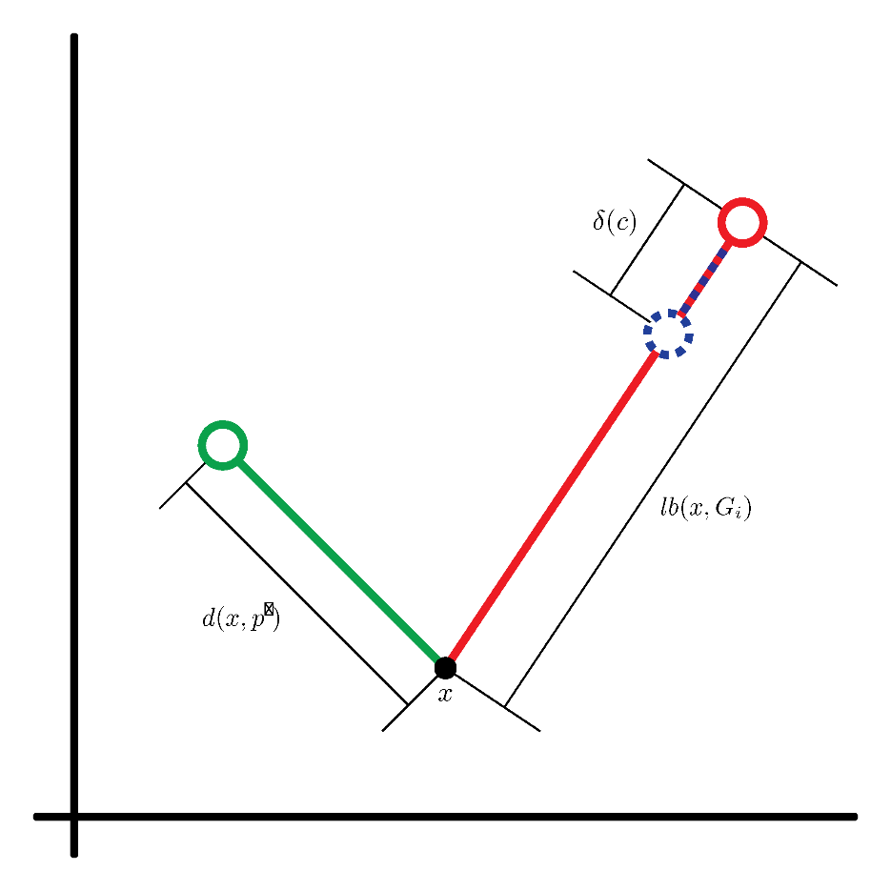



Local-Filtering Condition
$$d\left(x,p^{′}\right)<lb\left(x,G_{i}\right)−δ\left(c\right)$$
Smallest possible distance
between$x$ and $c^{′}$
Distance between
$x$ and $p^{′}$

Slide 16
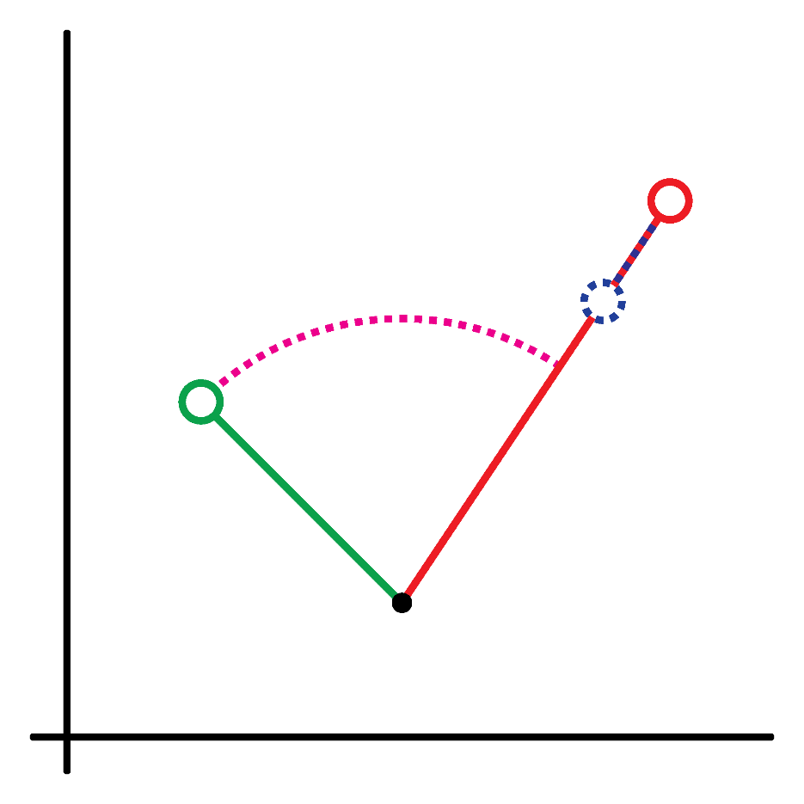

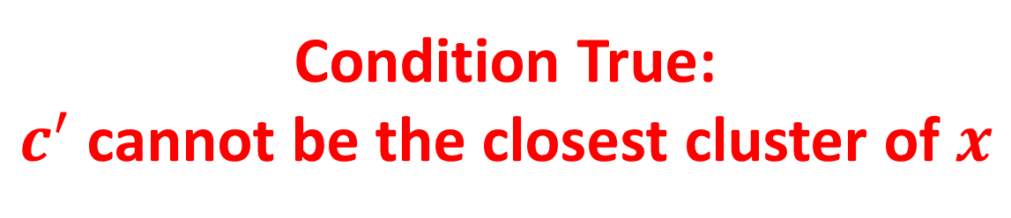
Local-Filtering Condition
$$d\left(x,p^{′}\right)<lb\left(x,G_{i}\right)−δ\left(c\right)$$
Condition True:
$c^{′}$ cannot be the closest cluster of $x$

Slide 17
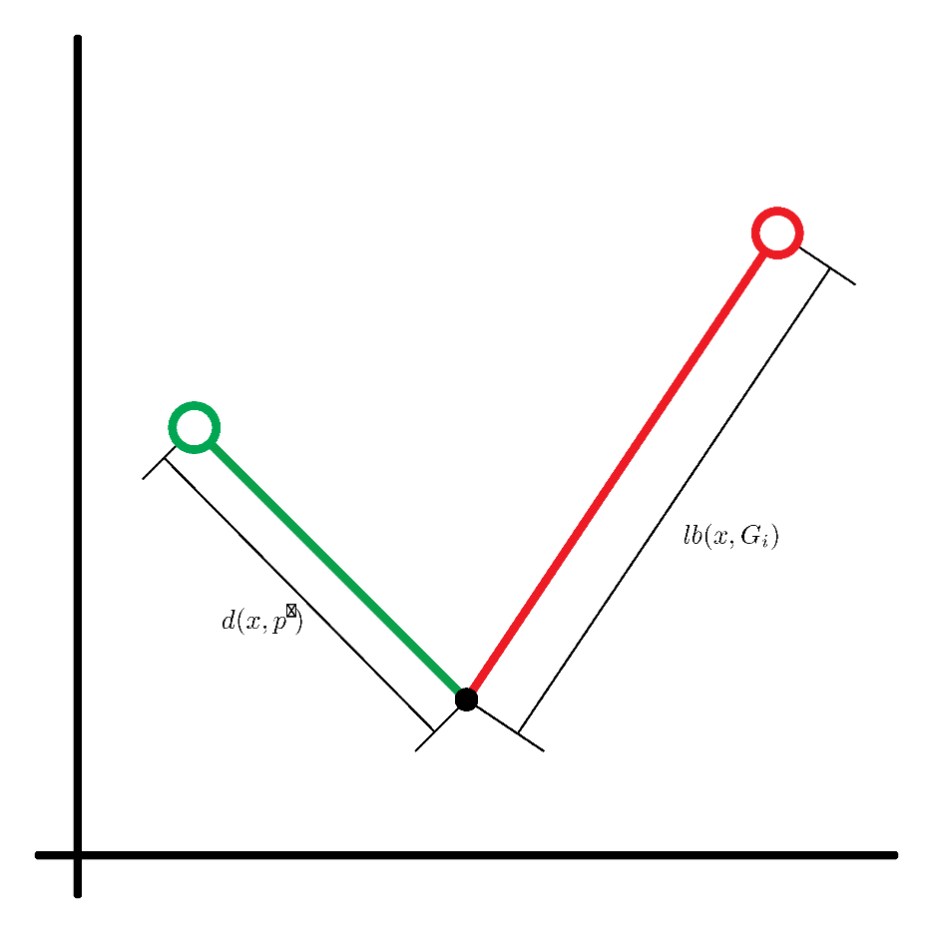
Local-Filtering Condition
$$d\left(x,p^{′}\right)<lb\left(x,G_{i}\right)−δ\left(c\right)$$

Slide 18
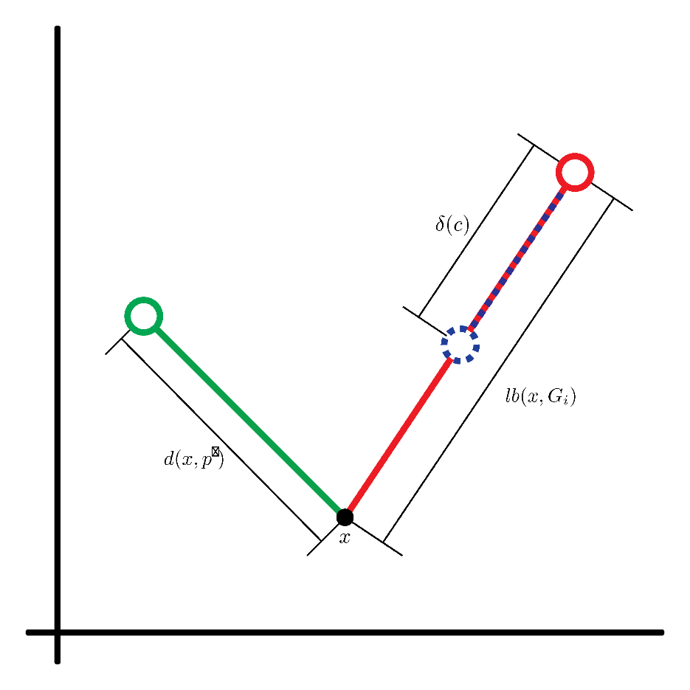

Local-Filtering Condition
$$d\left(x,p^{′}\right)<lb\left(x,G_{i}\right)−δ\left(c\right)$$
Distance between
$x$ and $p^{′}$
Smallest possible distance
between$x$ and $c^{′}$

Slide 19
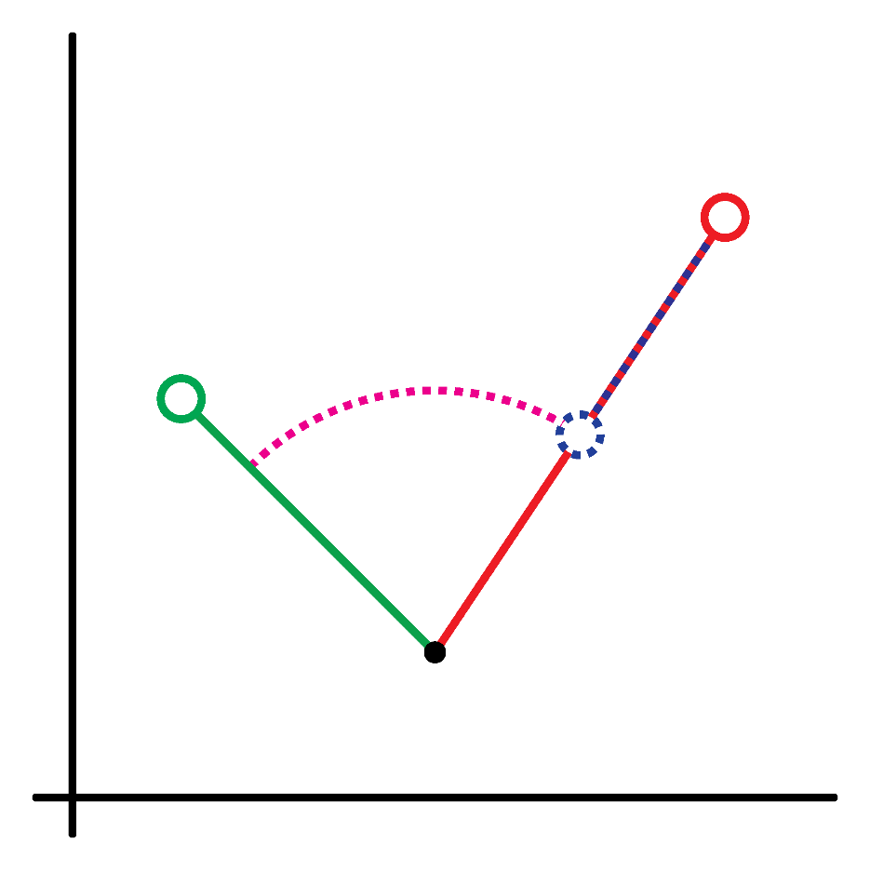

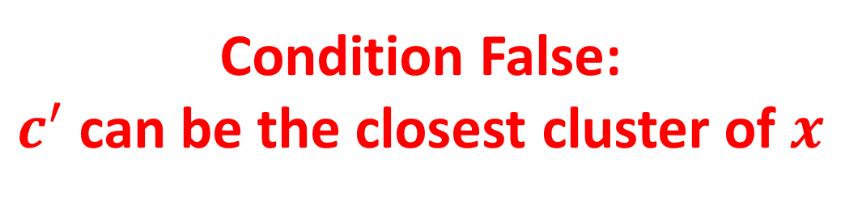
Local-Filtering Condition
$$d\left(x,p^{′}\right)≮lb\left(x,G_{i}\right)−δ\left(c\right)$$
Condition False:
$c^{′}$ can be the closest cluster of $x$

Slide 20
Results
Should converge to the same results in the same number of iterations as classic K-means when initialized with the same centers.
We were not able to achieve that result.
Larger data sets got closer.
# Clusters | # Features | # Samples/Cluster | Dist. Between Means
100 | 100 | 100 | 100
1,000 | 500 | 500 | 500
10,000 | 1,000 | 1,000 | 1,000

Slide 21
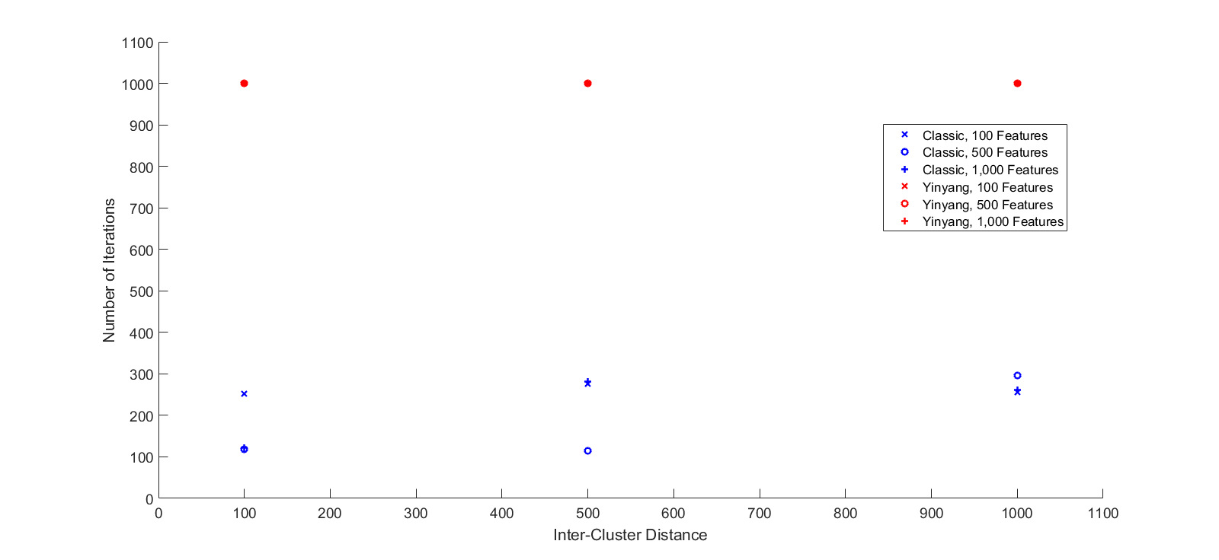
Results

Slide 22
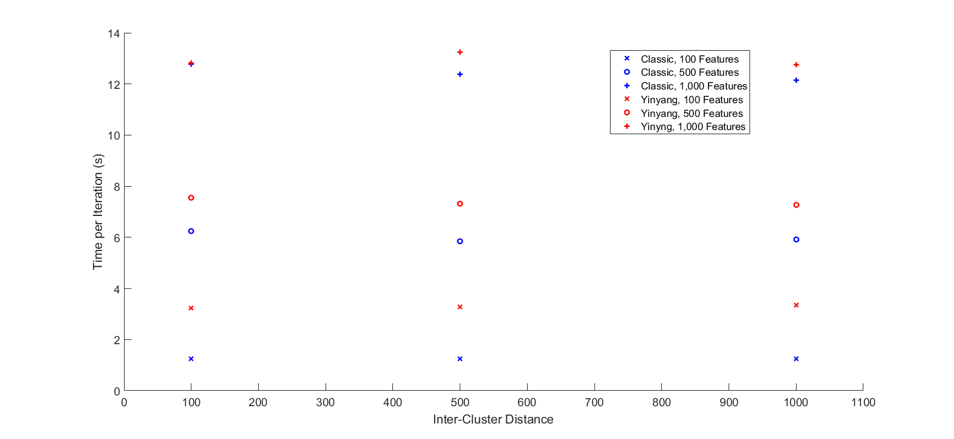
Results

