Slide 1
A reimplementation of Online Tracking by Learning Discriminative Saliency Map with Convolutional Neural Network
Steven Hoffman & Aaron Gonzales

Slide 2
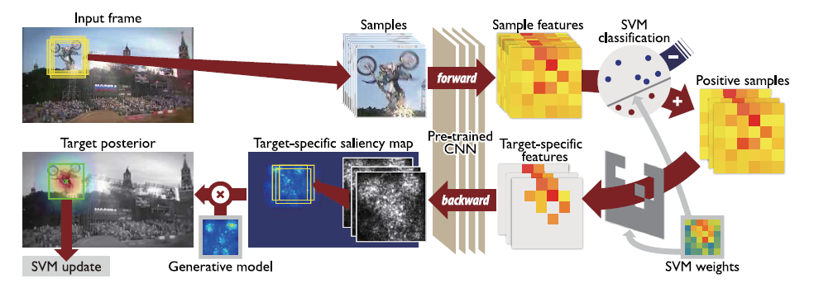
Overall Procedure
General outline of algorithm to be reimplemented
Online Tracking by Learning Discriminative Saliency Map with Convolutional Neural Network
Hong, et al.

Slide 3
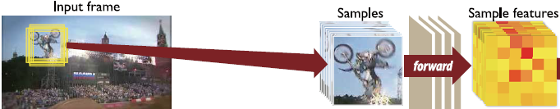
Sample Generation & Forward Propagation
120 samples generated from a normal distribution around target of interest at every frame.
Treat pre-trained CNN as black box transformation function:
sample features = CNN(samples, ‘first-fc-layer’)
Output of first fully-connected (fc) layer is treated as feature vector
Used VGG-F in MatConvNet

Slide 4
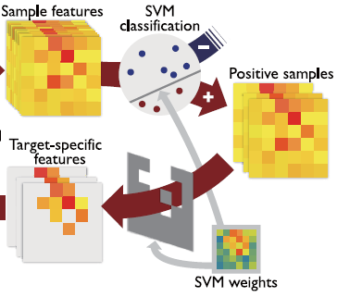
SVM Training & Classification
If the object we’re tracking is one from the benchmark, then we train the online SVM on a number of initial frames.
Each of these frames has ground truth information about the bounding box around the object, we use this defined sample as a positive example.
We use 24 samples which have an overlap of less than 30% with the ground truth sample to use as negative examples.
Each initial frame thus provides 25 training samples (1+/24-)
After classification, we only consider positively classified samples
It is possible that for some frames there are no positively classified samples
We then filter through these positive samples and keep only those dimensions corresponding to positive weights – as these have clearer contributions in the samples classification. All other features are set to 0.

Slide 5
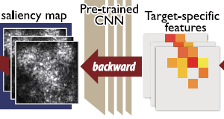
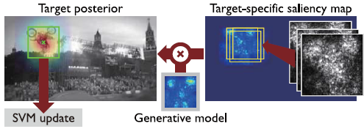
Backpropagation & Saliency Maps
After identifying target-specific features, we back-propagate those features which correspond most closely with our target
Back-propagation creates class-saliency maps same size as the inputs
Large pixel intensity = class-specific pixel
Class-saliency maps for each positive sample are aggregated (max magnitude) to create target-specific saliency map

Slide 6



Generative Model & Target Posterior
After having obtained a target-specific saliency map for the current frame, we must develop a generative model
$$H_{t}=\frac{1}{m}\sum_{k=t−m}^{t−1}{M_{k}(x_{k}^{∗})}$$
Generative Model
Class-saliency maps surrounding target in frame k
$$p\left(x_{t} | M_{1:t}\right)∝p\left(M_{t} | x_{t}\right) p(x_{t}|M_{1:t−1})$$
posterior
likelihood
prior
$$H_{t} ⨂M_{t}\left(x_{t}\right)$$
location-based

Slide 7
Generative Model & Target Posterior
After having obtained a target-specific saliency map for the current frame, we must develop a generative model
$$H_{t}=\frac{1}{m}\sum_{k=t−m}^{t−1}{M_{k}(x_{k}^{∗})}$$
Generative Model
Class-saliency maps surrounding target in frame k
$$p\left(x_{t} | M_{1:t}\right)∝p\left(M_{t} | x_{t}\right) p(x_{t}|M_{1:t−1})$$
posterior
likelihood
prior
$$H_{t} ⨂M_{t}\left(x_{t}\right)$$
location-based

Slide 8

Generative Model & Target Posterior
After having obtained a target-specific saliency map for the current frame, we must develop a generative model
$$H_{t}=\frac{1}{m}\sum_{k=t−m}^{t−1}{M_{k}(x_{k}^{∗})}$$
Generative Model
Class-saliency maps surrounding target in frame k
$$p\left(x_{t} | M_{1:t}\right)∝p\left(M_{t} | x_{t}\right)$$
posterior
likelihood
$$H_{t} ⨂M_{t}\left(x_{t}\right)$$

Slide 9
SVM Update
We now have a new “ground-truth” for the subsequent frame in our video
Under this assumption, we take the sample which gave the maximum posterior value and declare that it is a positive example of our class
Following the SVM initialization steps, we also take 24 negative samples (those with less than a 30% overlap with the positive example) from this frame
To help reduce the time requirement per frame we cap the size of our SVM training set to 300, plus twice the number of initial frames used. If 10 initial frames, the SVM training set size is capped at 320, where we always keep the positive examples of the first 20 frames.
In an attempt to further reduce computational complexity, we only retrain the SVM every third frame

Slide 10
Results

