Slide 1
Digital Signal Processing
Jiaqi LI

Slide 2
1.1 Signal in time domain
1.2 Signal in frequency domain
1.2.1 What is frequency domain?
1.2.2 Harmonic basis function summation
1.2.3 Fourier transform
1.2.4 Fast Fourier Transform
1.3 Filtering and convolution
1.3.1 Introduction to filtering
1.3.2 Introduction to convolution
1.3.3 Gibbs phenomena
1.3.4 Usages of Butter-worth filtering
1.4 Digitization
1.4.1 Digitization and Nyquist frequency

Slide 3
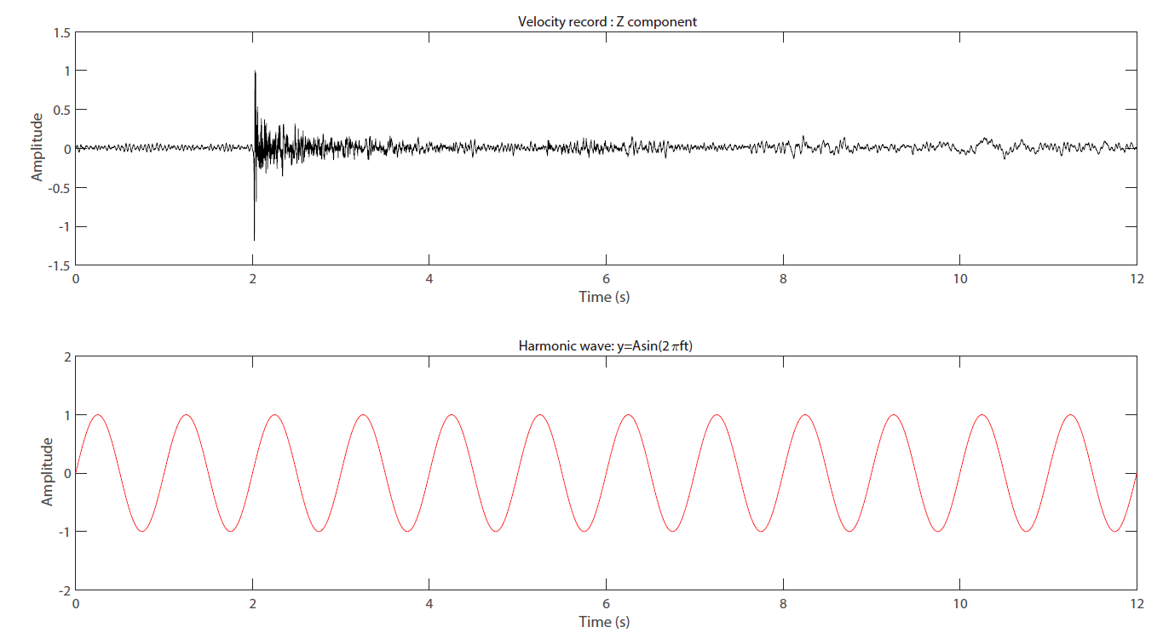

1.1 Signal in time domain
Earthquake
Harmonic wave
(Sine function)

Slide 4

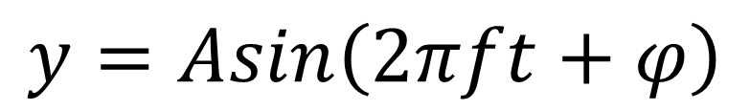


$$A brief review of sine function:$$
$$f=\frac{1}{T}$$
$$T=\frac{1}{f}$$
$$y=Asin\left(2πft+φ\right)$$
T (s) | f (Hz)
1s | 1Hz
2s | 0.5Hz
0.5s | 2Hz

Slide 5
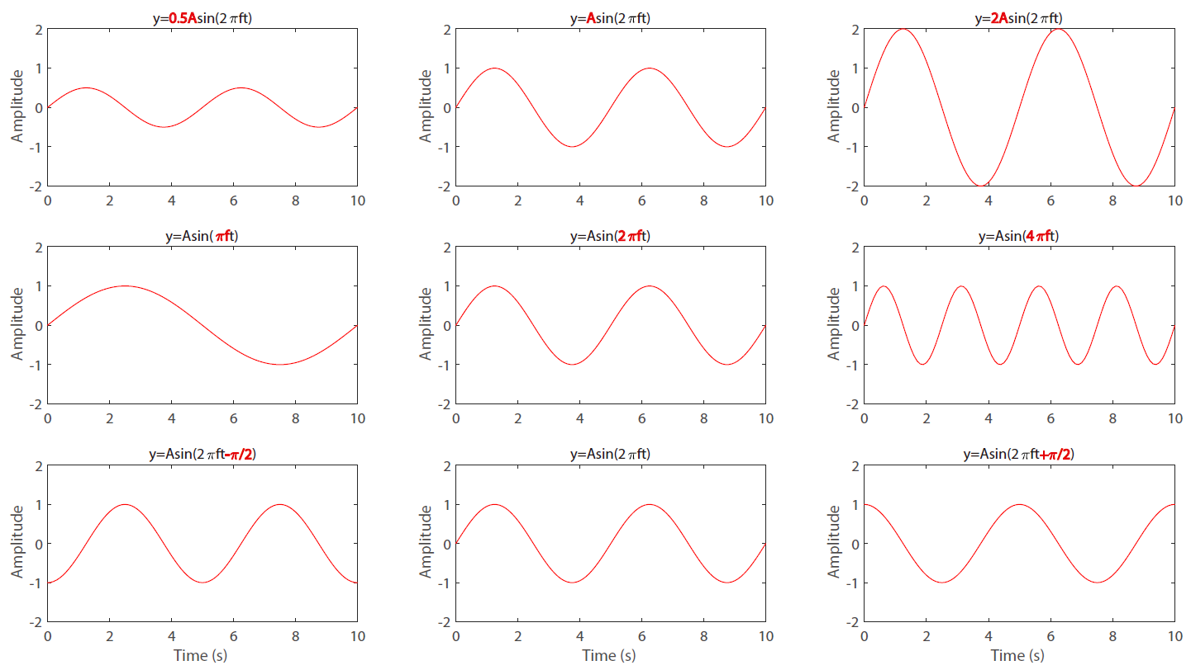

$$A brief review of sine function: y=Asin\left(2πft+φ\right)$$
$f=0.2Hz, A=1,$ $T=\frac{1}{f}$
T=5s
T=5s
T=5s
T=10s
T=5s
T=2.5s

Slide 6
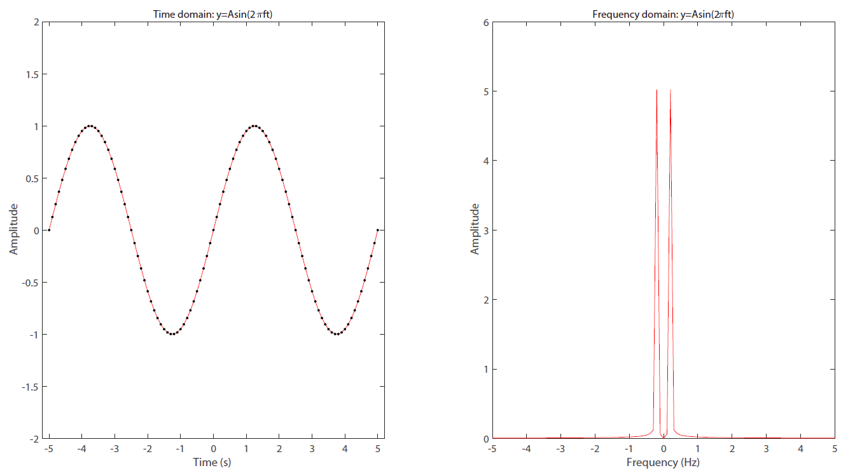

1.2 Signal in frequency domain
$$y=Asin\left(2πft+φ\right)$$
1.2.1 What is frequency domain?
5s
0.2Hz ~ 5s

Slide 7
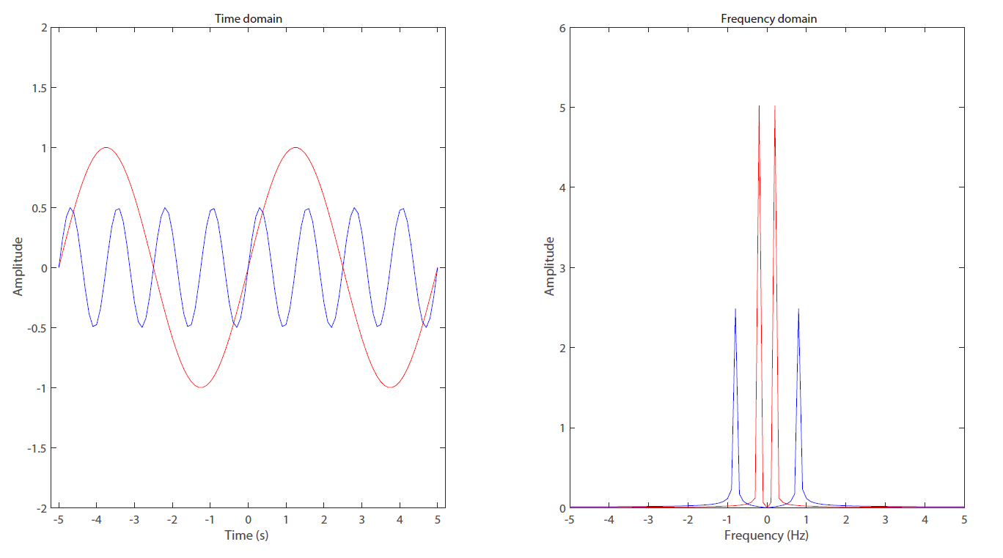

Slide 8
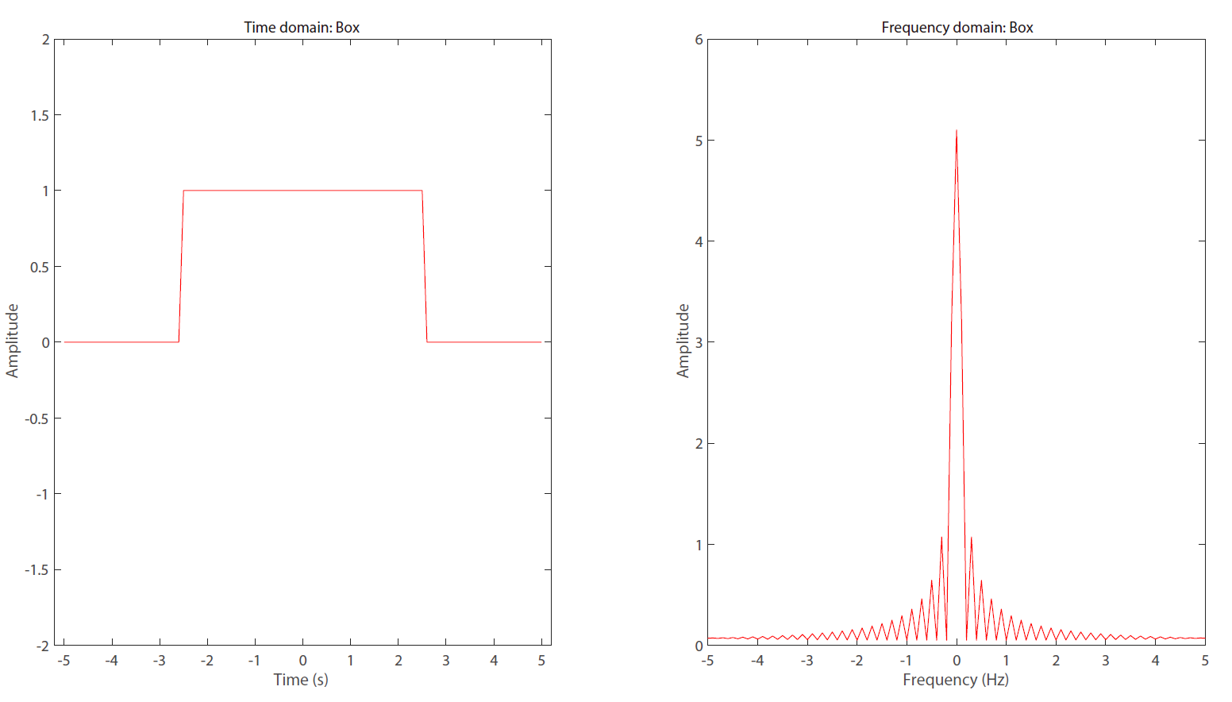

Slide 9
1.2 Signal in frequency domain
1.2.2 Harmonic basis summation
$A1\left(constant\right), A2sin\left(πft\right),$ $A3sin\left(2πft\right),A4sin\left(4πft\right)$, ……

Slide 10
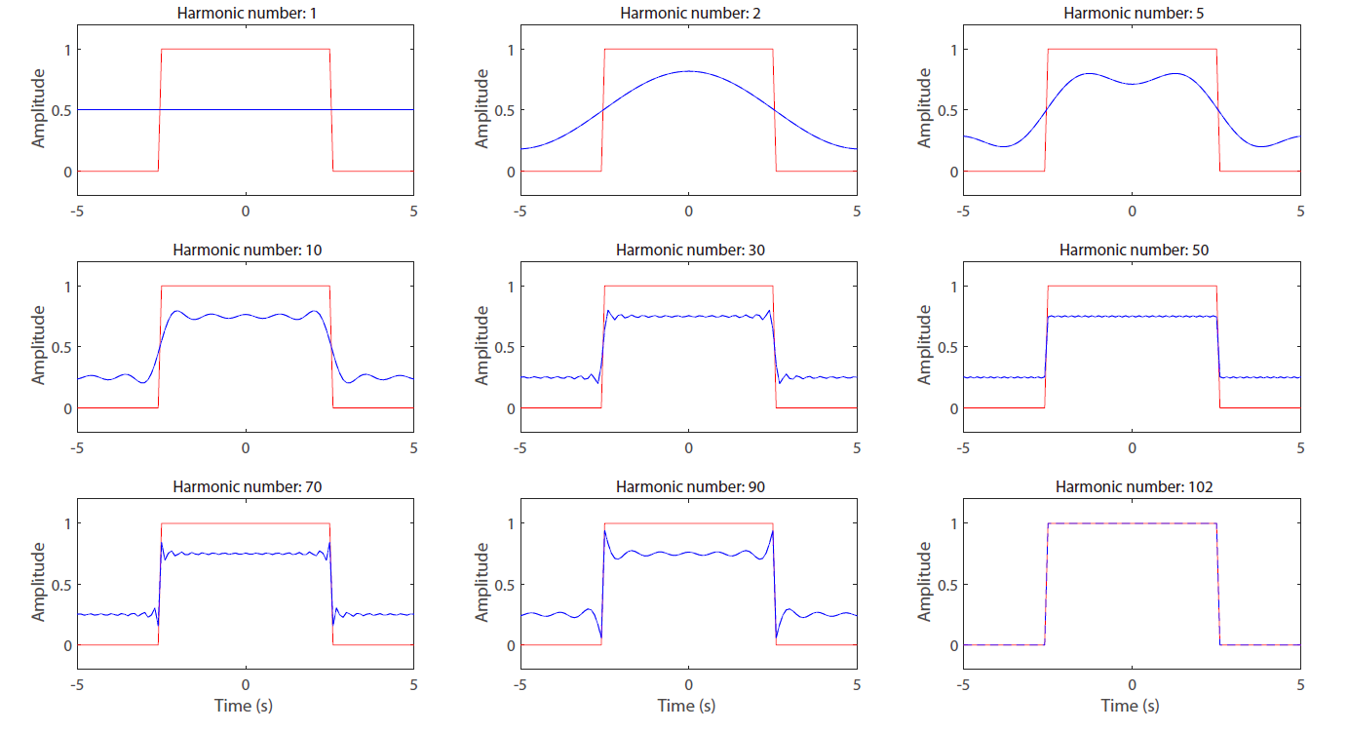

Slide 11
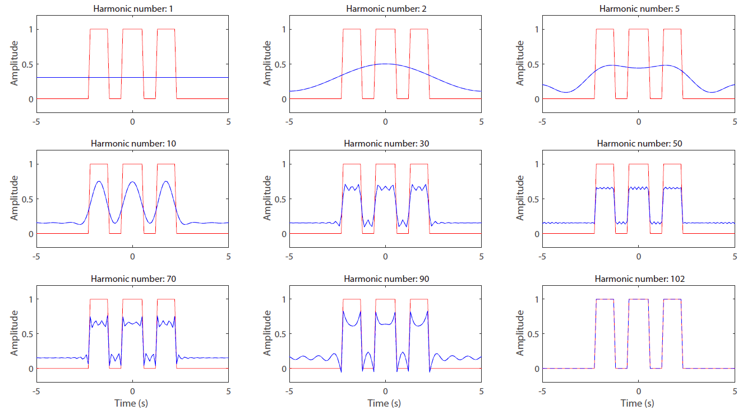

Slide 12
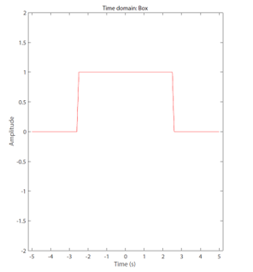
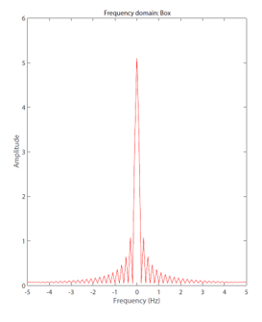


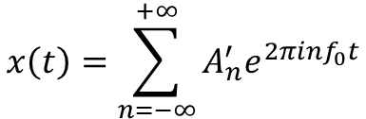
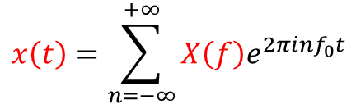
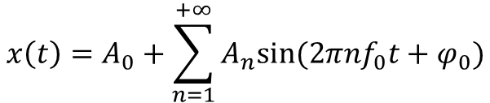
1.2 Signal in frequency domain
1.2.3 Fourier transform
x(0),x(1),x(2)
x(3),x(4),x(5)
$$x\left(t\right)=A_{0}+\sum_{n=1}^{+∞}{A_{n}sin⁡(2πnf_{0}t+φ_{0})}$$
t=0, 1, 2, 3, 4, 5
$$x\left(t\right)=\sum_{n=−∞}^{+∞}{{A_{n}^{′}e}^{2πinf_{0}t}}$$
(Harmonic basis function summation)
A0,
A1,
A2,
A3,A4,A5
$$x\left(t\right)=\sum_{n=−∞}^{+∞}{X\left(f\right)e^{2πinf_{0}t}}$$
$$e^{iφ}=\cos\left(φ\right)+isin\left(φ\right)$$
(Euler formula)
f=0, 1, 2, 3, 4, 5

Slide 13
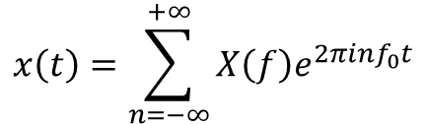
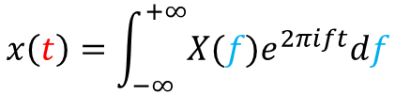
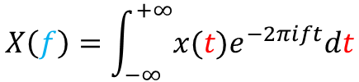
1.2 Signal in frequency domain
1.2.3 Fourier transform
$$x\left(t\right)=\int_{−∞}^{+∞}{X(f)e^{2πift}df}$$
Inversed fourier transform
Frequency domain → time domain
$$x\left(t\right)=\sum_{n=−∞}^{+∞}{X\left(f\right)e^{2πinf_{0}t}}$$
$$X\left(f\right)=\int_{−∞}^{+∞}{x(t)e^{−2πift}dt}$$
Fourier transform
Time domain→ frequency domain

Slide 14
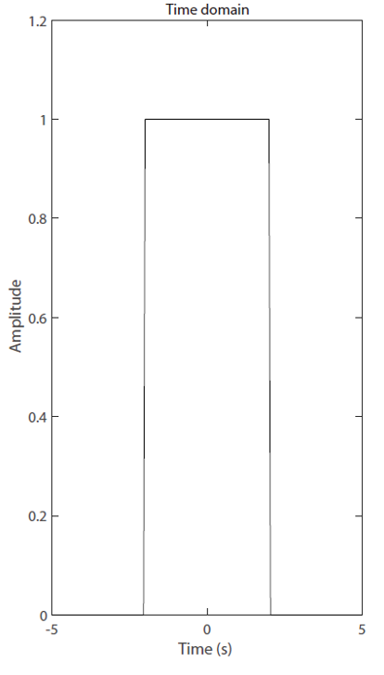
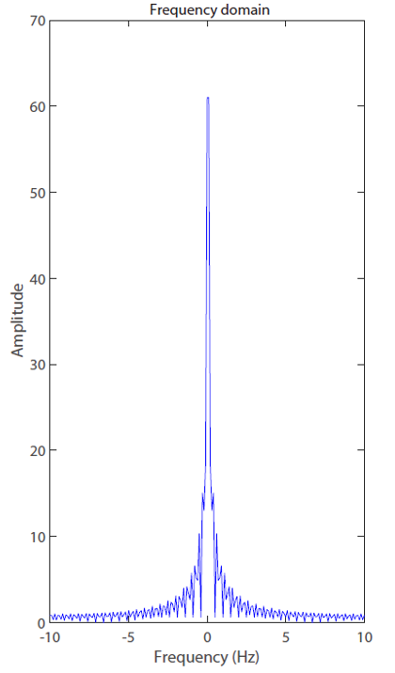
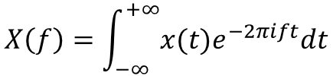
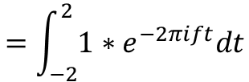




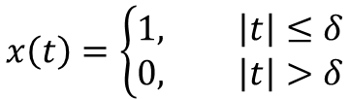
$$x\left(t\right)=\left\{\begin{aligned}1, \left|t\right|≤δ \\ 0, \left|t\right|>δ\end{aligned}\right.$$
$$X\left(f\right)=\int_{−∞}^{+∞}{x(t)e^{−2πift}dt}$$
$$=\int_{−2}^{2}{1∗e^{−2πift}dt}$$
$$=\frac{1}{−i2πf}(e^{−2δπift}−e^{2δπift})$$
$$=\frac{sin⁡(2δπf)}{πf}$$
$$−δ$$
$$δ$$

Slide 15
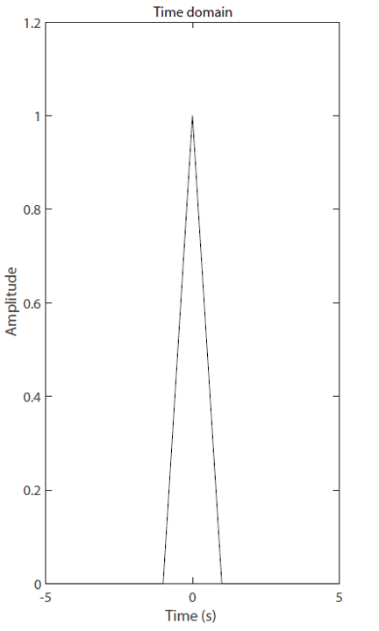
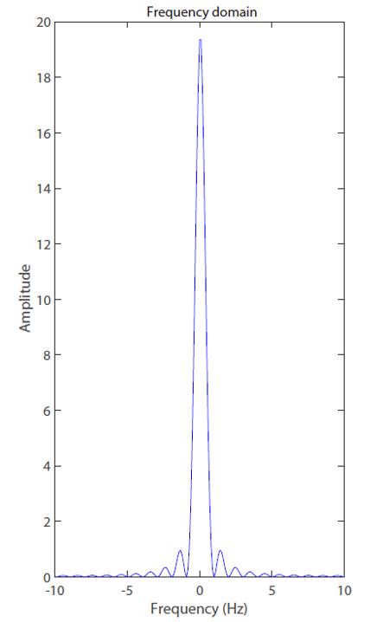
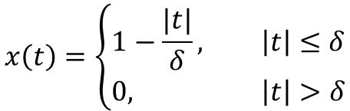

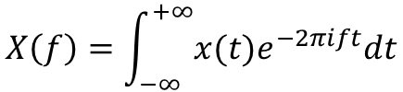


$$x\left(t\right)=\left\{\begin{aligned}1−\frac{|t|}{δ}, \left|t\right|≤δ \\ 0, \left|t\right|>δ\end{aligned}\right.$$
$$X\left(f\right)=\int_{−∞}^{+∞}{x(t)e^{−2πift}dt}$$
……
$$=\frac{\sin^{2}(πδf)}{π^{2}δf^{2}}$$
$$−δ$$
$$δ$$

Slide 16
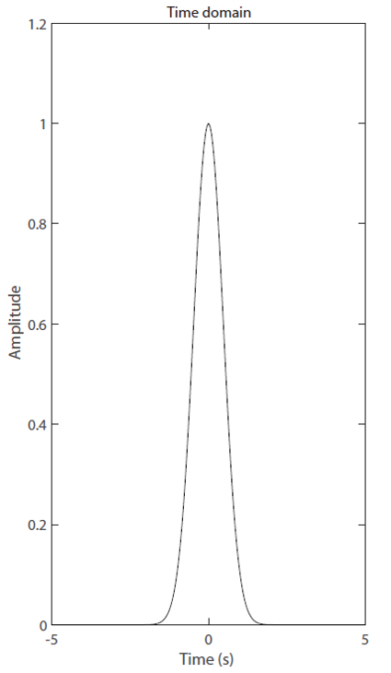
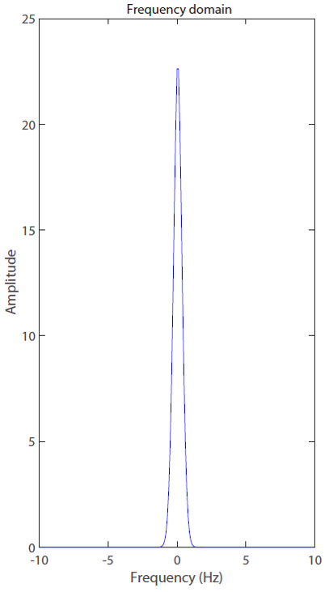


$$x\left(t\right)=e^{−δ^{2}t^{2}}$$
$$X\left(f\right)=\int_{−∞}^{+∞}{x(t)e^{−2πift}dt}$$
……
$$=\frac{\sqrt{π}}{δ}e^{−\frac{π^{2}f^{2}}{δ^{2}}}$$

Slide 17
1.2 Signal in frequency domain
1.2.4 Fast Fourier Transform
(Gooley & Tukey)
Matlab code
Python code
X(f)=fft(x(t));
X(f)=np.fft.fft(x(t))
x(t)=ifft(X(f));
x(t)=np.fft.ifft(X(f))

Slide 18
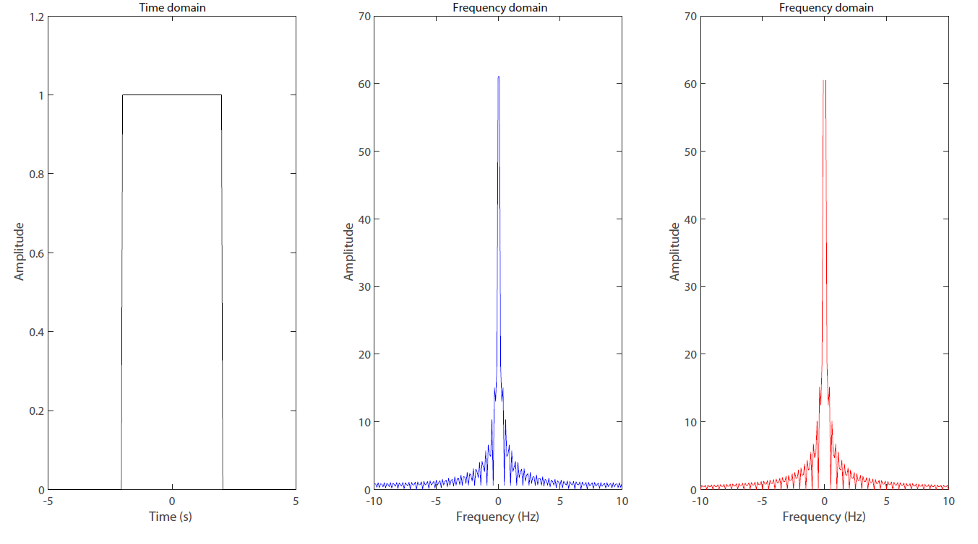
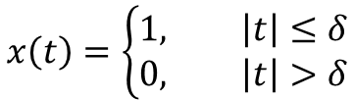


$$x\left(t\right)=\left\{\begin{aligned}1, \left|t\right|≤δ \\ 0, \left|t\right|>δ\end{aligned}\right.$$
$$X(f)=\frac{sin⁡(2δπf)}{πf}$$
$$fft(x(t))$$

Slide 19
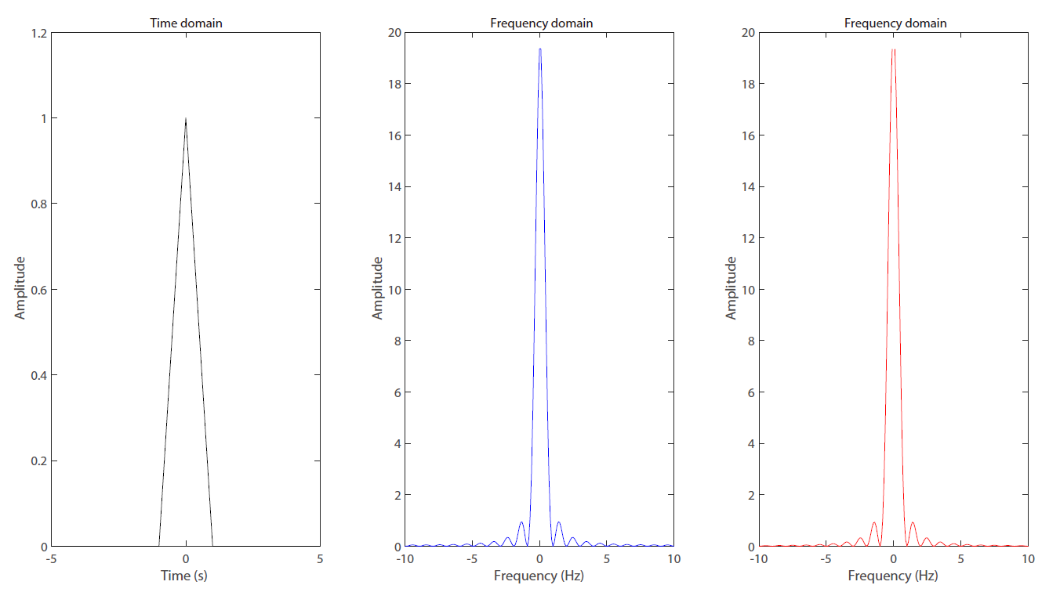

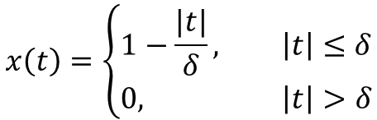

$$x\left(t\right)=\left\{\begin{aligned}1−\frac{|t|}{δ}, \left|t\right|≤δ \\ 0, \left|t\right|>δ\end{aligned}\right.$$
$$X(f)=\frac{\sin^{2}(πδf)}{π^{2}δf^{2}}$$
$$fft(x(t))$$

Slide 20
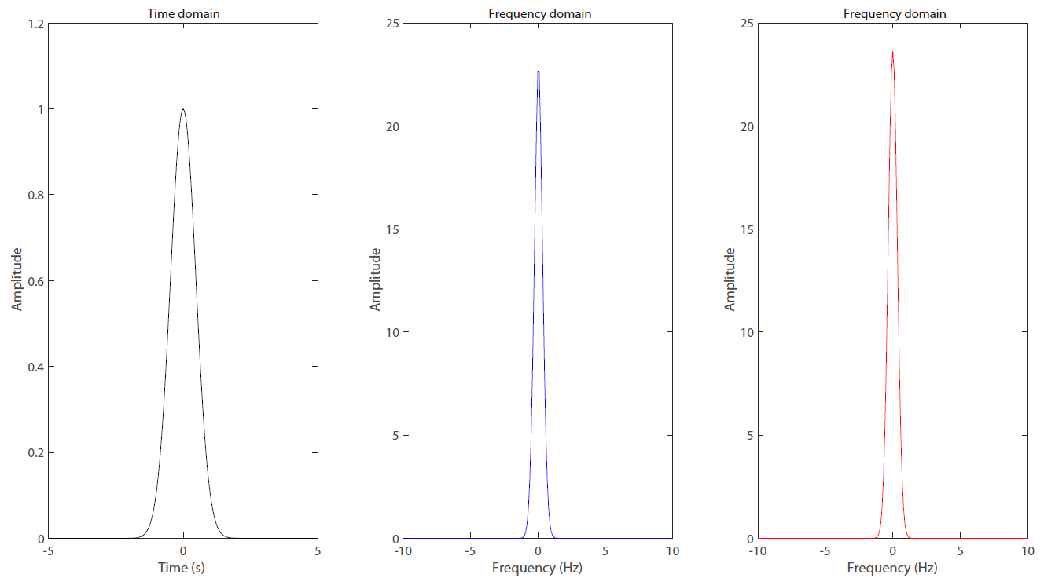



$$x\left(t\right)=e^{−δ^{2}t^{2}}$$
$$X(f)=\frac{\sqrt{π}}{δ}e^{−\frac{π^{2}f^{2}}{δ^{2}}}$$
$$fft(x(t))$$

Slide 21
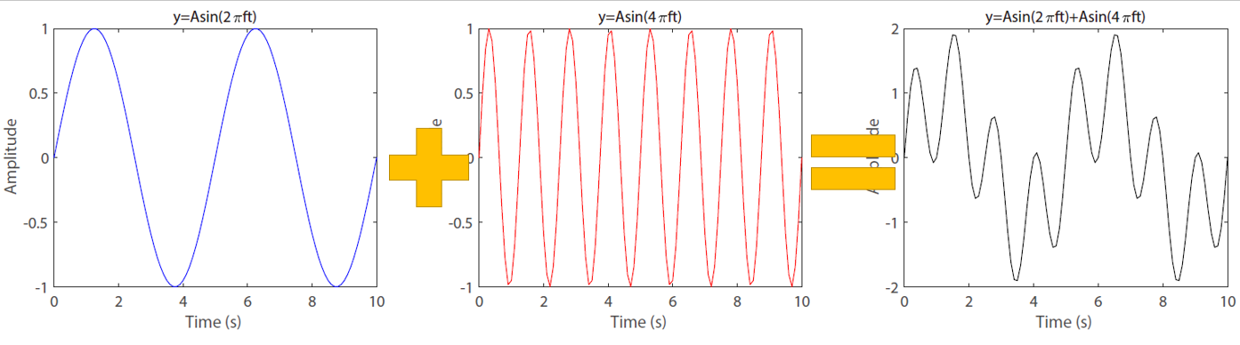
1.3 Filtering and convolution

Slide 22
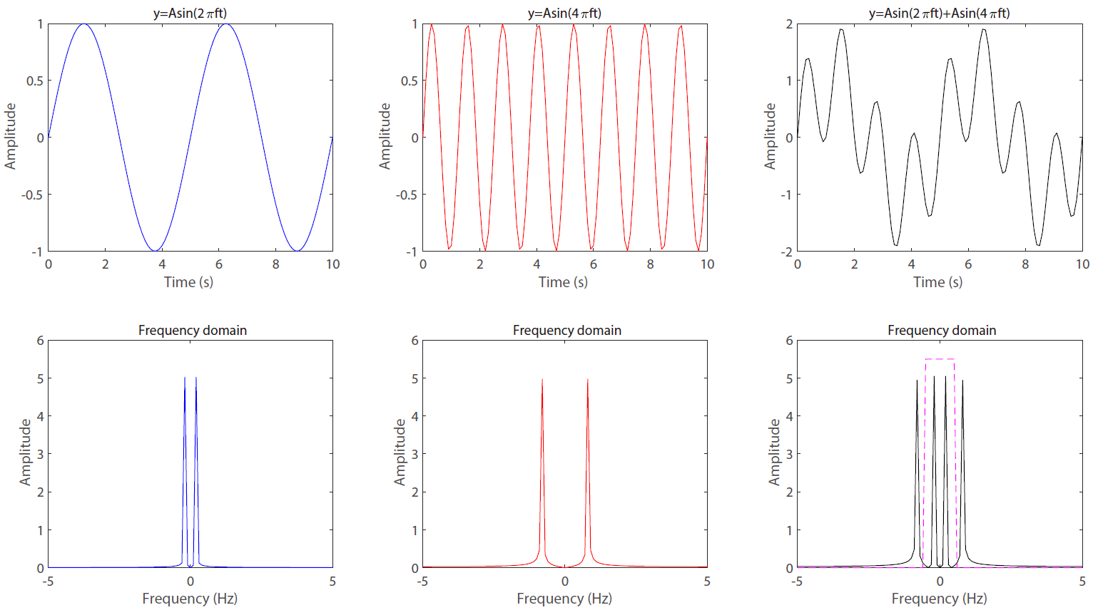

Slide 23
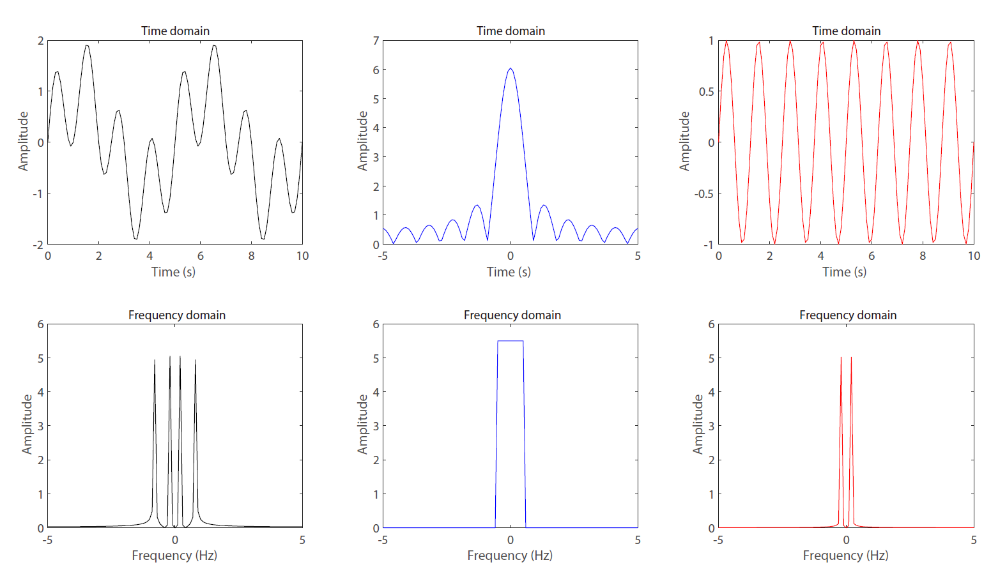

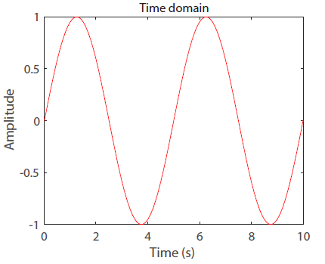
Low-pass Filtering
(High-cut Filtering)

Slide 24




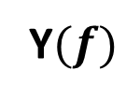


$$?$$
$$x(t)$$
$$h(t)$$
$$y(t)$$
$$X(f)$$
$$H(f)$$
Y$(f)$

Slide 25
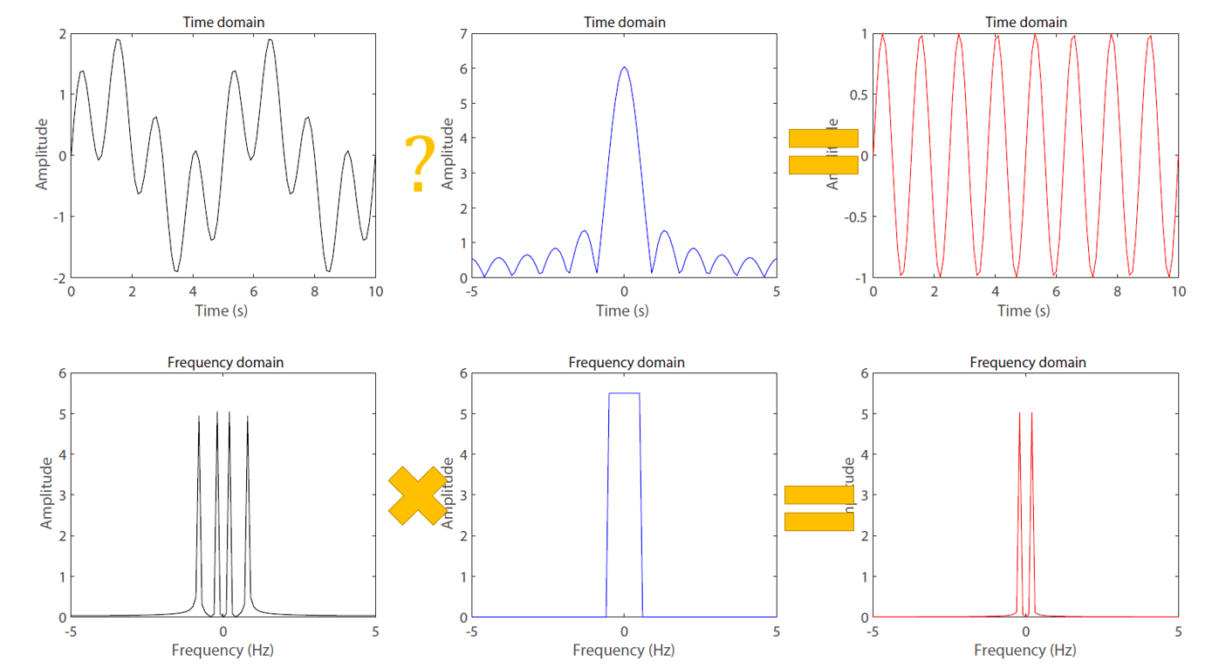




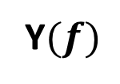


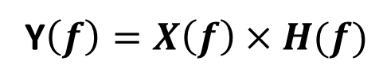
1.3 Filtering and convolution
1.3.2 Introduction to convolution
$$x(t)$$
$$h(t)$$
$$y(t)$$
Y$\left(f\right)=X\left(f\right)×H(f)$
$$y\left(t\right)=x\left(f\right) ?h\left(t\right)$$
$$X(f)$$
$$H(f)$$
Y$(f)$

Slide 26
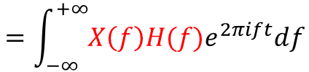
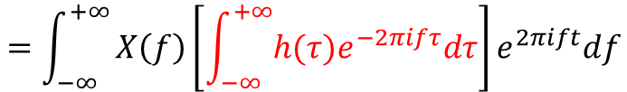
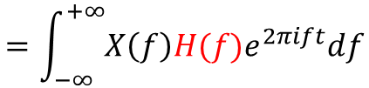
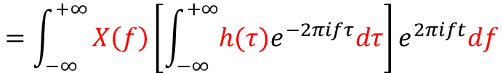
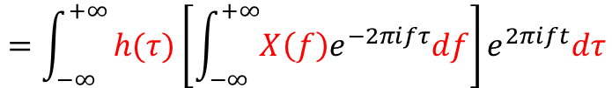
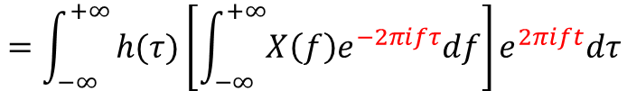
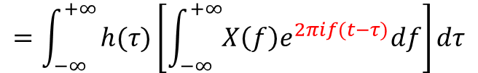
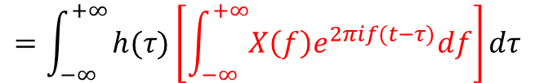
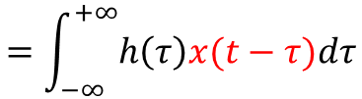

$$y\left(t\right)=\int_{−∞}^{+∞}{Y(f)e^{2πift}df}$$
$$=\int_{−∞}^{+∞}{X\left(f\right)H(f)e^{2πift}df}$$
$$=\int_{−∞}^{+∞}{X\left(f\right)H(f)e^{2πift}df}$$
$$=\int_{−∞}^{+∞}{X\left(f\right)\left[\int_{−∞}^{+∞}{h(τ)e^{−2πifτ}dτ}\right]e^{2πift}df}$$
$$=\int_{−∞}^{+∞}{X\left(f\right)\left[\int_{−∞}^{+∞}{h(τ)e^{−2πifτ}dτ}\right]e^{2πift}df}$$
$$=\int_{−∞}^{+∞}{h(τ)\left[\int_{−∞}^{+∞}{{X\left(f\right)e}^{−2πifτ}df}\right]e^{2πift}dτ}$$
$$=\int_{−∞}^{+∞}{h(τ)\left[\int_{−∞}^{+∞}{{X\left(f\right)e}^{−2πifτ}df}\right]e^{2πift}dτ}$$
$$=\int_{−∞}^{+∞}{h(τ)\left[\int_{−∞}^{+∞}{{X\left(f\right)e}^{2πif(t−τ)}df}\right]dτ}$$
$$=\int_{−∞}^{+∞}{h(τ)\left[\int_{−∞}^{+∞}{{X\left(f\right)e}^{2πif(t−τ)}df}\right]dτ}$$
$$=\int_{−∞}^{+∞}{h\left(τ\right)x(t−τ)dτ}$$

Slide 27








$$y\left(t\right)=\int_{−∞}^{+∞}{x\left(τ\right)h\left(t−τ\right)dτ}=x\left(t\right)∗h(t)$$
$$y\left(t\right)=x\left(f\right) ?h\left(t\right)$$
$$x(t)$$
$$h(t)$$
$$y(t)$$
Y$\left(f\right)=X\left(f\right)×H(f)$
$$y\left(t\right)=x\left(t\right)∗h(t)$$
Y$\left(f\right)=X\left(f\right)∗H(f)$
$$y\left(t\right)=x\left(t\right)×h(t)$$
$$X(f)$$
$$H(f)$$
Y$(f)$

Slide 28

1.3 Filtering and convolution
1.3.3 Gibbs phenomena

Slide 29



Slide 30

1.3 Filtering and convolution
1.3.3 Gibbs phenomena

Slide 31
1.3 Filtering and convolution
1.3.4 Usages of Butter-worth filtering
Parameters:
Frequency band
Band-pass: [low, high]
High-pass : high
Low-pass : low
Order
1,2,3, … ,n
3. Pass
1: filter / filtering
2: filtfilt
Matlab code
[bb,aa]=butter(Order,2*dt*[low_fre high_fre],'bandpass');
Output_data=filtfilt(bb,aa,Input_data);
Output_data=filter(bb,aa,Input_data);
Python code
b, a = signal.butter(Order, [2*delta*low_fre, 2*delta*high_fre], 'bandpass')
Output_data=signal.filtfilt(b, a, Input_data)
Output_data=signal.filtering(b, a, Input_data)
SAC code
>> r input_data
>> bandpass low_fre high_fre n Order p Pass
>> w output_data

Slide 32


Slide 33

Non-Causal
Zero phase
Causal
Non-zero phase

Slide 34


1.4 Digitization
1.4.1 Digitization and Nyquist frequency
$$F_{max}=\frac{1}{2∗dt}=\frac{1}{2∗0.1}=5Hz$$
dt=0.1s

Slide 35



1.4 Discretizing, down-sampling and Nyquist frequency
1.4.2 Down-sampling and artifact
dt=0.1s→0.2s
$$F_{max}=\frac{1}{2∗dt}=\frac{1}{2∗0.2}=2.5Hz$$

Slide 36



For a car running at 60km/h, the speed of the wheel is 8 laps per second.
The wheel has ten spokes, the max speed for the spoke is 8*10=80 /s, Roughly “80Hz”
The minimum time for human eyes to recognize is 40ms. ~ 1/0.04=25Hz
25Hz (Eye) << 80Hz (spoke)
Down-sampling
25Hz
80Hz

Slide 37
Thanks

