Slide 1
KAMARAJ COLLEGE, THOOTHUKUDI DEPARTMENT OF PHYSICS
GROUP MEMBERS:
M.DINESHKUMAR
S.MARI VIGNESHWARAN
M.SANKARA PARAMESH
M.SUDALAI MUTHU
PROJECT REPORT
THE TABLEAU HR SCORECARD: Measuring
success in talent management
1.Introduction:
1.1. overview:
Talent management includes all the ways that organizations bring employees ob board,keep
them happy and productive,and help them continue to develop their skills over time.Talent management
practives have evolved over the years to cater to people-specific trends much like all other aspects of
work and strategic talent management is a necessity in today’s hyper-change environment.
1.2 Purpose:
The purpose of talent management is to identify, recruit and hold on to people who drive
the success of your organisation. It’s a top priority,strategic process for forward looking people
companies who understand that their company performance depends on their workforce.

Slide 2
2.Problem Definition & Design Thinking:
Working in a comopany or running a business, then you might come across
professionals in your day to day life? But be true about how many among them are actually talented professionals? This is a great question of concern. In today’s time there is no inadequacy of
professionals, but what actuaaly lacks is the talent .The increasing population and advancement
in the education system have resulted in the creation of a huge talent gap.
2.1 Empathy Map :

Slide 3
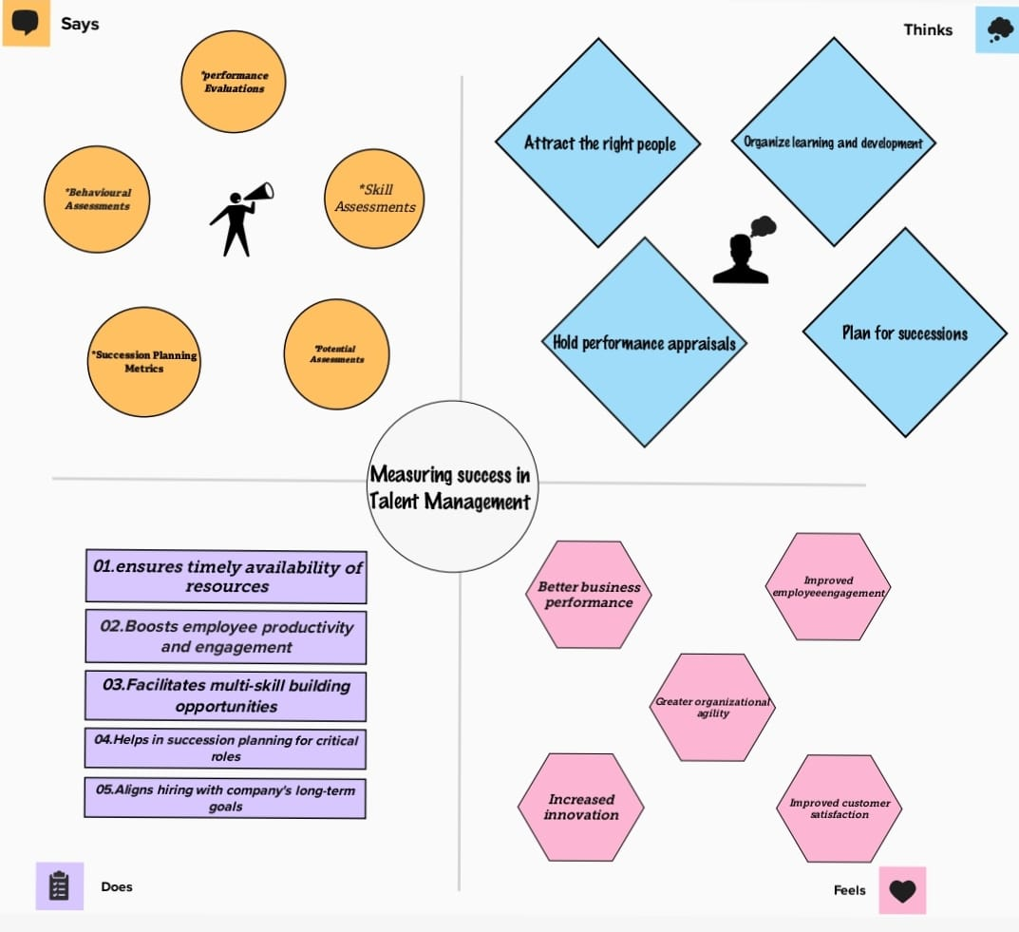

Slide 4
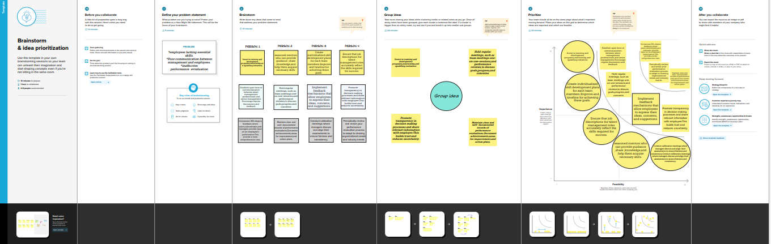
2.2 Brainstorm map

Slide 5

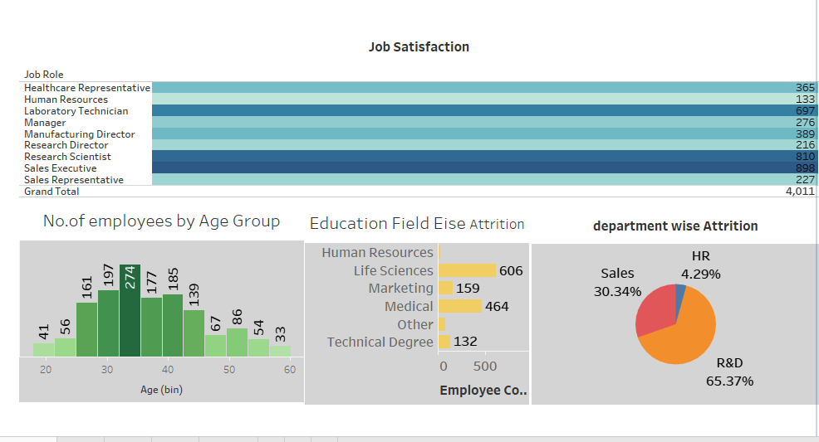
3.Result :

Slide 6
4.Advantages & disadvantages :
The advantages are help in ascertaining the right person is deployed in the
right position. Promotes effective communication across different disciplines.
the disadvantages are lack of support from line mangers can impede the level of
commitment from employees.
5.Applications :
performance Management : After succession planning and leadership
development, performance management comes next on the list. Without a
Thorough and standard wat to measure performsnce it is not possible to promote
right person to right positions and motivate them to perform for organizational
growth and development.
6.Conclusion :
Talent Management has become one of the most important buzzwords in
corporate Hr and training today. Organizations know that they must have the
best talent in order to succeed in hypercompetitive and increasingly complex
global economy. They must manage talent in a critical resource to achieve the
best possible results in long run.

Slide 7
7. Future Scope :
The Hr department of any organisation is vested with the responsibility of
managing the talent in addition to its conventional function of providing good human capital to an organization. In order to perform this function they use the following methods:
1.Identifying the talent which is required , 2. Right selection of the talent ,
3.Implementing competitive compensation plans ,
4.Aligning the acquired talent , 5.developing and nurturing the talent .
The future scope of talent management is quite wide and adopts an
integrative approach to the functions methods above.
8.Appendix :
*Strategic employee planning
*Talent acquisition and tetention
*Performance management
*Learning and motivation
*Compensations
*Career development
*Succession planning

