Slide 1
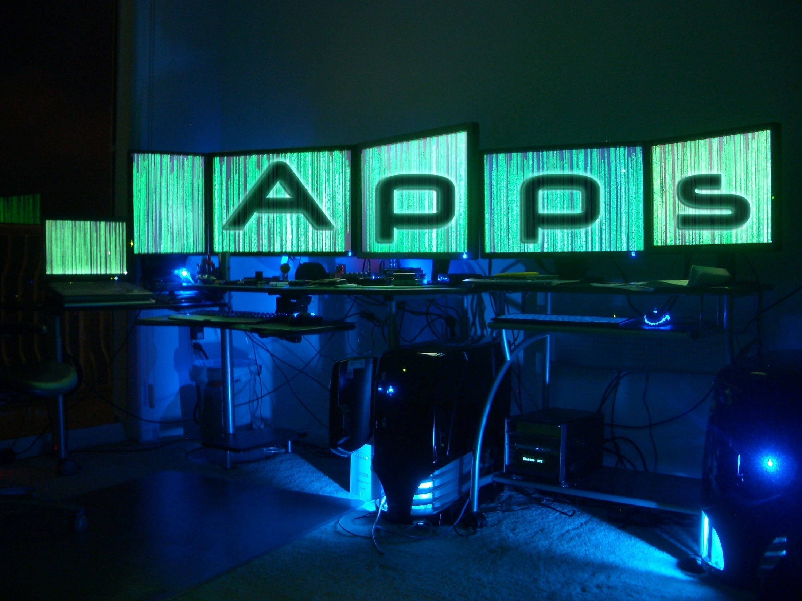

Slide 2
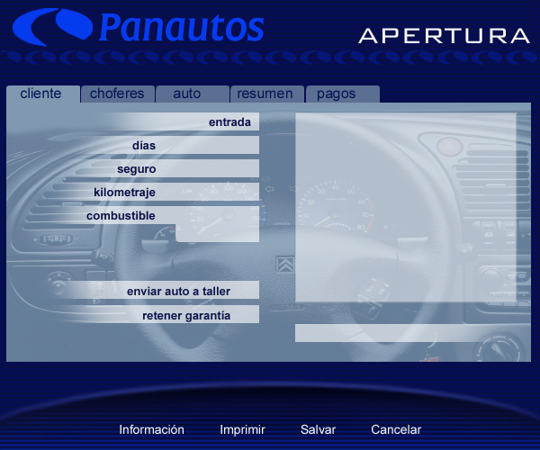

Slide 3
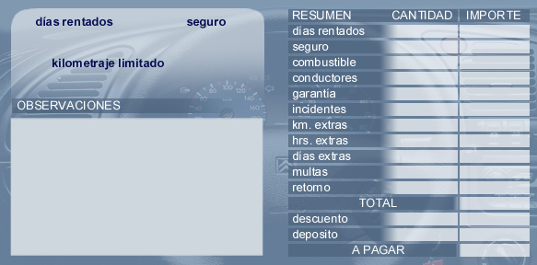

Slide 4
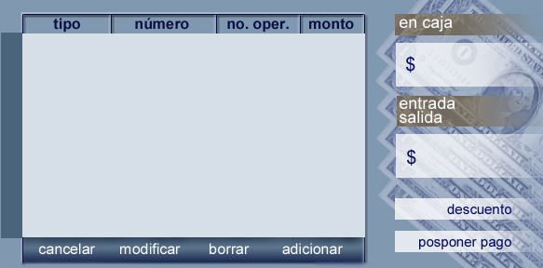
. ORM using Active Record
. CRUD through stored procs
. DDD
. Distributed
. XP practices

Slide 5
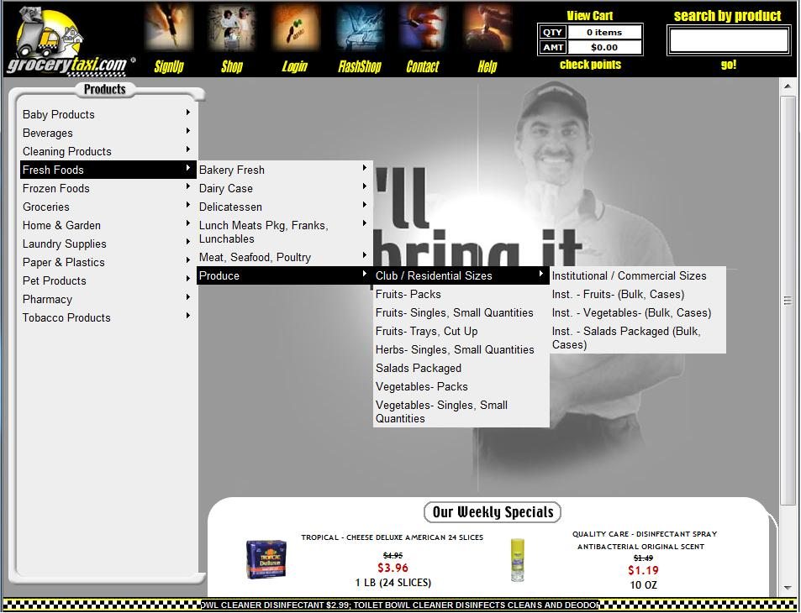

Slide 6
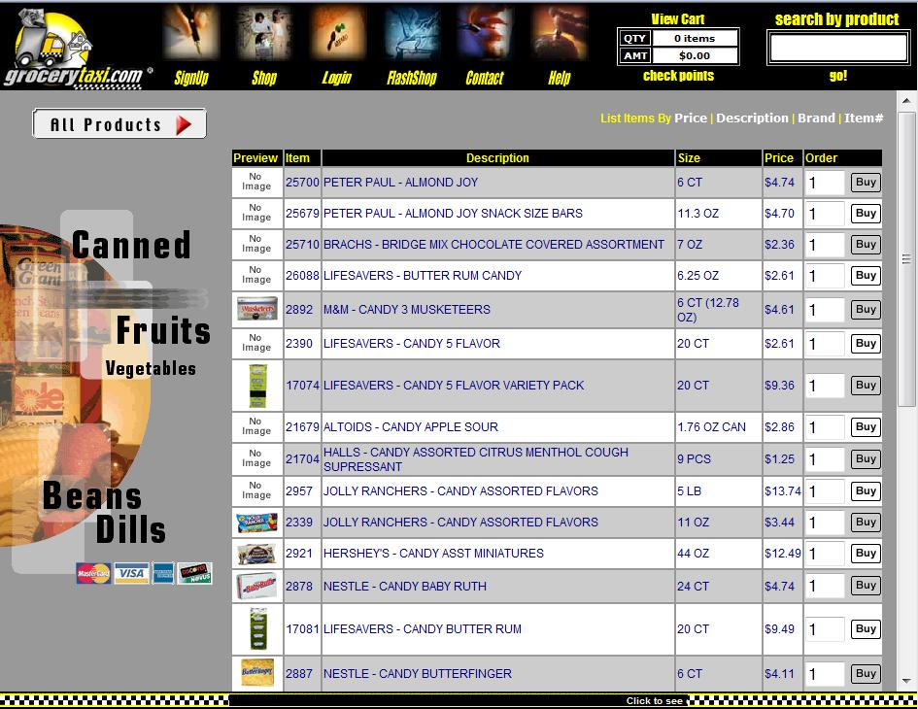

Slide 7
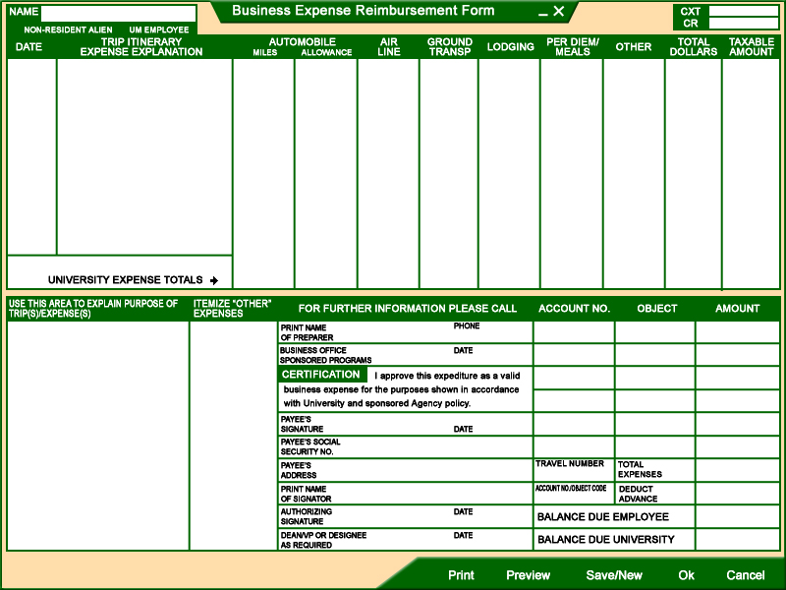

Slide 8
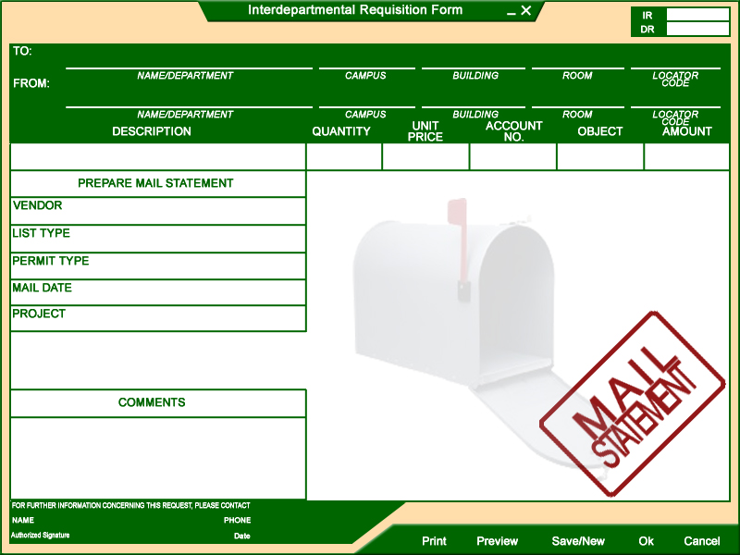
. RUP
. VSS

Slide 9
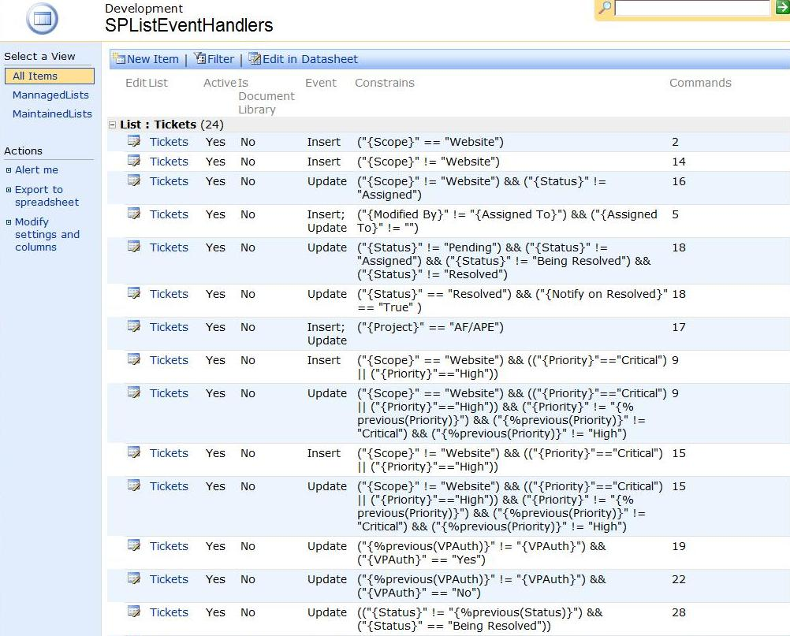

Slide 10
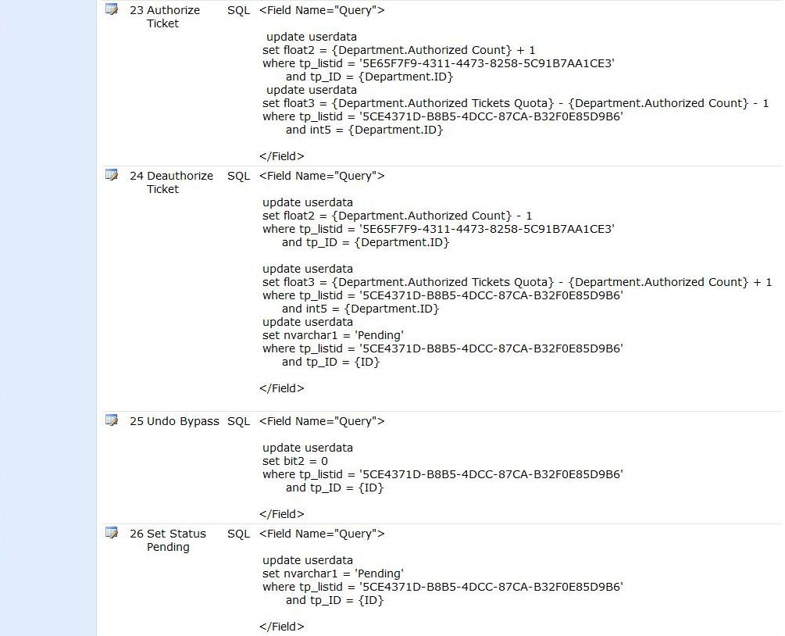

Slide 11
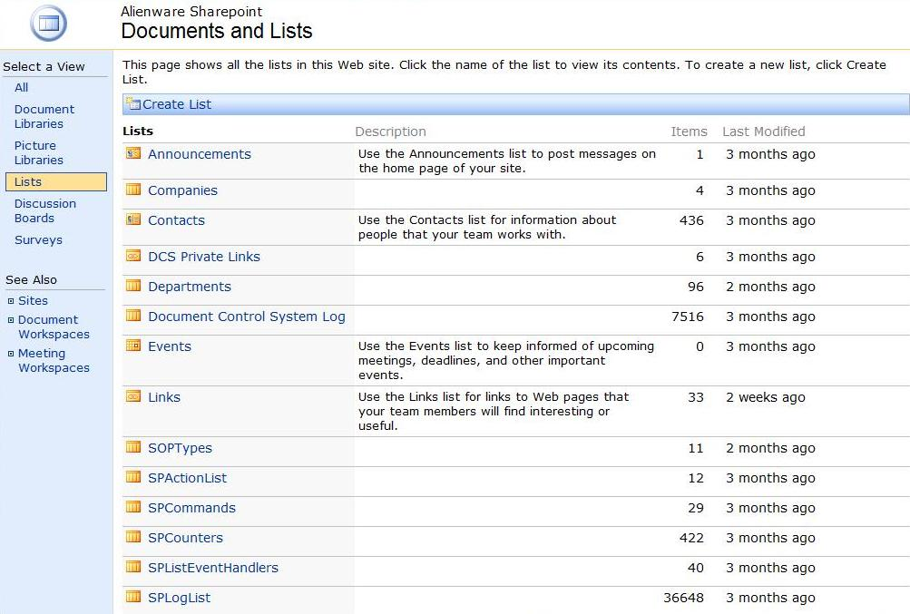
Agent Smith
. Workflow Engine
. Design Patterns
. Light, dynamic, flexible
. 20x80 rule
. Opinionated

Slide 12
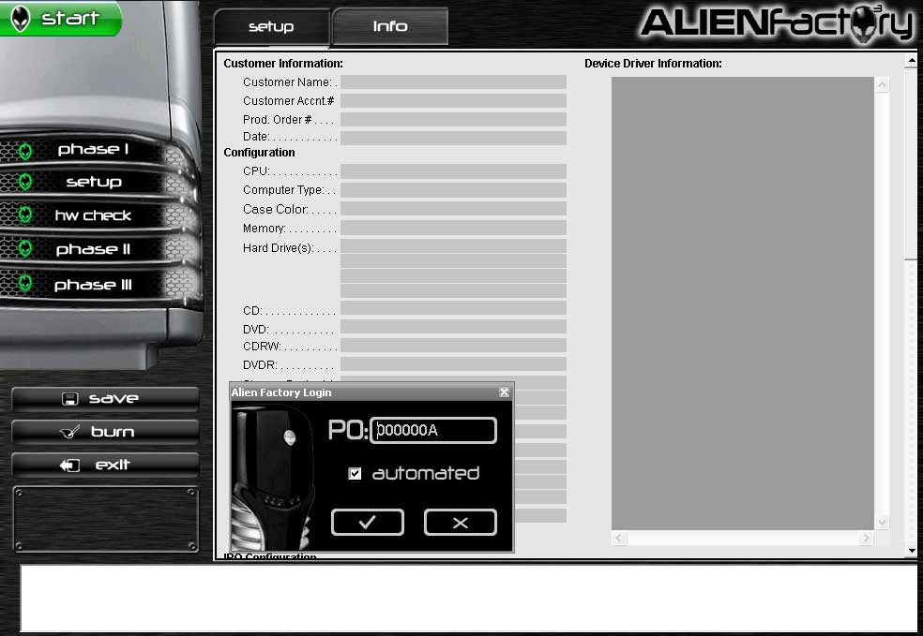

Slide 13
. Favorite business app
. Business critical
. Legacy code
. Dynamic domain
. v3 25% improvement

Slide 14
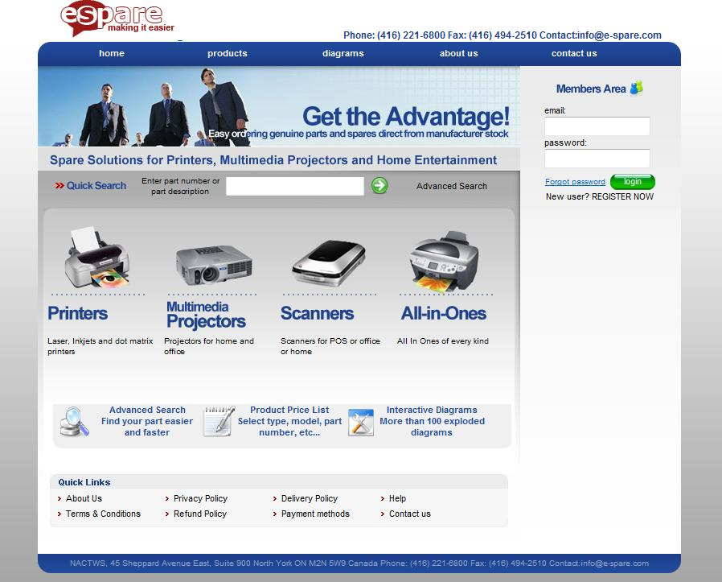

Slide 15
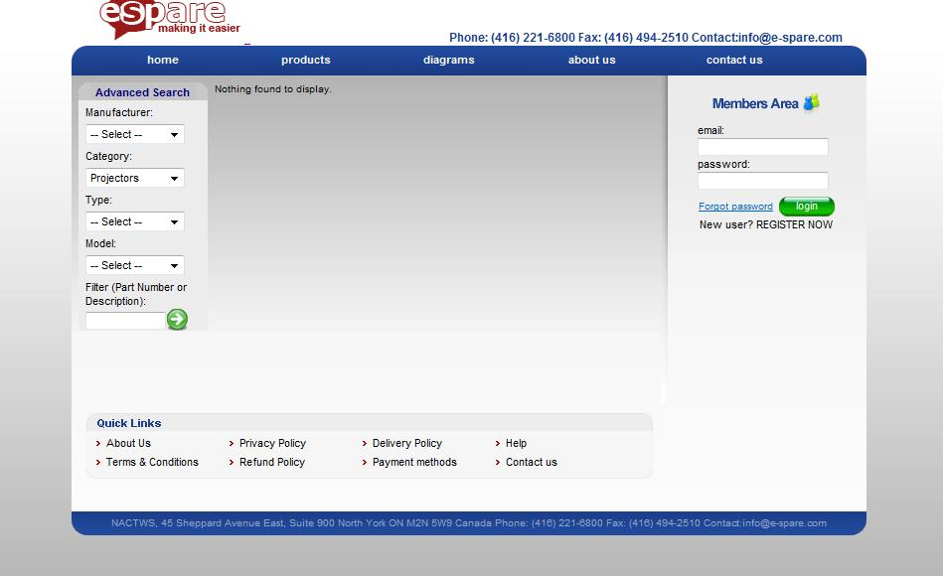
. Full-fledged agile
. Hibernate
. Spring-MVC
. JUnit, JMock
. AJAX
. CI via Continuum & SVN

Slide 16
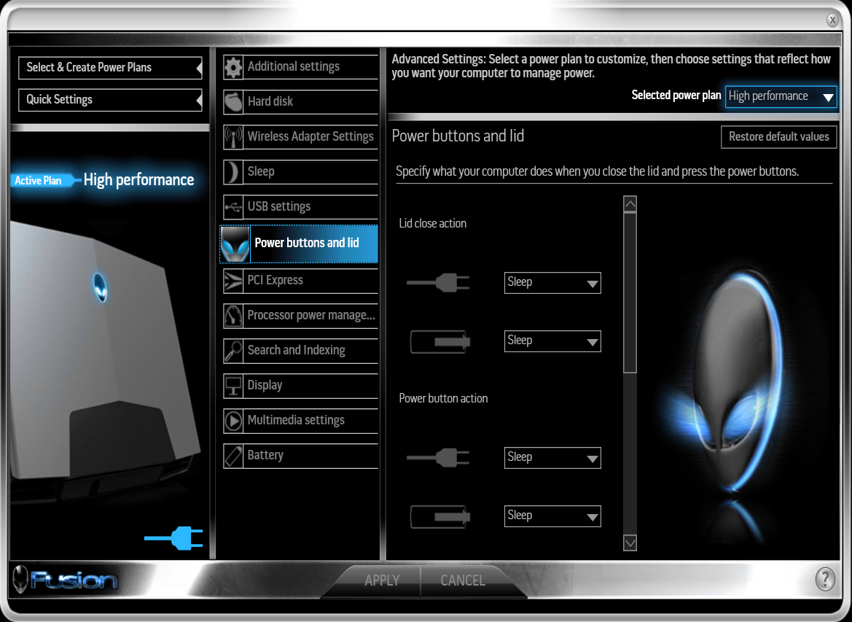

Slide 17
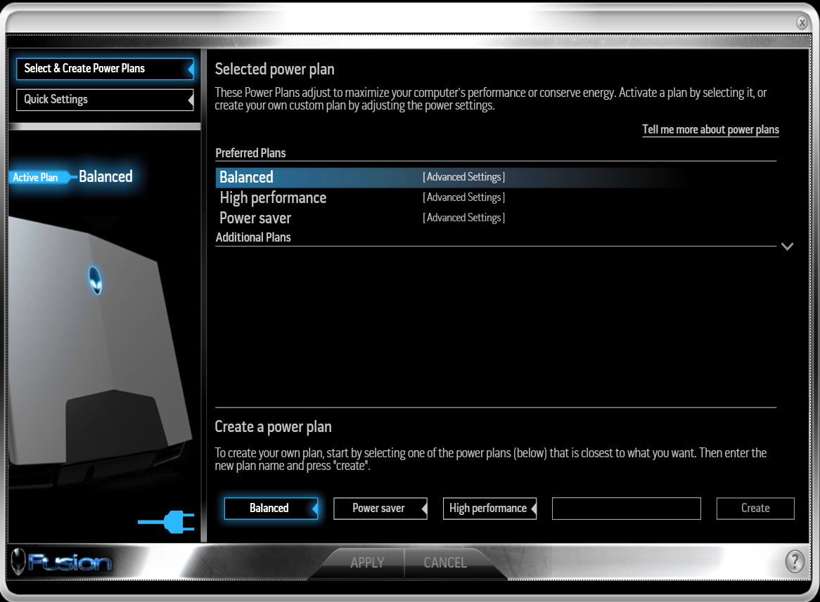
. First WPF app
. MSTest
. NMock, RhinoMocks
. COM+ WinServices API
. CI via MS Team Server

Slide 18
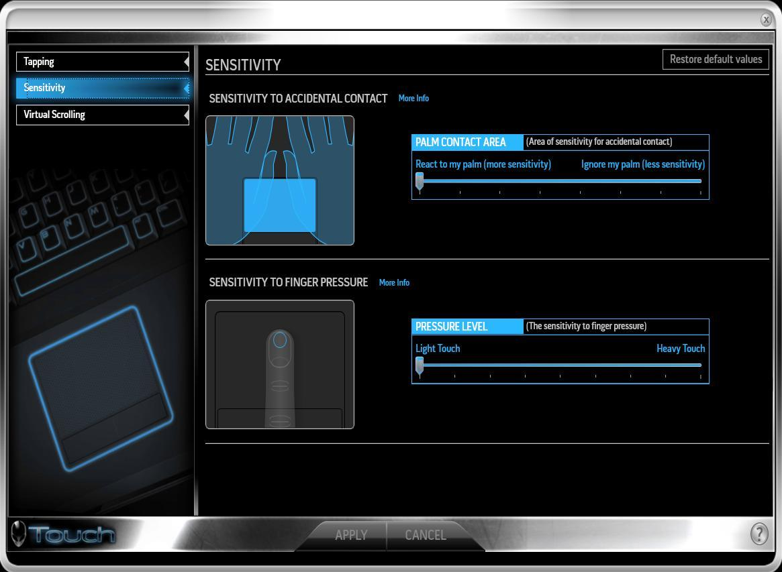

Slide 19
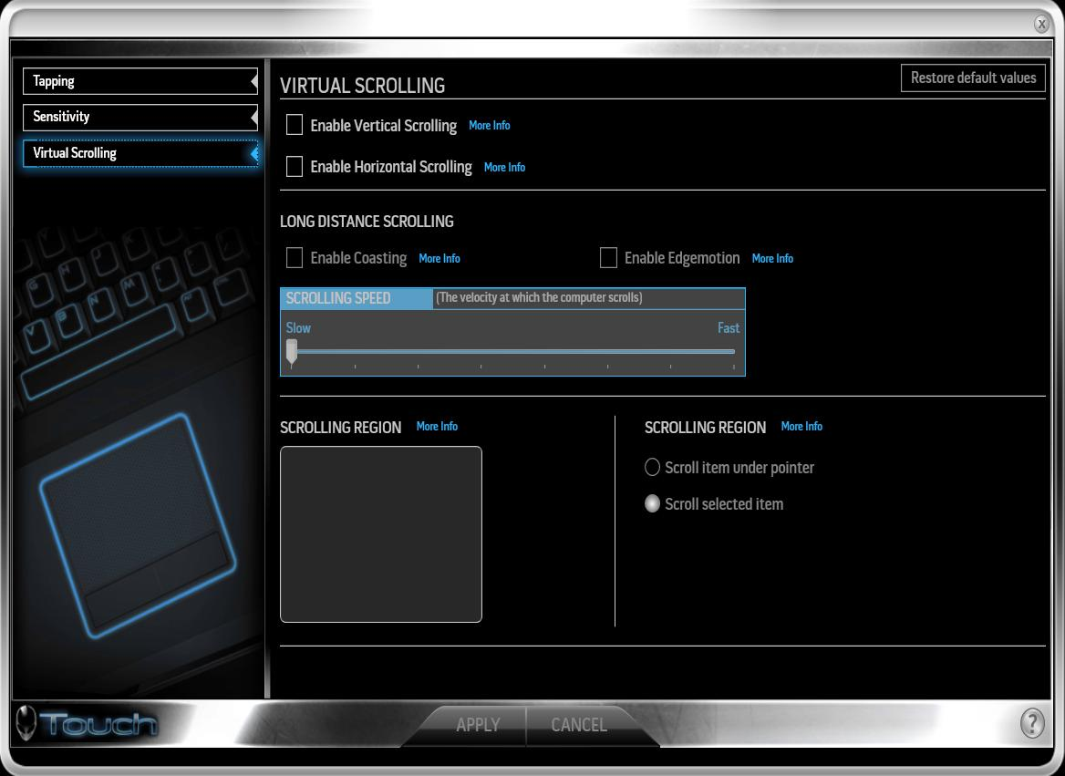

Slide 20
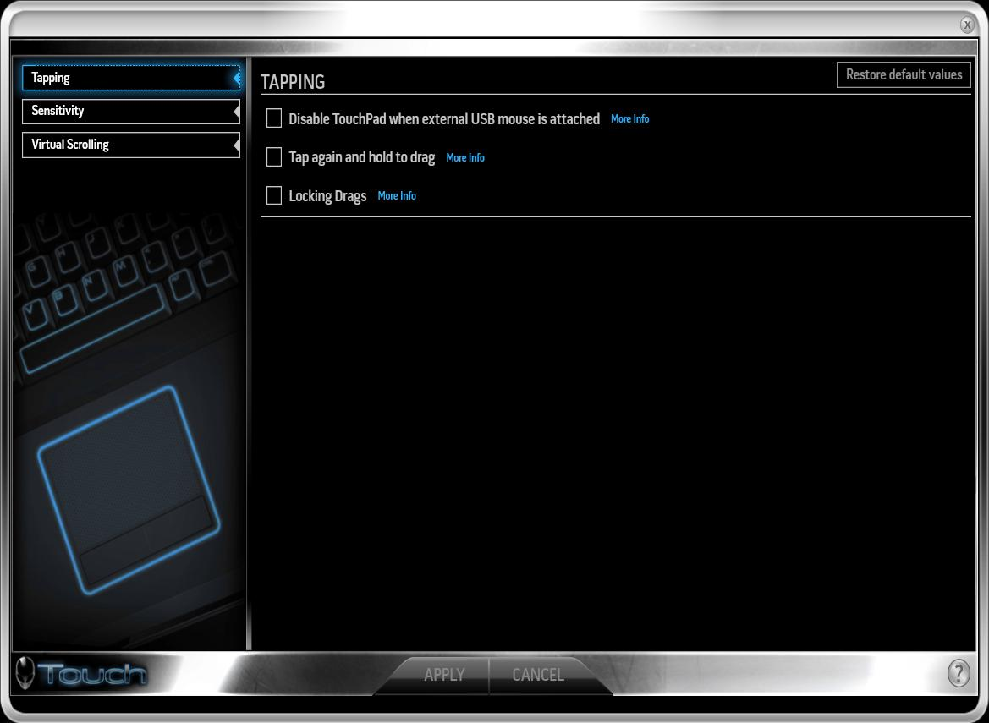
. Coached the team adopting agile
. MVP with domain command queue
. Highly decoupled
. Pair Programming
. BDD Implementation patterns
. Automated acceptance tests

Slide 21
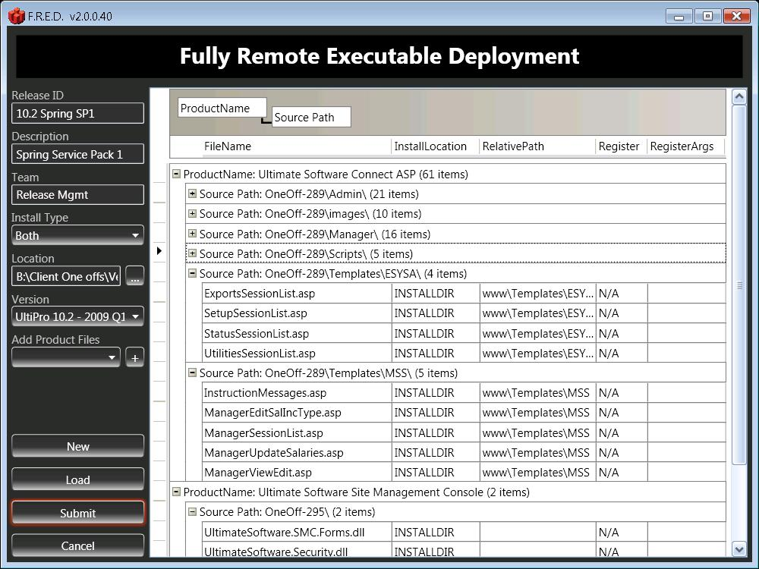

Slide 22
. First WPF app in TV
. Improved UX for OneOffs
. CCNet, NAnt, MSBuild
. Linked to BOM

Slide 23
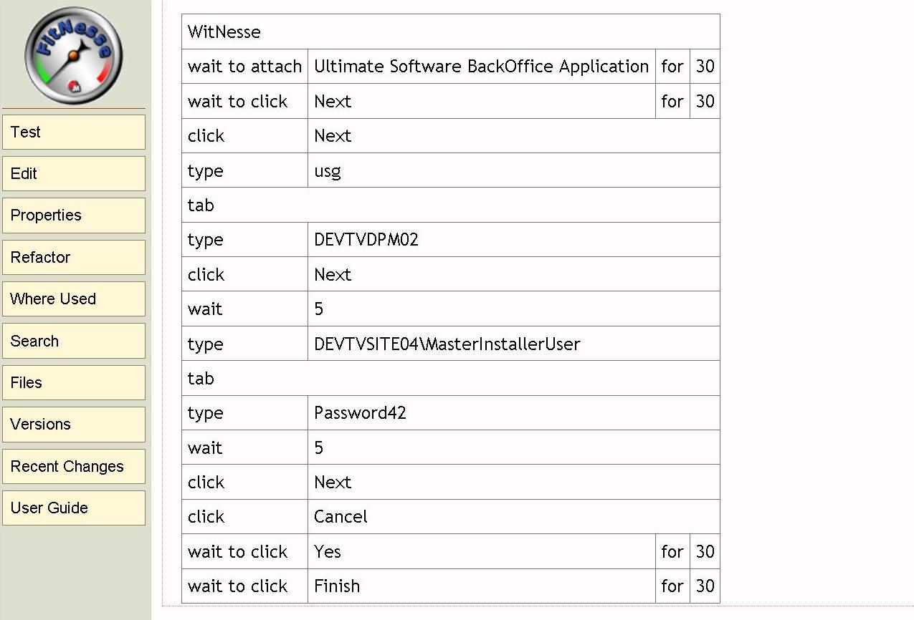

Slide 24
. UI testing framework for winapps
. White to FitNesse adapter
. Optimized for msi
. Automated manual tests
. Reduce regression effort
. Increase tester’s quality of work

Slide 25
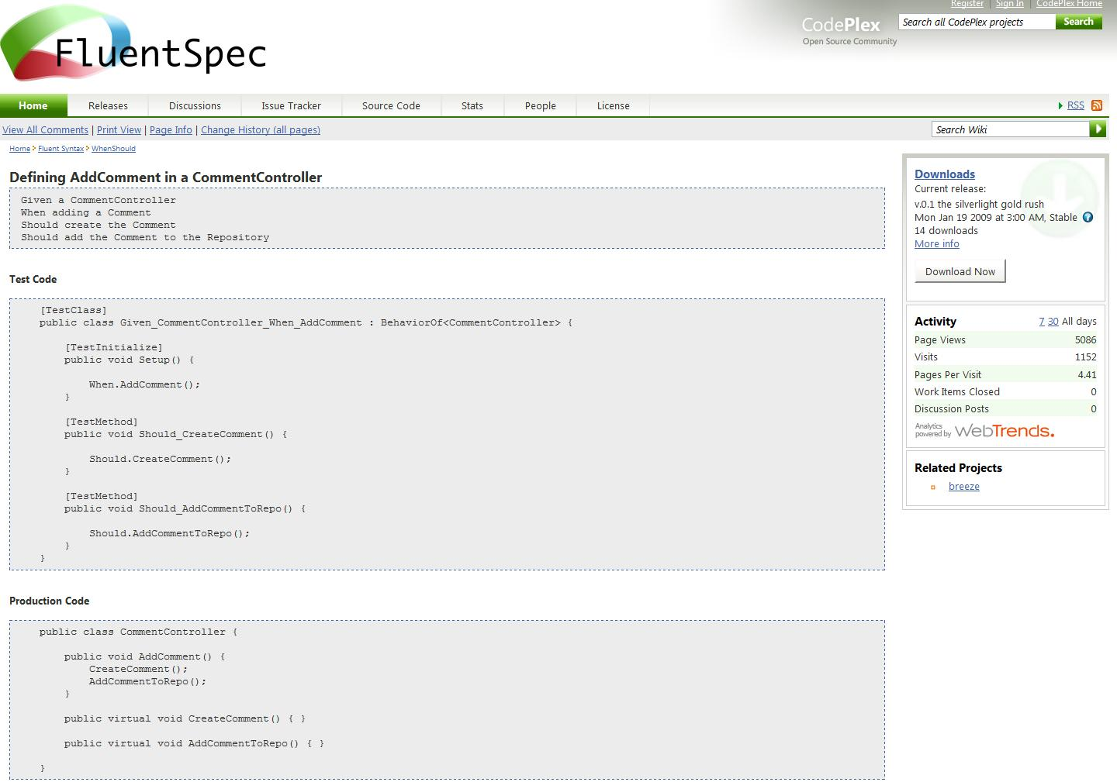

Slide 26
. Mock framework with BDD flavor
. Extreme isolation of SUT
. Simplicity
. Single test double to avoid Stub vs Mock
. Automock container promotes DIP
. Fluent interface to avoid lambdas

Slide 27
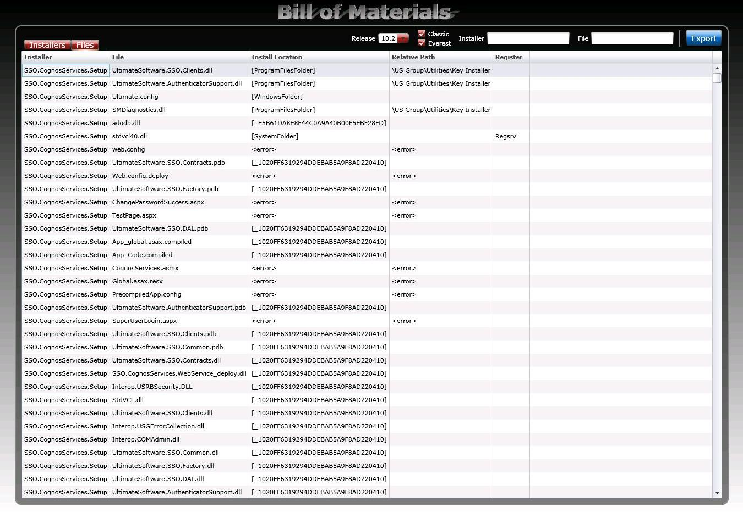

Slide 28
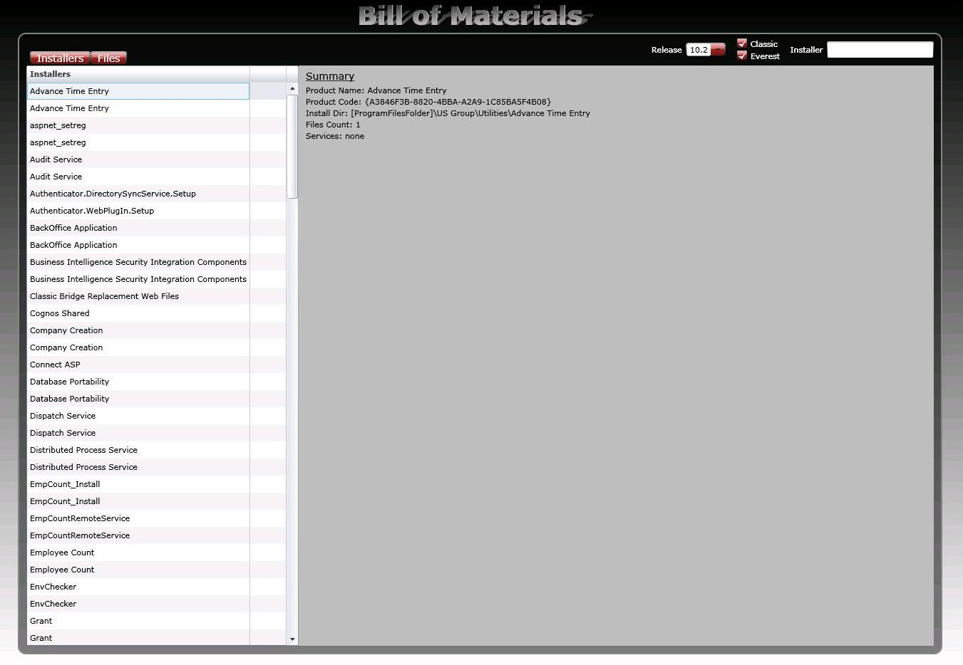
. Silverlight
. LINQ to msi via Wix
. SOAP provider for FRED
. ATDD

