Slide 1

Acceptance Tests running on Node with Decaf and Coffeescript

Slide 2


Slide 3


Slide 4


Slide 5


Slide 6
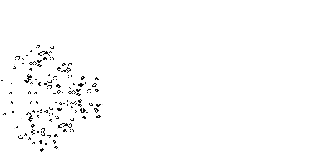

Slide 7
