Slide 1






https://github.com/limadelic/raconteur

Slide 2
rac·on·teur
noun /ˌrakˌänˈtər/ /-ən-/ raconteurs, plural
A person who tells anecdotes in a skillful and amusing way
Acceptance test framework for C#
Allows writing stories in plain text with VisualStudio The stories are executed as xUnit tests

Slide 3
Agenda
Definition
Advantages for testers
Advantages for developers
Hello Raconteur
Examples

Slide 4
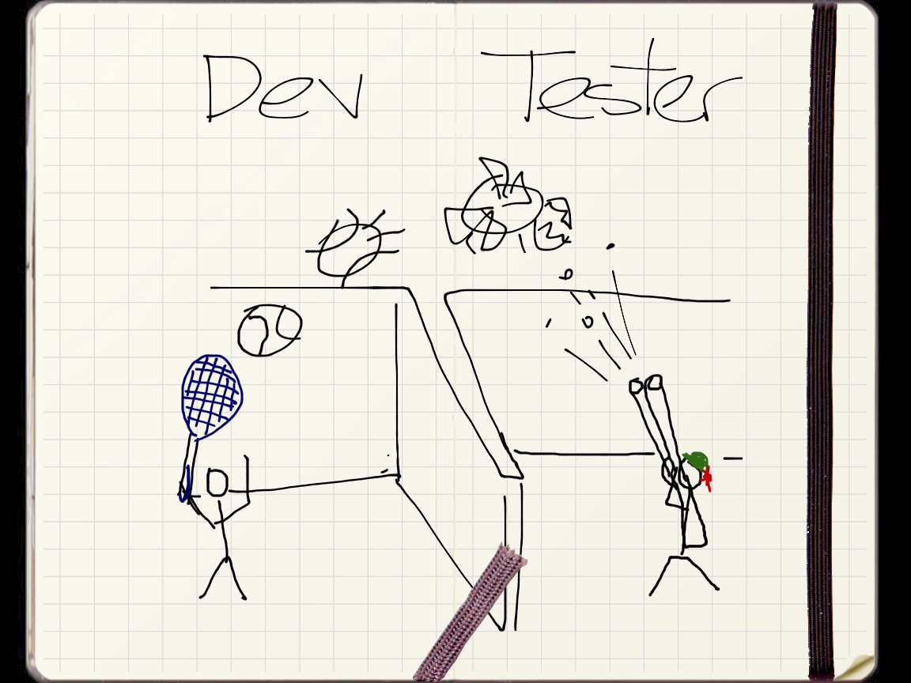

Slide 5
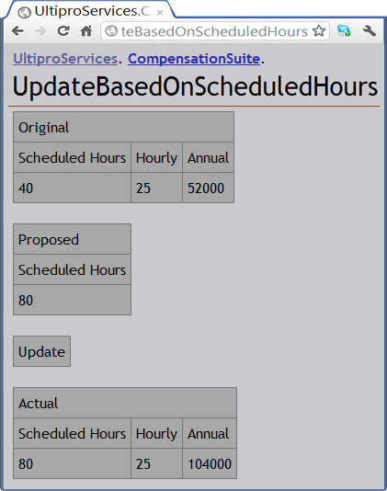
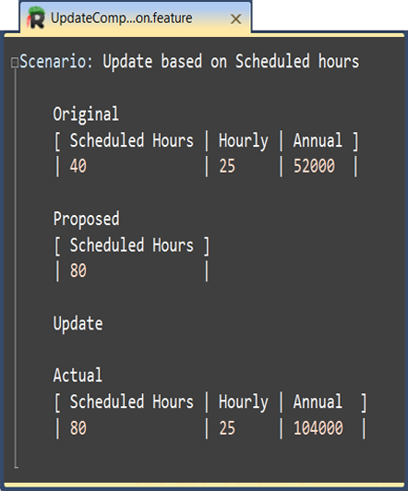
Tester - Keep syntax

Slide 6
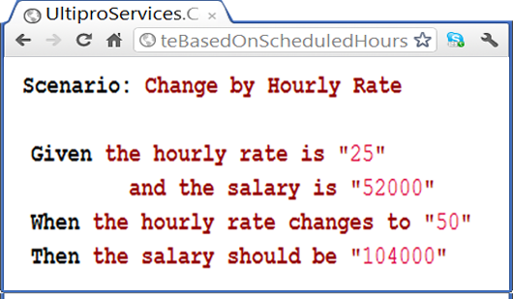
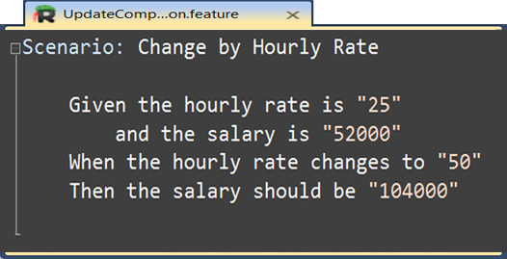
Tester - Keep syntax

Slide 7
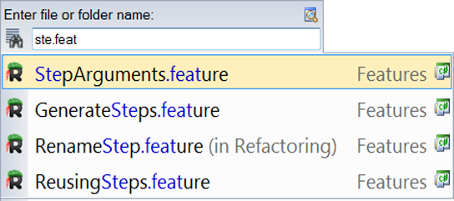
Tester - Search and navigation

Slide 8
Tester - Intellisense
Raconteur screenshot (pending ctrl+space)

Slide 9
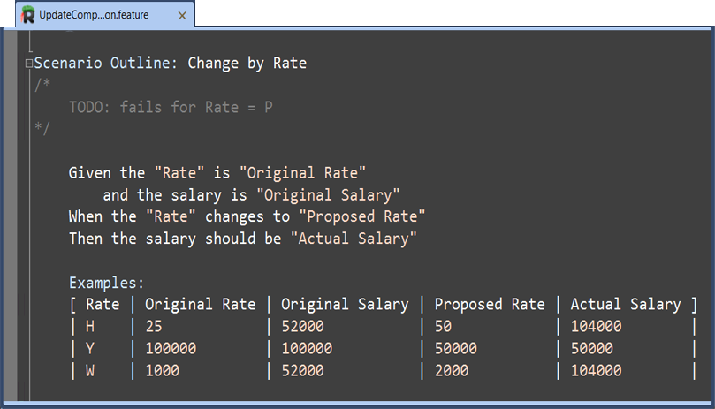
Tester - Syntax highlight

Slide 10
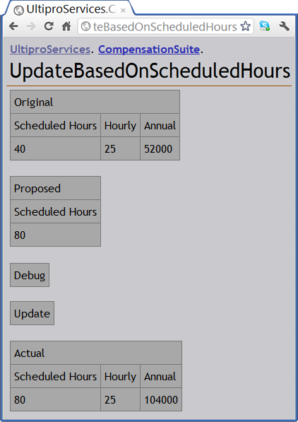
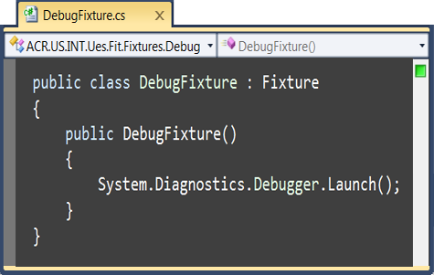
Tester - Debugging

Slide 11
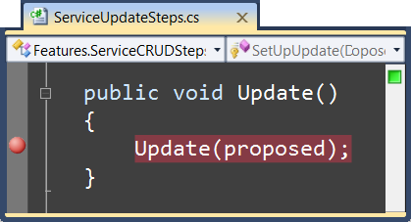
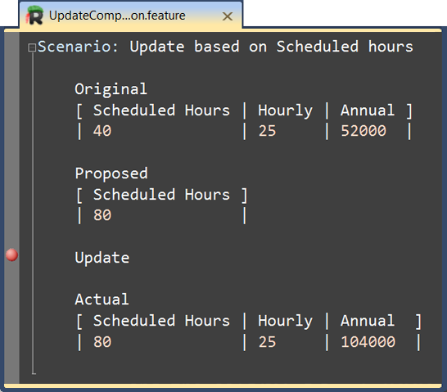
Tester - Debugging

Slide 12
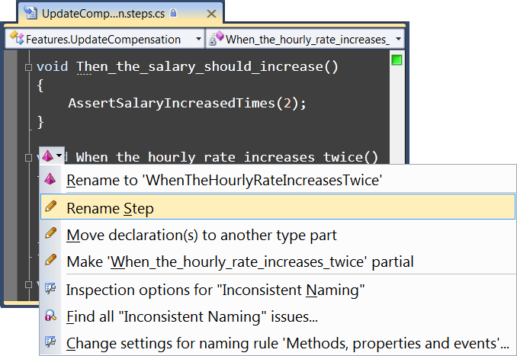
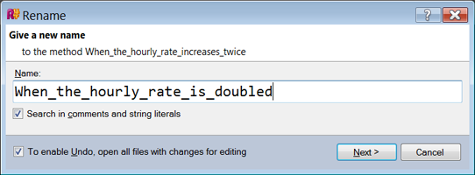
Tester- Refactoring

Slide 13
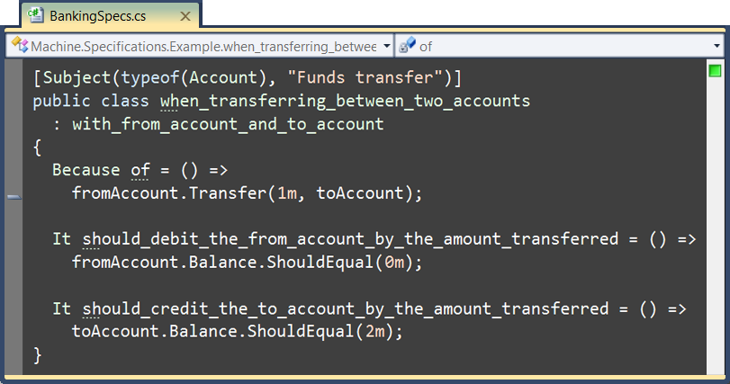
Developer – xUnit- Free text

Slide 14
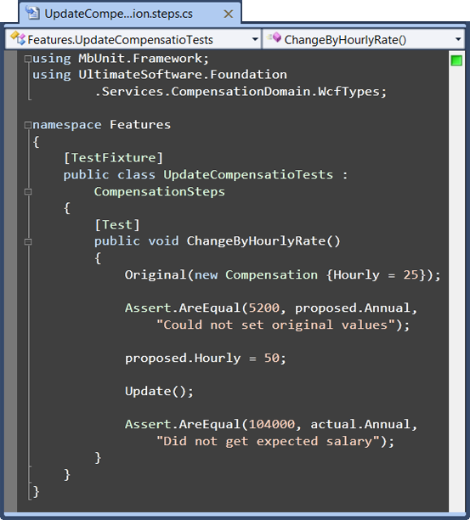
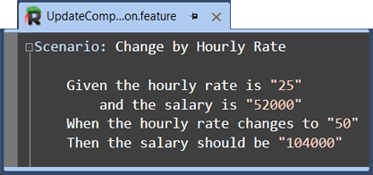
Developer – xUnit - SoC

Slide 15
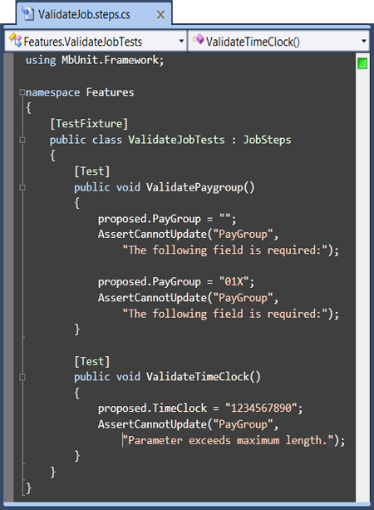
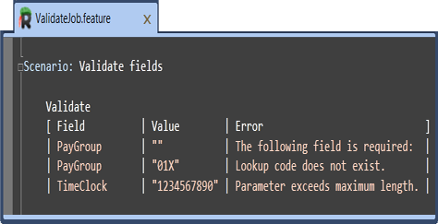
Developer – xUnit - External DSL

Slide 16
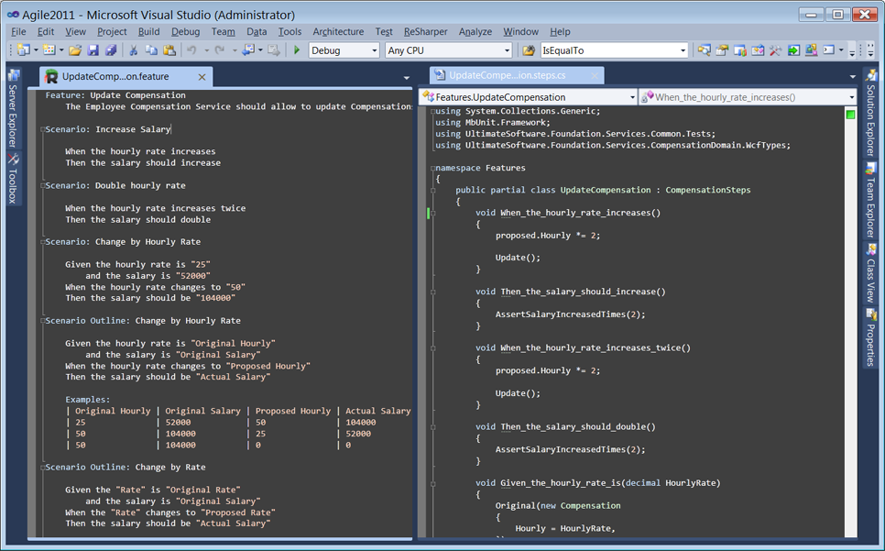
Developer – AT - IDE

Slide 17
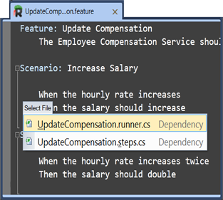
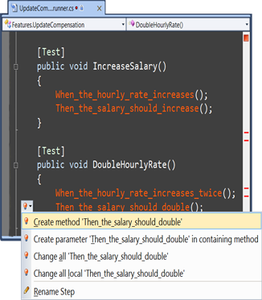
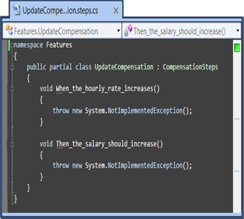
Developer – AT - Flow

Slide 18
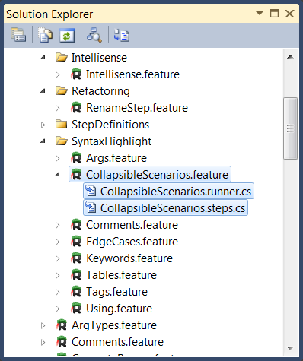
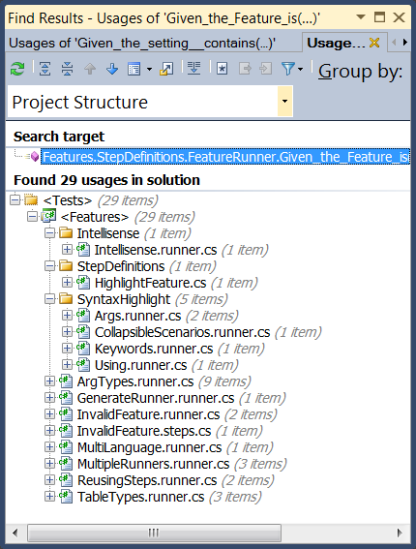
Developer – AT - Organization

Slide 19
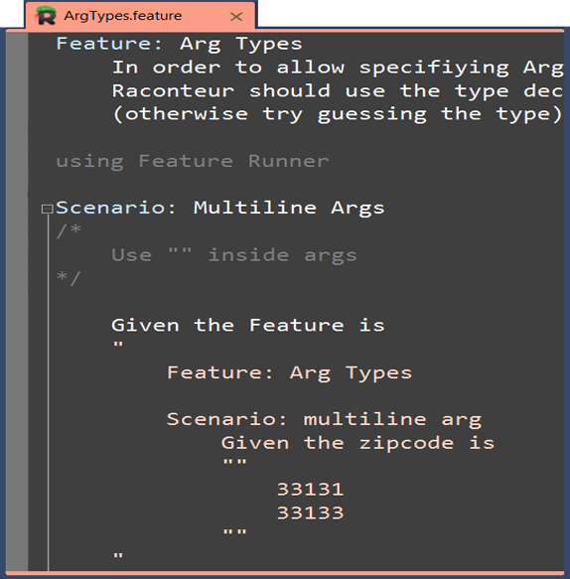
Developer – AT - Keep language

Slide 20
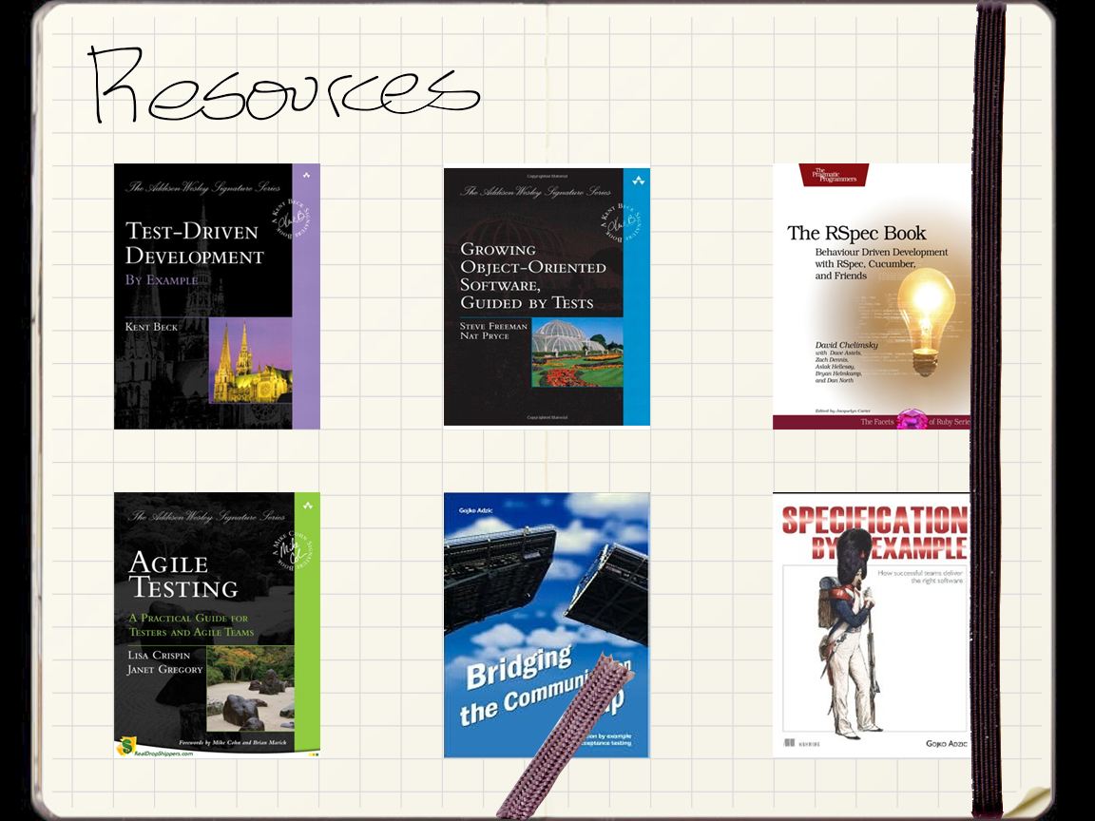

Slide 21
?

