Slide 1

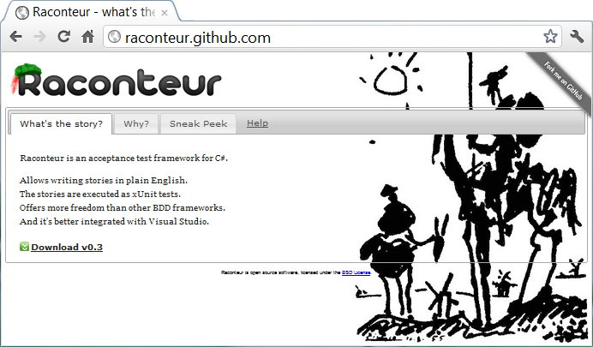
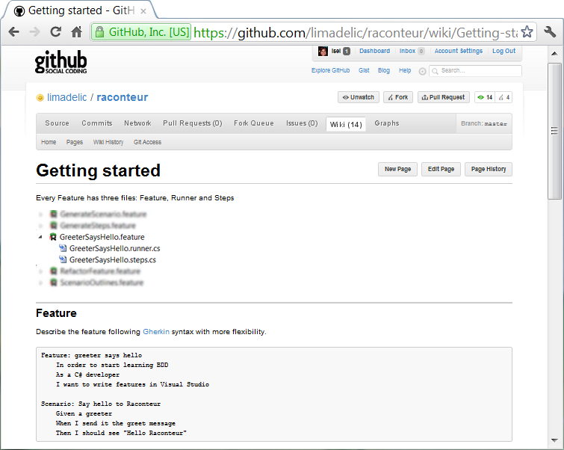




for Devs & Testers
@isel77
@jperkelens
@msuarz

Slide 2
rac·on·teur
noun /ˌrakˌänˈtər/ /-ən-/ raconteurs, plural
A person who tells anecdotes in a skillful and amusing way
Acceptance test framework for C#
Allows writing stories in plain text with VisualStudio The stories are executed as xUnit tests

Slide 3
Agenda
The Situation
Hello Raconteur
Testers
Developers
UltiPro Webservices
Update Compensation
Validate Job

Slide 4
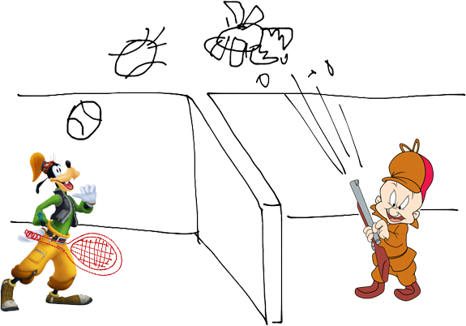
The Situation

Slide 5
Hello Raconteur!

Slide 6
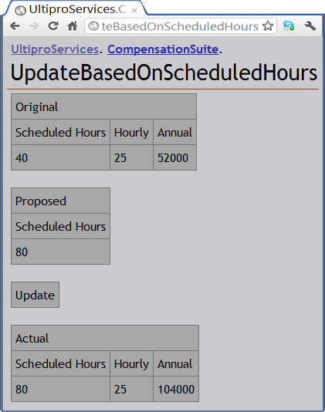
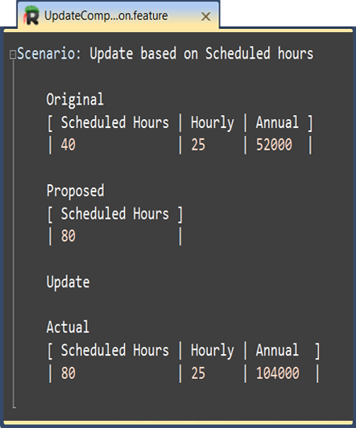

Fitnesse

Slide 7
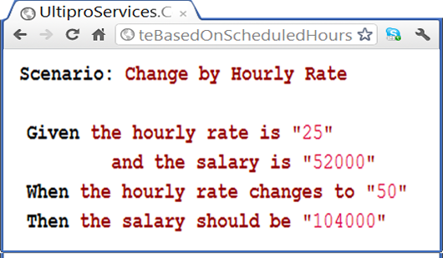
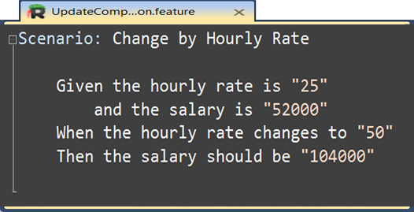
Cucumber

Slide 8
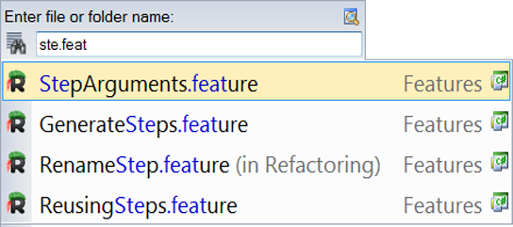
Search & Navigation

Slide 9
Intellisense
Raconteur screenshot (pending ctrl+space)

Slide 10
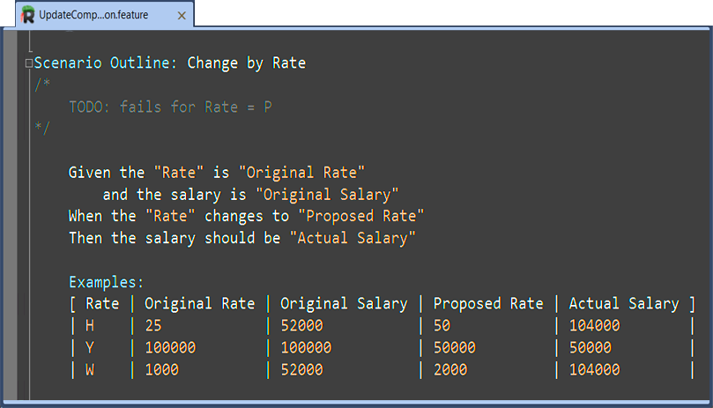
Syntax Highlight

Slide 11
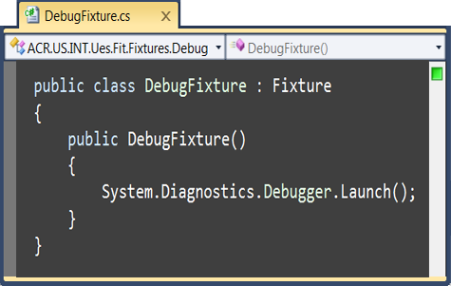
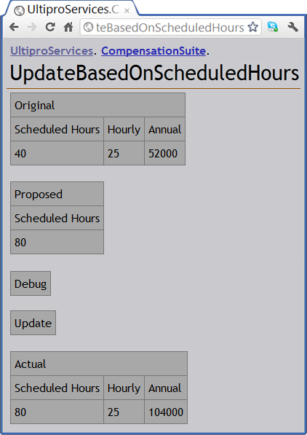
Debug

Slide 12
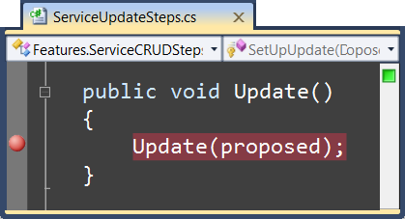
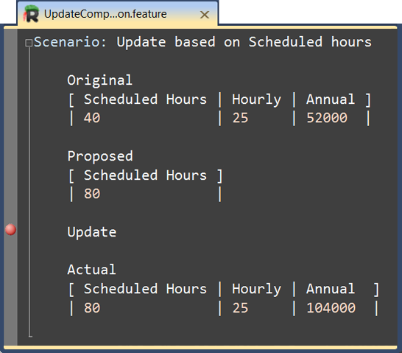
Debug

Slide 13
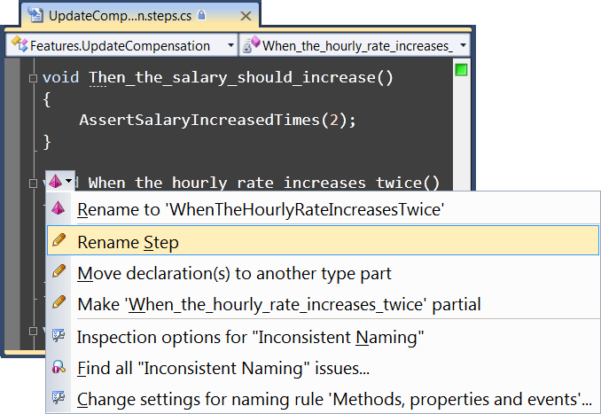
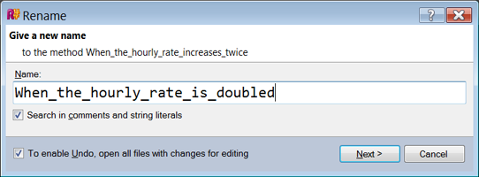
Refactoring

Slide 14
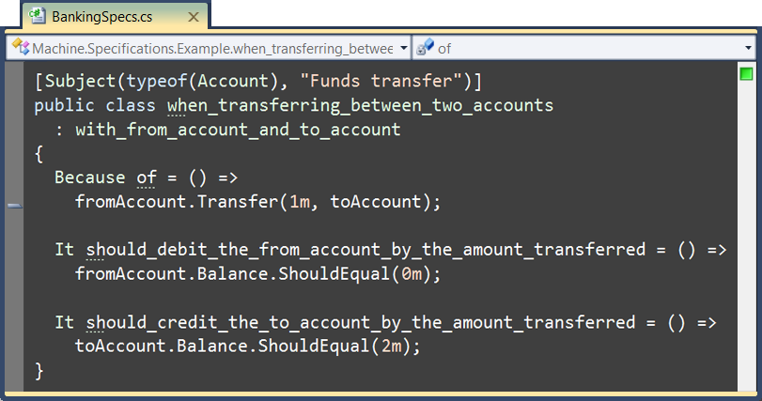

MSpec

Slide 15
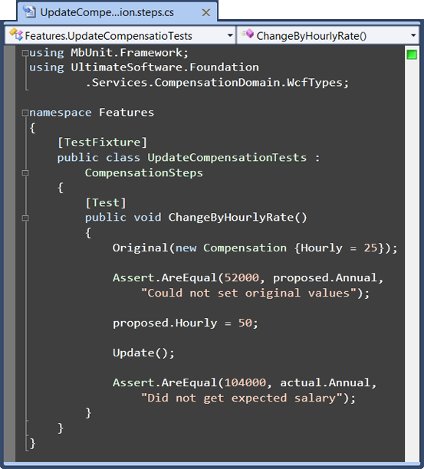
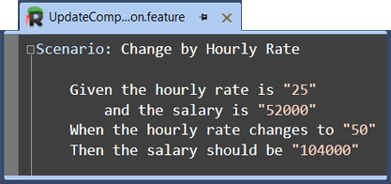
Separation of Concerns

Slide 16
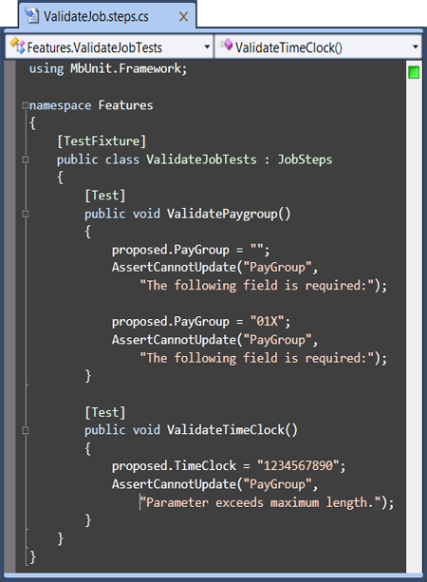
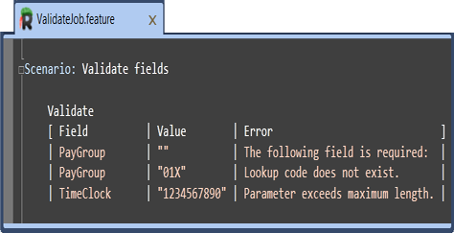
External DSL

Slide 17
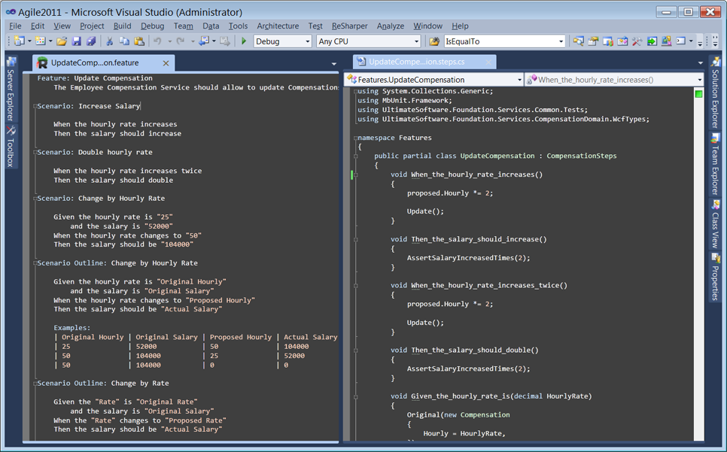
IDE

Slide 18
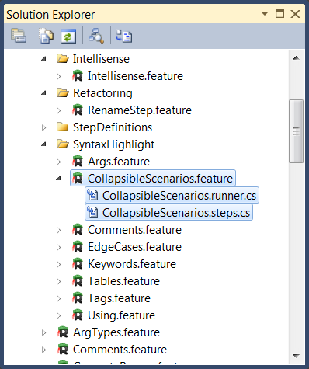
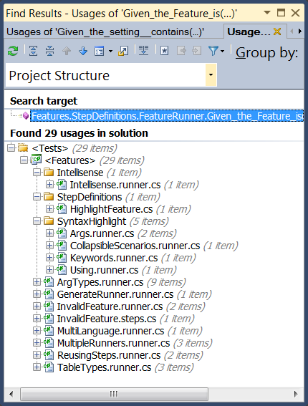
Organization

Slide 19
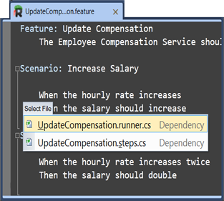
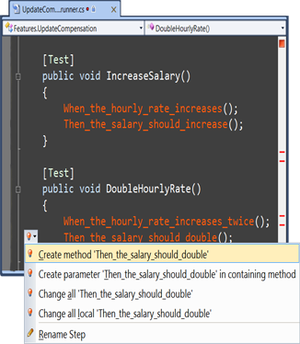
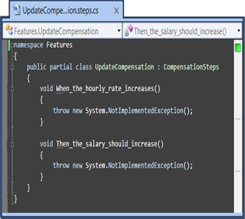
Flow

Slide 20
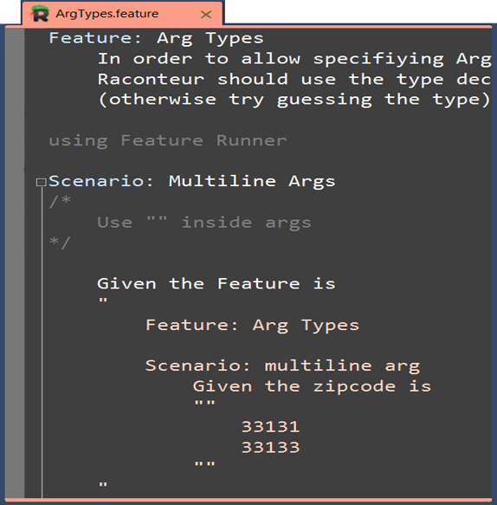
C#

Slide 21
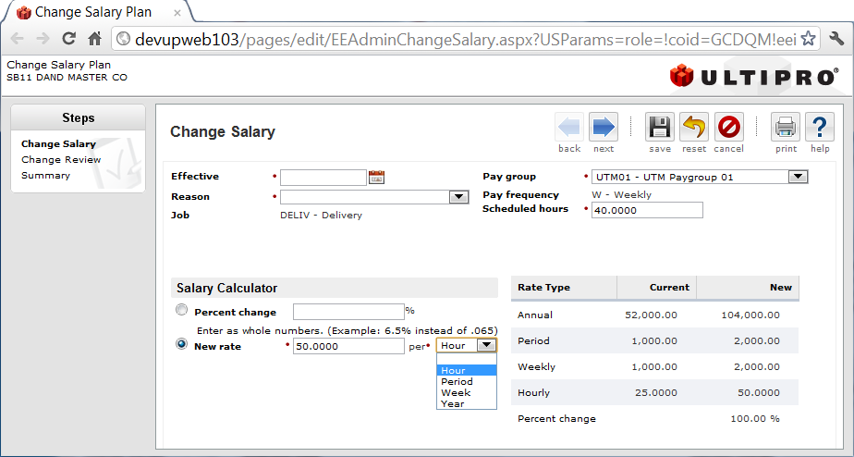


UltiPro Web Services
Update Compensation

Slide 22
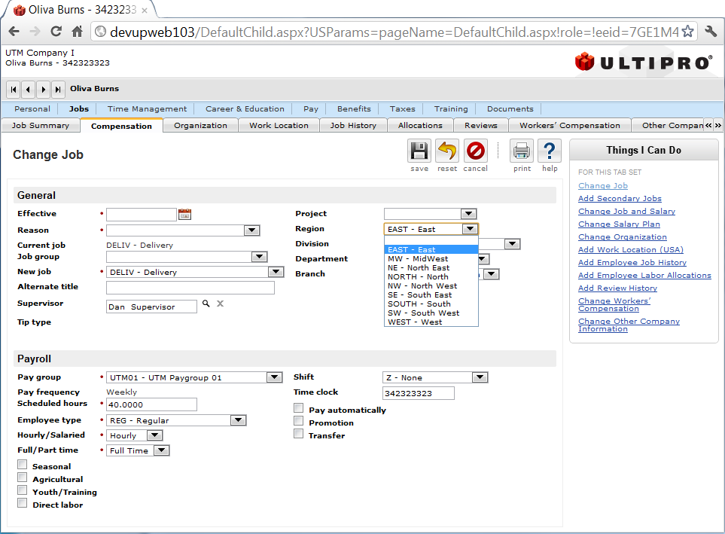
UltiPro Web Services
Validate Job

Slide 23
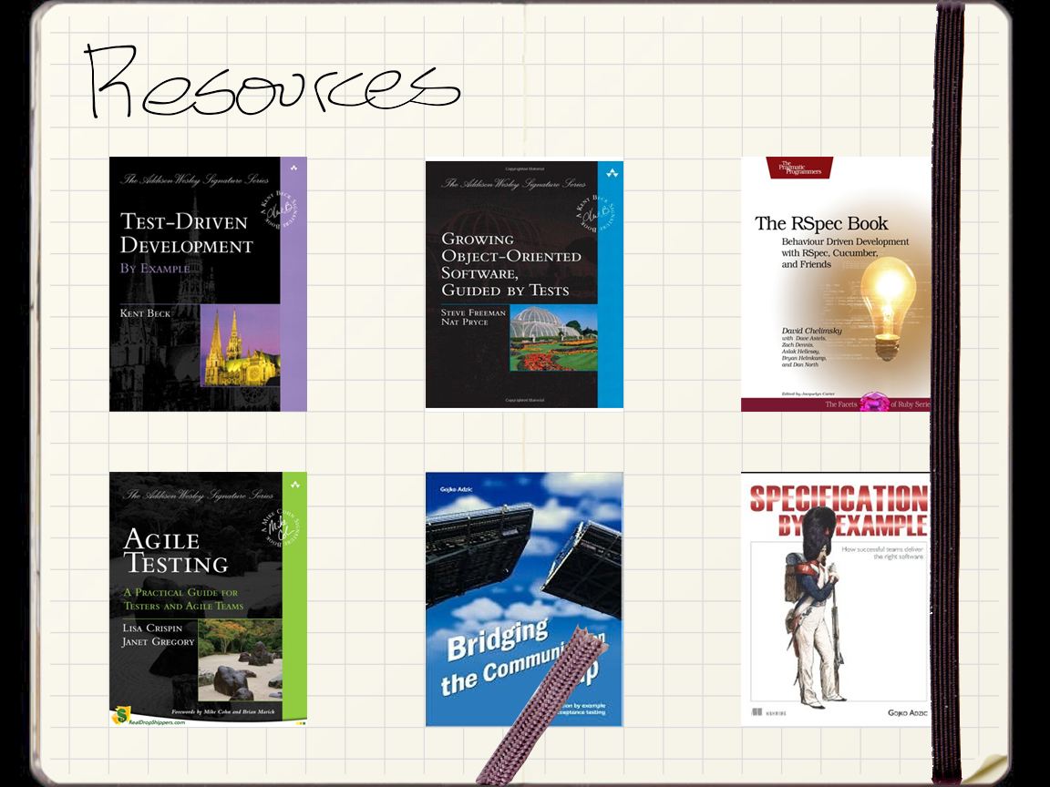
Resources

Slide 24
?

