Slide 1
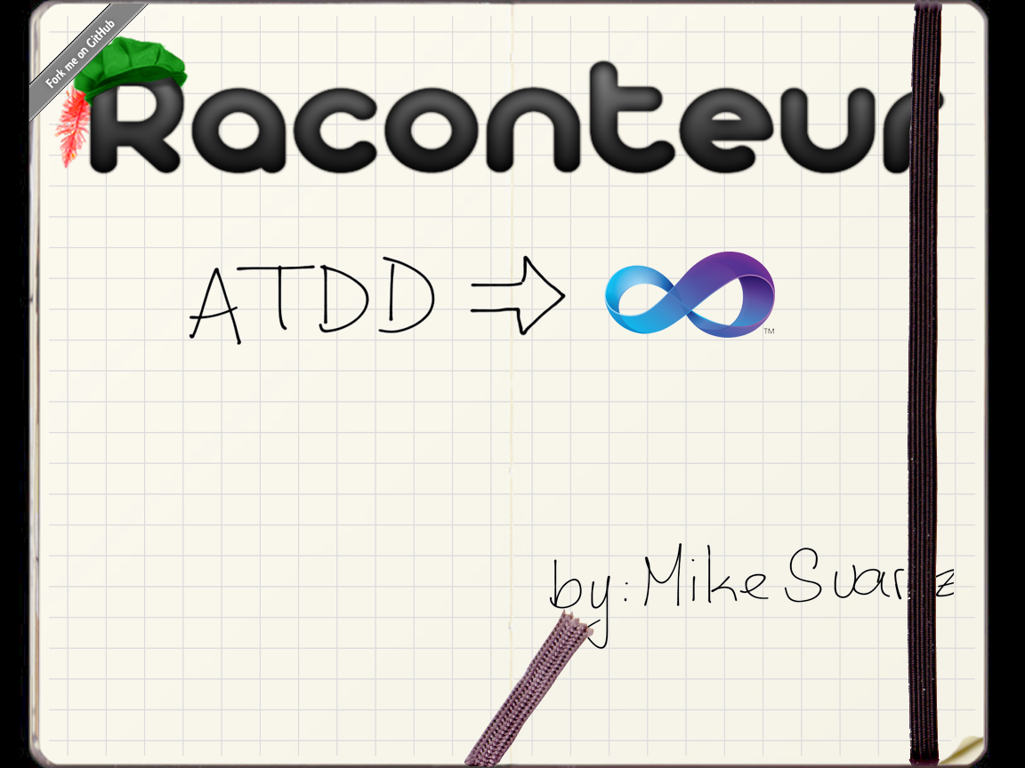



http://twitter.com/msuarz
http://msuarz.blogspot.com
http://github.com/msuarz

Slide 2
rac·on·teur
noun /ˌrakˌänˈtər/ /-ən-/ raconteurs, plural
A person who tells anecdotes in a skillful and amusing way
Acceptance test framework for C#
Allows writing stories in plain text with VisualStudio The stories are executed as xUnit tests

Slide 3
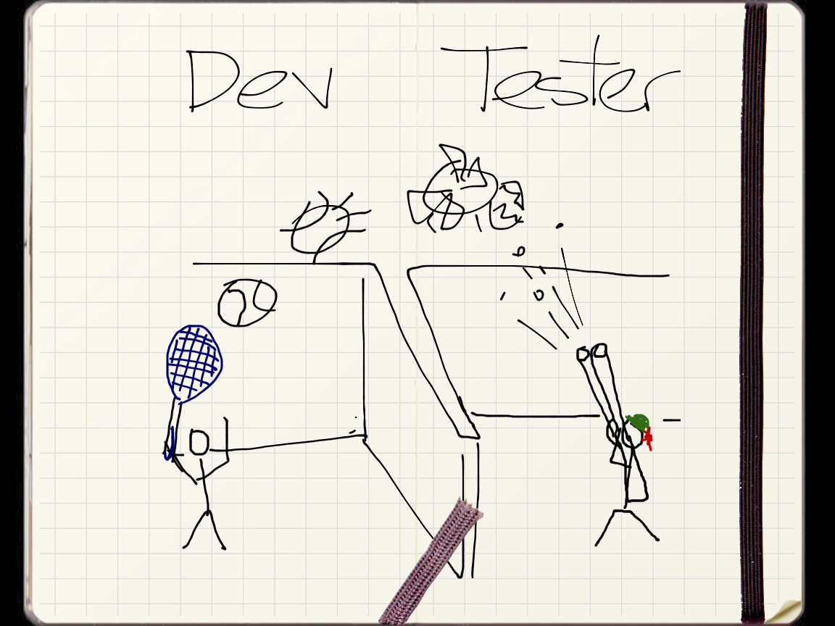

Slide 4
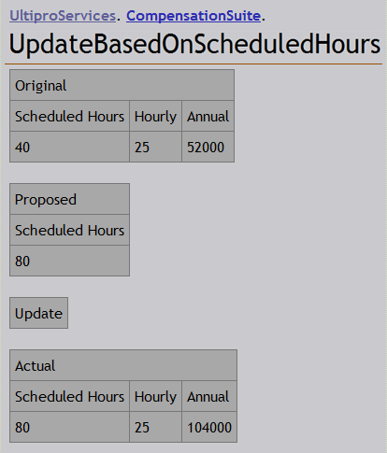
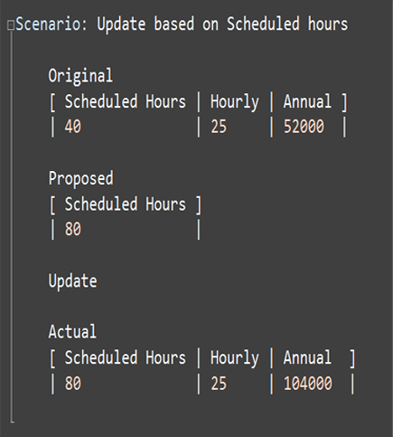
Tester - Keep syntax

Slide 5
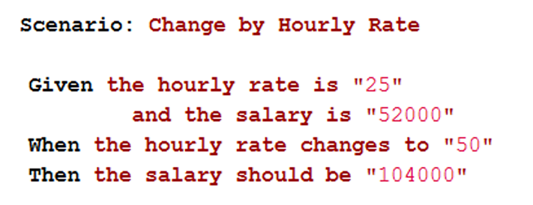
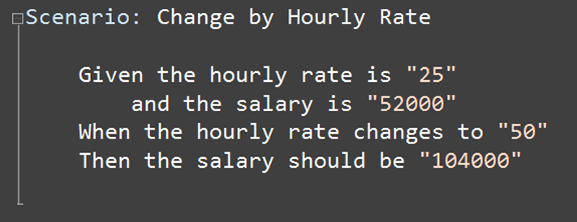
Tester - Keep syntax

Slide 6
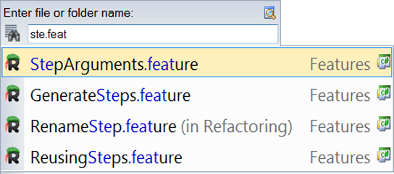
Tester - Search and navigation

Slide 7
Tester - Intellisense
Raconteur screenshot (pending ctrl+space)

Slide 8
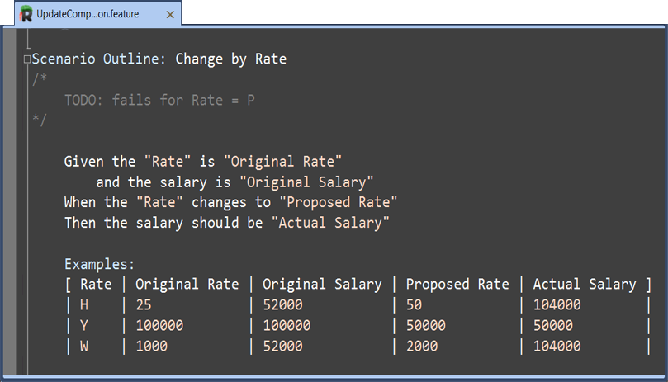
Tester - Syntax highlight

Slide 9
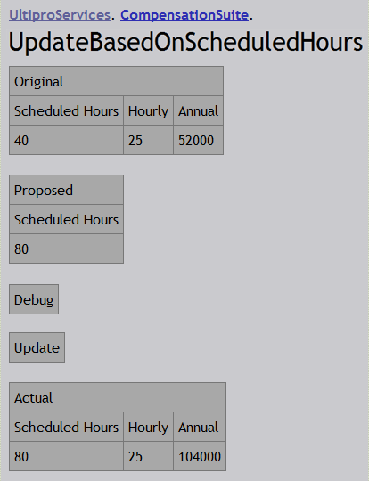
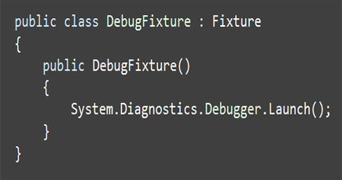
Tester - Debugging

Slide 10
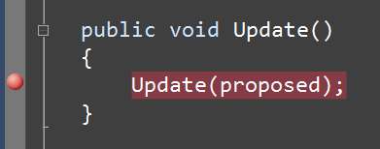
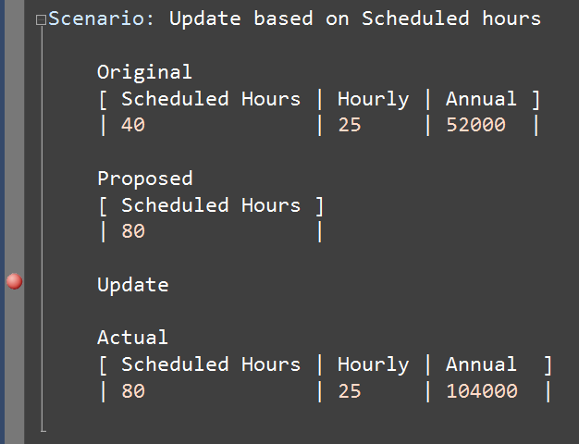
Tester - Debugging

Slide 11
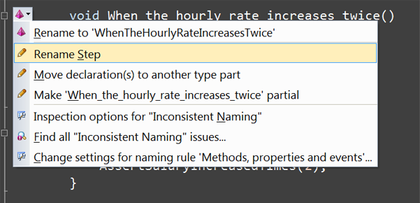
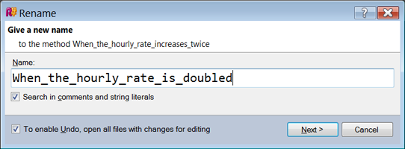
Tester- Refactoring

Slide 12
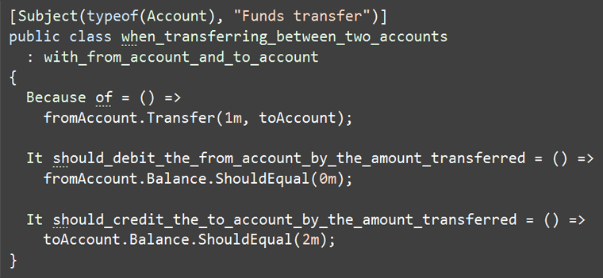
Developer – xUnit- Free text

Slide 13
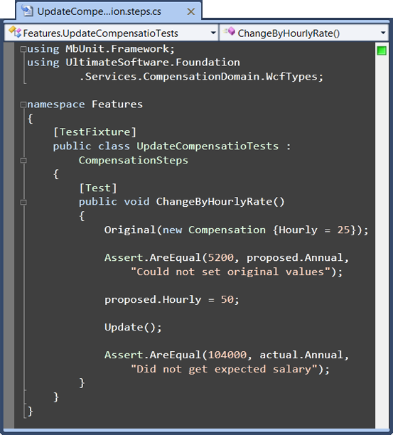
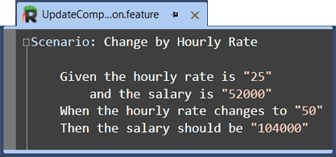
Developer – xUnit - SoC

Slide 14
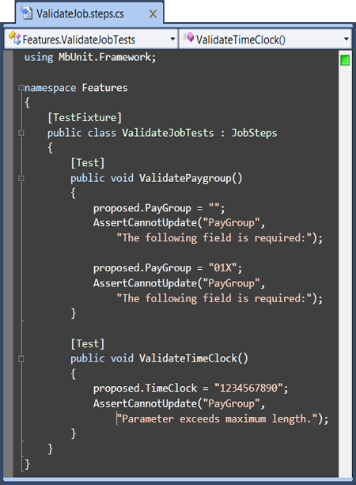
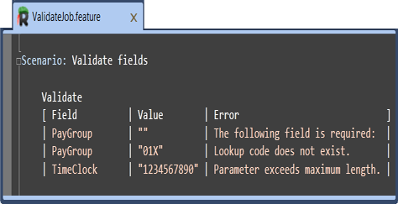
Developer – xUnit - External DSL

Slide 15
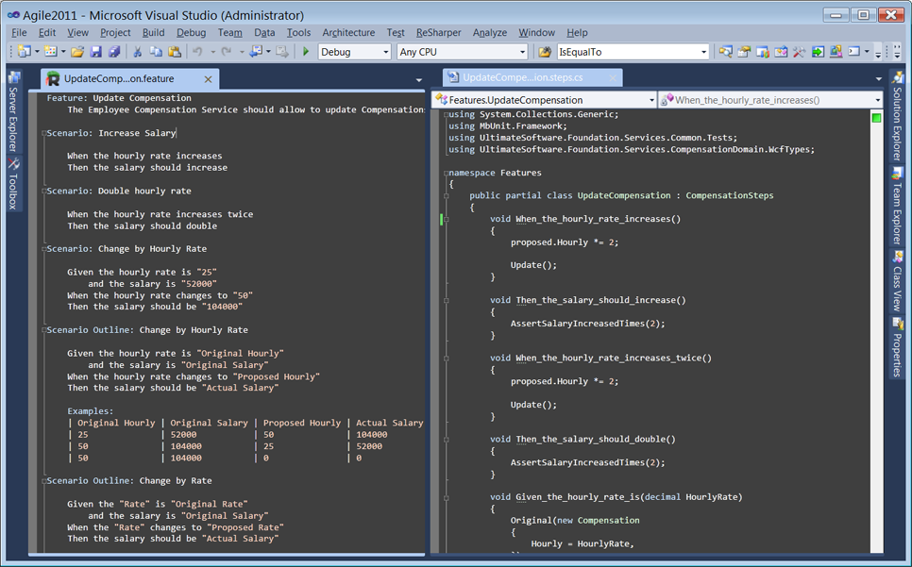
Developer – AT - IDE

Slide 16
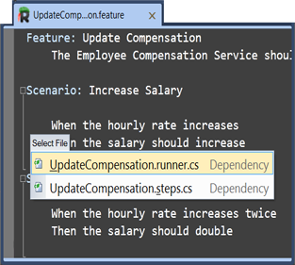
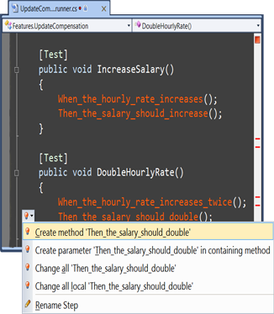
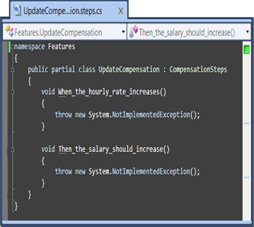
Developer – AT - Flow

Slide 17
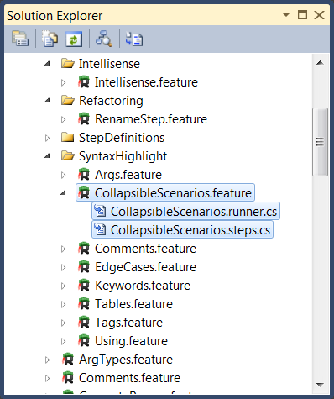
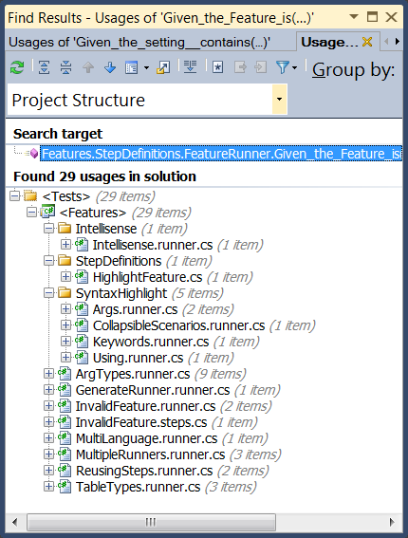
Developer – AT - Organization

Slide 18
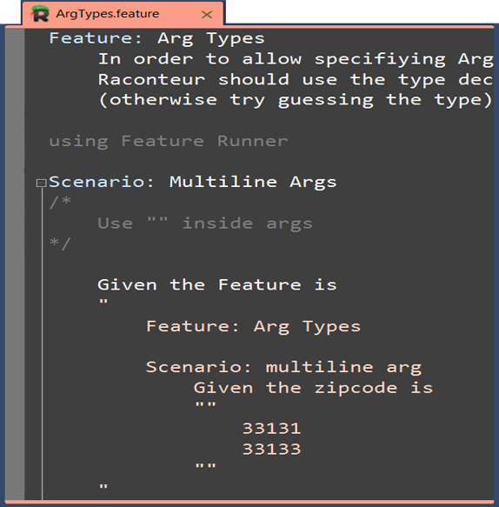
Developer – AT - Keep language

Slide 19
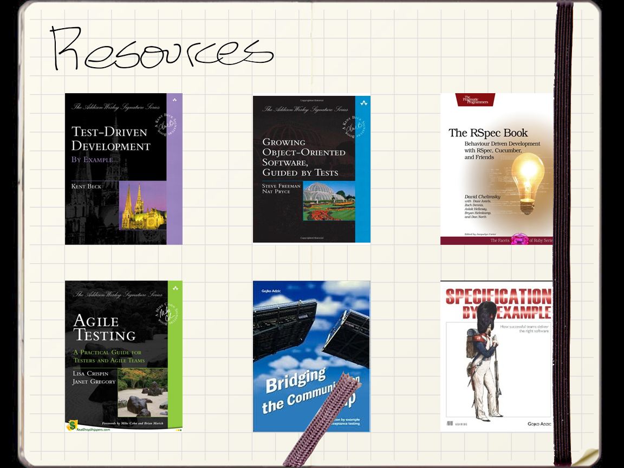

Slide 20


