Slide 1

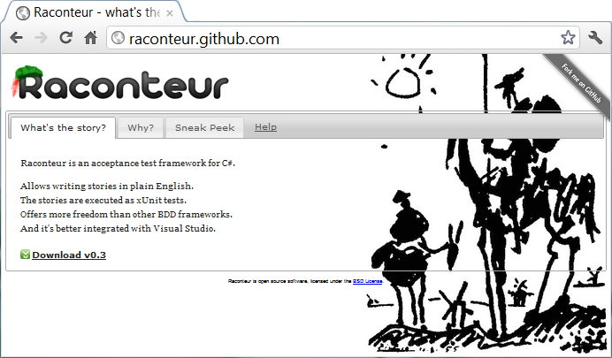
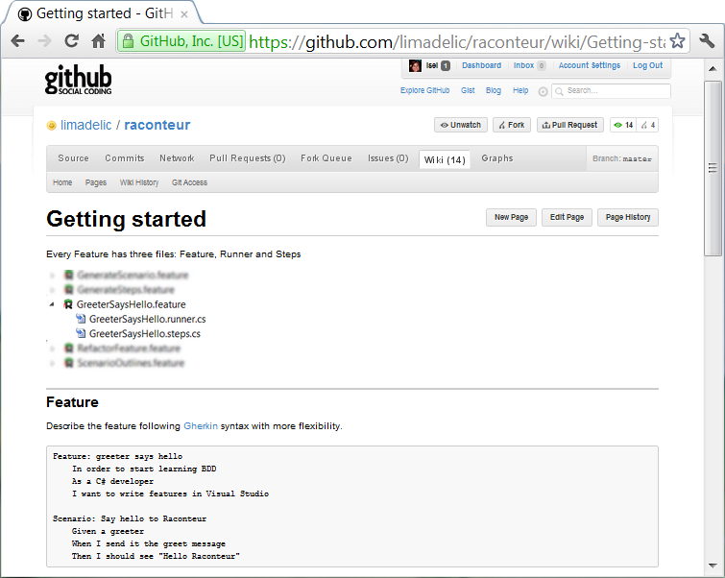




for Devs & Testers
@isel77
@jperkelens
@msuarz

Slide 2
rac·on·teur
noun /ˌrakˌänˈtər/ /-ən-/ raconteurs, plural
A person who tells anecdotes in a skillful and amusing way
Acceptance test framework for C#
Allows writing stories in plain text with VisualStudio The stories are executed as xUnit tests

Slide 3
Agenda
The Situation
Hello Raconteur
Testers
Developers
UltiPro Webservices
Update Compensation
Validate Job

Slide 4
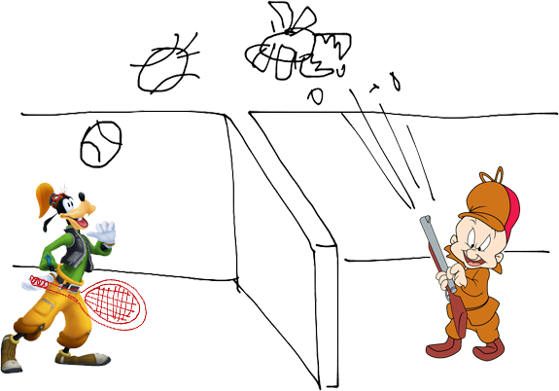
The Situation

Slide 5
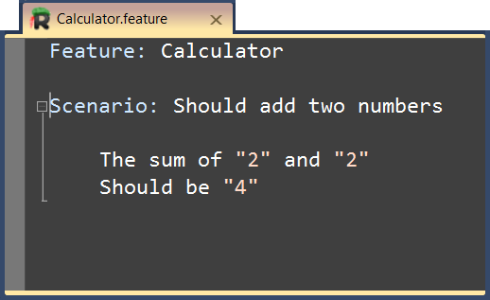
Hello Raconteur!

Slide 6
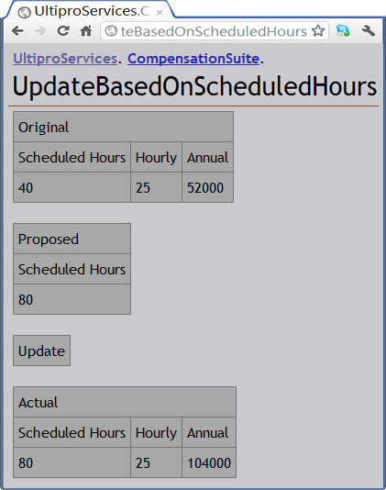
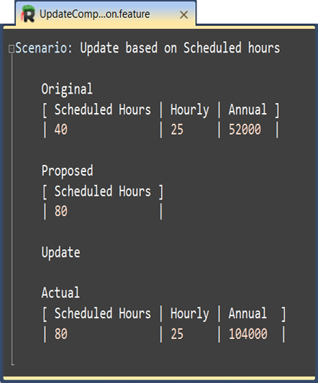

Fitnesse

Slide 7
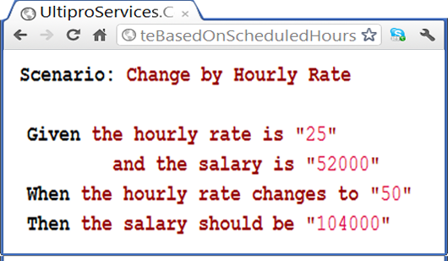
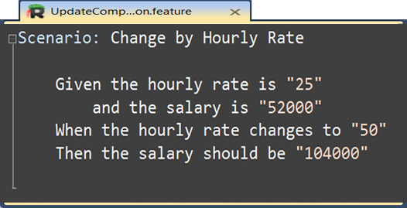
Cucumber

Slide 8
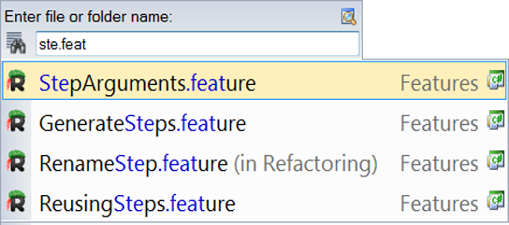
Search & Navigation

Slide 9
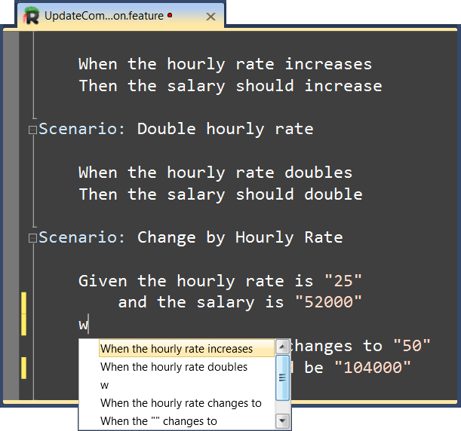
Intellisense

Slide 10
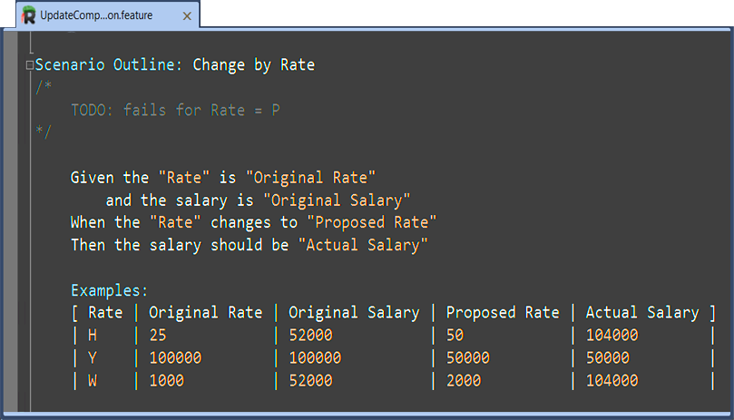
Syntax Highlight

Slide 11
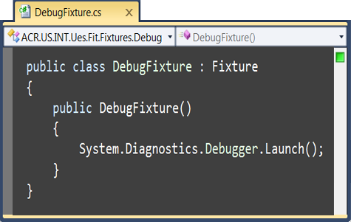
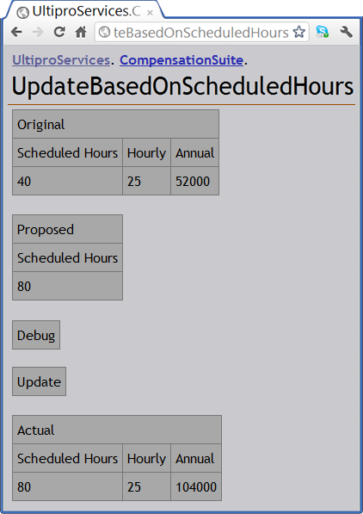
Debug

Slide 12
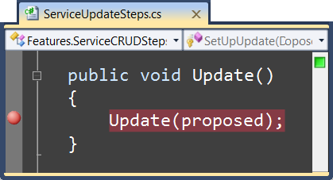
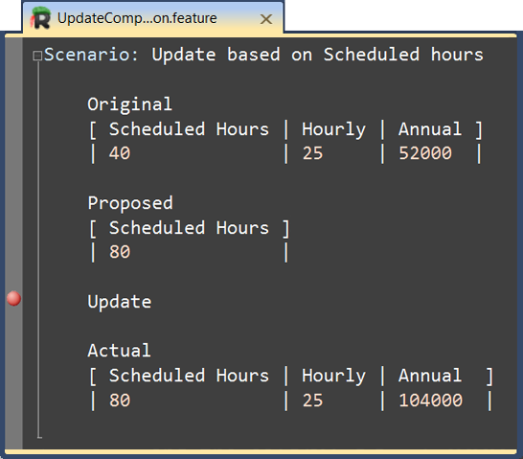
Debug

Slide 13
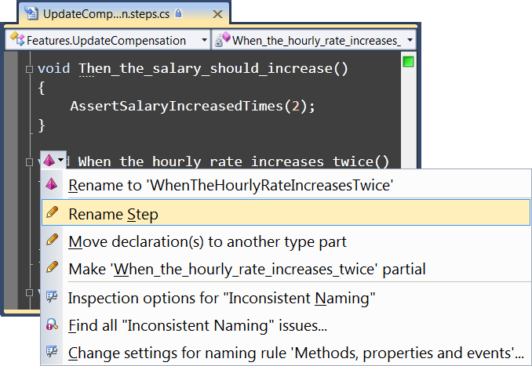
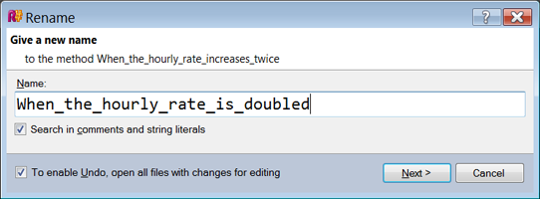
Refactoring

Slide 14
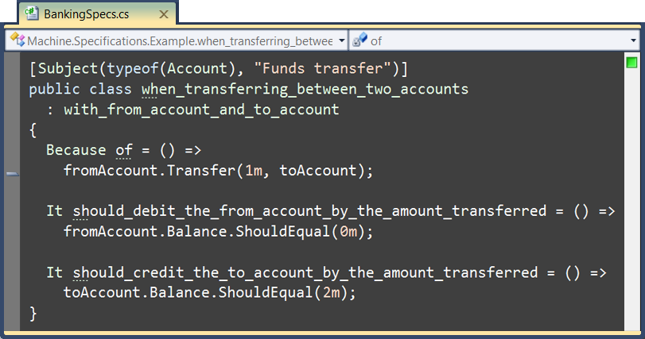

MSpec

Slide 15
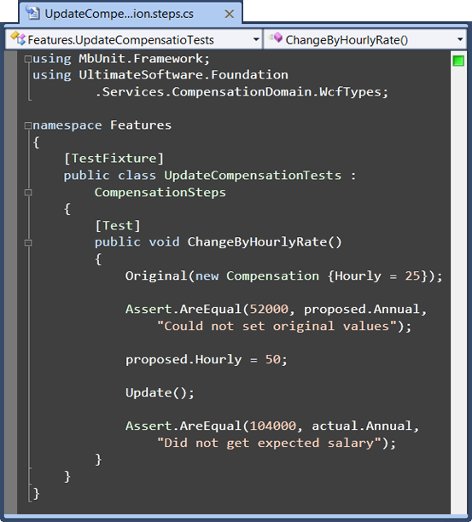
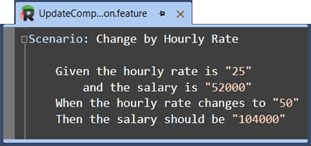
Separation of Concerns

Slide 16
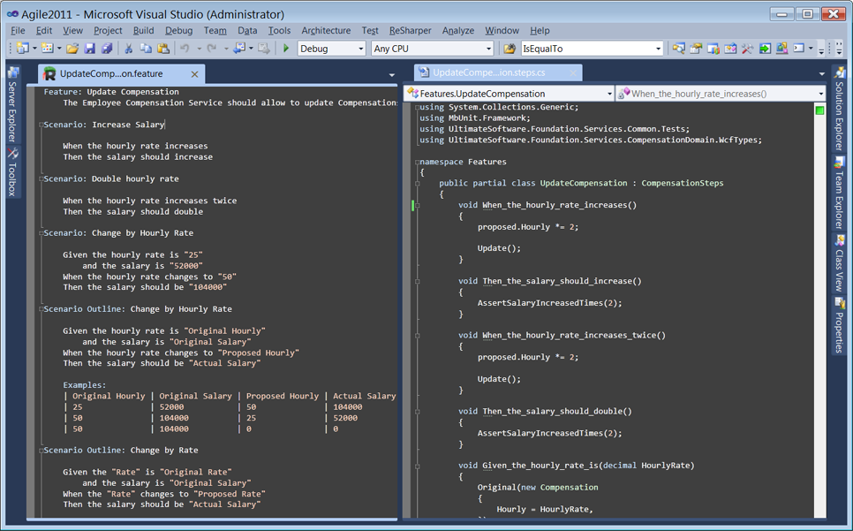
IDE

Slide 17
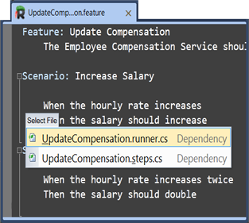
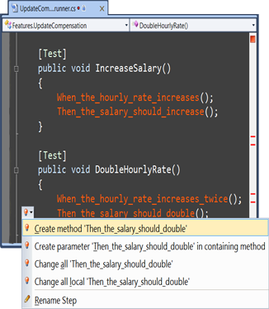
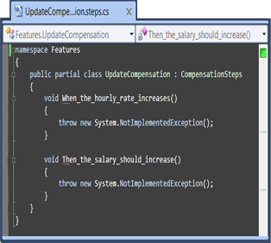
Flow

Slide 18
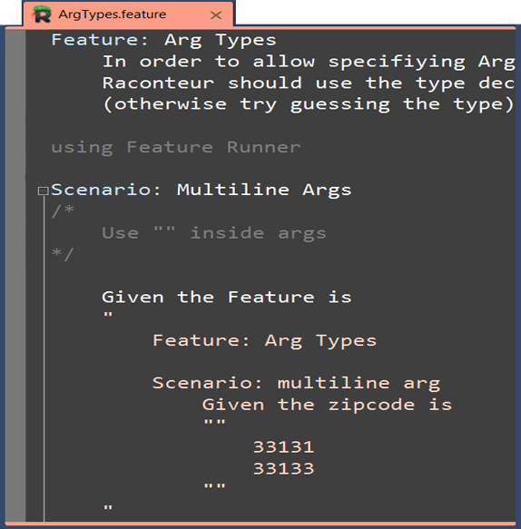
C#

Slide 19
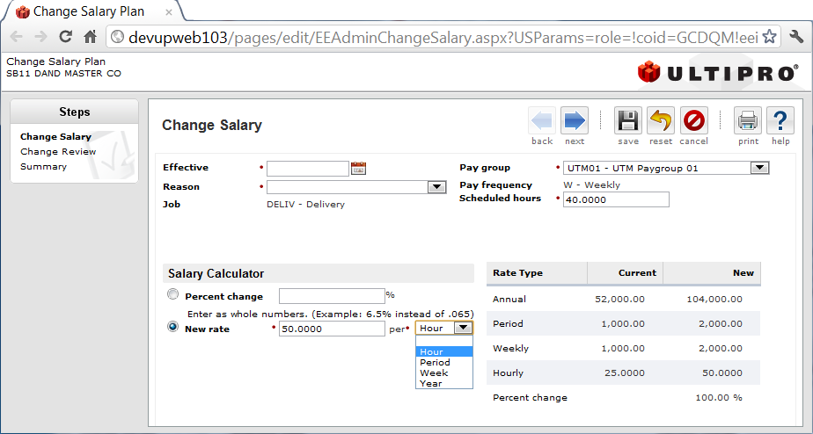


UltiPro Web Services
Update Compensation

Slide 20
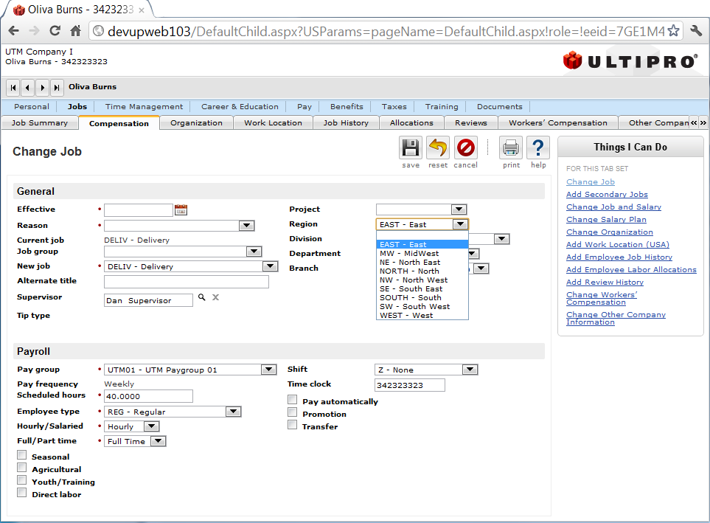
UltiPro Web Services
Validate Job

Slide 21
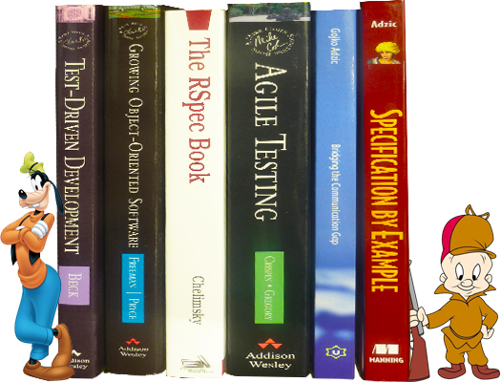
Resources

Slide 22
?

